Slide 1
Motion Tracking Comparison of HTC Vive and Vicon
Yuanqing Hong, Xin Jin

Slide 2
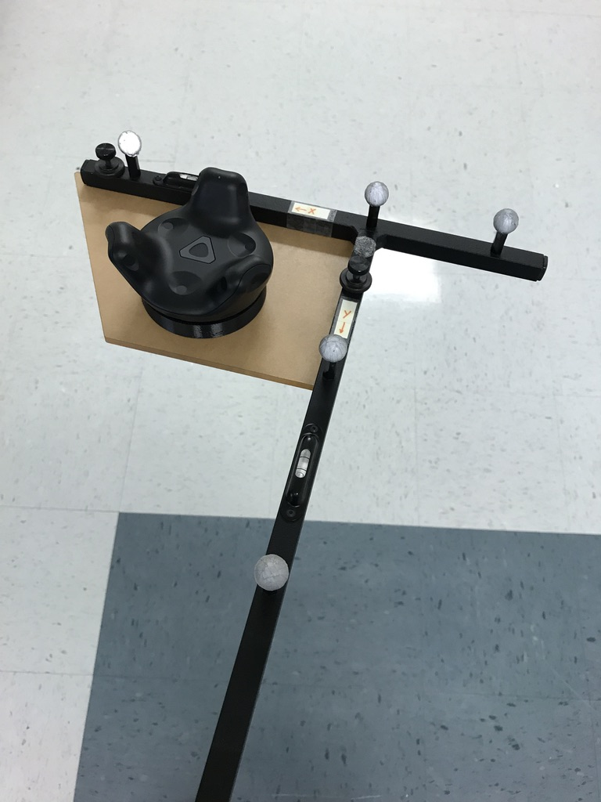
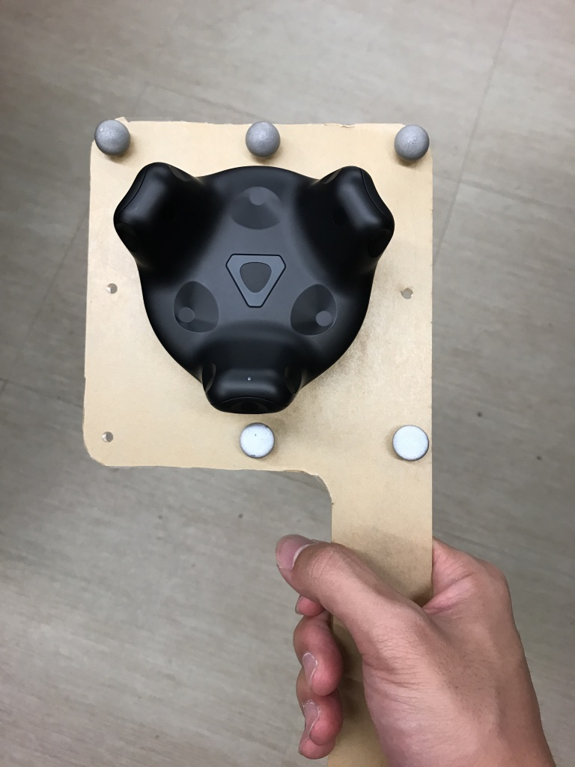
Computer2
Computer2
Unity
Unity
LocalFile
Computer
Computer
UDP
Unity
LocalFile
Unity
LocalFile
Computer1
Computer1
Vicon
LocalFile
Vicon
LocalFile
Vicon
Labview
Vicon
LocalFile

Slide 3
Experiments
Review
Experiment1
Experiment2
Experiment3
Experiment4
RMS
Max
RMS
Max
RMS
Max
RMS
Max
Data Set1:
2.7mm
10.2mm
5.1mm
22.7mm
2.7mm
11.0mm
2.1mm
7.5mm
Data Set2:
6.7mm
30.2mm
5.9mm
36.5mm
7.5mm
22.8mm
4.1mm
26.5mm
Slow
5.5
27.3mm
Data Set3:
5.0mm
24.3mm
7.4mm
20.8mm
7.3mm
29.8mm
Quick
9.9
37.5mm
Through UDP
Save Local Separately
Save Local in one laptop
New Device
(movement range: around 1 meter)

Slide 4
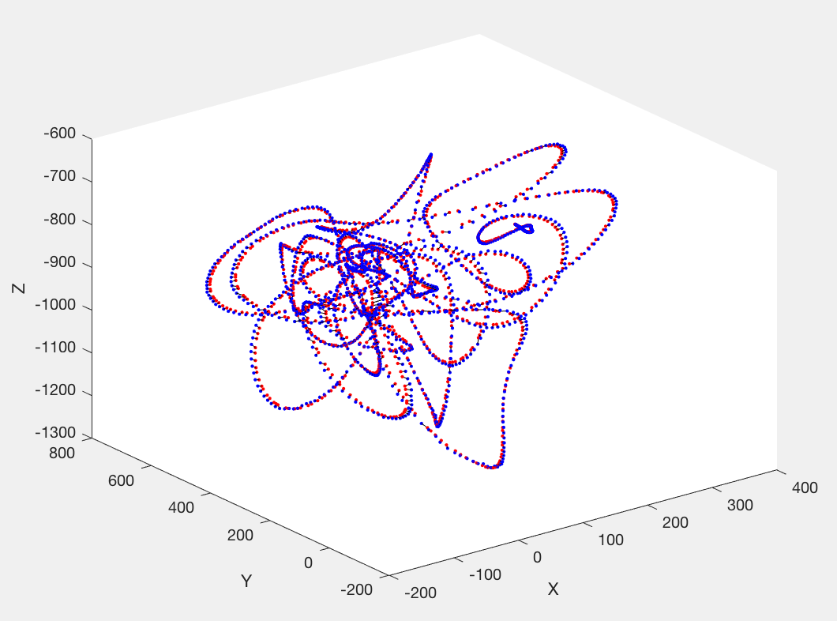

Slide 5
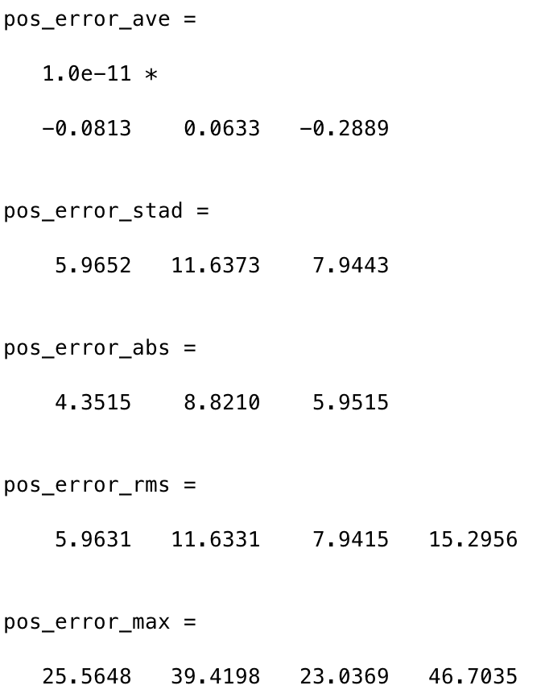
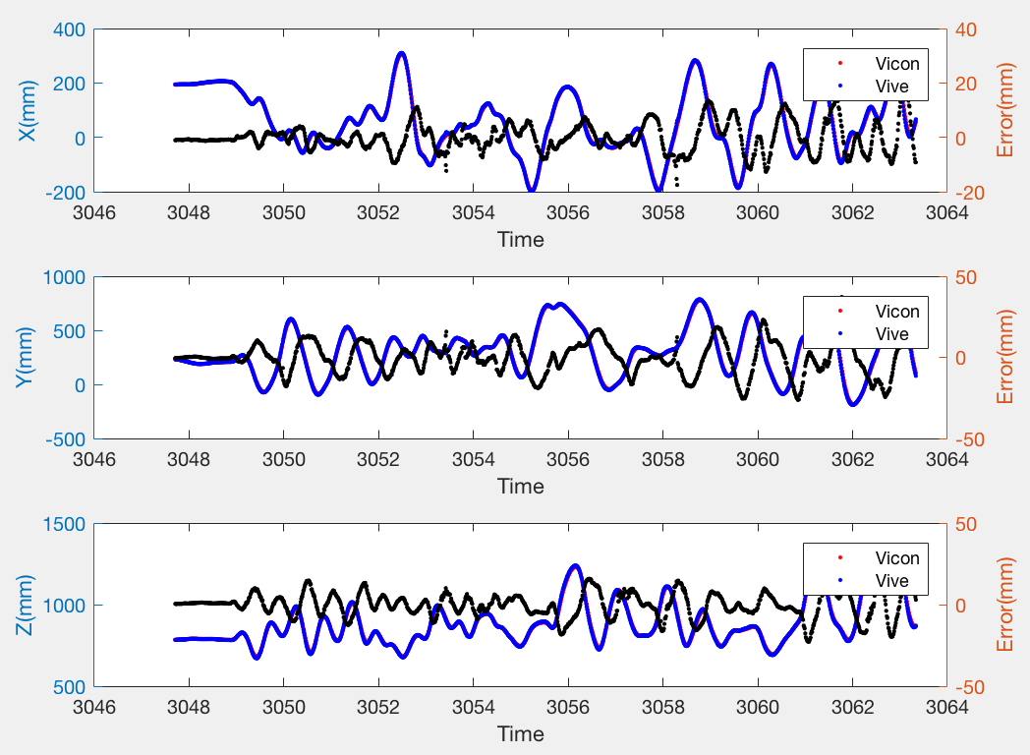
Error Analysis

Slide 6
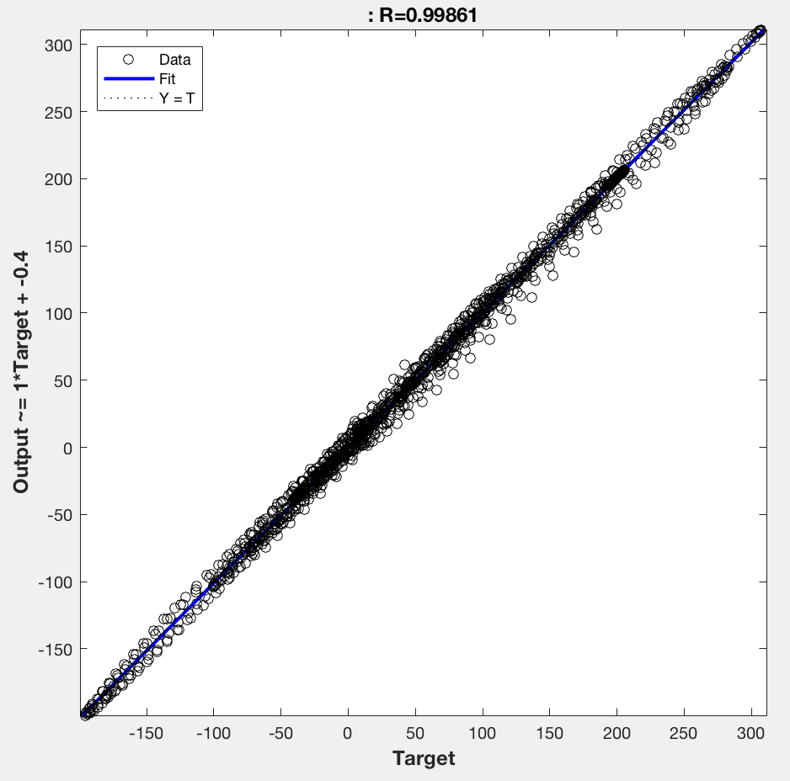


Error Analysis

Slide 7
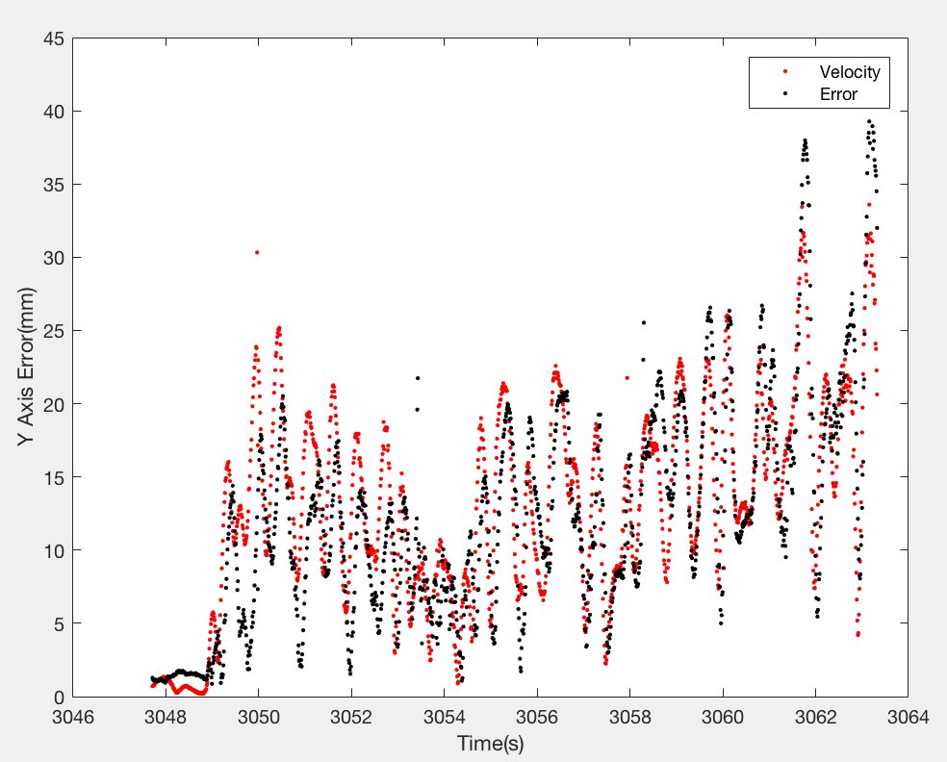
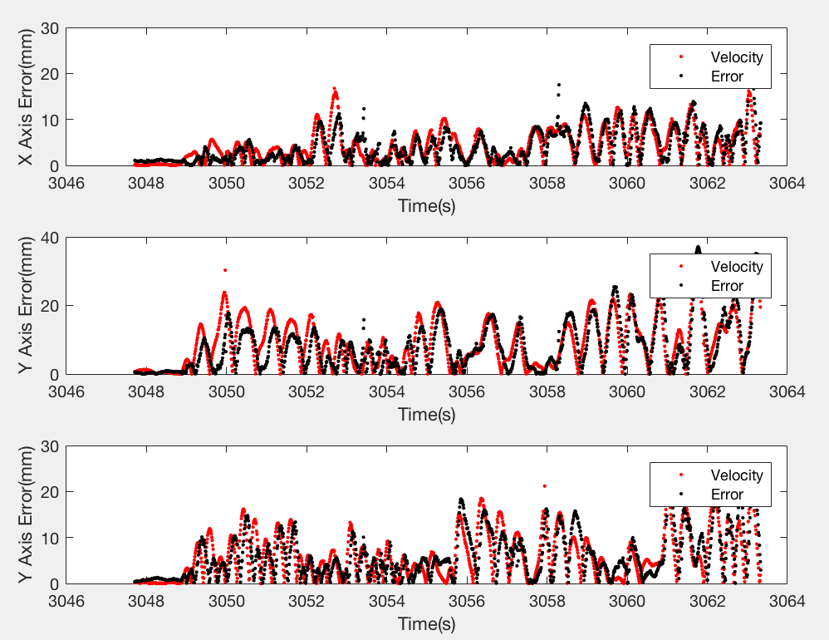
Velocity and Error

Slide 8
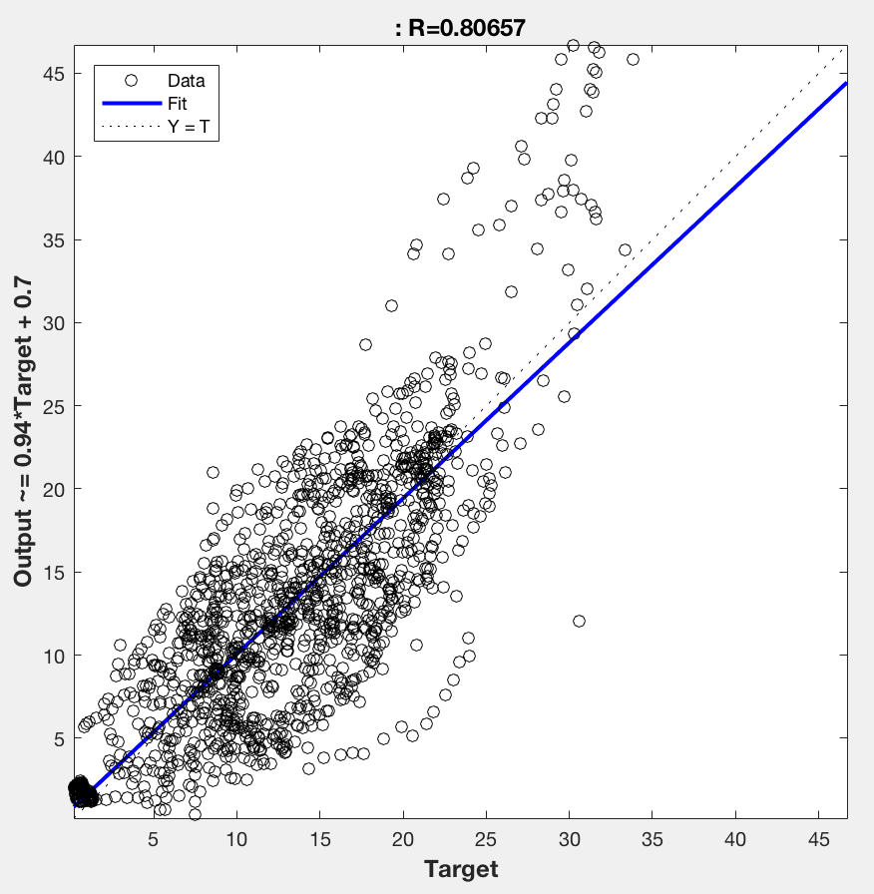
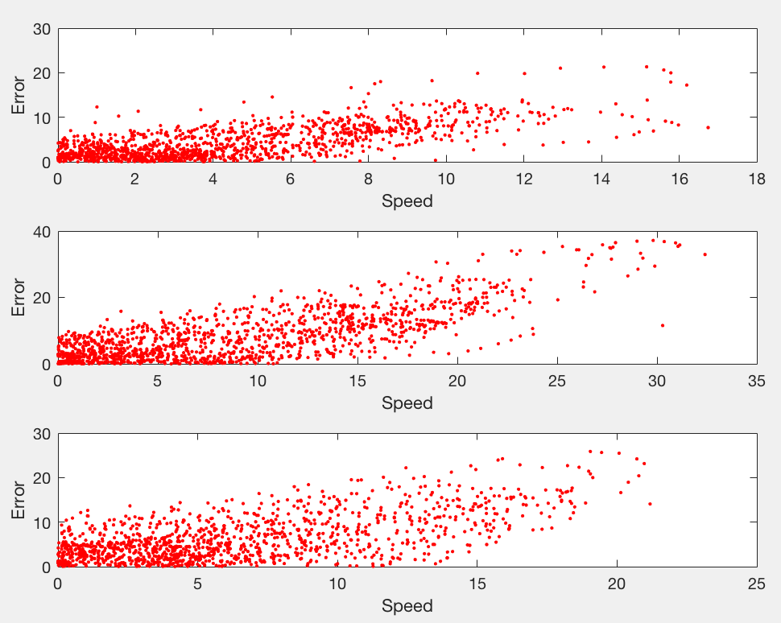

Velocity and Error

Slide 9
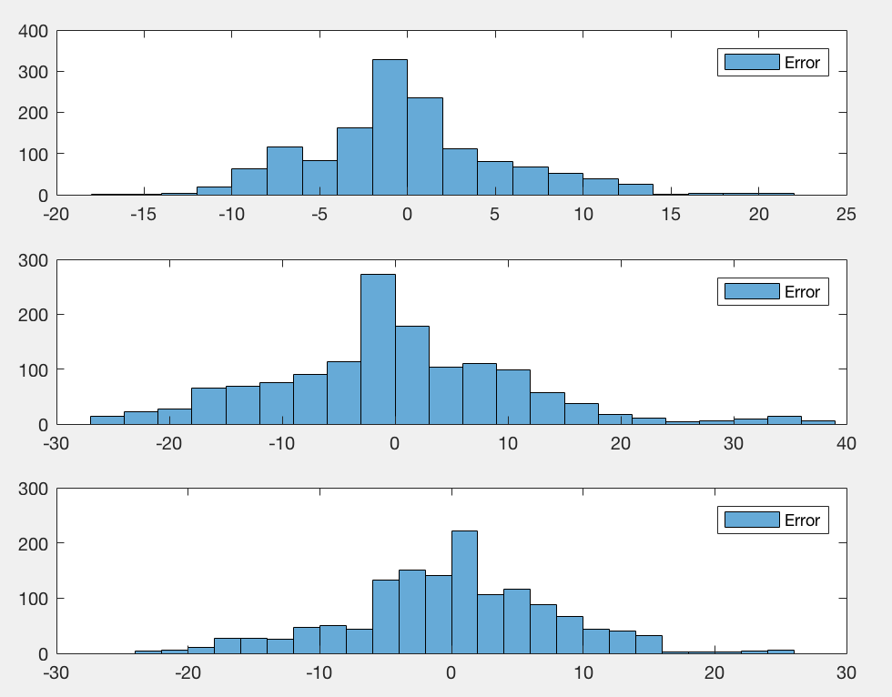
Error Distribution

Slide 10
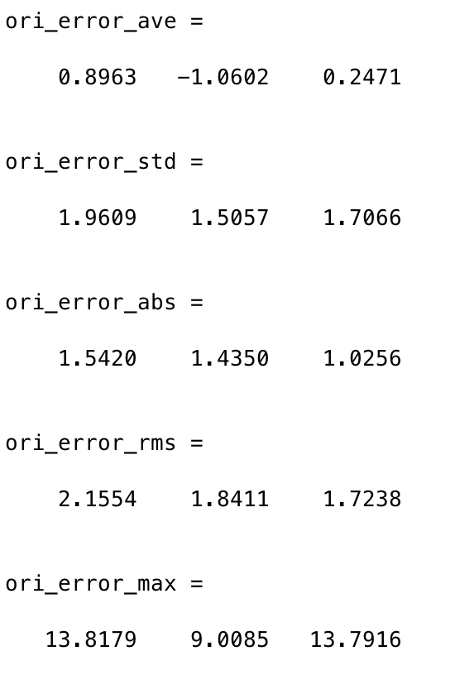
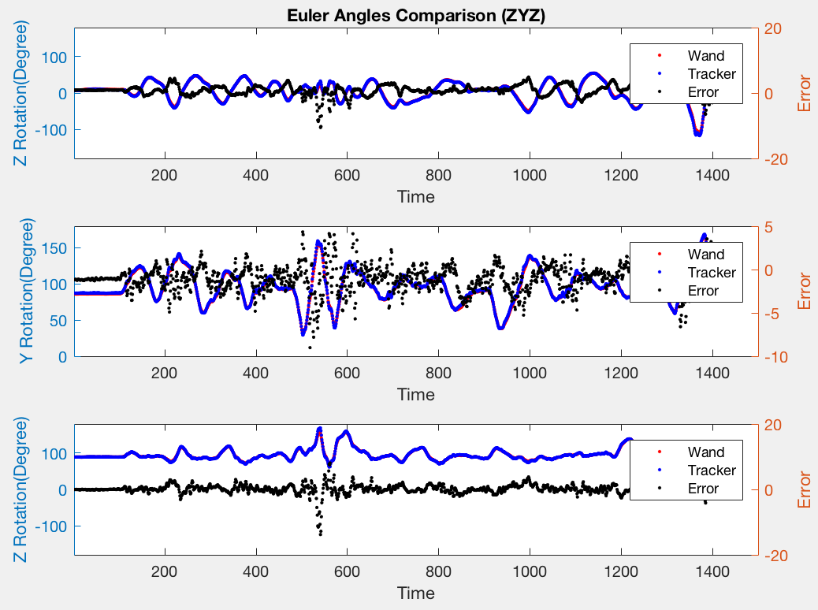
Orientation Comparison

Slide 11
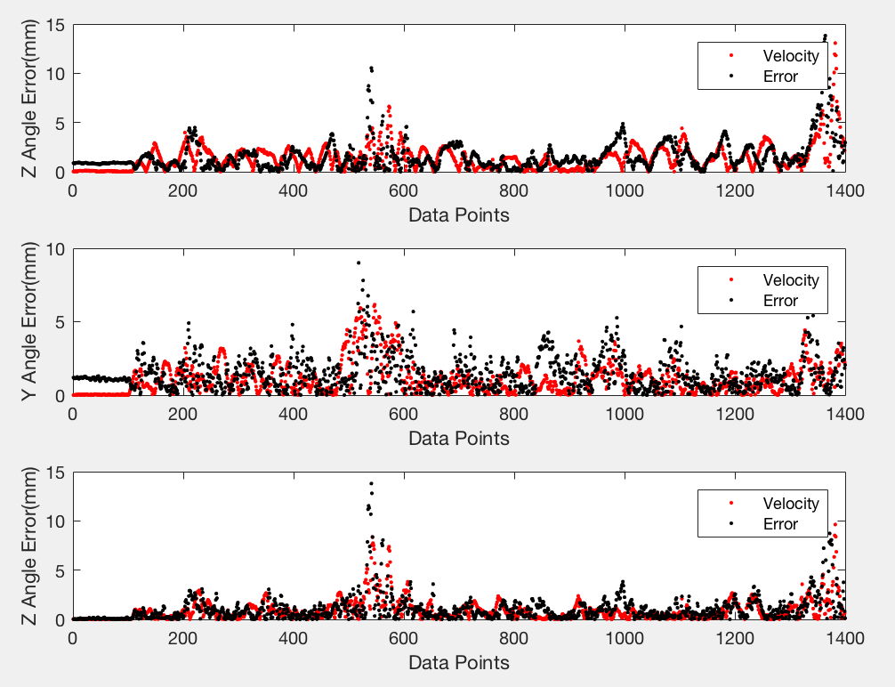
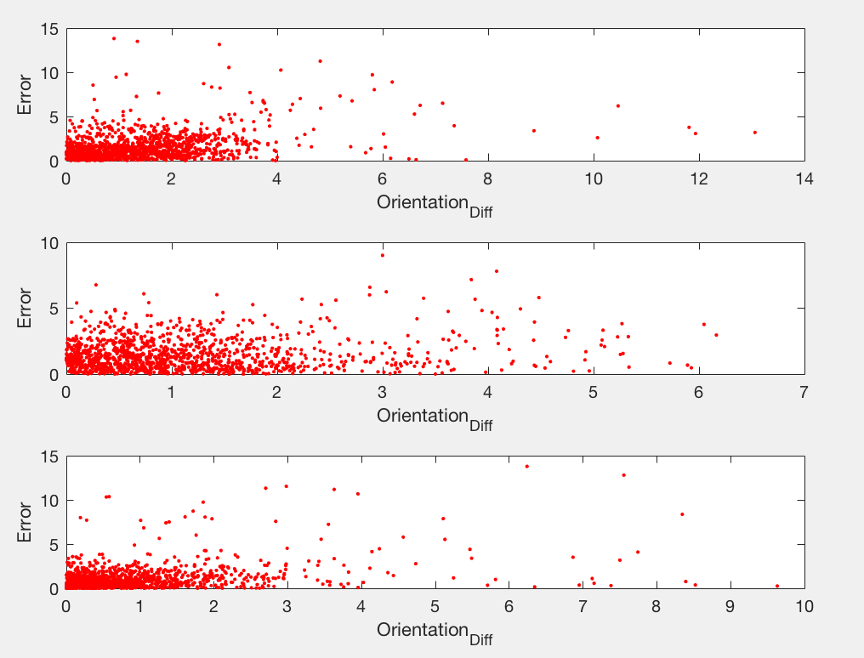
Velocity and Error

Slide 12
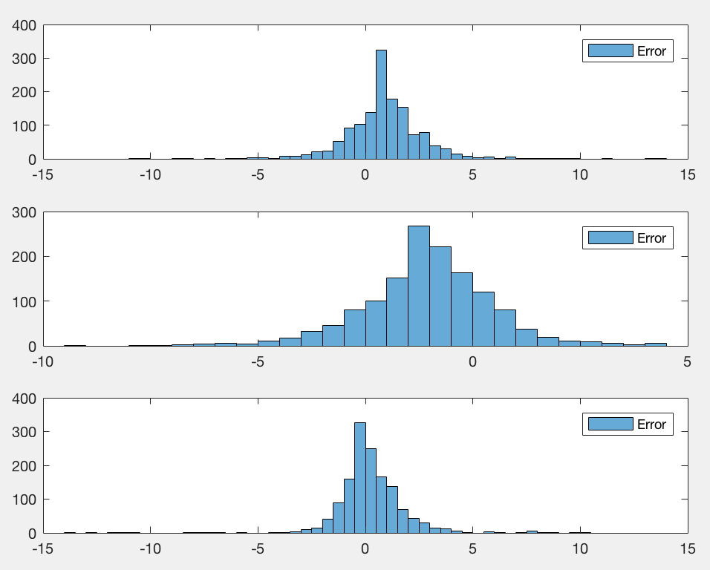
Error Distribution

Slide 13
Next step
Put tracker into C-Alex and add tracker from one to three
Using API to get data instead of Unity

