Slide 1

The GBM model and the Deep Learning with the mortgage probability of default data
Ian Huang

Slide 2
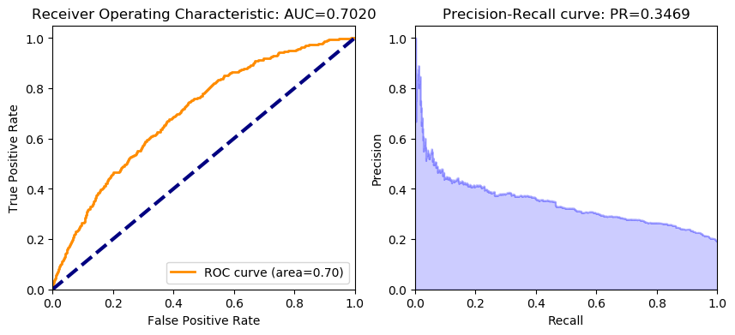
For GBM:

Slide 3
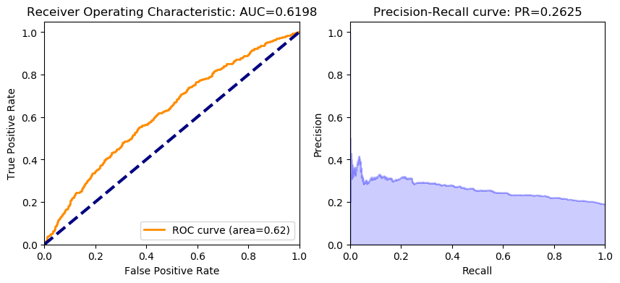
For H2O Deep learning:

