Slide 1

Assignment8
Ian Huang

Slide 2
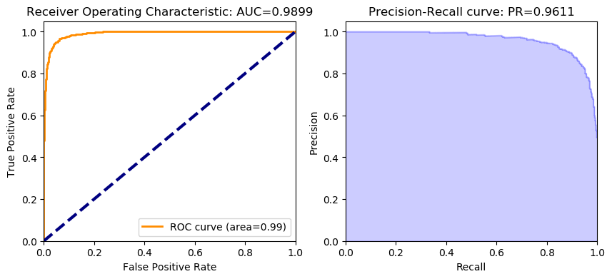
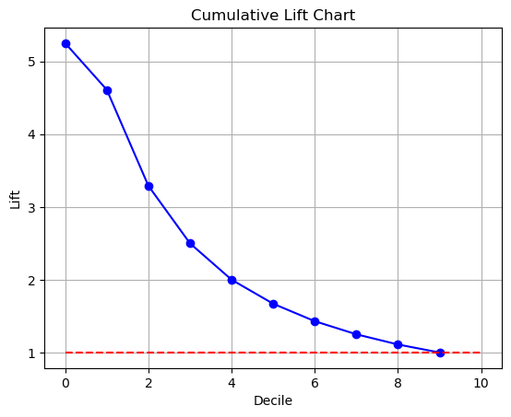
Hyperparameter | Value
ntrees | 50
max_depth | 20
min_rows | 1
nbins | 20
nbins_top_level | 1024
nbins_cats | 1024
sample_rate | 0.632
balance_classes | TRUE
max_after_balance_size | 5
max_confusion_matrix_size | 20
mtries | -1
col_sample_rate_change_per_level | 1
col_sample_rate_per_tree | 1
min_split_improvement | 1.00E-05
histogram_type | UniformAdaptive
categorical_encoding | Enum
calibration_method | PlattScaling
distribution | gaussian
stopping_tolerance | 0.001
seed | 1234

