Slide 1

A7: Health Care: Iforest and Auto encoder
Yihan Huang

Slide 2
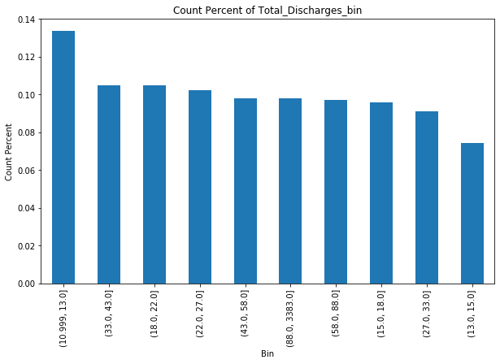
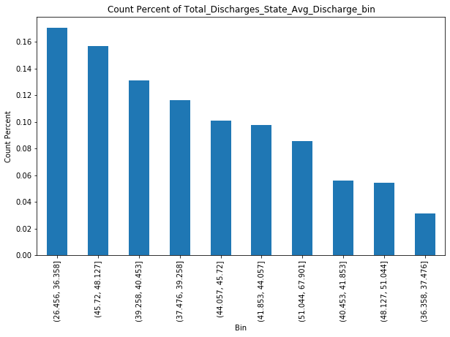
Features Engineering
Features for Binning and Analysis:
Total Discharges
Average Total Payments
Average Medicare Payment
Total Discharges State Avg Discharge
Average Medicare Payment DRG Avg Medicare
Average Total Payments City Avg
Average Total Payments State Avg
Provider Payment Difference
DRG Payment Ratio
Average Total Payments DRG Avg
DRG Count in State
Citywise Average Medicare Payment
Statewise Max Total Payments
DRGwise Min Medicare Payment
Hospital Service Volume

Slide 3
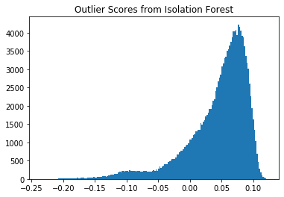
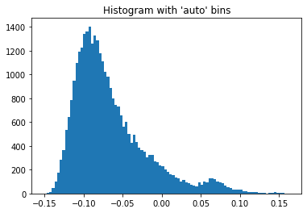
Isolation Forest
Deployed models (clf1, clf2, clf3) to generate an 'outlier score' for each record, considering various features like total discharges, average total payments, and provider payment difference.
Combined model scores using average and maximum of maximum methods for robust detection.
Outlier score distribution mostly below 2, indicating 'normal' data.
Scores above 2 deemed as potential anomalies - representing unusually high total payments, significantly different provider payment rates, or abnormally high discharge rates.

Slide 4
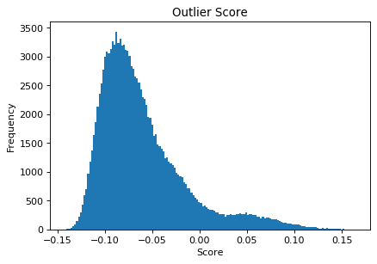
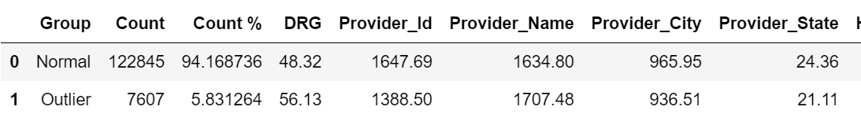
Auto Encoder
Utilized AutoEncoder model to detect anomalies in pharmaceutical data.
Defined a threshold, classifying samples with scores equal to or above 0.0 as outliers.
~5.83% of the dataset identified as outliers.
Detected outliers exhibited unique patterns in features like DRG, Provider_Id, Provider_Name, Average_Total_Payments, Provider_Payment_Difference.
Results aid in understanding anomalous behavior within the dataset, providing a basis for strategic actions.

Slide 5
Contents of This Template
Here’s what you’ll find in this Slidesgo template:
A slide structure based on a multi-purpose presentation, which you can easily adapt to your needs. For more info on how to edit the template, please visit Slidesgo School or read our FAQs.
An assortment of pictures that are suitable for use in the presentation can be found in the alternative resources slide.
A thanks slide, which you must keep so that proper credits for our design are given.
A resources slide, where you’ll find links to all the elements used in the template.
Instructions for use.
Final slides with:
The fonts and colors used in the template.
More infographic resources, whose size and color can be edited.
Sets of customizable icons of the following themes: general, business, avatar, creative process, education, help & support, medical, nature, performing arts, SEO & marketing, and teamwork.
You can delete this slide when you’re done editing the presentation.

