Slide 1

Production and Maintenance Monitoring Proposal
Ian Huang

Slide 2
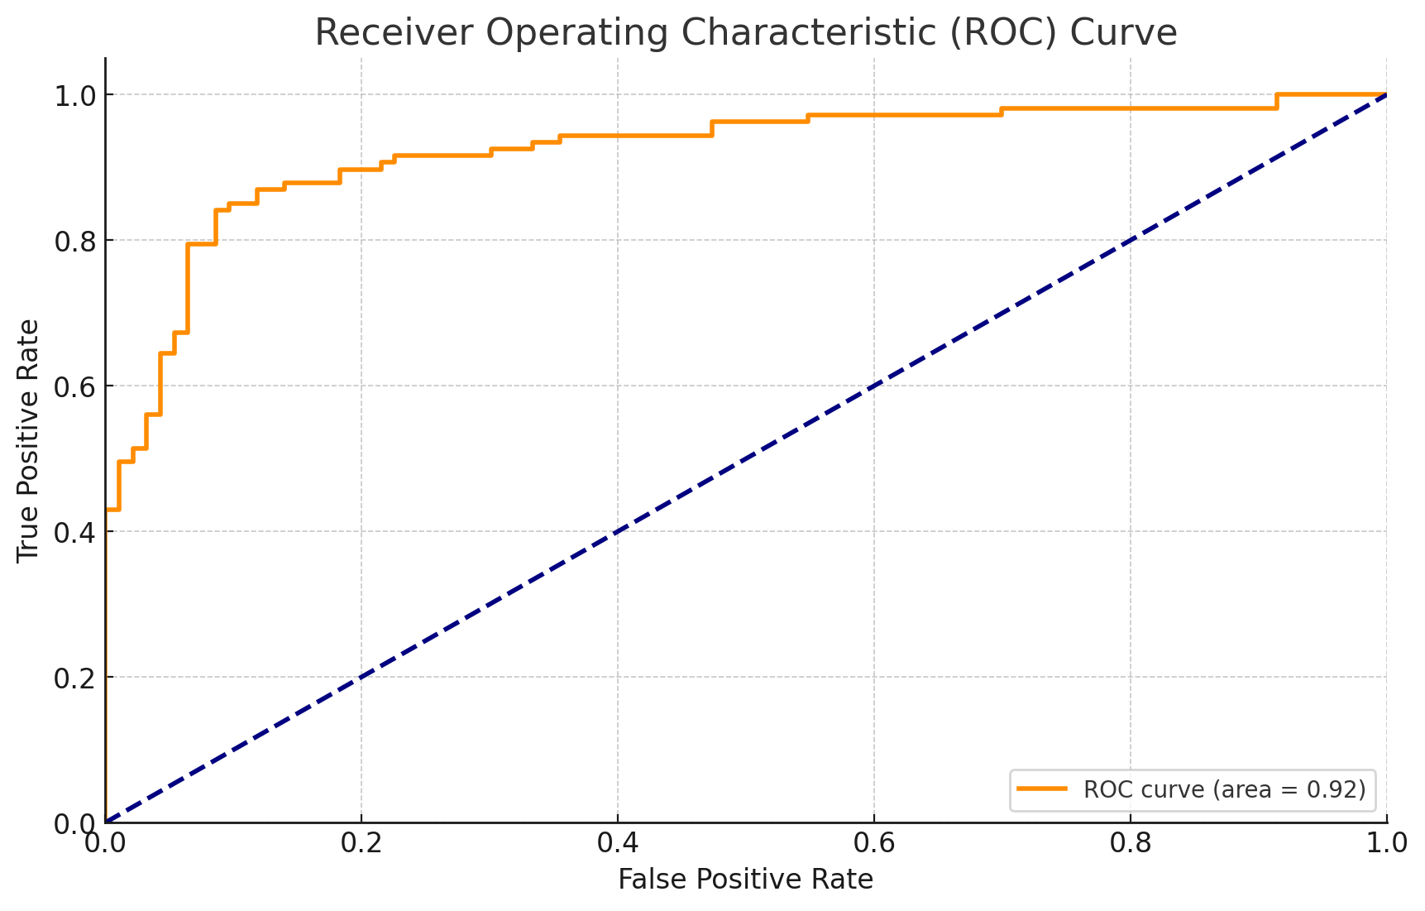
1. Model Evaluation Metrics
Accuracy: For classification problems, accuracy can be used to measure the proportion of correctly classified instances. Mean Squared Error (MSE): For regression problems, MSE can be used to quantify the difference between predicted and actual values. AUC-ROC: For binary classification, the area under the Receiver Operating Characteristic curve can be used to assess the model's ability to discriminate between classes. Confusion Matrix: A detailed breakdown of true positives, false positives, true negatives, and false negatives for classification problems.

Slide 3
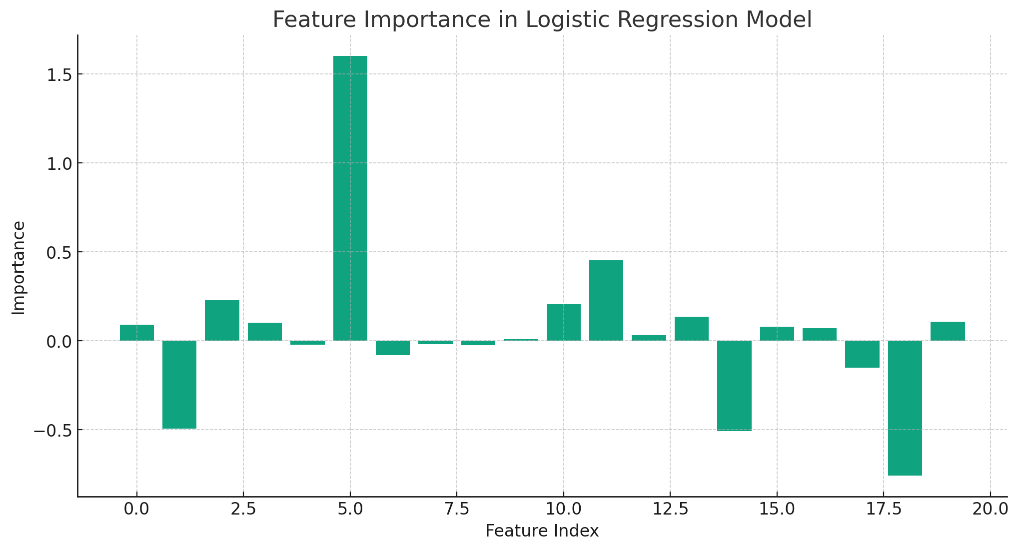
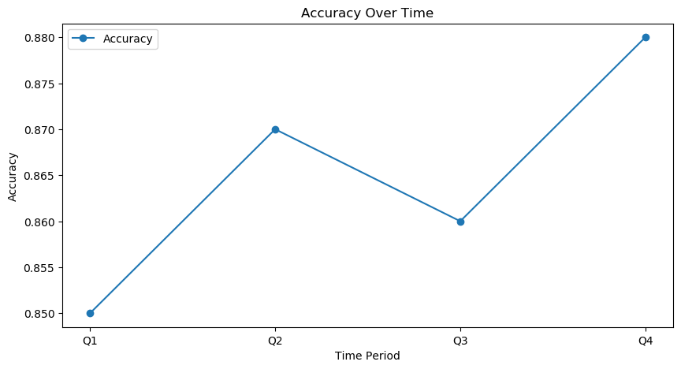
2. Real-time Monitoring Dashboard:
Performance Metrics Over Time: Plot the chosen evaluation metrics over time to detect any drift or change in model performance. Feature Importance: Monitor the importance of different features in the model to understand how changes in data distribution might affect performance. Residual Analysis: Plot residuals to identify any patterns that might indicate model misspecification.

Slide 4
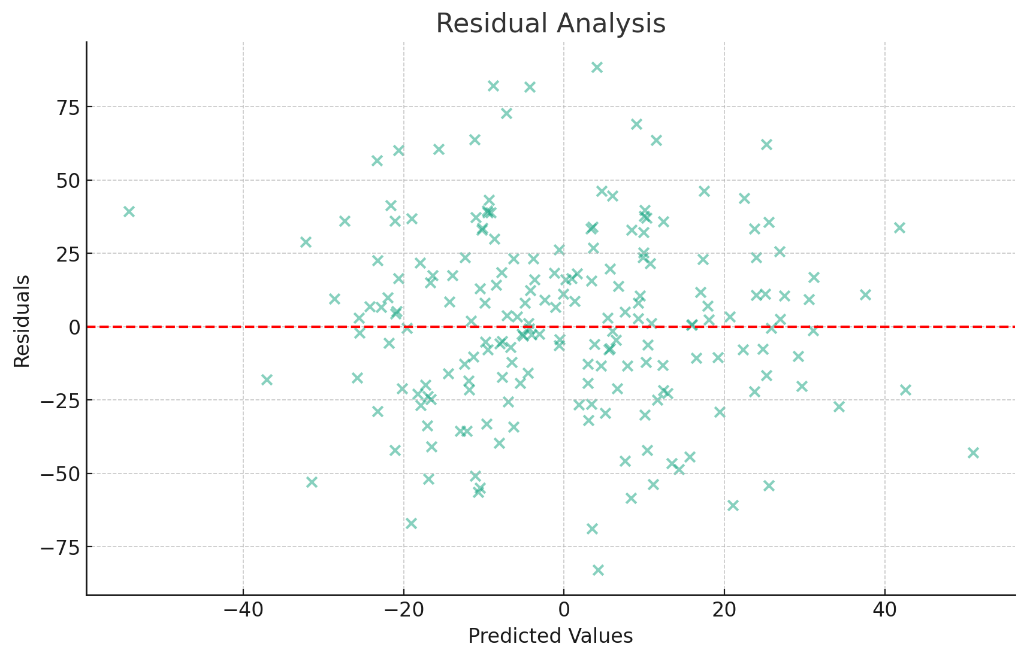
3. Alerting and Thresholds
Set thresholds for key metrics, and if the model's performance falls outside these thresholds, trigger alerts to notify the relevant team members.

Slide 5
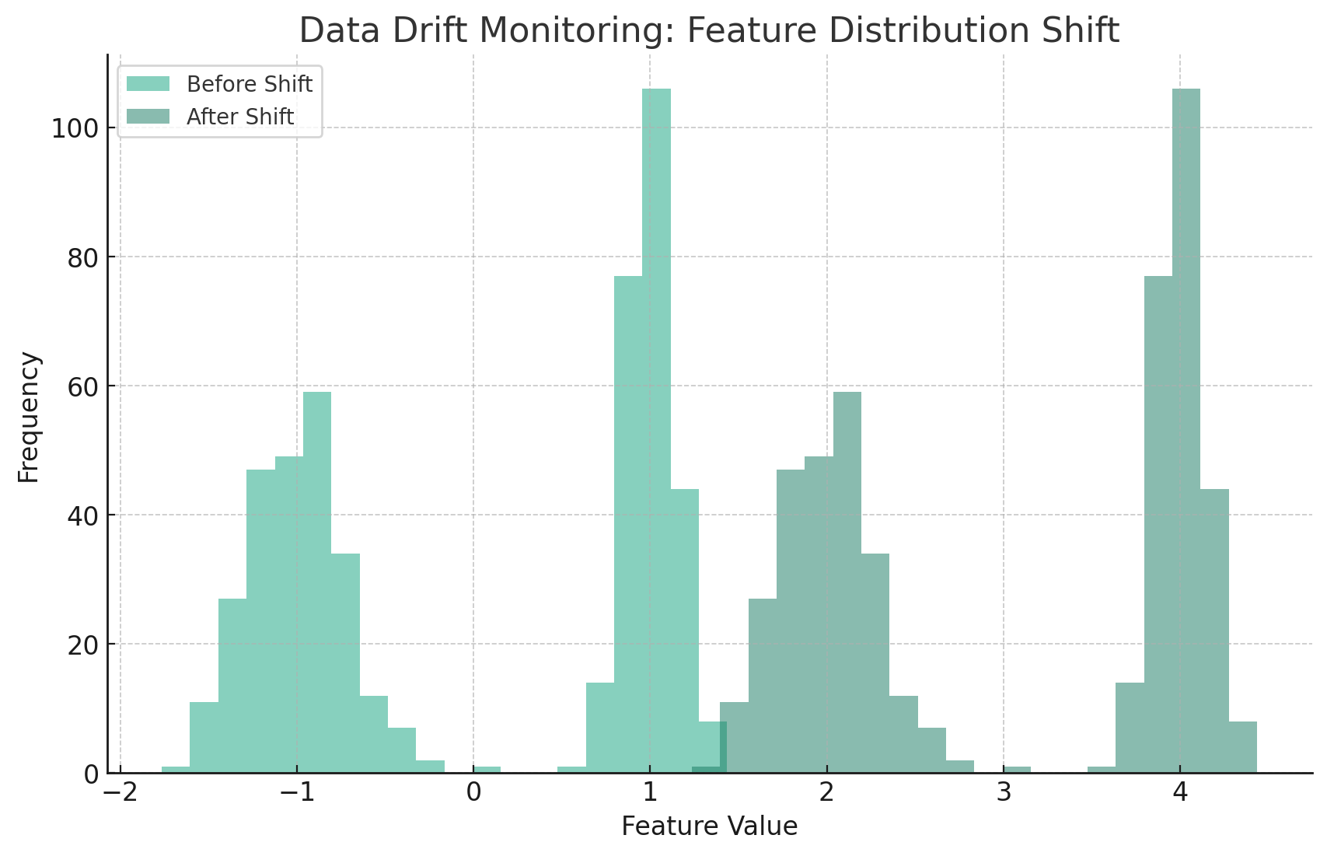
4. Data Drift Monitoring
Monitor changes in the distribution of input features to detect any shifts that might impact the model's performance.

Slide 6
5. Retraining Strategy
Triggering Retraining: Define criteria for triggering retraining, such as a drop in performance, changes in feature importance, or data drift.
Automated Pipeline: Develop an automated pipeline that includes preprocessing, training, validation, and deployment.
Model Validation: Include validation steps to ensure the new model meets the required performance criteria.
Versioning: Keep track of different model versions and associated data, allowing for rollback if necessary.

Slide 7
Model Predictions: Log predictions, input features, and other relevant information. Performance Metrics: Log key performance metrics over time to track changes. User Interactions: Track who is using the model and for what purpose. Compliance: Ensure logging practices comply with legal and regulatory requirements, especially when dealing with sensitive data. Anomaly Detection: Analyze logs to detect any unusual behavior or anomalies that may indicate issues with the model.
6. Logging and Auditing

Slide 8


