Slide 1
Merchant Profitability Analysis
Company XYZ
Feb, 2023

Slide 2
Executive Summary
1) Category, Subcategory and Average APR are the top 3 drivers for the variance between actual and predicted repayment.
2) Actual Repayment Percent, Category and Number of Loans per Merchant are the top 3 drivers for the variance between authorized and actual loan amount.
3) To reduce default and losses, we need to reduce the volumes in below subcategories:
All Other Health and Personal Care Stores - 446199
Jewelry Stores - 448310
Furniture Stores - 442110
Musical Instrument and Supplies Stores - 451140
Sporting Goods Stores - 451110
4)WOMENS’ FASHION generated the highest total profits among all categories. Women's Clothing Stores – 448120 generated the highest total profits among all subcategories.
5) In order to further evaluate their merchants’ profit, we need to gather business credit card statements, credit bureau information and social housing institute information, etc.
6) We need to build comprehensive commercial risk models on Probability of Default (PD), Loss Given Default (LGD), and Exposure at Default (EAD) parameters for a retail portfolio with information that is representative of the system, both cross-sections and for a relevant part of the economic cycle.

Slide 3
Repayment Analysis

Slide 4
Repayment Drivers The variance between actual and predicted repayment is the prediction errors of upstream predictive models
Actual Repayment
Predicted Repayment
Credit risk indicator:
Actual Repayment Percent=1, Merchant paid back full loan amount, no default/charge off
Actual Repayment Percent<1, Merchant paid back part or zero loan amount, defaulted/charged off
Scores from upstream predictive models
Driven by upstream model inputs(repayment history, fico scores, income to debt ratio, internal and external credit line, utilization, etc.)

Slide 5
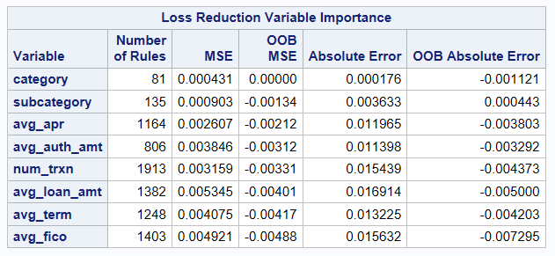
Repayment Drivers The variance between actual and predicted repayment is the prediction errors of upstream predictive models
Random Forest Feature Importance
Category, Subcategory and Average APR are the top 3 drivers for the variance between actual and predicted repayment

Slide 6
Loan Amount Analysis

Slide 7
Loan Amount Drivers The variance between authorized and actual loan amount is the variance between the loan amount the user requested and got approved
Authorized Loan Amount
Actual Loan Amount
Users’ shopping needs and wants
Decisions made by underwriting teams
Restricted by underwriting rules and processes, impacted by multiple credit risk factors (repayment history, fico scores, income to debt ratio, internal and external credit line, utilization, etc.)

Slide 8
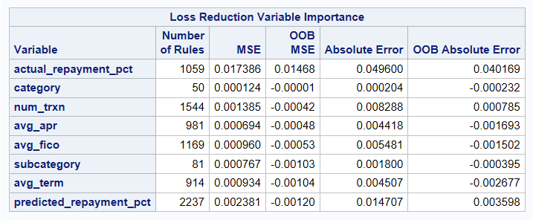
Loan Amount Drivers The variance between authorized and actual loan amount is the variance between the loan amount the user requested and got approved
Random Forest Feature Importance
Actual Repayment Percent, Category and Number of Loans per Merchant are the top 3 drivers for the variance between authorized and actual loan amount

Slide 9
Profit Analysis

Slide 10
Profit Drivers Profit is negatively impacted by defaults (not fully repay loan amount)
Top 10 Subcategories with highest default counts and loss counts
category | subcategory | profit | volume | default_count | loss_count
OTHER | All Other Health and Personal Care Stores - 446199 | $ 596,932.68 | 14 | 12 | 3
JEWELRY | Jewelry Stores - 448310 | $ 682,615.66 | 21 | 10 | 1
HOME_FURNISHINGS | Furniture Stores - 442110 | $ 458,711.50 | 17 | 6 | 3
OTHER | Musical Instrument and Supplies Stores - 451140 | $ 1,166,838.16 | 10 | 6 | 1
OTHER | Sporting Goods Stores - 451110 | $ 18,119.21 | 10 | 5 | 3
OTHER | Electronics Stores - 443142 | $ 121,916.76 | 5 | 4 | 0
AUTO_PARTS | Automotive Parts and Accessories Stores - 441310 | $ 193,976.88 | 5 | 3 | 1
WOMENS_FASHION | Women's Clothing Stores - 448120 | $ 4,488,397.36 | 4 | 3 | 0
OTHER | Hobby, Toy, and Game Stores - 451120 | $ (1,304.98) | 3 | 2 | 1
OTHER | Security Systems Services (except Locksmiths) - 561621 | $ 16,630.29 | 2 | 2 | 0
To reduce default and losses, we need to reduce the volumes in below subcategories:
All Other Health and Personal Care Stores - 446199
Jewelry Stores - 448310
Furniture Stores - 442110
Musical Instrument and Supplies Stores - 451140
Sporting Goods Stores - 451110
Note: profit=(avg_apr-(1-actual_repayment_pct))*avg_loan_amt*num_trxn*avg_term
default count is defined as actual repayment percent<1, loss count is defined as profit<0

Slide 11
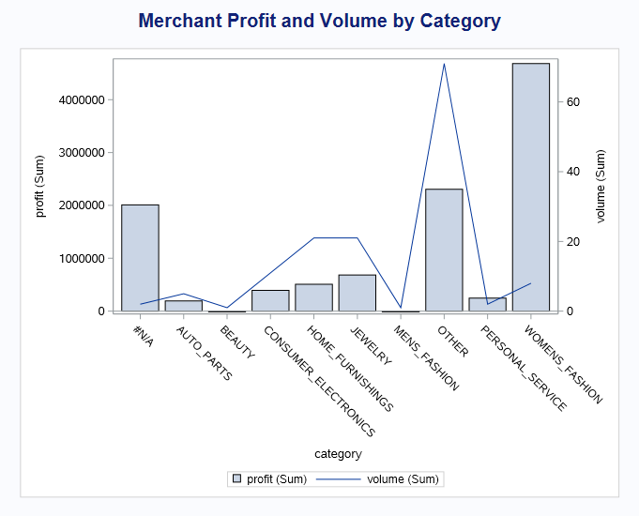
Profit Drivers Profit is driven by interest rate that charged to the user and actual repayment made by the user
WOMENS’ FASHION generated the highest total profits among all categories.
Women's Clothing Stores – 448120 generated the highest total profits among all subcategories.
Note: profit=(avg_apr-(1-actual_repayment_pct))*avg_loan_amt*num_trxn*avg_term

Slide 12
Next Steps

Slide 13
Commercial Risk Models
In order to further evaluate merchants’ profit and convey a system-wide dimension to parameters and identify if there exists common credit risk factors, three sources of information are needed to collect:
Business credit card statements that describe loan-level data information related to outstanding balance, interest rate, actual payments, minimum required payment, and date of payment. This information is designed to describe the payment behavior of borrowers, identify recovery in subsequent periods after default and allow the identification of the exposure at the time of default.
Credit bureau information that consists of individual credit records, including information such as the number of loans the borrower had with other banks in the analyzed period, its performance and the time elapsed since the borrower first received a loan in the system.
Social housing institute information which collects payroll deductions from workers and describes borrower.

Slide 14
Commercial Risk Models
Commercial risk models are estimated with information that reflects payment experience. These parameters tend to describe individual credit issuer's experience and often show different explanatory factors when compared to other companies’ models.
LGD
EAD
PD
probability of default (PD), which gives the average percentage of obligors that default in a rating grade in the course of one year
loss given default (LGD), which gives the percentage of exposure the bank might lose if the borrower defaults
exposure at default (EAD), which gives an estimate of the outstanding amount (drawn amounts plus likely future draw-downs of yet unused lines) in case the borrower defaults
Expected Loss is calculated by (PD * LGD * EAD)

Slide 15
Q&A

Slide 16
Thank You

