Slide 1
Modeling eye movement data during spoken language comprehension

Slide 2
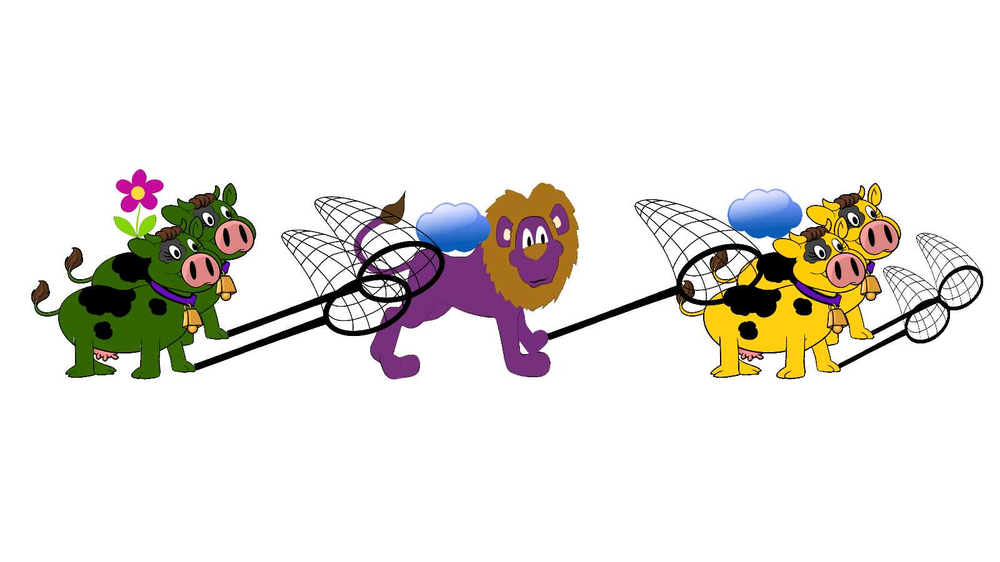
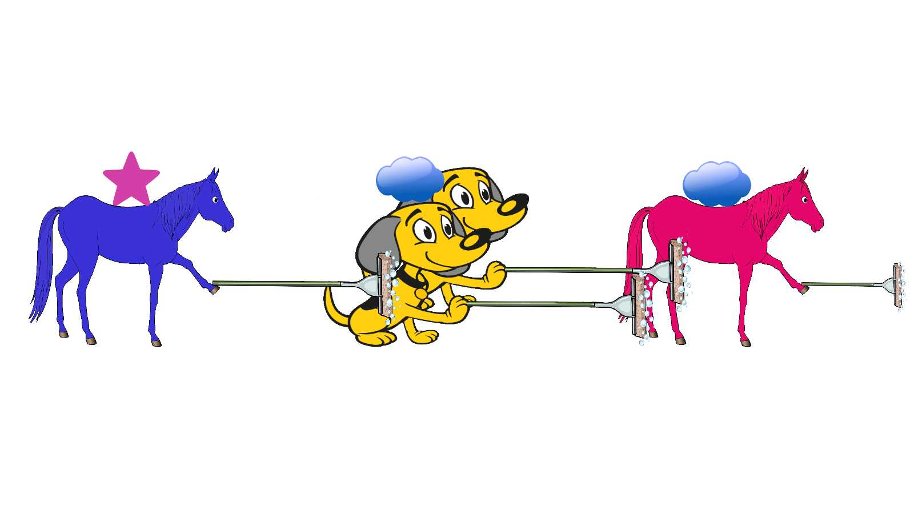
What color is the horse that the dogs are washing?
What color is the horse that is washing the dogs?
There are two cows on the left. There are two cows on the right. And there is also a lion.
What color are the cows that he is catching?
What color are the cows that are catching him?

Slide 3
There are two cows on the left. There are two cows on the right. And there is also a lion.
What color are the cows that he is catching?
Distractor Middle Target

Slide 4
There are two cows on the left. There are two cows on the right. And there is also a lion.
What color are the cows that are catching him?
Target Middle Distractor

Slide 5

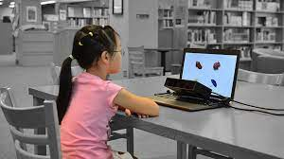

Slide 6
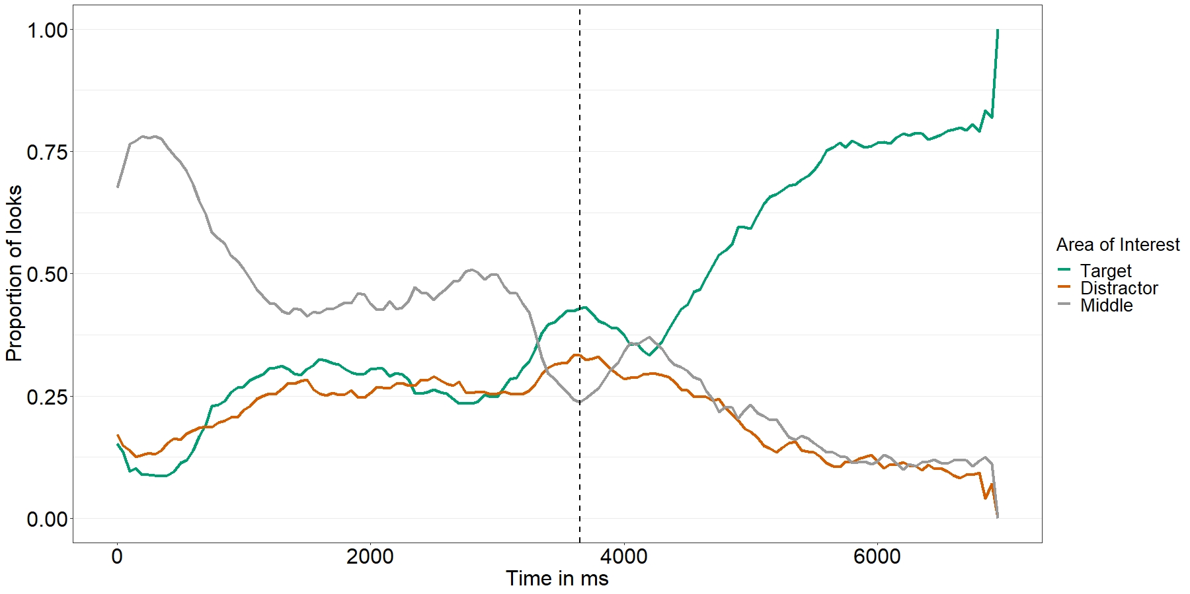
What color is the horse with the cloud

Slide 7
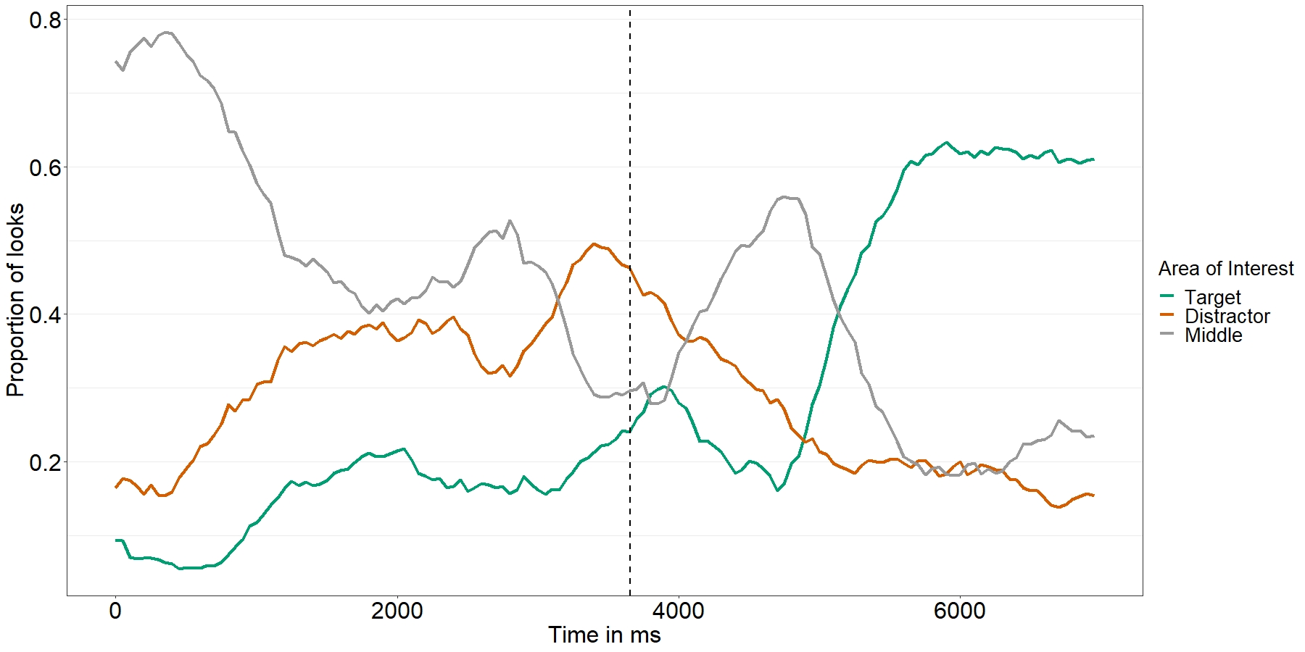
What color are the cows that the lion is catching?

Slide 8
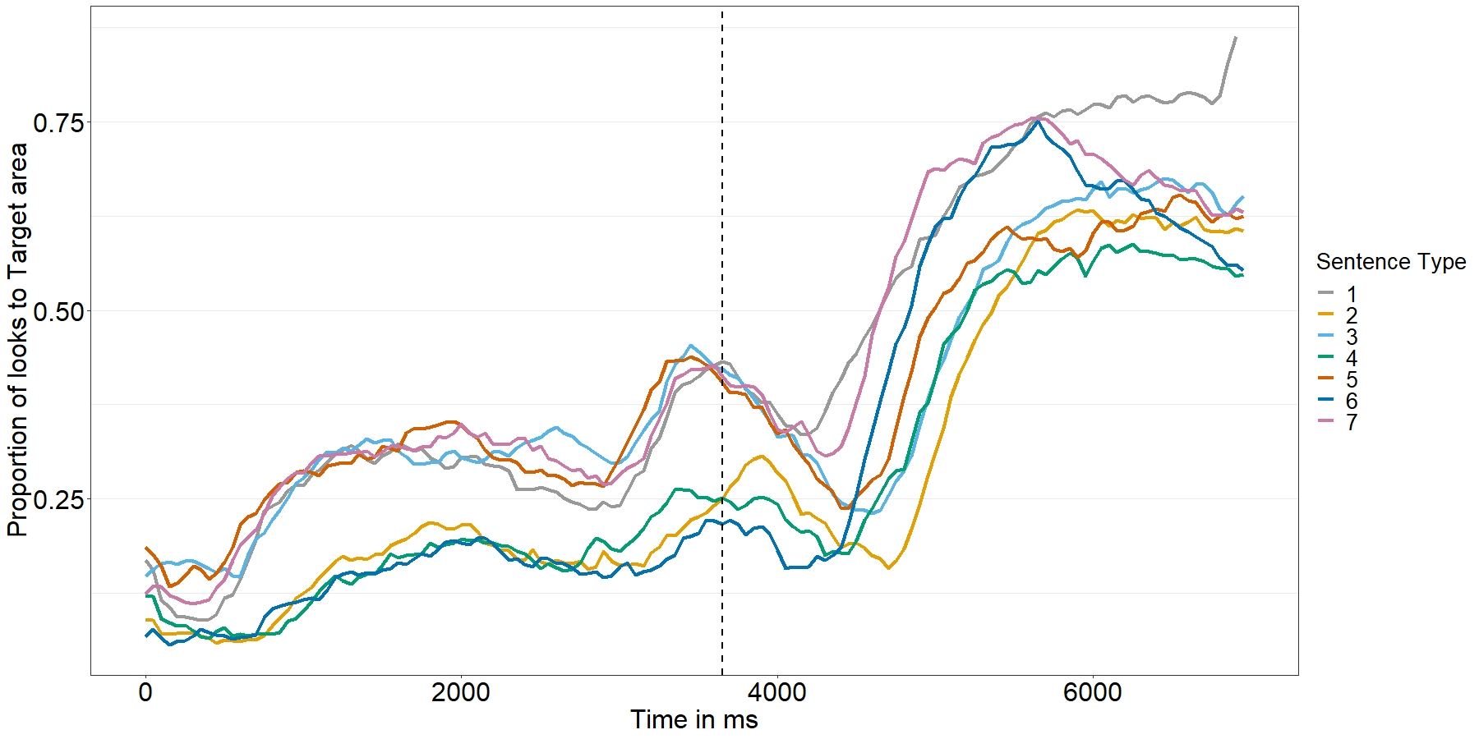
What color are the cows that the lion is catching?
What color are the cows that he is catching?
…

