Slide 1











Apex
R.R.S
by Apex Neural System

Slide 2




01
Problem
Statement

Slide 3





What is the problem?
Slow Food Delivery
Labor shortages
Lack of manpower during peak hours
Required labor

Slide 4





~ 2 min
to serve a tray to a table
1 tray
at a time for a single waiter

Slide 5
02
Proposed Solution

Slide 6




How it works (Steps)
Chef will select the which table for the robot waiter to serve
The robot hand will grab the food and place it onto the table
Step 1
Step 3
Step 2
Step 4
The robot waiter will be send to that table
The robot waiter move back to the starting point

Slide 7
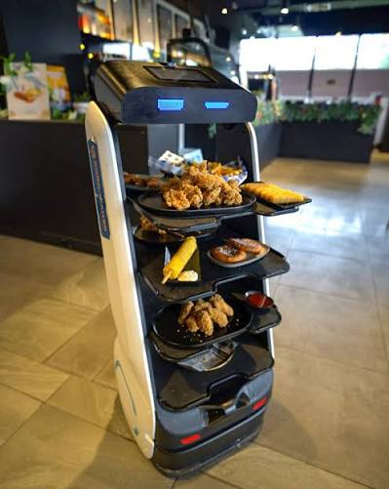
~66%
of manpower reduced
up to 3 tray
can be carried by Neural RRS instead of 1 tray by a waiter

Slide 8


Why Our Solution?
Reduce Manpower
Suitable for Repetitive Task
A robotic car for food delivering and robotics arm for handling grabbing food.
Designed to reduce the labour needed for serving food repetatively

Slide 9
03
Market
Size

Slide 10




TAM - $4.2B
Total global restaurant service robotics market
SAM - $1.6B
SOM
Total Asia Pacific restaurant service robotics market
SOM - $16M
SAM
Capture 1% of the resturant robotics market within Asia Pacific.
TAM
source : Restaurant Service Robot Market Size

Slide 11
04
Business Model

Slide 12




Business Model
Robotics-as-a-Service
(RaaS)
Onboarding & Setup
Load
Monthly fees per robot
RM2000/unit for 2 years
RM2000 once for integration fees covering POS/ kitchen system setup & floor mapping

Slide 13
Estimation of ROI
Item | Cost (RM)
Labour Cost (RM2500 * 2 person * 12 months) | 60,000
Apex RRS Subscription (RM2000 * 2 unit * 12 months) | 48,000
Apex RRS Setup Fees | 2,000
Cost Saved | 10,000
Annual ROI = RM(10000/ 50000) x 100
= 20%
source : Food Robotics Market

Slide 14
05
Road Map

Slide 15
Roadmap
Deliver robot and live testing on few restaurant
Expand into whole Malaysia
Now
Year 2 - 3
Next 12 Months
Expand the robot into important city & mall

Slide 16
06
Technical Part

Slide 17



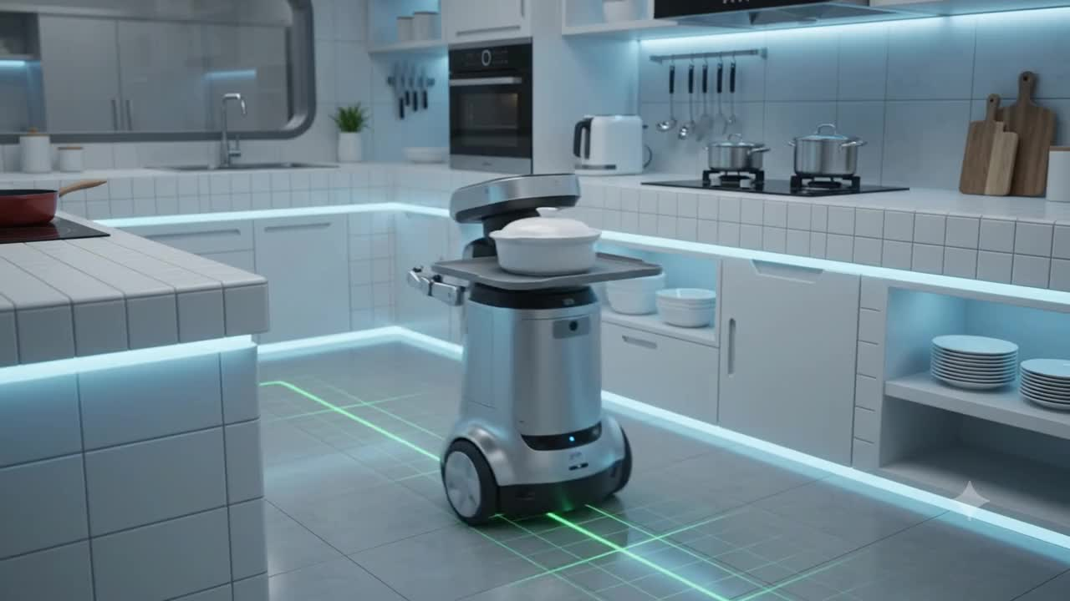



Slide 18
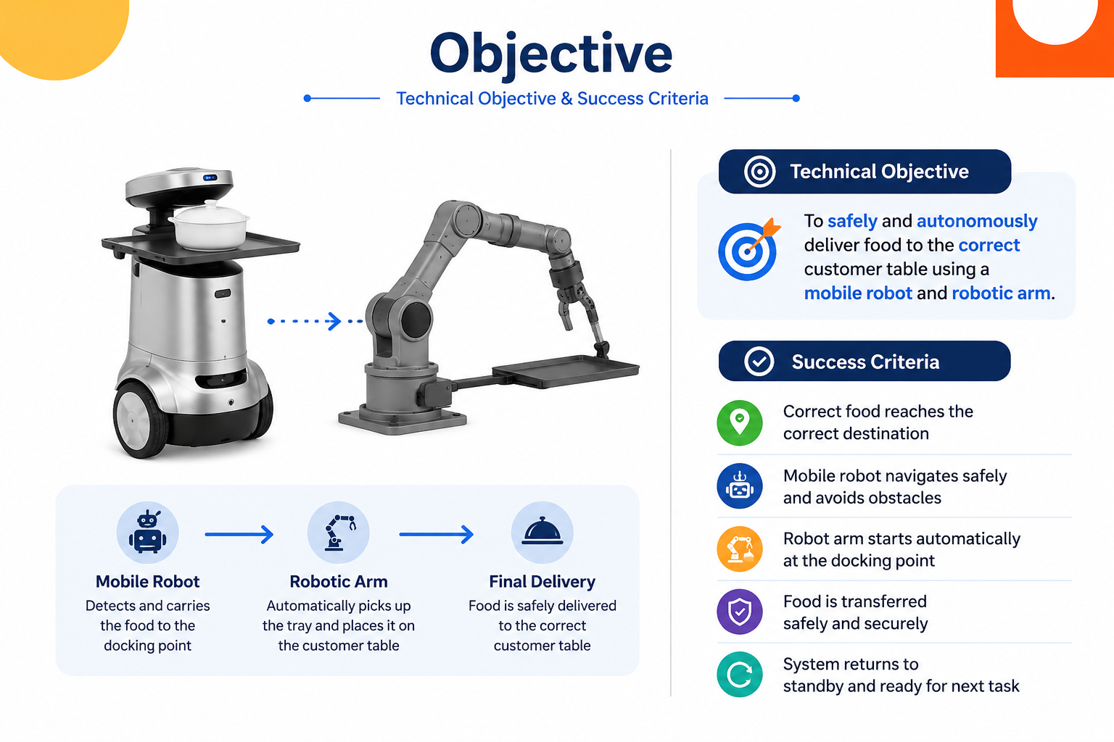

Slide 19
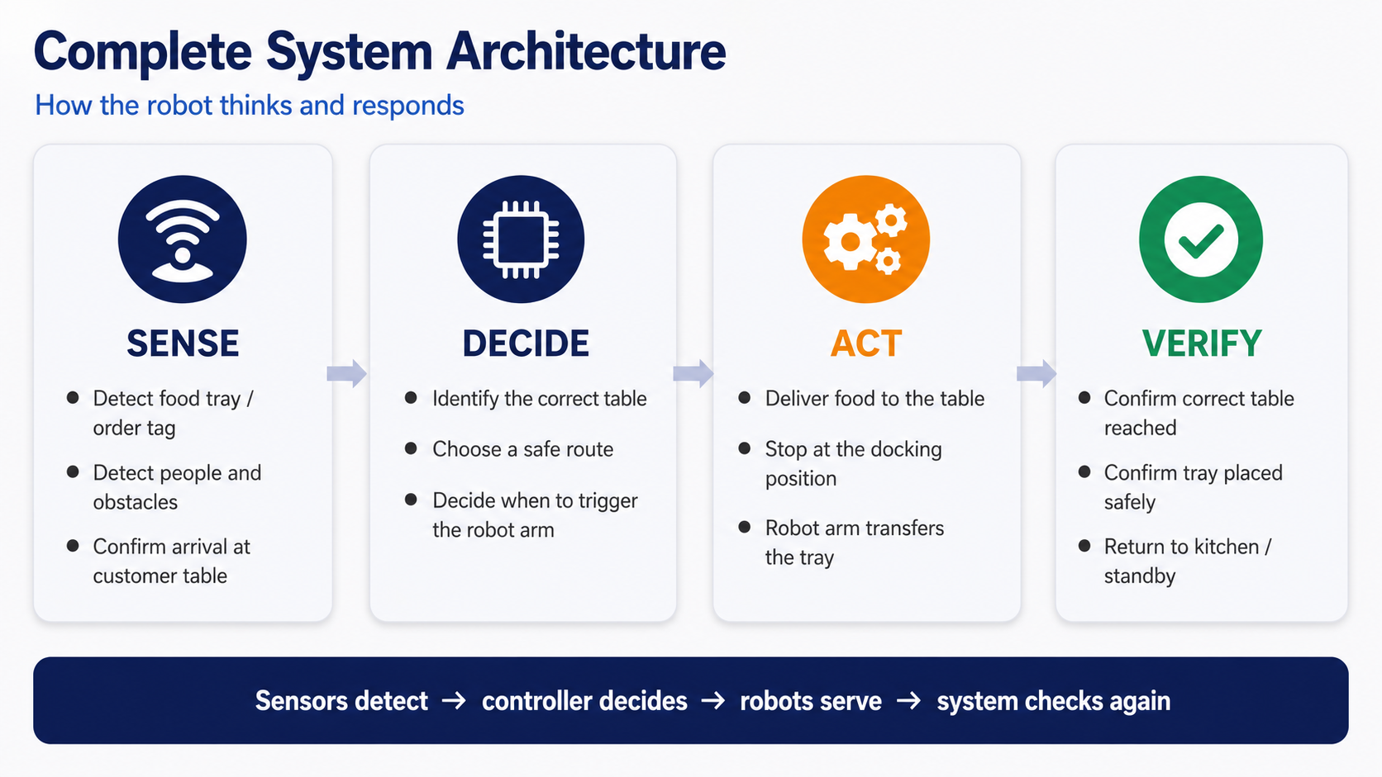

Slide 20

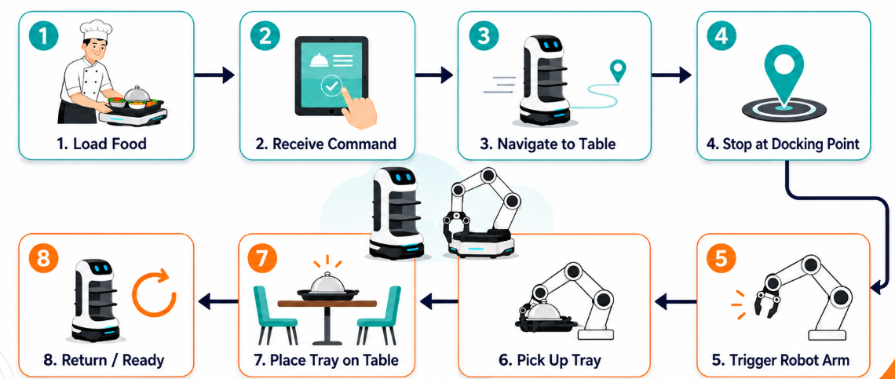

Slide 21
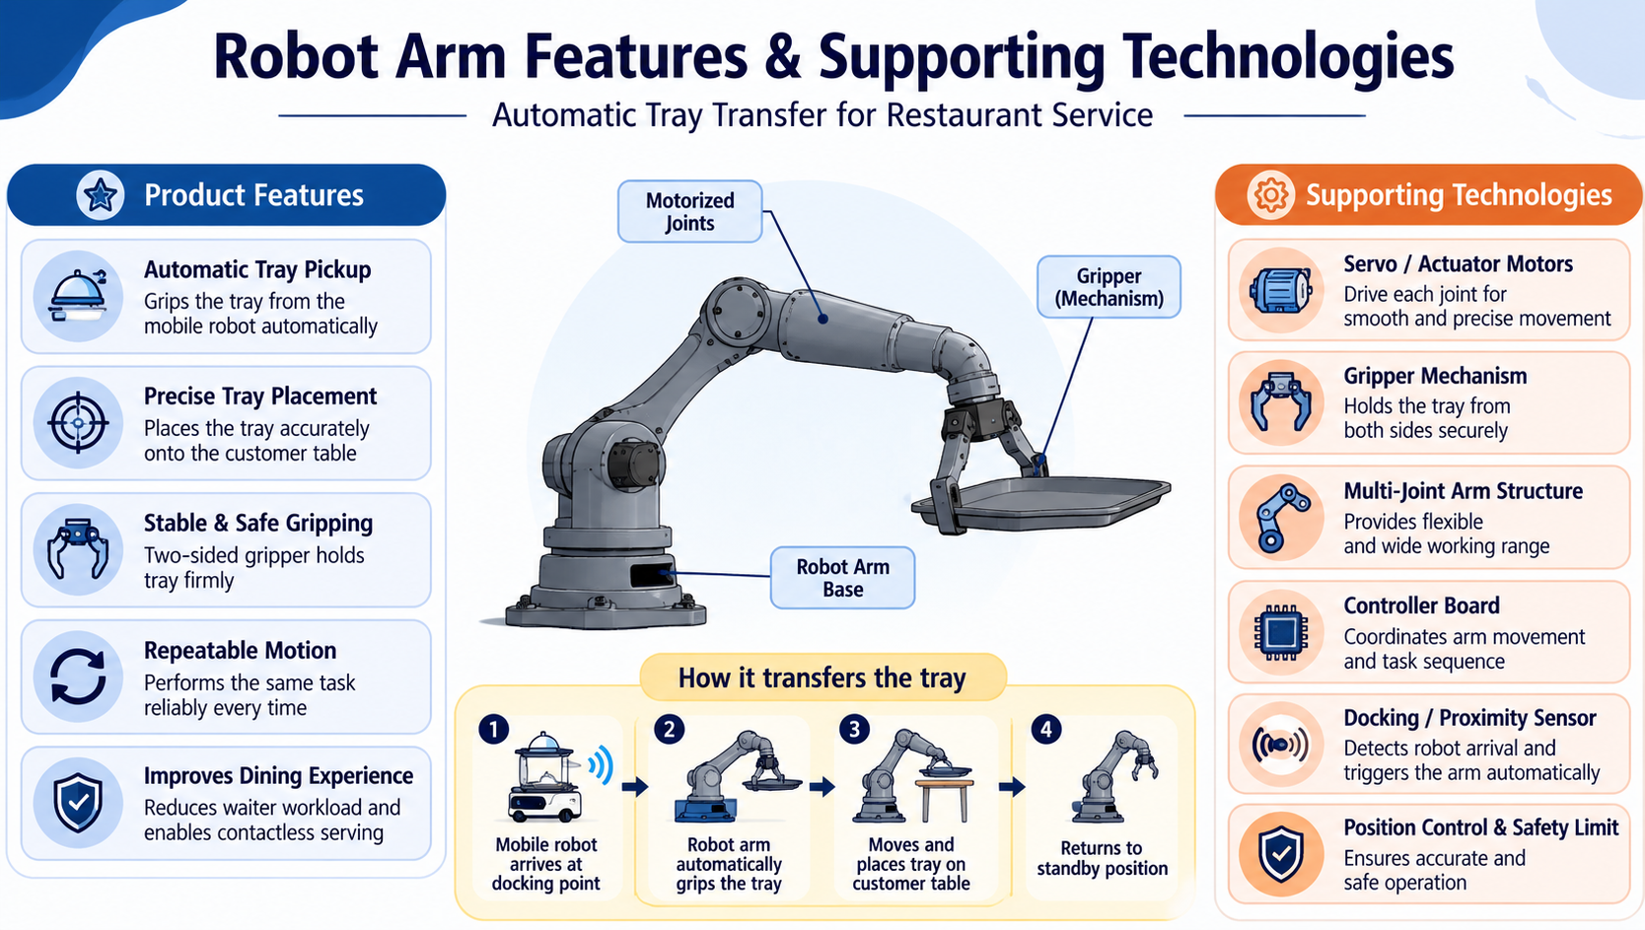
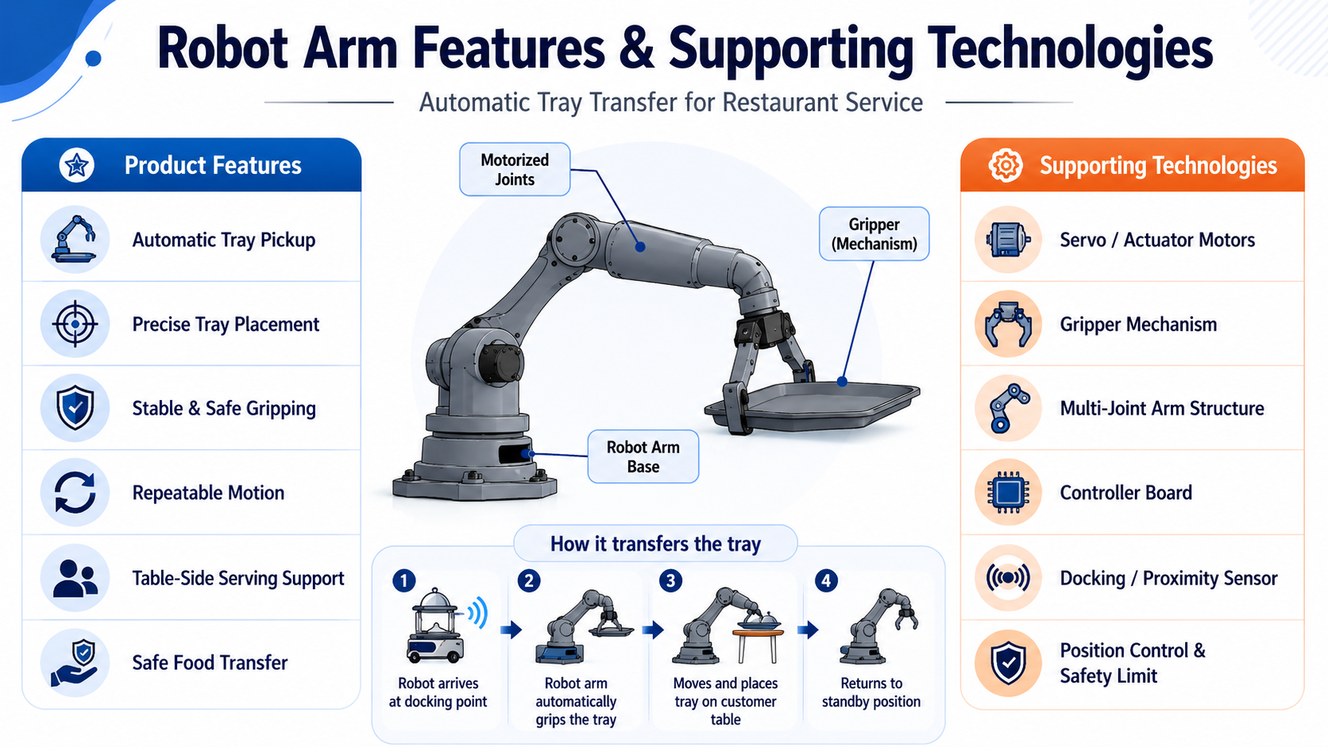
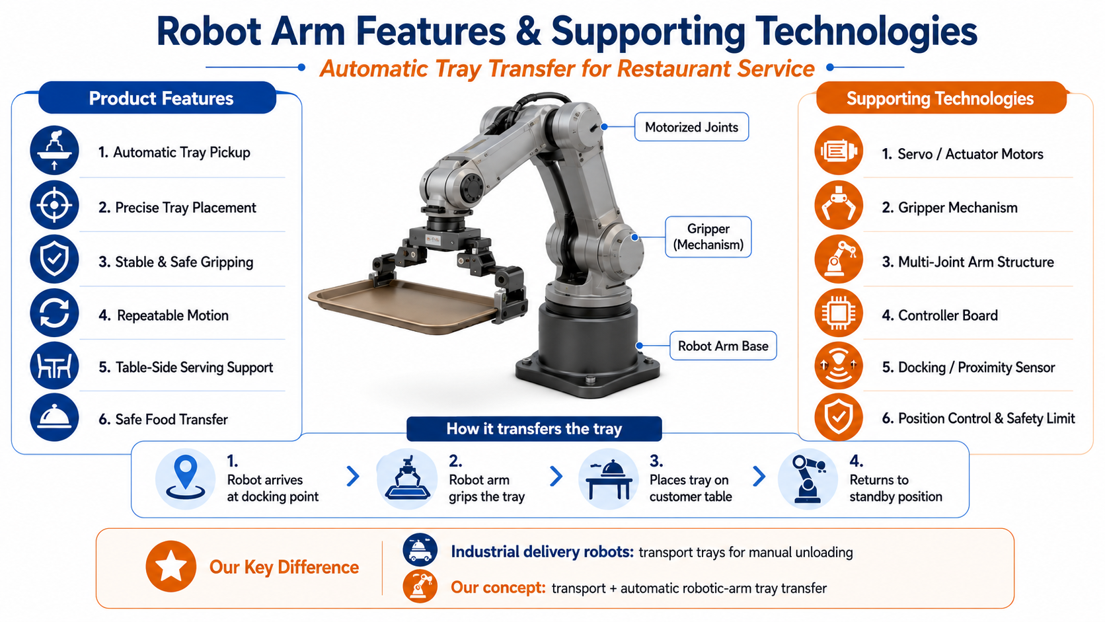

Slide 22
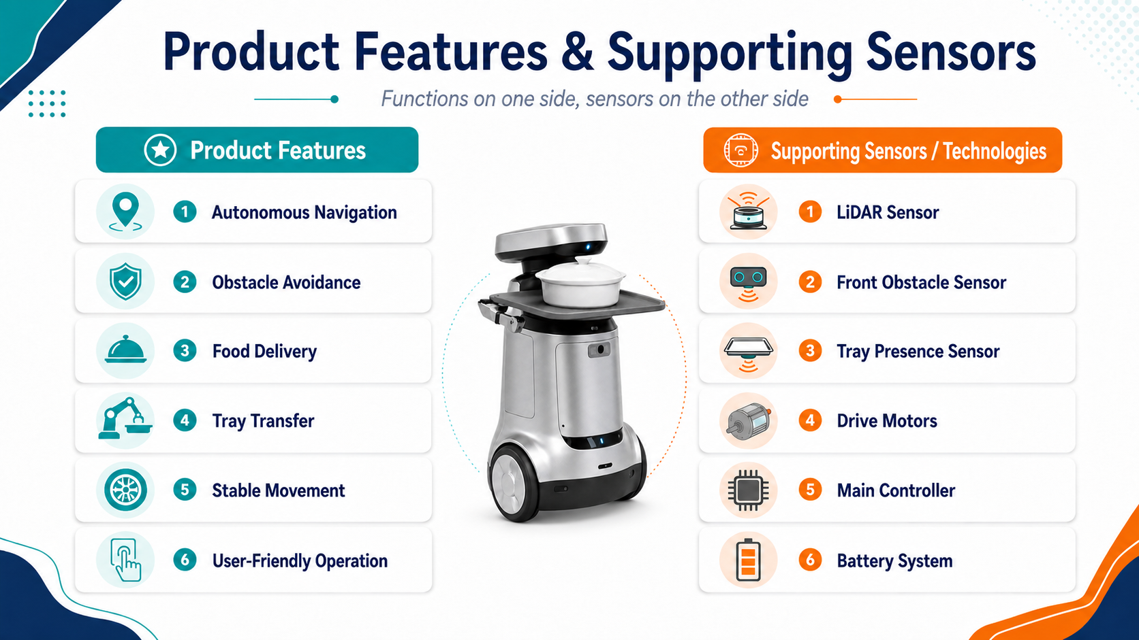

Slide 23
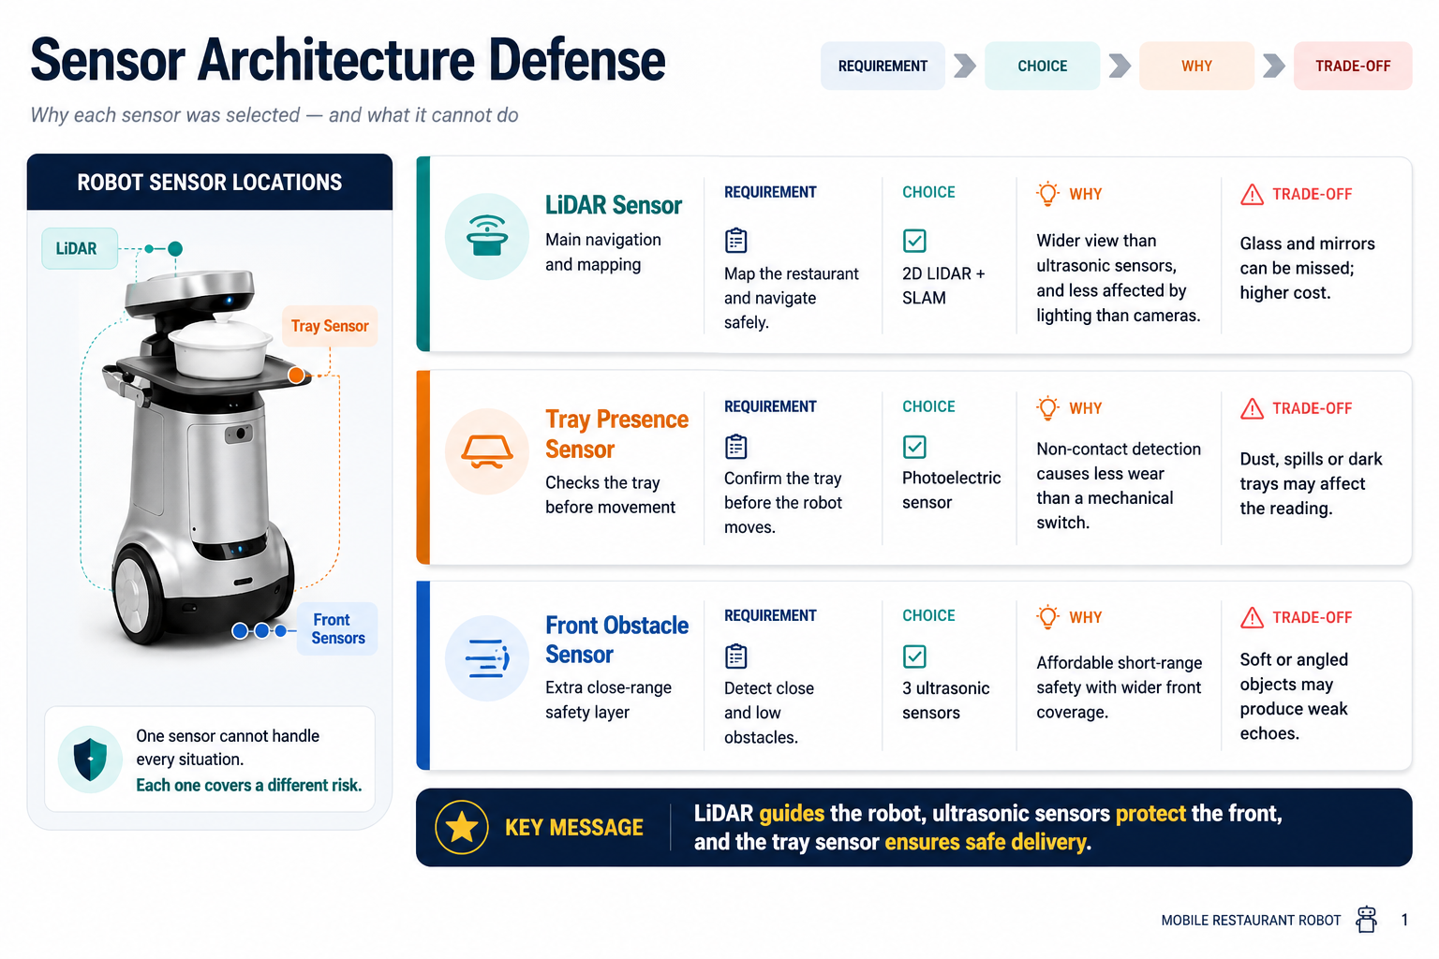
A 2D LiDAR scans at one fixed height, so it may miss very low obstacles.

Slide 24
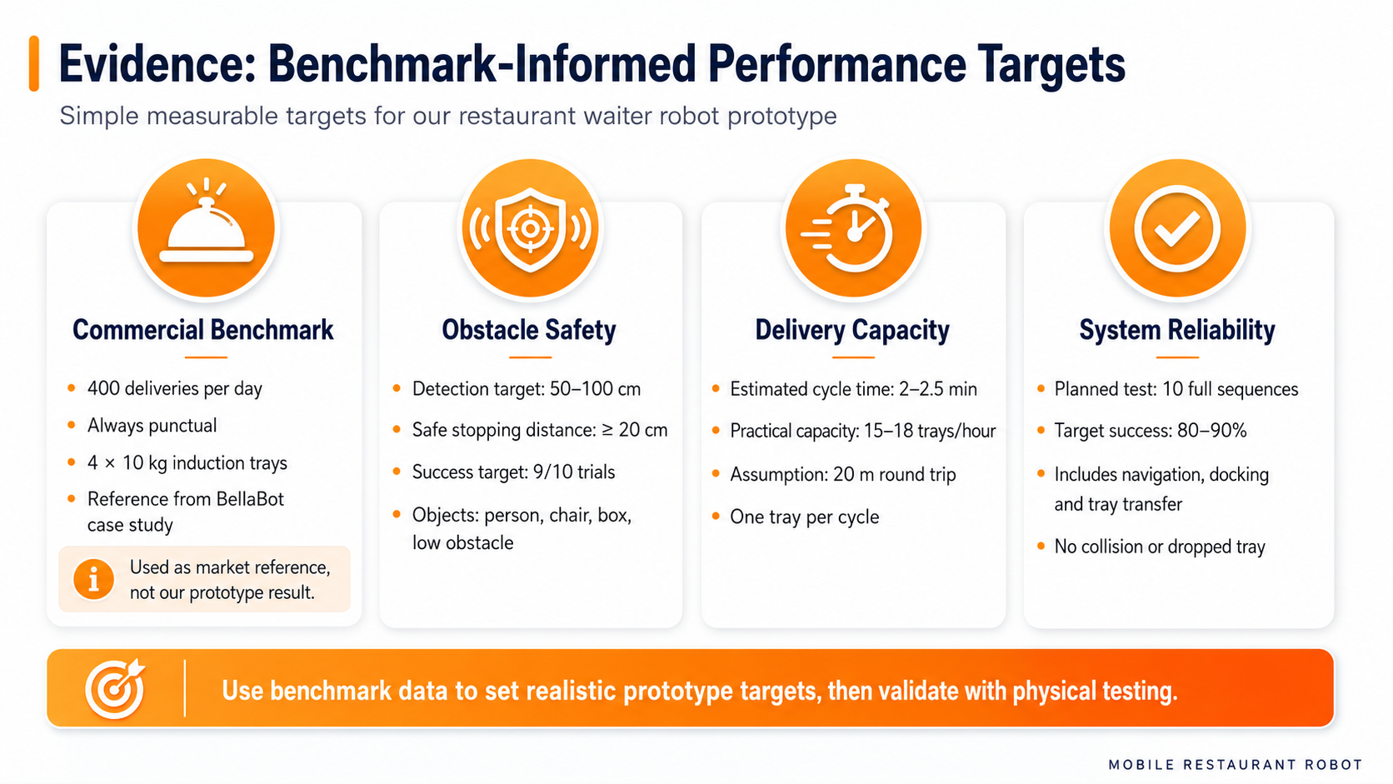

Slide 25
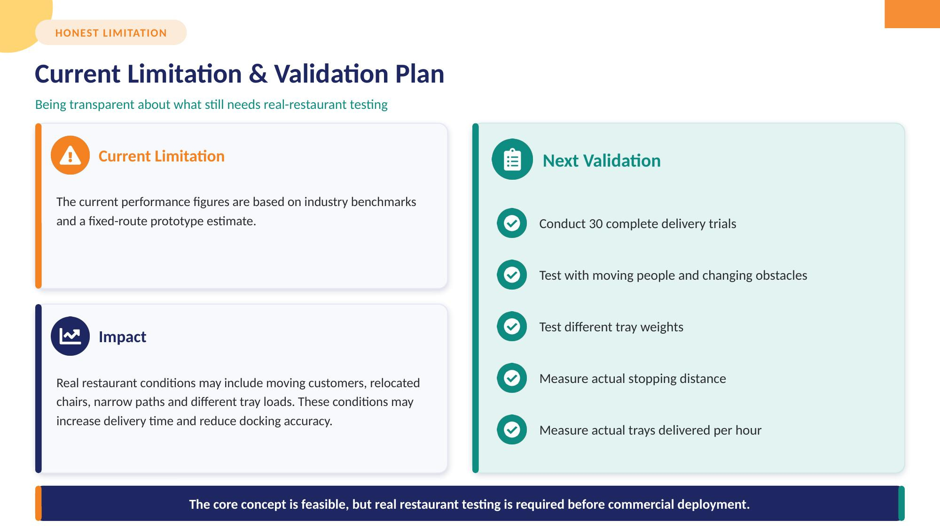
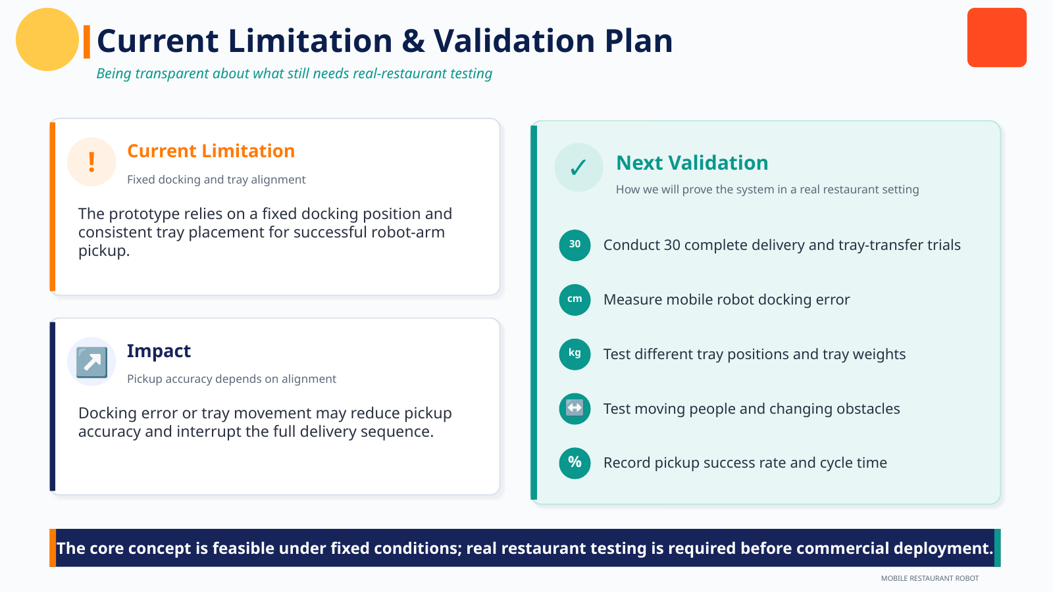

Slide 26
Future
Improvement

Slide 27
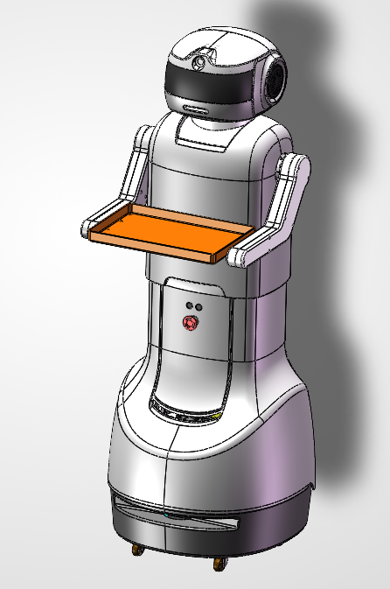
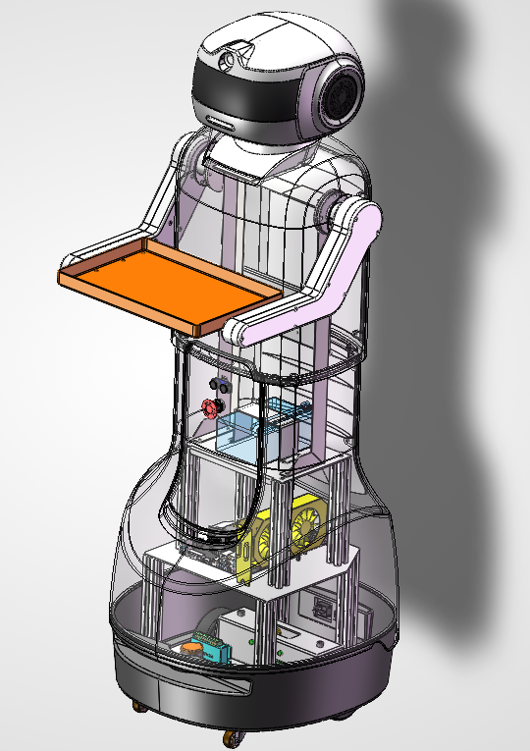
Conceptual Design

Slide 28
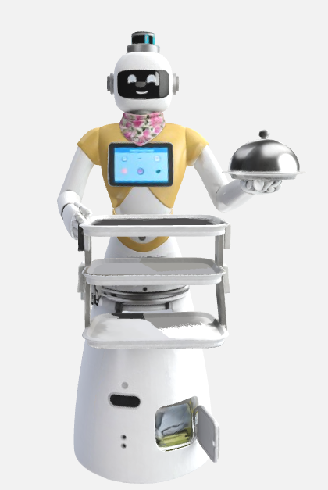
Future Improvement View

Slide 29
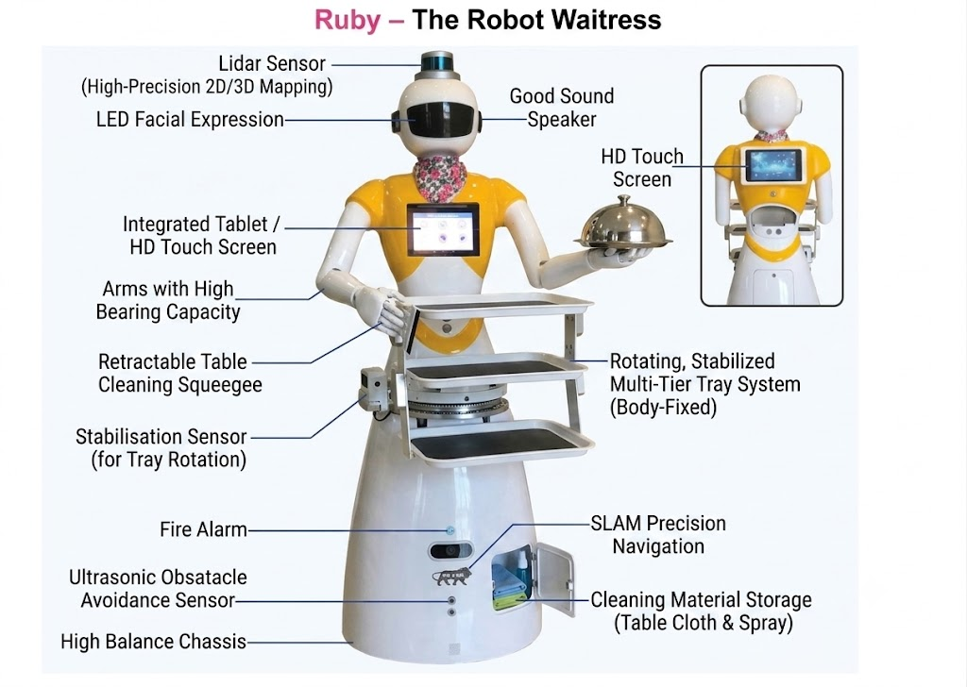

Slide 30
Demo

Slide 31








Thanks!
Do you have any questions?
service@apexnueralsys.com
+6012 3456789
apexnueralsystem.com

