Slide 1
IBM University Engagement Project Submission
“Exploring the Power of Agentic AI with IBM Granite and LangFlow”

Slide 2
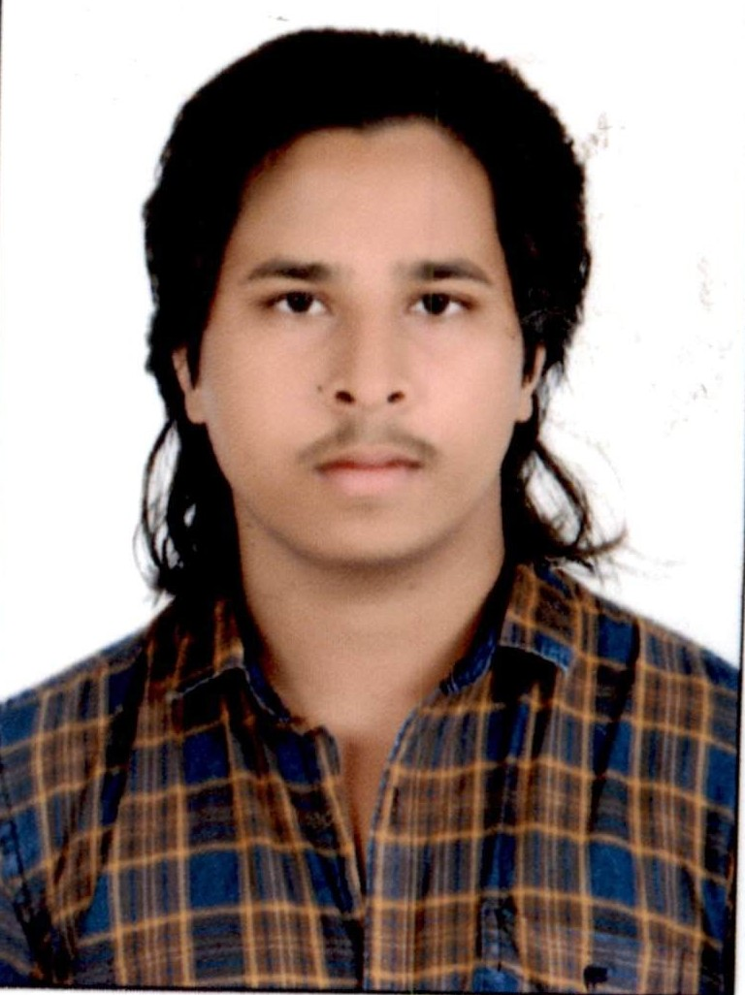
Project Tile – GirGuard AI
Domain of Project – Environmental Sustainability
Student Name | Recent Passport Photo | Email ID | Mobile number [WhatsApp]
Yadav Hardip |  | yhardeep834@gmail.com | 9936010358

Slide 3
Problem Statement - AI-Based Gir Forest Human-Wildlife Conflict Mitigation System
The Challenge
Communities around Gir Forest face recurring human-wildlife conflict involving Asiatic lions and leopards straying into villages, leading to livestock loss, human injury, and retaliatory harm to wildlife due to delayed alerts and poor coordination. .
The Objective
The Challenge Communities around Gir Forest face recurring human-wildlife conflict involving Asiatic lions and leopards straying into villages, leading to livestock loss, human injury, and retaliatory harm to wildlife due to delayed alerts and poor coordination.
Real-Time Detection & Alerts – Use AI-powered camera traps and sensors to detect lion and leopard movement near villages and forest boundaries.
Early Warning System – Instantly notify villagers, forest officials, and rescue teams via SMS and app-based alerts.
Smart Coordination – Connect the forest department, police, and local response teams for faster, unified action.
Multi-Agent System –
Detection Agent (identifies wildlife presence from sensor and camera data)
Alert & Notification Agent (sends real-time warnings to stakeholders)
Coordination Agent (routes alerts to forest officials and local response teams)
Data Logging & Analysis Agent (tracks conflict patterns for future prevention)
Community Safety Dashboard – Visualize conflict hotspots, alert history, and response times.
Preventive Insights – Analyze movement patterns to predict high-risk zones and seasons.

Slide 4
Proposed Solution - using real-time AI detection and instant multi-agent alerts to prevent lion-leopard conflicts in villages around Gir Forest.
Proposed Solution: is a multi-agent AI-powered Nutrition Agent built using LangFlow, IBM watsonx.ai, and Granite Models to provide personalized, real-time dietary guidance. The system addresses challenges in diet planning, nutrition tracking, and preventive healthcare through an intelligent, modular architecture.
At its core, the solution uses a Retrieval-Augmented Generation (RAG) pipeline to fetch accurate nutritional data from trusted sources such as USDA and WHO datasets. This data is embedded and stored in a vector database, enabling the system to retrieve and summarize food nutrition details (calories, macros, vitamins) using Granite models.
The system consists of four key agents:
Nutrition Knowledge Agent retrieves and summarizes nutritional information using RAG.
Diet Recommendation Agent generates personalized meal plans based on user inputs such as age, health conditions, dietary preferences, and fitness goals.
Health Advisory Agent provides preventive health suggestions, including disease-specific diets (e.g., diabetes-friendly or heart-healthy plans).
Food Log & Feedback Agent allows users to log meals via text, voice, or images and delivers instant nutritional analysis with actionable feedback.
The solution includes a user-friendly dashboard (built with Streamlit or React) that visualizes daily and weekly nutrient intake, highlights deficiencies, and tracks progress toward health goals.
LangFlow is used to orchestrate agent workflows, while watsonx.ai ensures scalable model deployment, embeddings, and AI governance. Granite models power reasoning, summarization, and personalization.
Overall, this solution delivers an end-to-end intelligent nutrition assistant that promotes healthier lifestyles through personalized insights, real-time feedback, and preventive healthcare recommendations.

Slide 5
Technology Used
Langflow platform -For designing and orchestrating multi-agent workflows visually
IBM Granite model - for eg – ibm-granite-3-2-8b – For natural language understanding, reasoning, and personalization
IBM Cloud – It provides the infrastructure to build, deploy, and scale the Nutrition Agent efficiently. IBM Cloud enables a reliable, secure, and scalable environment for deploying the Nutrition Agent.
RAG– RAG to fetch real data first, then generate intelligent answers, making the Nutrition Agent more trustworthy and effective.
IBM Watsonx.ai - For model deployment, embeddings, and AI governance
Vector Database (FAISS/Chroma) – For RAG-based nutritional data retrieval

Slide 6
Langflow component Used -
1) Chat Input – Interface where users enter their queries, preferences, or meal details (text/voice/image).
2) IBM watsonx AI Agent - Processes user input using Granite models to generate personalized nutrition insights and recommendations.
3) Name of IBM Granite model - Granite-4.0-8B-Instruct → Fast, efficient for real-time diet recommendations
4) Chat output -Displays AI-generated responses such as diet plans, nutritional analysis, and health suggestions.
5) File component - Stores and retrieves user data, meal logs, and nutritional datasets for analysis and tracking.

Slide 7

Role of Agentic AI in the solution
Role of Agentic AI in Nutrition Agent
Agentic AI enables the Nutrition Agent to function as an intelligent, autonomous system rather than a simple chatbot. Using IBM watsonx.ai and IBM Granite models, it coordinates multiple specialized agents to deliver personalized nutrition guidance.
Each agent performs a specific role—such as retrieving nutritional data, generating diet plans, providing health advice, and analyzing food logs—while working collaboratively. This multi-agent approach ensures efficient task execution and accurate results.
Agentic AI also brings context awareness, understanding user details like age, health conditions, and fitness goals to generate tailored recommendations.
It supports real-time adaptation, continuously updating suggestions based on user inputs like daily meals.
Additionally, agents communicate with each other, enabling better decision-making and improved outcomes.
Overall, Agentic AI makes the system proactive, personalized, and goal-driven, acting like a smart digital nutritionist that helps users maintain a healthy lifestyle.

Slide 8
Novelty and Uniqueness
The proposed Nutrition Agent stands out by combining Agentic AI, RAG, and personalization into a single intelligent system.
Multi-Agent Intelligence – Instead of a single chatbot, multiple specialized agents collaborate to deliver accurate and context-aware nutrition guidance.
RAG-Based Accuracy – Integrates real-time data retrieval with AI generation, reducing misinformation and ensuring trustworthy recommendations.
Hyper-Personalization – Tailors diet plans based on health conditions, cultural preferences, and fitness goals.
Real-Time Feedback Loop – Continuously adapts recommendations based on daily food logs and user behavior.
Multi-Modal Input – Supports text, voice, and image-based meal tracking for better usability.
Preventive Healthcare Focus – Goes beyond diet planning to provide disease-specific nutrition advice.
Scalable & Enterprise-Ready – Built on IBM watsonx.ai with IBM Granite models, ensuring reliability and governance.
This makes the solution a smart, adaptive, and proactive digital nutritionist, not just a static diet recommendation tool.

Slide 9
Git Hub Links
GITHUB REPOSITORY LINK :- https://github.com/yhardeep834/IBM-PROJECT-
GITHUB UPLOADED WEBSITE LINK:- https://yhardeep834.github.io/IBM-PROJECT-/response.html
·
·
·

Slide 10
Future Scope
1. Integration with IoT & Camera Trap Networks –
The system can be expanded with a wider network of AI-enabled camera traps, motion sensors, and drones across Gir Forest boundaries. This will enable more accurate, real-time tracking of lion and leopard movement across a larger area, improving early detection coverage.
2. Multilingual Voice-Based Alerts –
Adding voice-enabled, multilingual alert delivery (Gujarati, Hindi, English) will make warnings more accessible to villagers, especially in remote areas with low literacy or limited smartphone access, ensuring faster community response.
·
·
·

Slide 11
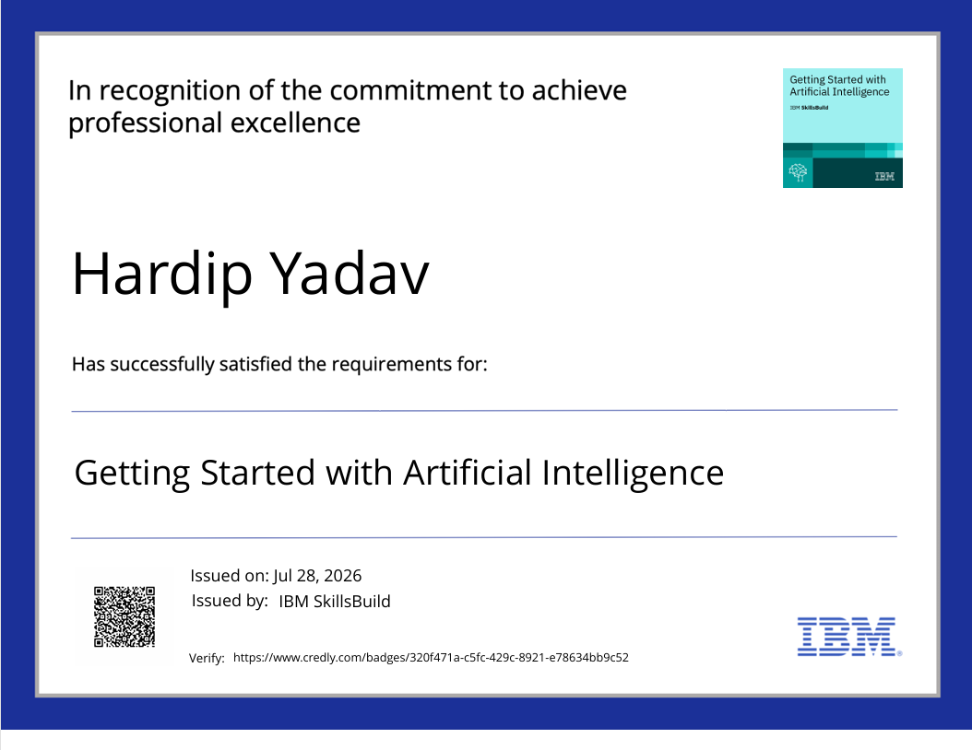
Certificates Earned:
Please add your credly certificate

Slide 12
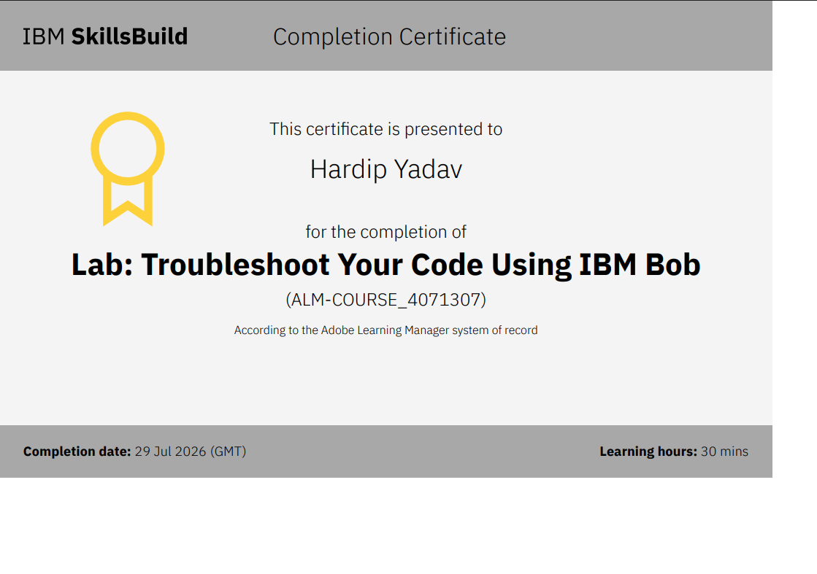
Certificates Earned:​
Add your IBM BOB Certificate

Slide 13


