Slide 1

BLG561 Deep Learning Term Project - Car Brand and Model Detection Using Deep
Learning
30.12.2025
Hasan Şenyurt – 504241580
Barış Akalın – 504241575

Slide 2
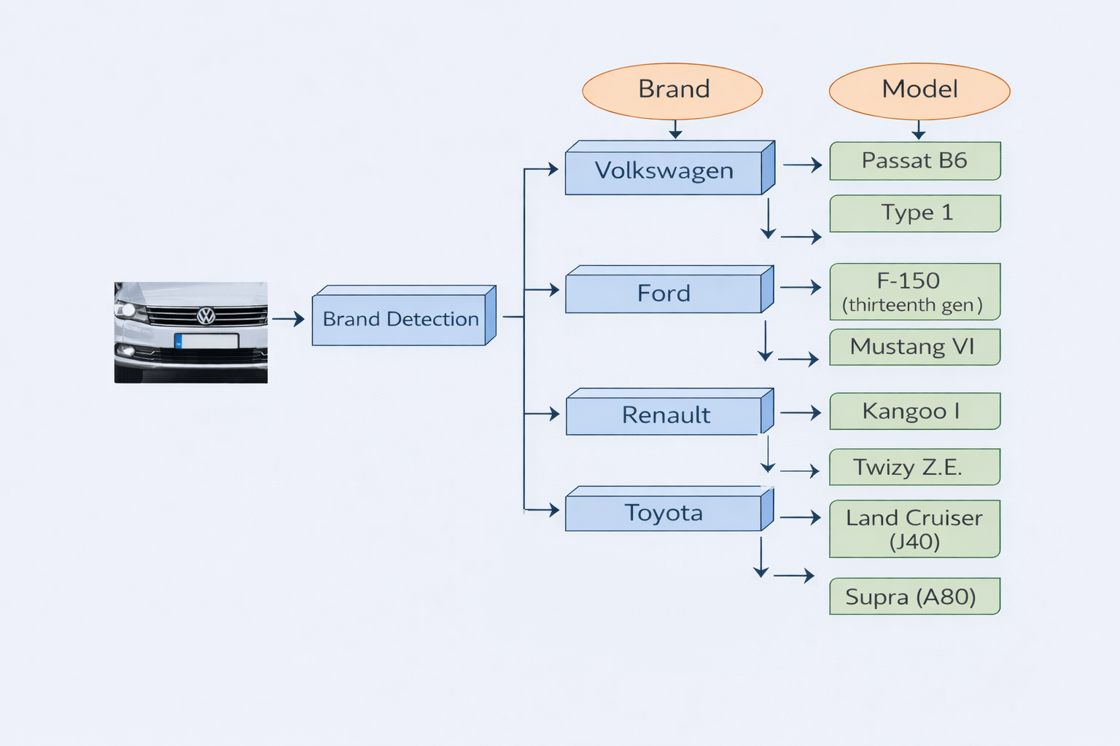
Problem Definition and Approach
Problem Definition
Fine-grained vehicle brand and model recognition from images
Sensitivity to lighting, viewpoint, background, and reflections
Limitations of traditional image processing for complex visual patterns
Approach
1 Custom Resnet Model for brand detection
4 Custom Resnet Model for car model detection
Hasan Şenyurt – 504241580
Barış Akalın – 504241575
Figure-1: Brand/Model Detection Approach
Notes:
- Firstly, we can define the problem. The main idea is detecting car brand and model from each angle of the car.
- Sometimes logo can be missing in the image, or image can be rear, side or front of the car. So, there is no single image type to detect brand and model.
- So, what is our approach to solve these problems?
- We build our own custom resnet model. We did not use pre-trained model, we designed its layers, activations etc.
- And this is our pipeline. Firstly, image goes to the brand detection model. 4 class are our concerns. Renault, ford, volkswagen and toyota.
- After brand prediction, program chooses one of the car model detection models. Lastly, we can see which brand and model detected. For example brand detection decide this image is toyota. So toyota model detection model decide this is a supra.
- Why do we choose this approach because we have small dataset.

Slide 3
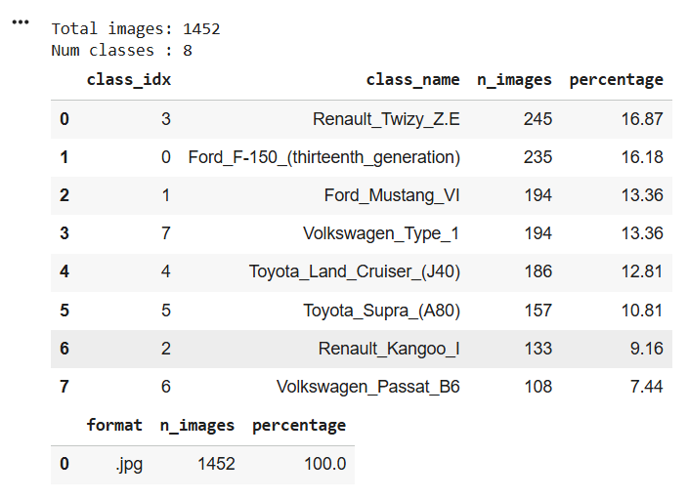
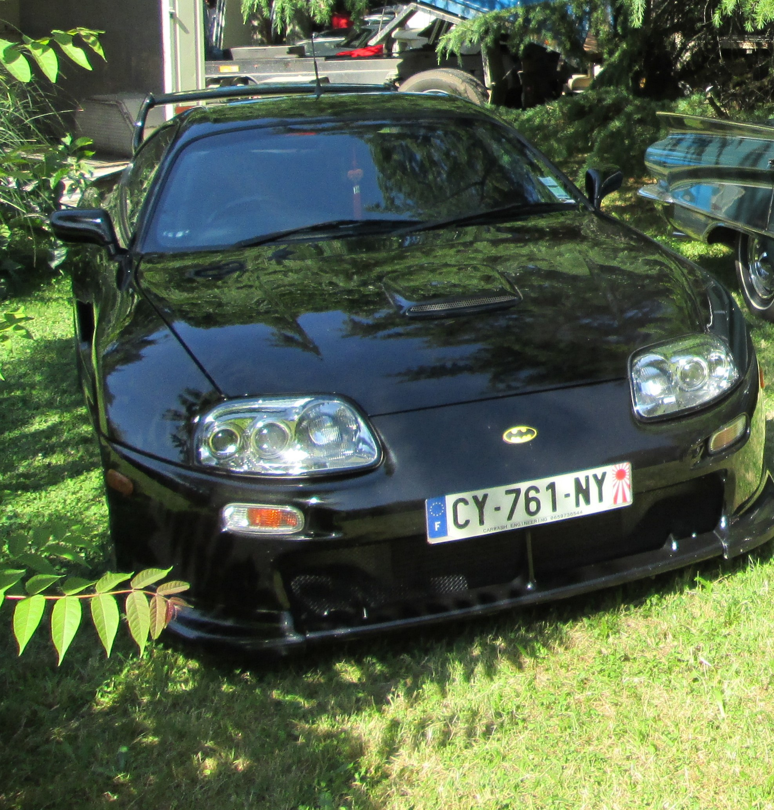
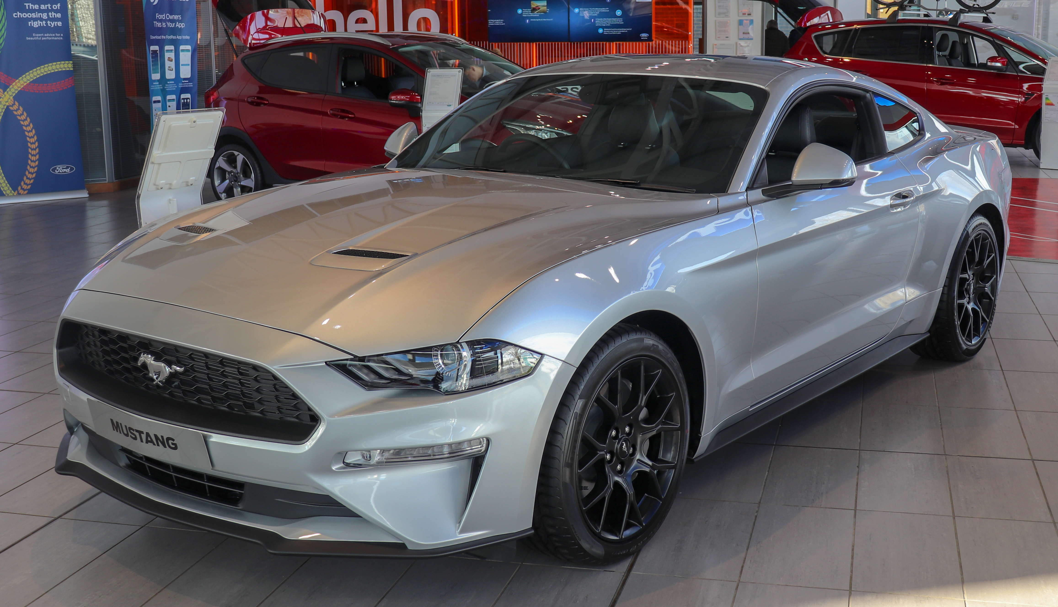
Dataset Collection
Web scraping script, data source:
https://commons.wikimedia.org
10 car photos are taken by ourselves
Brands and Models:
Ford_F-150_(thirteenth_generation)
Ford_Mustang_VI
Renault_Kangoo_I
Renault_Twizy_Z.E.
Toyota_Land_Cruiser_(J40)
Toyota_Supra_(A80)
Volkswagen_Passat_B6
Volkswagen_Type_1
Figure-2: Dataset Classes and Image Numbers
Hasan Şenyurt – 504241580
Barış Akalın – 504241575
Notes:
- We use web scraping techniques to collect dataset. Also we added 10 photos manually.
- We struggled when we try to fetch images by web scraping because most of the web-sites dont allow scripts and bots.
- This is why our image size of classes differ.
- These are the brands and models that our project can detect.

Slide 4
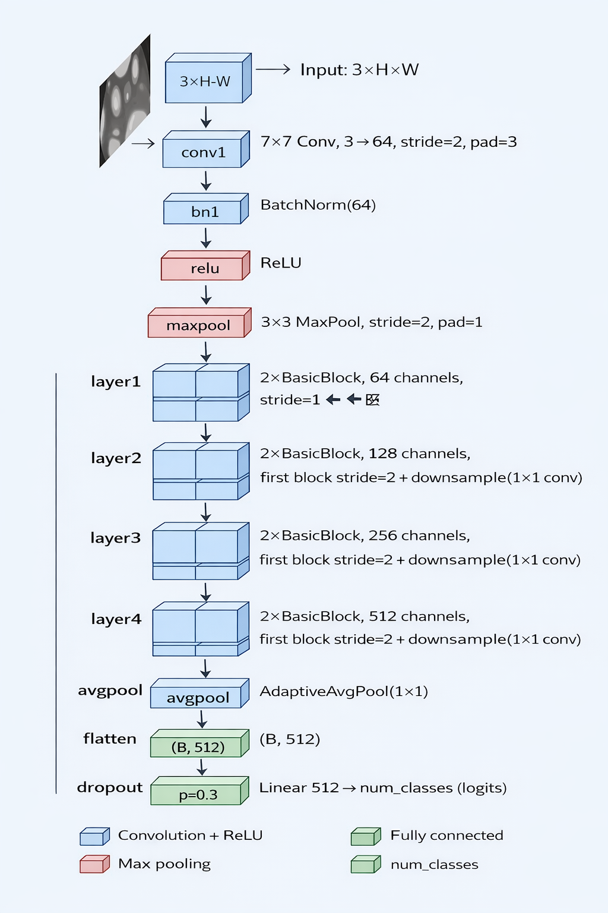
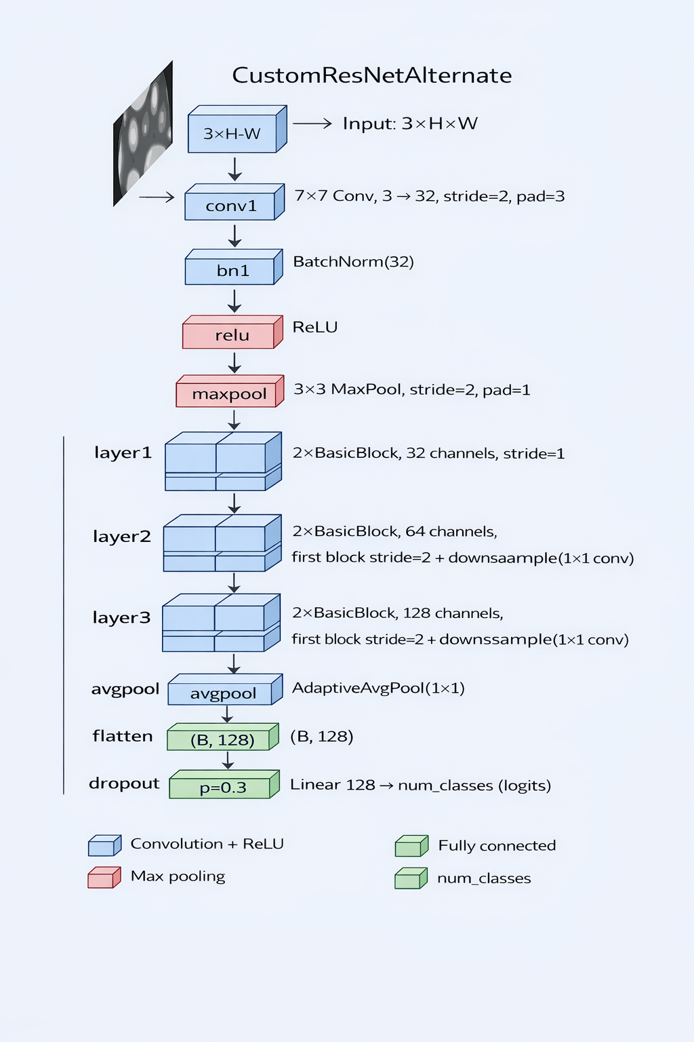
Model Architecture
Figure-3: Custom ResNet Architecture
Hasan Şenyurt – 504241580
Barış Akalın – 504241575
Figure-4: Custom ResNet Alternate Architecture
Notes:
- These are our custom resnet models. You can see the architectures. Left one is our main custom model and right one is alternate custom model to make experiments and see the difference when you change layer number, neuron number, learning rate etc.
- main custom resnet model has 4 layers, output dimension is 512. Our alternate resnet model has 3 layers, less neurons than main model. Both of them have normalization, regularizations and poolings.
- Now, my friend Barış will talk about results, experiments and conclusion.

Slide 5
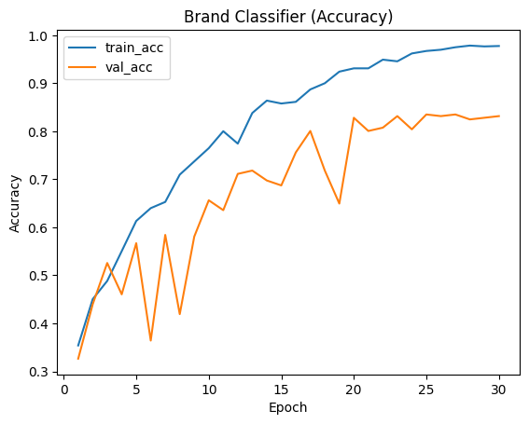
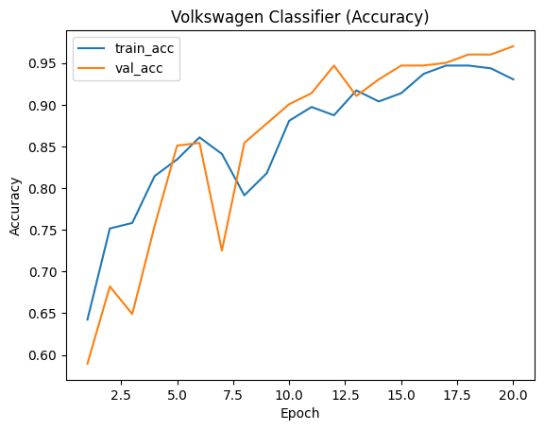
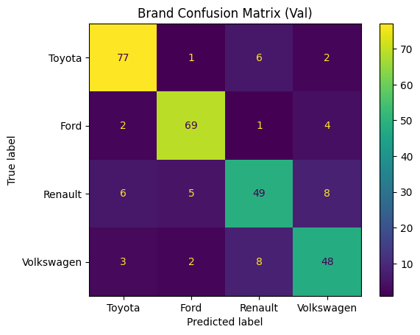
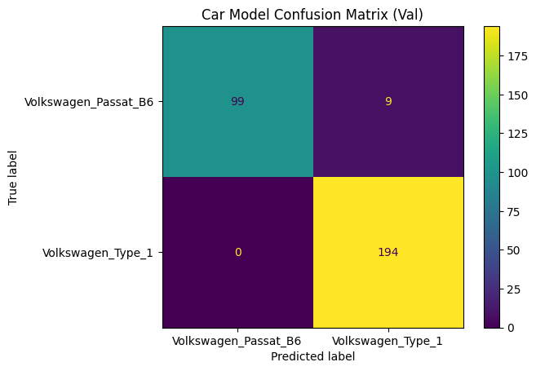
Custom Resnet Results
Results and Experiments
Brand Classifier: Best val acc: 0.83 Model Classifier: Best val acc: 0.97
Hasan Şenyurt – 504241580
Barış Akalın – 504241575

Slide 6
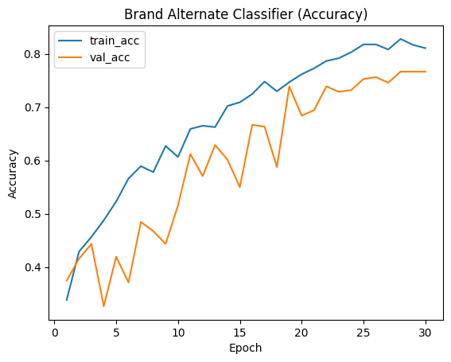
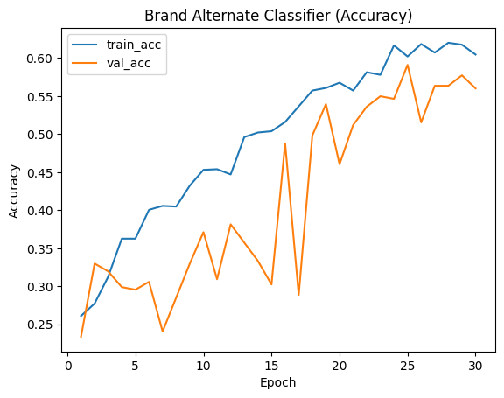
Results and Experiments
Custom Resnet with Less Layers Results Custom Resnet Alternate Results
Brand Classifier: Best val acc: 0.76 Brand Classifier: Best val acc: 0.59
Hasan Şenyurt – 504241580
Barış Akalın – 504241575

Slide 7
Conclusion
Testing with one sample for each car model: 7/8 success
Hierarchical brand–model classification effectiveness
Performance gain with deeper network architectures
Depth vs. efficiency trade-off between architectures
Robust feature learning for fine-grained vehicle recognition
Hasan Şenyurt – 504241580
Barış Akalın – 504241575

Slide 8
BLG561 Deep Learning Term Project - Car Brand and Model Detection Using Deep
Learning
Thank You, Questions?
30.12.2025
Hasan Şenyurt – 504241580
Barış Akalın – 504241575

