Slide 1



Course Title: Automotive Heating And Air Conditioning
Course Code: BAE 276/MCE 276
MAY,2026

Slide 2
General Course Objectives
1
2
3
1. Ability to explain the basic functions, requirements, layouts, and operations of vehicle heating, ventilation, air conditioning and climate control systems.
2. Knowledge regarding the working of different vehicle HVAC components used in automobiles.
3. Ability to diagnose problems with basic vehicle HVAC systems and components using appropriate tools

Slide 3
Reading Materials
Schnubel, M. (2009). Automotive heating and air conditioning classroom manual and shop manual (3rd ed.). Boston: Cengage Learning.
Daly, S. (2011). Automotive air conditioning and climate control systems. Elsevier.
Stubblefield, M., & Haynes, J. H. (2009). The Haynes Automotive Heating & Air-conditioning Systems Manual

Slide 4
LESSON ONE
Fundamentals of Automotive Air-conditioning

Slide 5
LESSON 1 OBJECTIVES
Give an overview of the historical development of the heating and ventilation system and the Introduction of the air-conditioning (A/C) system.
to understand the fundamental requirements of the heating, cooling, ventilation and air-conditioning system.

Slide 6
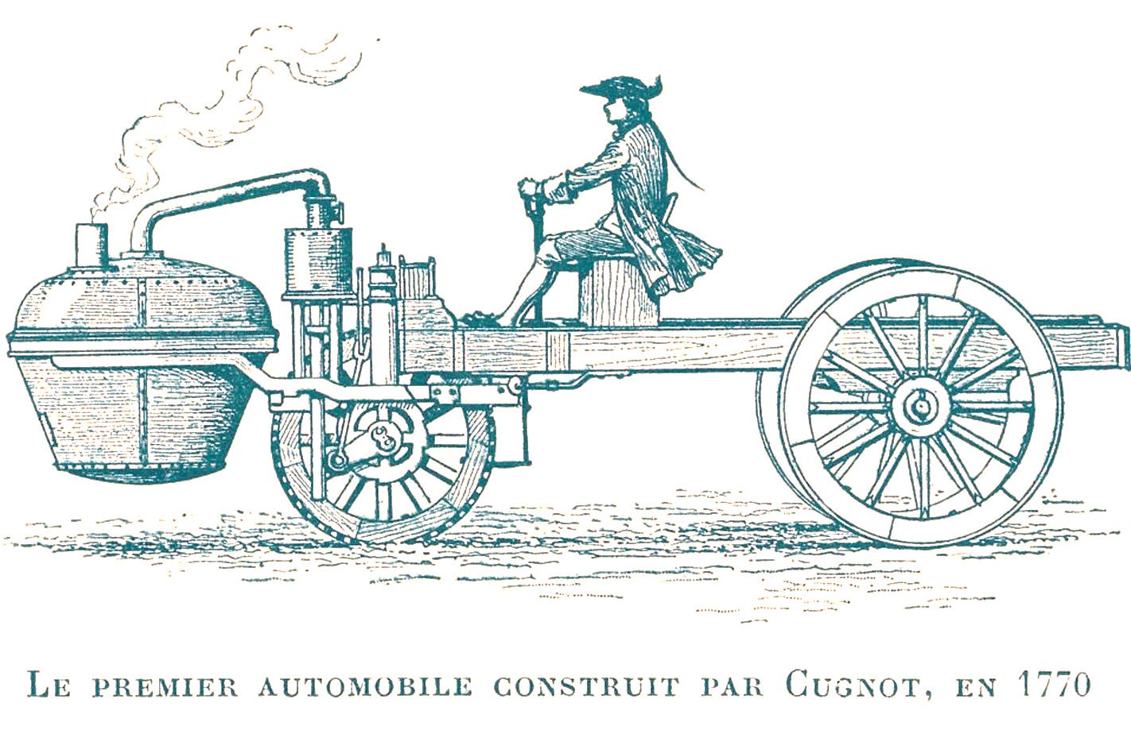
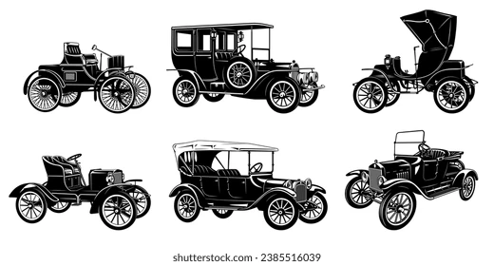
History of automotive air-conditioning systems
Early automobiles had cabin spaces that were open to the outside environment. This means that the occupants had to adjust their clothing to accommodate different weather conditions.

Slide 7

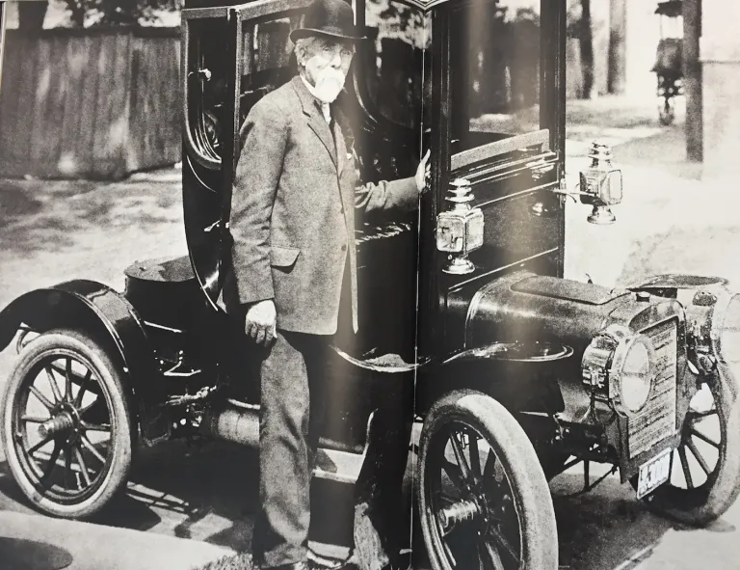
History of automotive air-conditioning systems
Closed cabin spaces were eventually introduced, which required heating, cooling and ventilating to meet customer expectations.
Early heating systems included heating clay bricks and placing them inside the vehicle or using simple fuel burners to add heat to the vehicle’s interior.
Notes:
In an Ironical twist the founder of Lincoln developed the first closed body automobile, but it was a Cadillac. Henry Leland, who took over the Henry Ford Company in 1902 and later establish the Cadillac Automobile Company, developed a prototype in 1905 called the Osceola that offered solid protection from the outside elements.

Slide 8
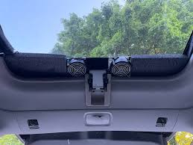
History of automotive air-conditioning systems
Ventilation inside the vehicle was achieved through opening or tilting windows or the windscreen; vents were added to doors and the bulkhead to improve air circulation
Air flow was difficult to control because it was dependent upon the vehicle speed and sometimes would allow dirty, humid air, which contained fumes, to enter the interior from the engine compartment.
Cooling could be as simple as having a block of ice inside the vehicle and allowing it to melt
However, these methods were not effective during extremely hot or cold weather conditions.

Slide 9
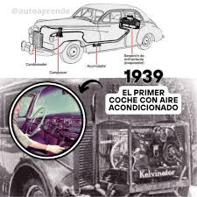
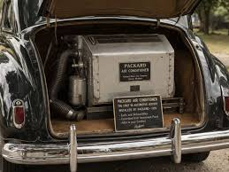
History of automotive air-conditioning systems
The first automotive air-conditioning systems were introduced in the late 1930s. Packard became one of the first automobile manufacturers to install factory-fitted air-conditioning systems in passenger cars.
These early systems were bulky, expensive, and mounted in the trunk of the vehicle. They lacked automatic temperature control and were difficult to operate. The only system control was a blower switch.

Slide 10
Basic Functions of an Automotive HVAC System
An automotive HVAC (Heating, Ventilation, and Air-Conditioning) system is designed to provide passenger comfort, maintain good air quality, and improve driving safety under different weather conditions.
The basic purpose of a heating, ventilation, and air conditioning (HVAC) system in vehicle air conditioning is not only to add heat or remove unwanted heat from the passenger cabin, but also to purify and circulate air throughout the vehicle.

Slide 11
Basic Functions of an Automotive HVAC System
The operation of the HVAC system may be controlled either automatically or manually by the driver. In some high-end luxury vehicles, conditioned air distribution can be “Zone” controlled for each seating position. The objective here is to provide a thermally comfortable environment for every passenger as per his or her requirements.
The basic functions of the system include;
heating
ventilation,
air conditioning,
humidity control, and
windshield defrosting.
Notes:
Modern HVAC systems may also include automatic climate control, which uses sensors and electronic controls to maintain a desired cabin temperature automatically for improved comfort and convenience.

Slide 12
Basic Functions of an Automotive HVAC System
The heating function warms the passenger compartment during cold weather by using heat from the engine coolant. Hot coolant passes through the heater core, and air is blown across it and directed into the cabin to increase passenger comfort.
The ventilation function supplies fresh air into the vehicle and removes stale or contaminated air from the cabin. Proper ventilation improves air circulation, reduces odours, and helps maintain a healthy and comfortable interior environment.
Notes:
To dehumidify means to remove moisture or water vapor from the air or a surrounding environment. The process lowers the overall level of humidity (dampness), making the air drier and more comfortable.

Slide 13
Basic Functions of an Automotive HVAC System
3. The air-conditioning function cools and dehumidifies the cabin air during hot weather conditions. The system removes heat and moisture from the air using the refrigeration cycle, thereby improving passenger comfort and reducing fatigue during driving.
4. Another important function is humidity control and defrosting. The HVAC system removes excess moisture from the cabin air, helping to prevent fogging and frosting of the windshield and windows. This improves visibility and enhances driving safety during rainy or cold conditions.
Notes:
To dehumidify means to remove moisture or water vapor from the air or a surrounding environment. The process lowers the overall level of humidity (dampness), making the air drier and more comfortable.

Slide 14
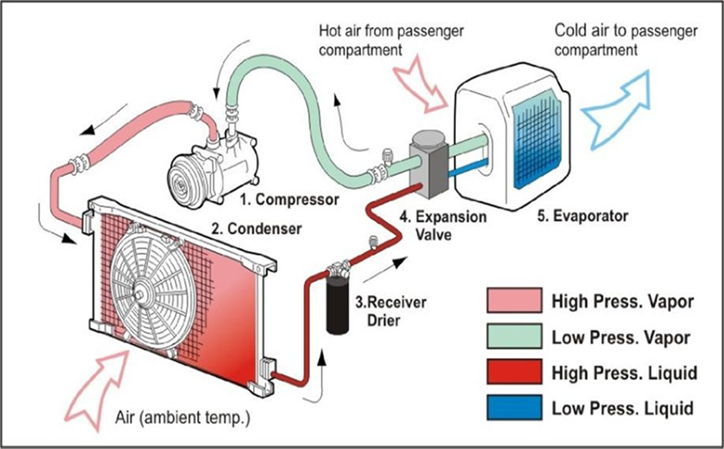
Fundamental Requirements of an Automotive HVAC System
The fundamental requirements of an automotive HVAC (Heating, Ventilation, and Air-Conditioning) system are the essential conditions and functions needed to ensure passenger comfort, proper air circulation, safety, and efficient system operation inside a vehicle. These requirements include the following:

Slide 15
Fundamental Requirements of an Automotive HVAC System
Temperature Control: The HVAC system must be capable of maintaining a comfortable cabin temperature under different weather conditions.
Explanation:
During cold weather, the heating system should warm the passenger compartment, while during hot weather, the air-conditioning system should cool the cabin effectively. Proper temperature control improves passenger comfort and reduces driver fatigue.

Slide 16
Fundamental Requirements of an Automotive HVAC System
Adequate Ventilation: The system must provide continuous circulation of fresh air inside the vehicle cabin.
Explanation
Ventilation removes stale air, odours, smoke, and harmful gases while supplying fresh air to passengers. Good ventilation improves air quality and creates a healthier cabin environment.
Humidity Control: The HVAC system should control moisture levels inside the vehicle.
Explanation: Excess humidity can cause discomfort and fogging of windows. The air-conditioning system removes moisture from the air through dehumidification, improving visibility and passenger comfort.

Slide 17
Fundamental Requirements of an Automotive HVAC System
Air Cleaning and Filtration: The system should remove dust, pollen, and contaminants from incoming air.
Explanation: Cabin air filters are used to trap airborne particles before air enters the passenger compartment. This improves air quality and protects passengers from allergens and pollutants.
Proper Air Distribution: The HVAC system must distribute conditioned air evenly throughout the cabin.
Explanation: Air ducts, vents, and blower systems direct heated or cooled air to different parts of the vehicle, including the dashboard, floor, and windshield areas, ensuring uniform comfort.

Slide 18
Fundamental Requirements of an Automotive HVAC System
Safety and Environmental Protection: The HVAC system must operate safely and use environmentally friendly refrigerants.
Explanation: Modern HVAC systems use refrigerants with low ozone depletion and low global warming potential. Proper system design also prevents refrigerant leakage and protects passengers during operation and servicing.
Energy Efficiency: The HVAC system should provide comfort with minimum energy consumption.
Explanation: Efficient HVAC systems reduce engine load and fuel consumption while maintaining effective heating and cooling performance.

Slide 19
Fundamental Requirements of an Automotive HVAC System
Windshield Defrosting and Defogging: The system must be capable of clearing fog, frost, or moisture from the windshield and windows.
Explanation: Warm and dry air is directed toward the windshield to improve visibility and driving safety during cold or rainy weather conditions.
The fundamental requirements of an automotive HVAC system are aimed at providing thermal comfort, clean air, proper ventilation, safety, and efficient operation under varying environmental conditions. A properly designed HVAC system improves passenger comfort, enhances visibility, and contributes to safe and efficient vehicle operation.

Slide 20
Lesson Recap
https://youtu.be/KQ77pSVyCik?si=x5ObIwwP8FWWnq7i

Slide 21
Lesson Recap
Briefly describe how HVAC was achieved in the early automobiles
Describes the functional requirements of the automotive HVAC system

