Slide 1
LAMAS
Lecturer Academic Management
and Accountability System
Institution: Ho Technical University – Dept. of Computer Science
Supervisor: Mr. Carlos Ankrah
Authors: Sylvester Fiagbedzi · Redeemer Botchway · Manuel Aformaley
Course: BTech ICT 400 · May 2024
Project Defence Presentation

Slide 2
Presentation Outline
Slide 2
01
The Problem
07
Key Features
Why this project was necessary
Core functional modules
02
Aims & Objectives
08
Database Design
What we set out to achieve
16-model relational schema
03
Literature & Gaps
09
Security & Access Control
What exists and what is missing
RBAC and auth flow
04
System Overview (LAMAS)
10
Compliance & Analytics
What the system does
Dashboard and scoring
05
Technology Stack
11
Results & Impact
How it was built
Outcomes of the system
06
System Architecture
12
Conclusion & Recommendations
Three-tier design
Summary and next steps

Slide 3
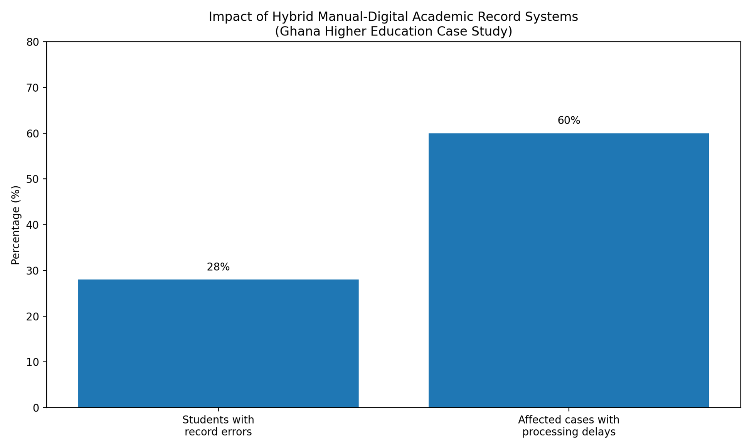
The Problem We Are Solving
Slide 3
Delayed Submissions
Paper-based processes and informal email channels result in chronic late filing of semester plans and reports.
No Centralized Storage
Documents are scattered across emails and drives — impossible to audit or retrieve reliably.
of academic reports submitted
after deadlines using
manual methods
Weak Accountability
Administrators cannot easily verify whether required documents have been submitted within stipulated timelines.
Poor Audit Trails
Without structured tracking, institutions lack the evidence needed for quality assurance reviews.
➜ Findings confirmed: existing processes are fragmented, untracked, and error-prone.

Slide 4
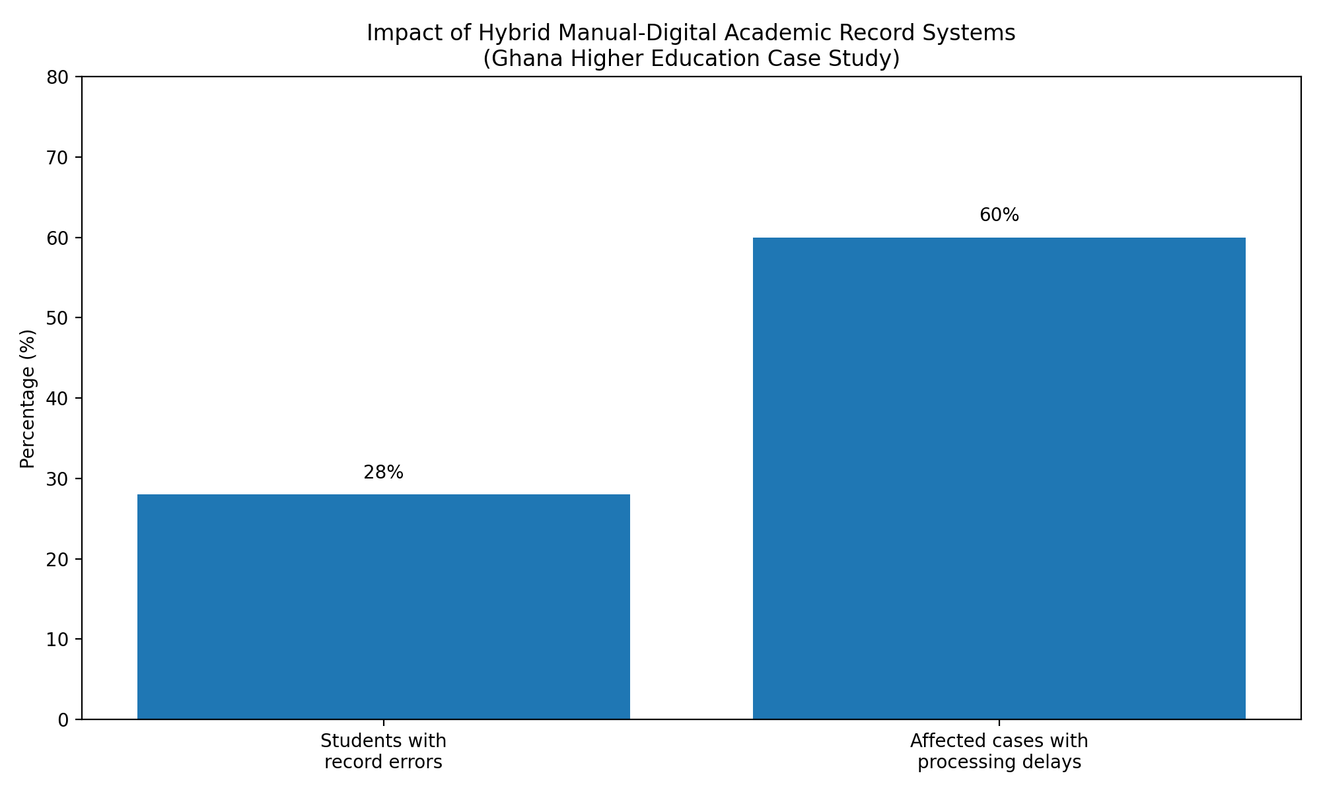
The Problem We Are Solving
Slide 4
➜ Findings confirmed: existing processes are fragmented, untracked, and error-prone.

Slide 5
Aims & Objectives
Slide 4
AIM — Design and implement a lecturer academic management and accountability system that enables structured submission, efficient tracking, and centralized management of lecturer-related academic activities.
Structured Submission Framework
Administrative Dashboard
01
Enable lecturers to submit semester calendars and course topics in a standardized, trackable digital format.
04
Real-time visualization of submission status and lecturer activity summaries for HODs and admins.
Centralized Reporting Hub
Activity Tracking & Audit Log
02
A single platform for uploading, storing, and retrieving observation reports and academic documentation.
05
Automated logging of every lecturer action for monitoring, compliance, and institutional audit.
Deadline Management
Secure Centralized Database
03
Automated notifications and reminders to promote timely submission of all required documents.
06
Ensure data integrity, structured storage, and efficient retrieval of all academic records.

Slide 6
Literature Review & Research Gaps
Slide 6
What Already Exists
Critical Gaps (Justifying LAMAS)
AI-based lecturer evaluation (96% MLP prediction accuracy)
AI systems need heavy infrastructure
Impractical for technical universities in Ghana.
Automated lecture style assessment (biometric indicators)
ERP modules are expensive & complex
Bundled features don't fit lean institutional needs.
Web-based monitoring systems (LEMS – attendance tracking)
No standalone lecturer-only platform
All systems embed lecturer modules inside student-facing systems.
University ERP modules (GeniusEduERP – scheduling, payroll)
No submission + deadline + notification combo
Existing tools don't integrate these three in one lightweight app.
Learning Management Systems (LMS adoption studies)
No research for Ghanaian tech. education context
Infrastructure, culture, and budget differ from developed-country studies.
LAMAS directly addresses all five gaps identified above.

Slide 7
System Overview — What LAMAS Does
Slide 7
LAMAS is a web-based, role-aware academic management platform that digitises every step of lecturer compliance — from document submission to administrative oversight.
LECTURER
HOD
ADMIN
SUPER ADMIN
Submits semester calendars, course topics & weekly plans. Views deadlines & personal compliance score.
Reviews and approves/rejects lecturer submissions. Views departmental compliance heatmaps.
Provisions accounts, manages deadlines, sends broadcast messages, exports Excel reports.
Full system access across all departments. Configures academic terms and system-wide settings.
Submit Documents
→
Track Deadlines
→
Review & Approve
→
Score & Report

Slide 8
Technology Stack
Slide 7
Next.js 16
App Router
Socket.IO v4
Real-Time
Hybrid server rendering, collocated API routes, Middleware RBAC guards, security headers.
Bi-directional WebSocket for live broadcast announcements pushed to all connected users instantly.
TypeScript 5
Language
Resend SDK
Email Delivery
End-to-end type safety across all models, API handlers, and UI components. Prevents runtime role-check bugs.
Transactional emails for account provisioning, deadline reminders, and admin broadcasts via DKIM-signed service.
Prisma 7
ORM / PostgreSQL
Tailwind CSS v4
UI Styling
Type-safe queries, 16-model relational schema, connection pooling (max 20), ACID compliance.
Utility-first CSS across 4 role dashboards — consistent spacing, responsive breakpoints, zero bespoke CSS files.
Auth.js v5
Authentication
node-cron + Zod
Background + Validation
JWT sessions, bcrypt hashing, role + departmentId embedded in token, 30-min timeout with refresh.
Scheduled CRON pipeline for deadline processing; Zod validates every API request body at runtime.

Slide 9
Three-Tier System Architecture
Slide 8
CLIENT LAYER (Browser)
React 19 UI Components
Tailwind CSS v4 Styling
Recharts Dashboards
Socket.IO Client (WebSocket)
HTTPS / WebSocket
APPLICATION SERVER LAYER (Next.js 16)
Middleware.ts (RBAC)
API Route Handlers
Auth.js v5 (JWT)
CRON /deadlines
Prisma Client / pg Pool
DATA & SERVICES LAYER
PostgreSQL (pg Pool·20)
Prisma Client 7 (ORM)
Resend (Email)
Socket.IO Server

Slide 10
Key Features of LAMAS
Slide 9
Structured Submission Workflow
Automated Deadline Engine
Lecturers submit semester calendars, course topic plans, and weekly topics through structured, validated forms — versioned and stored centrally.
CRON job scans deadlines every cycle: sends 24-hr reminders to non-submitters and escalates 7-day overdue reports to HODs.
Analytics & Reporting
Peer Observation Management
Visual analytics that provide a high-level view of academic performance and contribution.
HODs schedule peer classroom observations; lifecycle tracked (Pending → Completed → Reviewed) with written feedback attached.
Compliance Scoring
Broadcast & Notifications
Score = (Approved on-time submissions / Total required) × 100. Late and rejected submissions are penalised in the numerator.
Admins push real-time announcements via Socket.IO; all in-app alerts persisted to Notification table; email via Resend SDK.

Slide 11
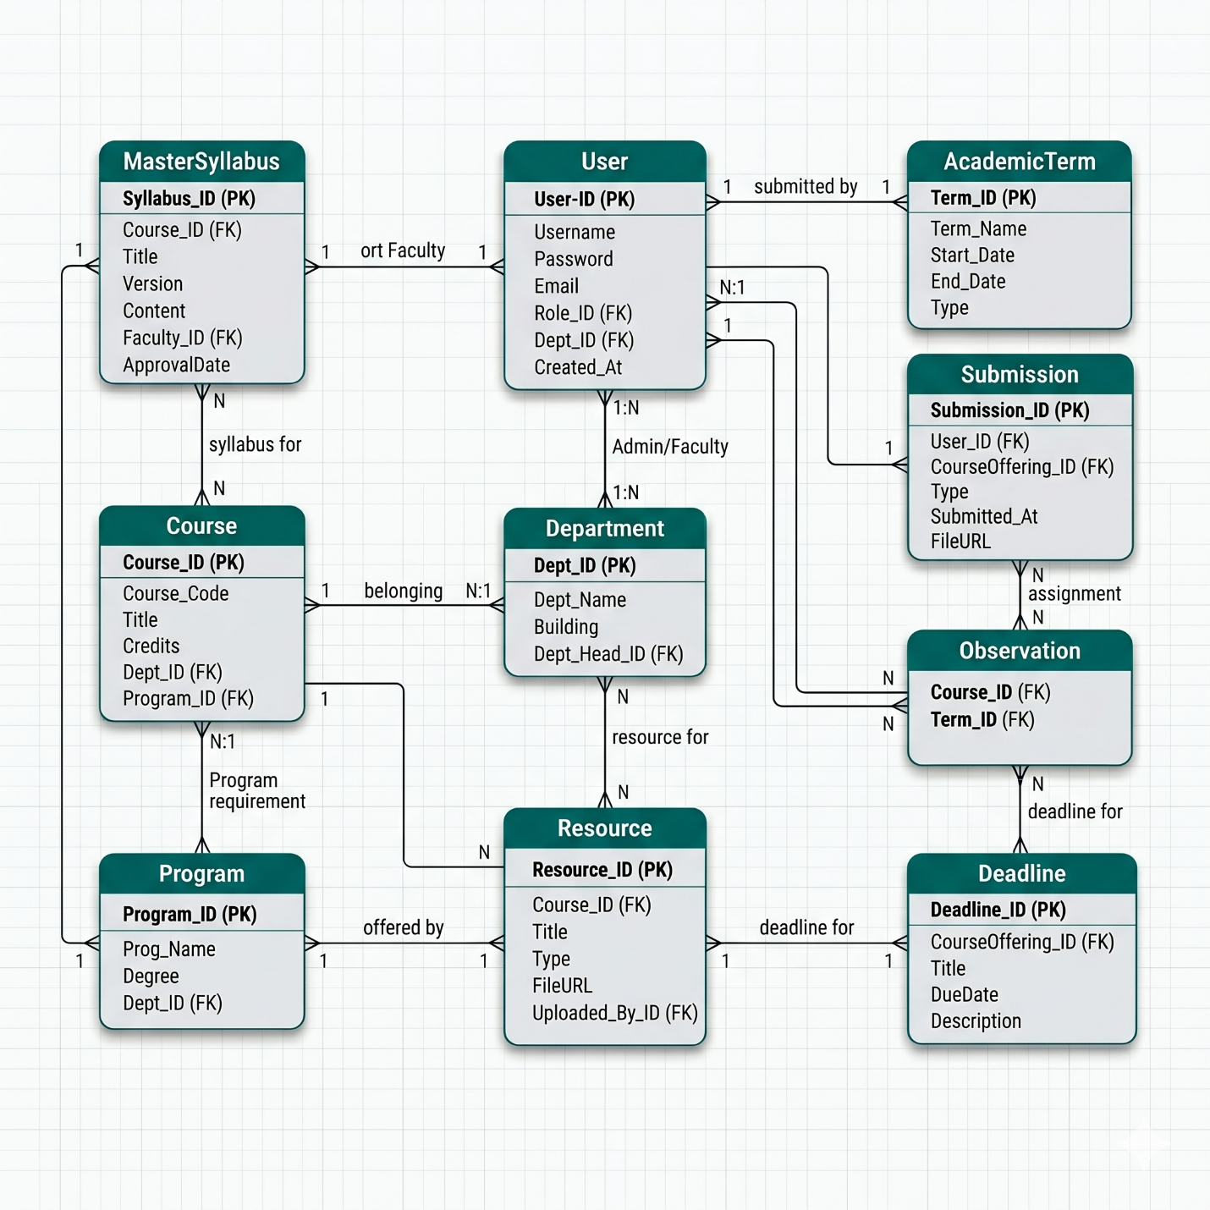
Database Design — 16-Model Relational Schema
Slide 11

Slide 12
Security & Role-Based Access Control
Slide 11
Authentication & Authorisation Flow
Role Access Matrix
1. Login
Feature
LEC
HOD
ADMIN
SU
User submits email + password to /api/auth/callback/credentials
2. DB Lookup
Submit Docs
✓
✓
✓
✓
Prisma queries PostgreSQL for matching active user record
Review Subs
–
✓
✓
✓
3. bcrypt Verify
bcryptjs compares plaintext password against stored hash
Deadlines
–
–
✓
✓
4. JWT Issued
Auth.js embeds { id, role, departmentId, lastActivity } into signed JWT
Broadcasts
–
–
✓
✓
5. HttpOnly Cookie
JWT stored as secure, HttpOnly cookie — inaccessible to client JS
Provision
–
–
✓
✓
6. Middleware RBAC
Every request: Middleware decodes JWT, checks role vs path, rejects if unauthorised
Sys Config
–
–
–
✓
Defence-in-depth: Middleware RBAC at the edge + auth() session check inside every API route handler.

Slide 13
Research Methodology
Design Science Research (DSR)
6-Phase Agile-DSR Process
Hevner et al. (2004) — Why DSR?
Goal: design and build a purposeful artefact (LAMAS) that resolves a clearly identified institutional deficiency — not merely study it.
3 Justification Pillars
1. Problem Relevance — fragmented paper-based lecturer management is a real HTU institutional challenge
2. Artefact Centrality — LAMAS software system is the primary research contribution
3. Iterative Evaluation — each module individually built, tested, and demonstrated to stakeholders
Why Not Waterfall?
Requirements evolved as the 4 user roles (Lecturer, HOD, Admin, Super Admin) were progressively clarified — Waterfall's rigid sequentialism would have been ill-suited.
01
Problem Identification
Stakeholder analysis; compliance gap identified at HTU
02
Requirements Elicitation
Role-based feature mapping for all 4 user roles; functional spec
03
System Design
16-model Prisma schema, 3-tier architecture, UI wireframes
04
Development
Sprint-based implementation: Auth, Submissions, Observations, Analytics, CRON
05
Evaluation & Testing
TypeScript tsc, ESLint, Prisma validation, manual role-path testing
06
Communication — Thesis documentation, diagrams, and defence presentation

Slide 14
Database Design & System Testing
PostgreSQL Database — 16 Prisma Models, ACID-Compliant, Relational Integrity Enforced
USER (Central)
Role enum:
LECTURER | HOD | ADMIN | SUPER_ADMIN
Bcrypt-hashed password, isActive flag, lastLogin tracking, departmentId FK
Relations: Submissions, Observations (2 named), Attendance, Notifications, ActivityLog
SUBMISSION
State Machine:
DRAFT → PENDING → SUBMITTED / LATE → REVIEWED → APPROVED / REJECTED
Compliance Score: APPROVED / totalRequired x 100. LATE counts against score. Version snapshots stored.
OBSERVATION
lecturerId + observerId — two named Prisma relations to USER. Status: PENDING | COMPLETED | REVIEWED.
NOTIFICATION & AUDIT
Append-only tables. 24-hr dedup window prevents notification fatigue. Bulk createMany() for efficiency.
ACTIVITY_LOG: Full admin audit trail across all system actions.
System Testing & Validation Strategy
Static Type Checking
Tool: TypeScript 5 tsc --noEmit
Catches role mismatches and data-type errors before any code reaches production. All 16 Prisma models fully typed.
Static Code Analysis
Tool: ESLint + Next.js ruleset
Enforces code quality gates each sprint. Lint reports serve as empirical evidence of design refinement under DSR.
Database Validation
Tool: Prisma validate + migrate
Schema integrity, FK constraints, and timestamped migrations verified. Zod validates all API inputs at runtime, preventing SQL injection.
Manual Role Testing
Method: RBAC path protection tested per role
Unauthorised access to /admin, /hod, /lecturer paths returns 403. Middleware edge + API double-layer confirmed. CRON pipeline tested for dedup and email fallback logic.

Slide 15
Limitations & Future Work
Acknowledged Limitations
Recommended Future Work
1
Limited Real-World Testing
System tested with seeded data, not live HTU institutional records
AI-Powered Lecturer Insights
Integrate MLP neural network (ref: 96%-accuracy study) for performance prediction and early-warning triggers
2
Infrastructure Constraints
Unreliable internet and power supply can disrupt real-time Socket.IO features
Student Module Integration
Extend LAMAS with student assessment, grade tracking, and feedback loops to complete the academic cycle
3
Student Module Excluded
Scope was lecturer-centred only — student assessment, exams excluded by design
Offline-First PWA
Progressive Web App with service workers to address Ghana's connectivity challenges during submission periods
4
Digital Literacy Gap
Technology adoption varies among Ghanaian university lecturers (TAM theory acknowledged)
Multi-Institution Deployment
Scale LAMAS across Ghana's Technical University network with tenant-aware architecture and shared analytics
5
No Longitudinal Evaluation
Long-term institutional impact of compliance analytics not yet measurable
Longitudinal Compliance Study
Track impact of LAMAS on submission timeliness over 2–3 academic terms to validate institutional effectiveness
LAMAS is a working, deployable artefact — a foundation, not a ceiling.

Slide 16
Conclusion
LAMAS delivers a practical, lightweight, and cost-effective solution to a real institutional problem at Ho Technical University. By combining structured document submission, automated deadline enforcement, role-based oversight, and real-time notifications in a single platform, it directly resolves the fragmented, paper-based workflows that cause about 60% late-submission rates.
What will be achieved
Fully functional multi-role web application (Next.js 16 + TypeScript 5)
16-model type-safe relational database (Prisma 7 / PostgreSQL)
Automated CRON deadline notification pipeline with email delivery
Classroom observation modules
Real-time broadcast system via Socket.IO
Compliance scoring engine with admin analytics dashboard

