Slide 1
Characteristics of Cloud Computing
Topic 3

Slide 2
Key Characteristics of Cloud Computing
Elasticity & Scalability – Adjust resources as needed
Self-Service Provisioning – Users access resources instantly
APIs (Integration) – Easy system communication
Pay-as-you-go – Billing based on usage
IaaS, PaaS, SaaS ,scalable =⇒ „elastic“ network-centric =⇒ services/resources are accessible over the internet abstracted =⇒ independent of the concrete hardware on-demand =⇒ prompt request completion pay as you go

Slide 3
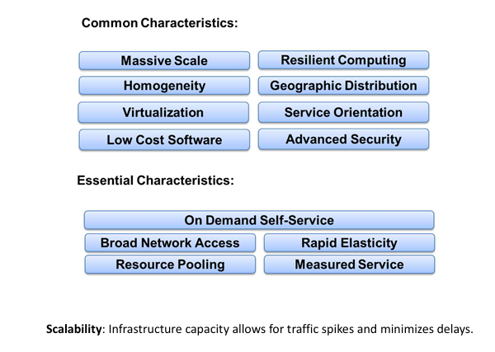
Notes:
Lower costs Ease of utilization Quality of Service (QoS) Reliability Outsourced IT management Simplified maintenance and upgrade Low Barrier to Entry

Slide 4
Cloud Computing– Focal Points by Definition
Part 1: Fundamental technologies– basis of Cloud Computing
Virtualization for shared and efficient resource utilization
Web Services (REST/SOAP) for communicating with the services
Part 2: Cloud services and their characteristics
IaaS, PaaS, SaaS
Scalable =⇒ „elastic“
Network-centric =⇒ services/resources are accessible over the internet
Abstracted =⇒ independent of the concrete hardware
On-demand =⇒ prompt request completion
Pay as you go

Slide 5
How many users and objects?
Flickr has 10 billion photos
Facebook has 1.4 billion daily active users
Google is serving 3.5 billion queries/day on over 130 trillion pages
5 billion videos/day watched on YouTube

Slide 6
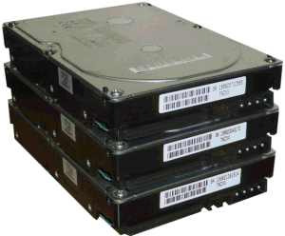
How much data?
Modern applications use massive data:
Rendering 'Avatar' movie required >1 petabyte of storage
eBay has >6.5 petabytes of user data
CERN's LHC will produce about 15 petabytes of data per year
In 2008, Google processed 20 petabytes per day
German Climate computing center dimensioned for 60 petabytes of climate data
Google now designing for 1 exabyte of storage
NSA Utah Data Center is said to have 5 zettabyte
How much is a zettabyte?
1,000,000,000,000,000,000,000 bytes
A stack of 1TB hard disks that is 25,400 km high
25,400 km

Slide 7
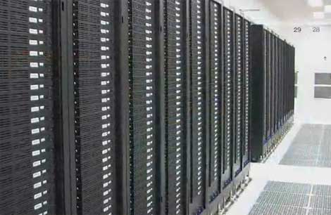
How much computation?
No single computer can process that much data
Need many computers!
How many computers do modern services need?
Facebook is thought to have more than 60,000 servers
1&1 Internet has over 70,000 servers
Akamai has 95,000 servers in 71 countries
Intel has ~100,000 servers in 97 data centers
Microsoft reportedly had at least 200,000 servers in 2008
Google is thought to have more than 1 million servers, is planning for 10 million

Slide 8
Why should I care?
Suppose you want to build the next Google
How do you...
... download and store billions of web pages and images?
... quickly find the pages that contain a given set of terms?
... find the pages that are most relevant to a given search?
... answer 1.2 billion queries of this type every day?
Suppose you want to build the next Facebook
How do you...
... store the profiles of over 500 million users?
... avoid losing any of them?
... find out which users might want to be friends?

Slide 9
Intro to Cloud Computing: Agenda
Computing at scale
The need for scalability; scale of current services
Scaling up: From PCs to data centers
Problems with 'classical' scaling techniques
Utility computing and cloud computing
What are utility computing and cloud computing?
What kinds of clouds exist today?
What kinds of applications run on the cloud?
Virtualization: How clouds work 'under the hood'
Some cloud computing challenges

Slide 10
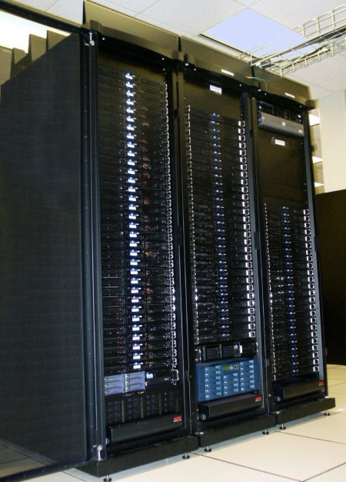
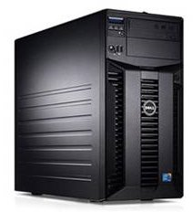
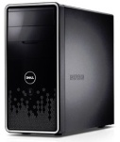
Scaling up
PC
Server
Cluster
What if one computer is not enough?
Buy a bigger (server-class) computer
What if the biggest computer is not enough?
Buy many computers

Slide 11
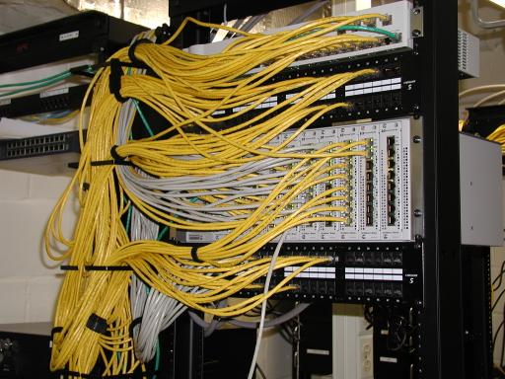
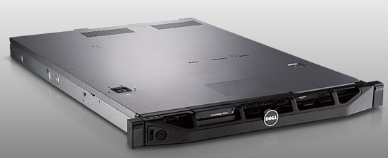
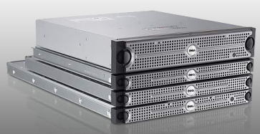
Clusters
Network switch (connects nodes with each other and with other racks)
Rack
Many nodes/blades (often identical)
Storage device(s)
Characteristics of a cluster:
Many similar machines, close interconnection (same room?)
Often special, standardized hardware (racks, blades)
Usually owned and used by a single organization

Slide 12
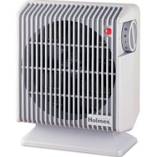
Power and cooling
Clusters need lots of power
Example: 140 Watts per server
Rack with 32 servers: 4.5kW (needs special power supply!)
Most of this power is converted into heat
Large clusters need massive cooling
4.5kW is about 3 space heaters
And that's just one rack!

Slide 13
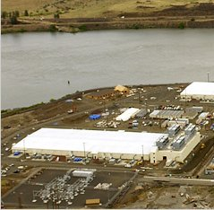
Scaling up
PC
Server
Cluster
Data center
What if your cluster is too big (hot, power hungry) to fit into your office building?
Build a separate building for the cluster
Building can have lots of cooling and power
Result: Data center

Slide 14
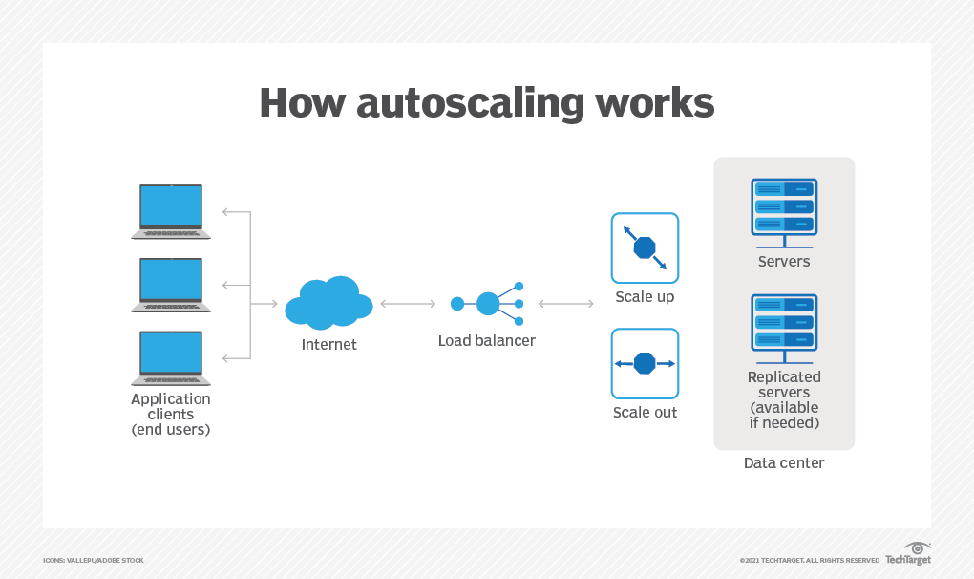
Scaling the Cloud
Notes:
Scaling in cloud computing refers to the process of adjusting the available resources, such as computing power, storage, and networking capacity, to accommodate changes in demand for an application or service. As can be seen in the diagram, the user resources are monitored by the Load Balancer which is configured to detect periods of high utilization and load utilization so as to automatically adjust the resources to meet the users demands. Scaling could either be done vertically or horizontally.

Slide 15
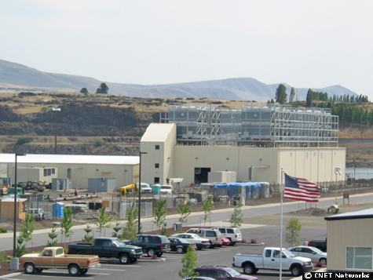
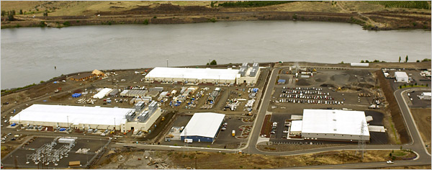
What does a data center look like?
Cooling plant
Data centers (size of a football field)
Google data center in The Dalles, Oregon
A warehouse-sized computer
A single data center can easily contain 10,000 racks with 100 cores in each rack (1,000,000 cores total)

Slide 16
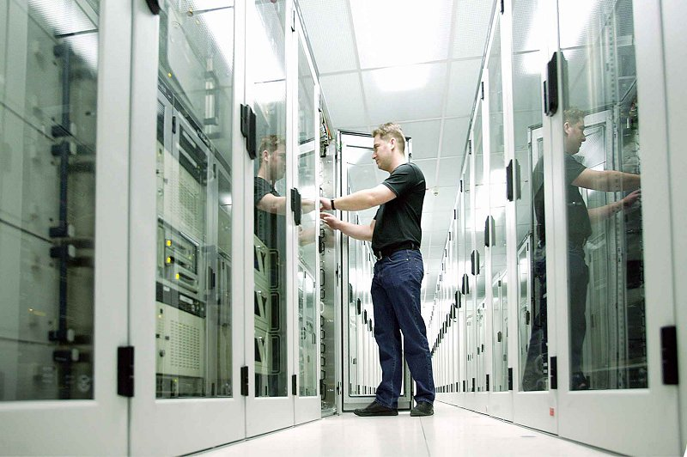
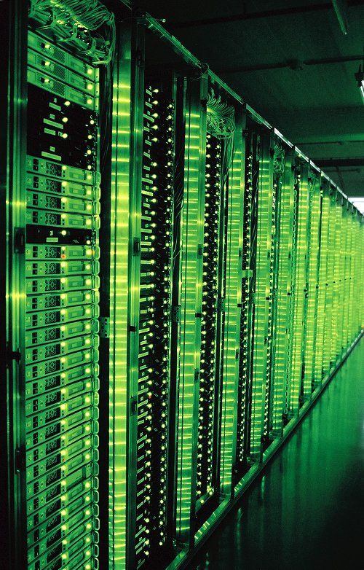
What's in a data center?
Source: 1&1
Hundreds or thousands of racks

Slide 17
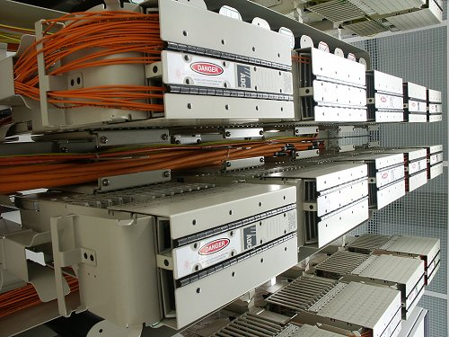
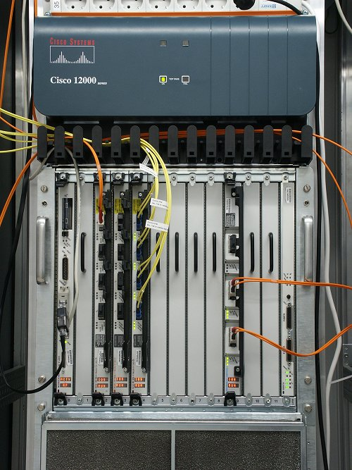
What's in a data center?
Source: 1&1
Massive networking

Slide 18
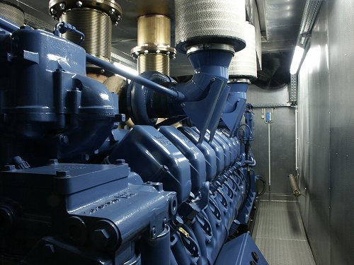
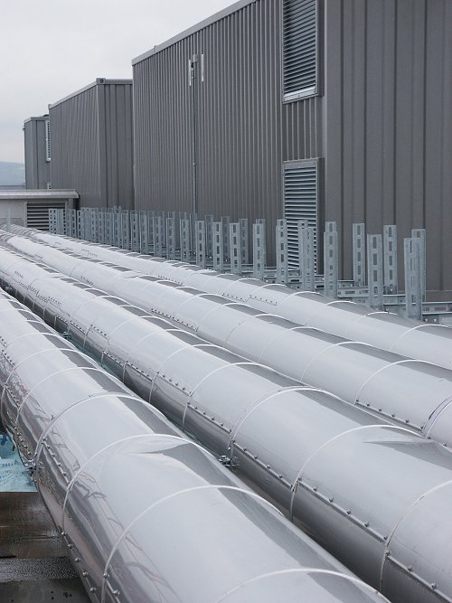
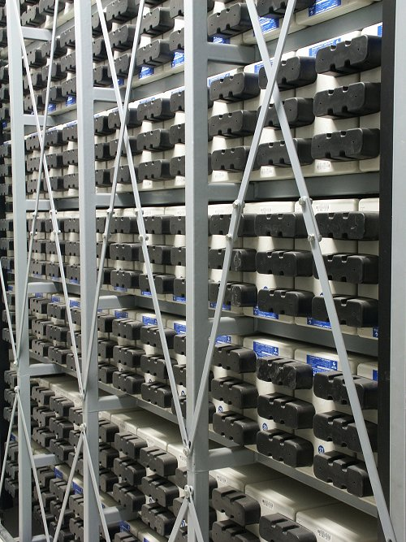
What's in a data center?
Source: 1&1
Emergency power supplies

Slide 19
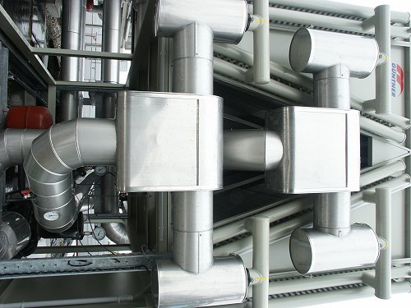
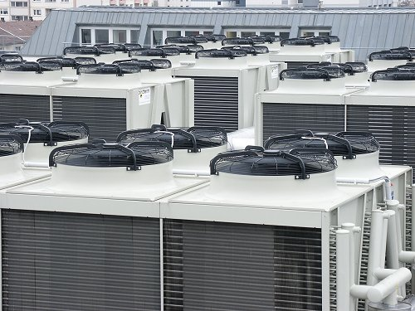
What's in a data center?
Source: 1&1
Massive cooling

Slide 20
Energy matters!
Company | Servers | Electricity | Cost
eBay | 16K | ~0.6*10⁵ MWh | ~$3.7M/yr
Akamai | 40K | ~1.7*10⁵ MWh | ~$10M/yr
Rackspace | 50K | ~2*10⁵ MWh | ~$12M/yr
Microsoft | >200K | >6*10⁵ MWh | >$36M/yr
Google | >500K | >6.3*10⁵ MWh | >$38M/yr
USA (2006)
10.9M
610*10⁵ MWh
$4.5B/yr
Source: Qureshi et al., SIGCOMM 2009
Data centers consume a lot of energy
Makes sense to build them near sources of cheap electricity
Example: Price per KWh is 3.6ct in Idaho (near hydroelectric power), 10ct in California (long distance transmission), 18ct in Hawaii (must ship fuel)
Most of this is converted into heat → Cooling is a big issue!

Slide 21
Energy matters!
There are even bigger energy consumers:
http://motherboard.vice.com/read/bitcoin-could-consume-as-much-electricity-as-denmark-by-2020
2020 14 Gigawatts (Total power generation capacity of Denmark)
1 Bitcoin in 2020 would consume half the annual household usage emitting 4,000 kg of CO₂
This is a big issue because of the enthusiasm for the Blockchain driving new functionality

Slide 22
Scaling up
PC
Server
Cluster
Data center
Network of data centers
What if even a data center is not big enough?
Build additional data centers
Where? How many?

Slide 23
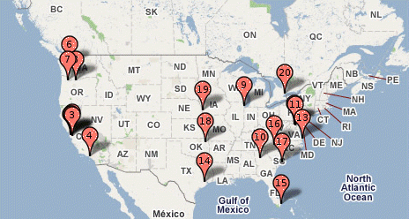
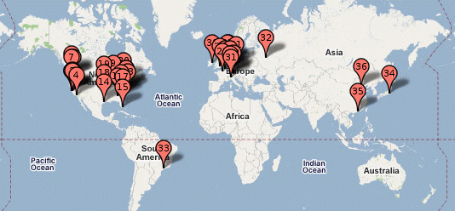
Global distribution
Data centers are often globally distributed
Example above: Google data center locations (inferred)
Why?
Need to be close to users (physics!)
Cheaper resources
Protection against failures

Slide 24
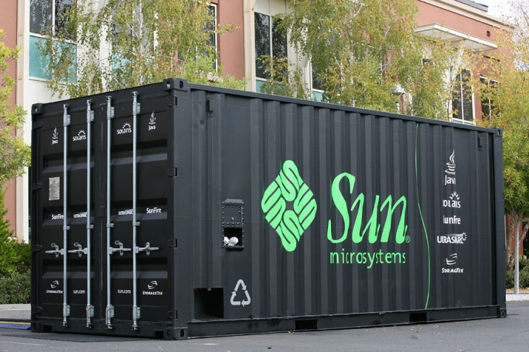
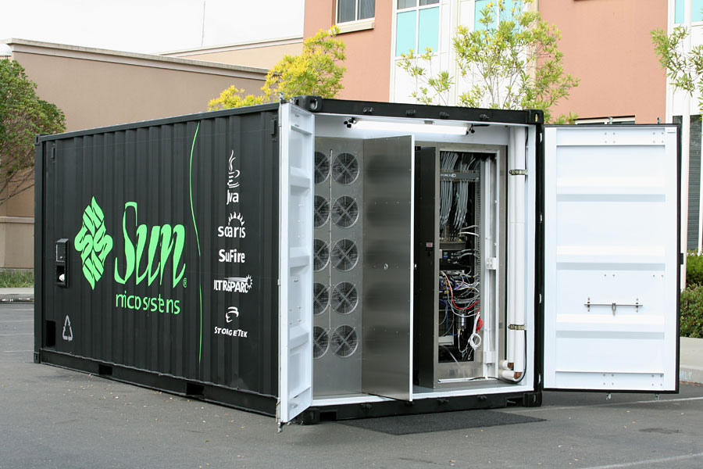
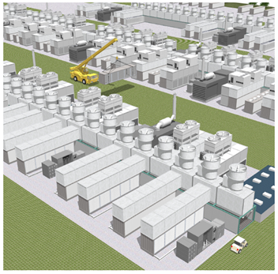
Trend: Modular data center
Need more capacity? Just deploy another container!

Slide 25
Plan for today
Computing at scale
The need for scalability; scale of current services
Scaling up: From PCs to data centers
Problems with 'classical' scaling techniques
Utility computing and cloud computing
What are utility computing and cloud computing?
What kinds of clouds exist today?
What kinds of applications run on the cloud?
Virtualization: How clouds work 'under the hood'
Some cloud computing challenges

