Slide 1
CTE
New Member
Self-Introduction
MXA DS TEAM
DATA SCIENCE INTERN ENGINEER
HAOCHEN YANG

Slide 2
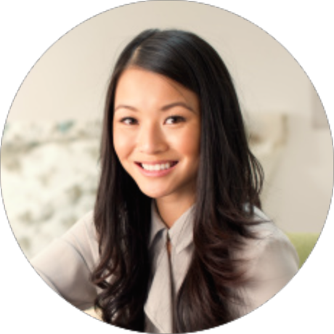
ABOUT
YANG HAOCHEN
25 years old
Born in XI’AN
New Data Science Intern Engineer in MXA
SOMETHING ABOUT MYSELF

Slide 3
Education
&
Experience
Studying in The University of Sydney
Major in Electronic Engineering and Computer Science
Deep Learning, Image Classification
Research on Human Action Recognition with Domain Adaptation
2020 MASTER’S DEGREE (EXPECTED)
Graduated from The University of Melbourne
Major in Electric System
Embedded System
FPGA development
2017 BACHELOR’S DEGREE

Slide 4



Interests &
Hobbits
Basketball
Music
Cooking

Slide 5

Future
Development
How do I know Micron?
Why do I choose Micron?
When I become a DS engineer, I want to do…

Slide 6
THANK YOU!

