Slide 1

LLM Tutorial
Yudha Herwono

Slide 2
Stroke Patients - Background
I use free version of ChatGPT for the prompts
The following references are used as the source of expertise:
American Stroke Association. (2024). Types of Stroke and Treatment. https://www.stroke.org/en/about-stroke/types-of-stroke
Gesensway D. (2009, June). Which neurologic imaging does your patient need? https://todayshospitalist.com/which-neurologic-imaging-does-your-patient-need/
Mayo Clinic. (2023, January 18). Telestroke (stroke telemedicine). https://www.mayoclinic.org/tests-procedures/stroke-and-telemedicine/about/pac-20395081
Mohamed A, Elsherif S, Legere B, Fatima N, Shuaib A, Saqqur M. (2023, September 26). Is telestroke more effective than conventional treatment for acute ischemic stroke? A systematic review and meta-analysis of patient outcomes and thrombolysis rates. International Journal of Stroke, Volume 19, Issue 3. https://journals.sagepub.com/doi/10.1177/17474930231206066

Slide 3
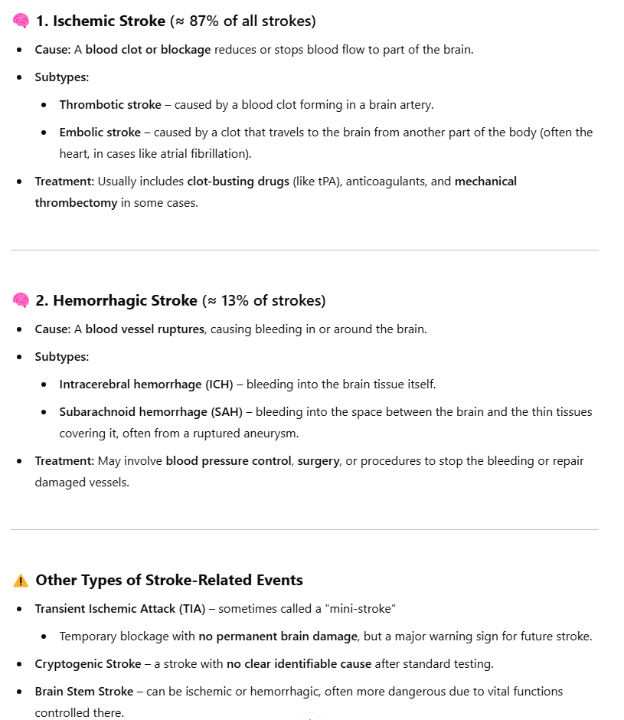
Stroke Patients – Zero-shot prompting
Prompt: What types of stroke are known?
Evaluation:
This is consistent with the information coming from American Stroke Association (ASA)
ASA also mentioned that 87% of all strokes is ischemic stroke
ChatGPT answer:

Slide 4
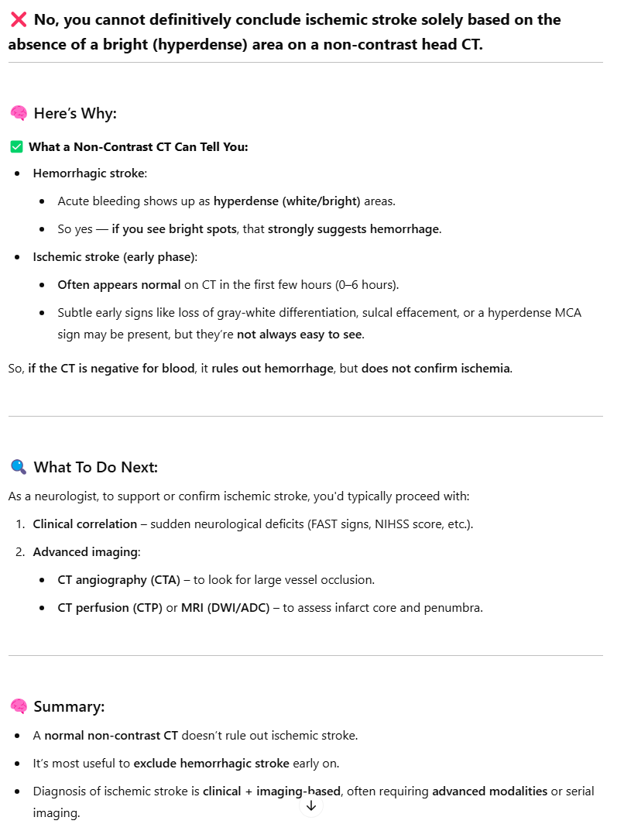
Stroke Patients – One-shot prompting
Prompt: A hemorrhagic stroke can be positively identified through non-contrast head CT scan by looking at anything that shows up as “white or bright”. As a neurologist, I see a head CT scan with no white or bright spot can I conclude that the patient has ischemic stroke?
Evaluation:
This is correct, it is more difficult to identify ischemic stroke by just having a head CT scan, an MRI scan may allow radiologist to say whether a patient has had ischemic stroke (Gesensway, 2009)
ChatGPT answer:

Slide 5
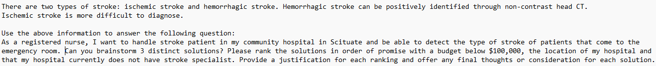
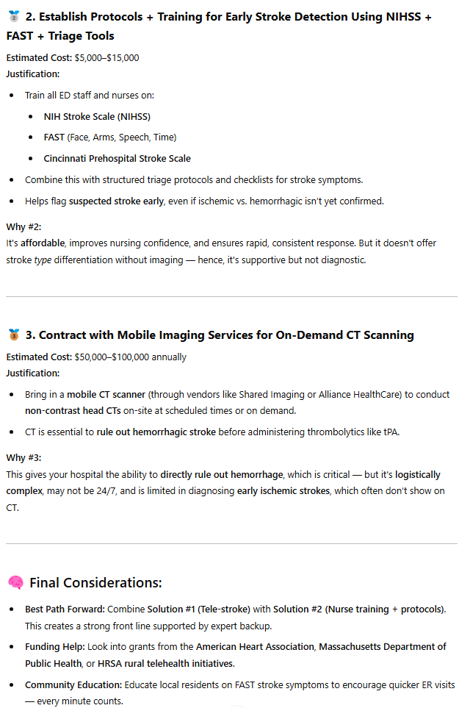
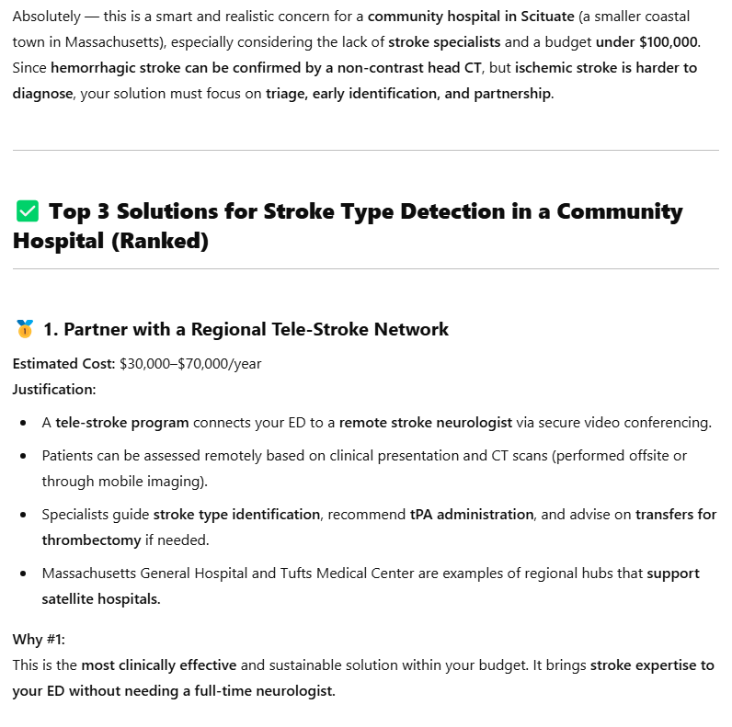
Stroke Patients – Tree of thoughts
Prompt:
ChatGPT answer:
Evaluation:
Answer appears to be sound based on reference materials.
Telestroke is a remote stroke monitoring program where healthcare providers with advanced training in treating stroke can use technology to treat people who have had strokes in another location (Mayo Clinic, 2023).
Mohamed et al. (2023) evaluated multiple studies comparing telemedicine (TM) and non-telemedicine (NTM) for acute ischemic stroke (AIS) patients between 1999 and 2022 and concluded that the use of telestroke in the treatment of AIS patients is safe with minimal differences in long-term outcomes compared with face-to-face treatment.

Slide 6
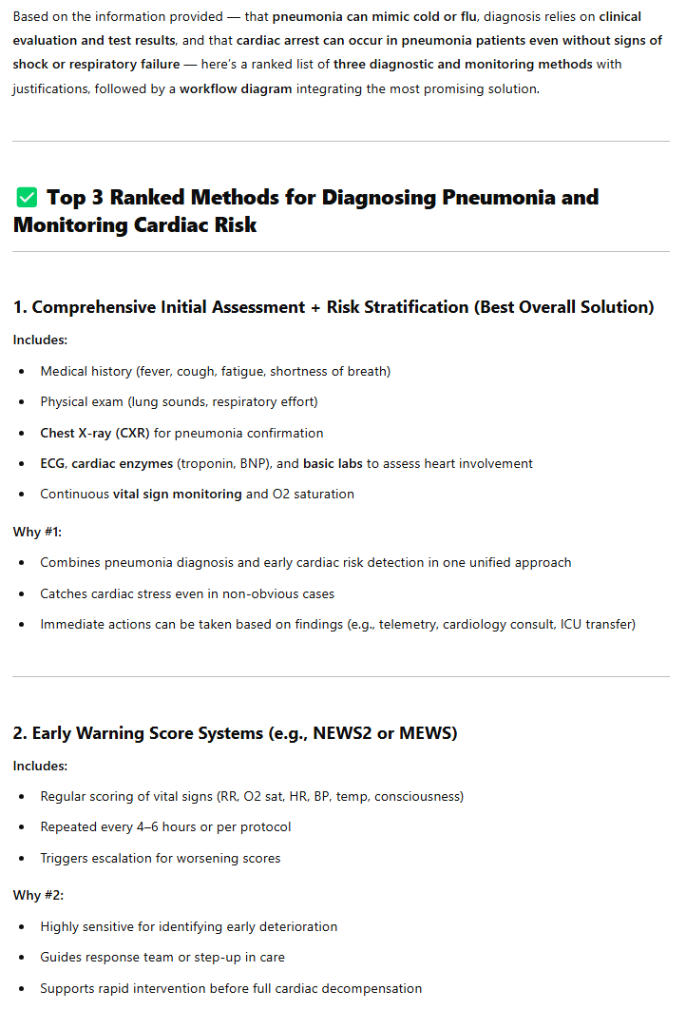
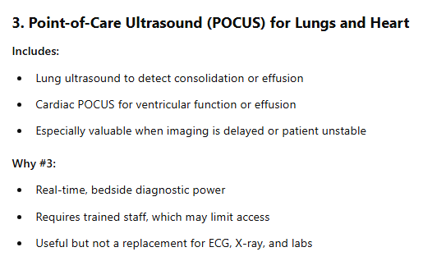
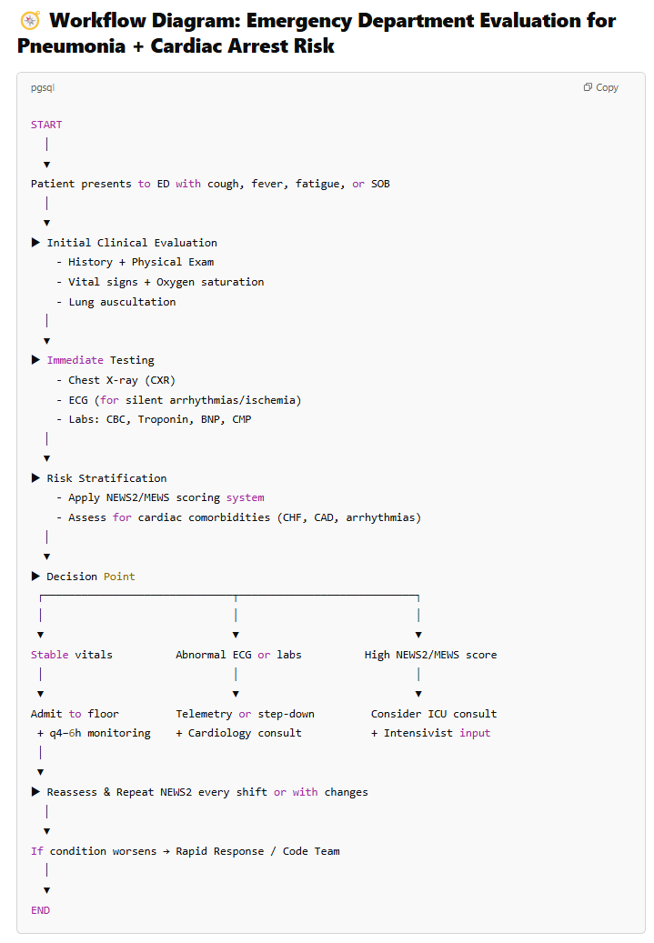
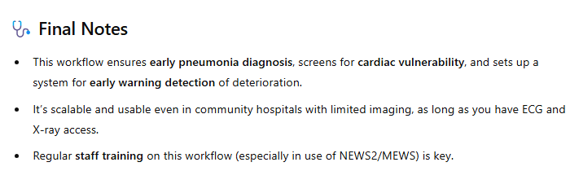
Pneumonia and Cardiac Arrest– Tree of thoughts
Prompt:
ChatGPT answer:

Slide 7
Parkinson’s Disease Dataset
Dataset with comprehensive health information for diagnosing Parkinson’s Disease.
Original dataset provided by Mr. Rabie El Kharoua.
2,105 patients with demographic details, lifestyle factors, medical history, clinical measurements, cognitive and functional assessments, symptoms, and a diagnosis indicator.
Source: https://www.kaggle.com/datasets/rabieelkharoua/parkinsons-disease-dataset-analysis/data, Kaggle
For LLM Analysis, only the following attributes are used:
Age: The age of the patients ranges from 50 to 90 years.
Diet Quality: Diet quality score, ranging from 0 to 10.
UPDRS: Unified Parkinson's Disease Rating Scale score, ranging from 0 to 199. Higher scores indicate greater severity of the disease.
MoCA: Montreal Cognitive Assessment score, ranging from 0 to 30. Lower scores indicate cognitive impairment.
FunctionalAssessment: Functional assessment score, ranging from 0 to 10. Lower scores indicate greater impairment.
Tremor: Presence of tremor, where 0 indicates No and 1 indicates Yes.
Rigidity: Presence of muscle rigidity, where 0 indicates No and 1 indicates Yes.
Bradykinesia: Presence of bradykinesia (slowness of movement), where 0 indicates No and 1 indicates Yes.
Diagnosis: Diagnosis status for Parkinson's Disease, where 0 indicates No and 1 indicates Yes.

Slide 8
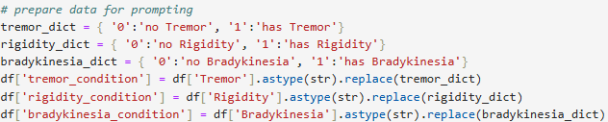
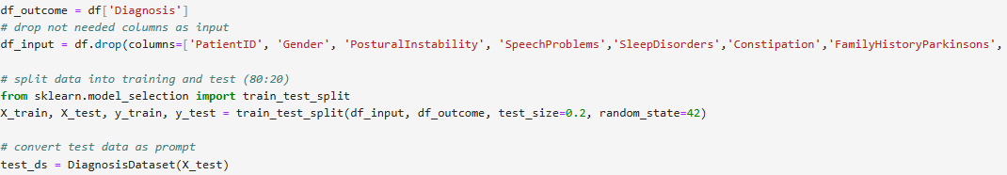
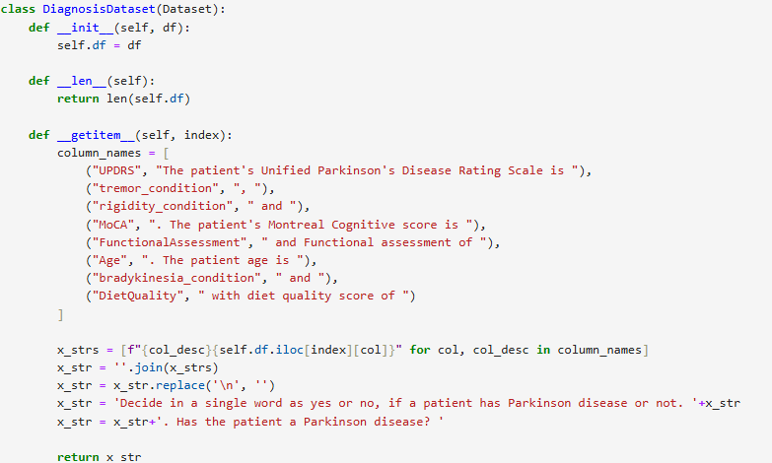
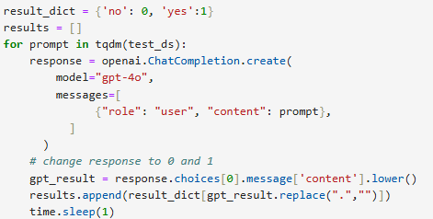
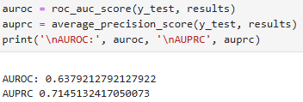
Zero-shot ChatGPT Parkinson's disease prediction
Sample Prompt:

Slide 9
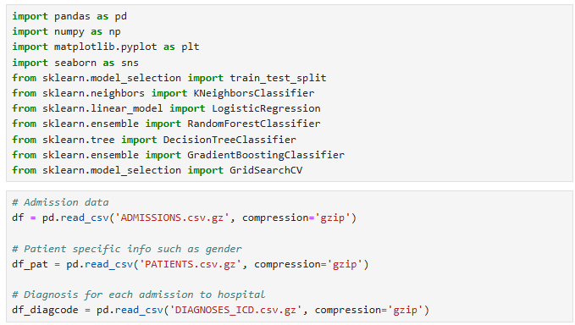
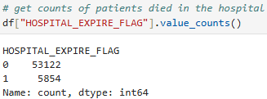
Import libraries and data load
Predicting death in the hospital is a binary classification, therefore classifiers are used as algorithm and imported here.
MIMIC III dataset is available in the gzip format
HOSPITAL_EXPIRE_FLAG is used to determine patient’s death in the hospital.
There are 5,854 in-hospital deaths from the raw dataset.

Slide 10
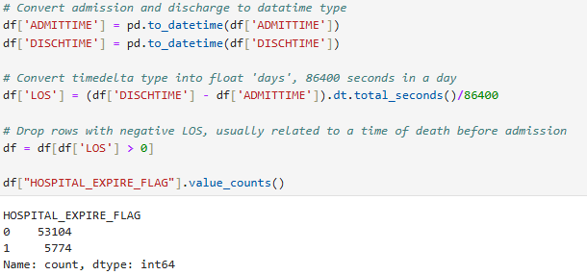
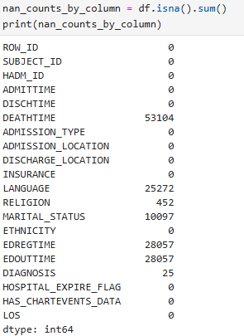
Admission Data Exploration
LOS is calculated to include only patients that are still alive at the time of admission
80 records are removed from the dataset (LOS <=0)
There are many missing data for LANGUAGE and MARITAL_STATUS therefore these features won’t be used in the analysis

Slide 11
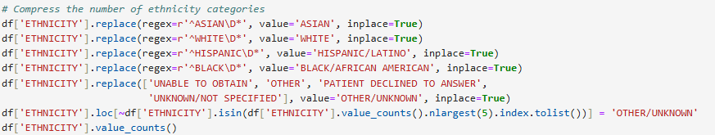
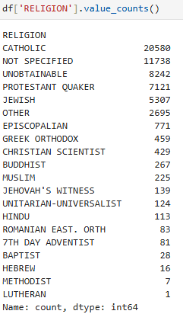
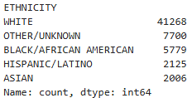
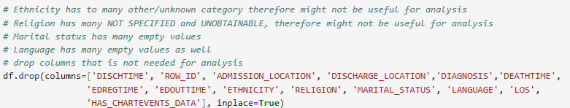
Admission Feature Engineering: Ethnicity and Religion
After grouping ethnicity, too many ‘OTHER/UNKNOWN’ in the dataset, therefore this feature won’t be used in the analysis
There are too many ‘NOT SPECIFIED’ in Religion values, therefore this feature won’t be used in the analysis either

Slide 12
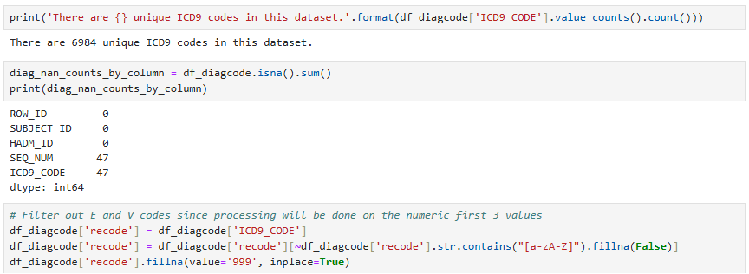
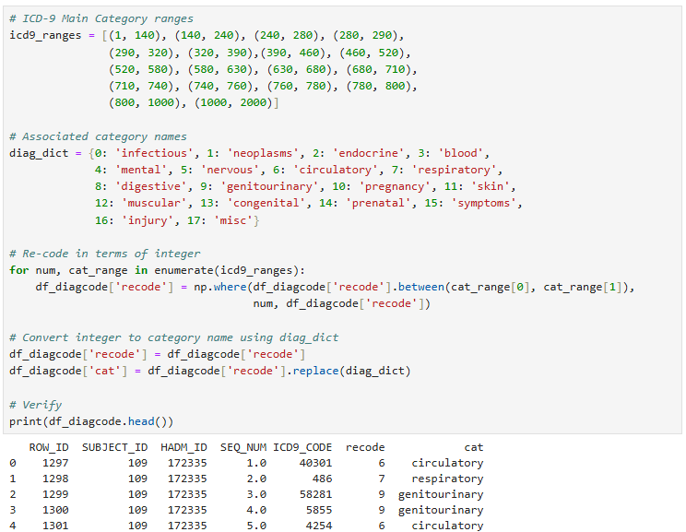
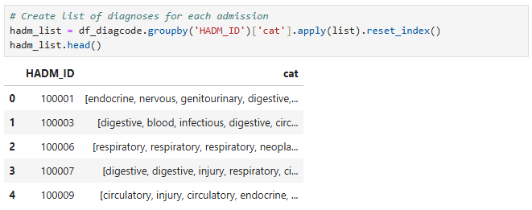
DIAGNOSES_ICD Feature Engineering
Too many unique values for ICD code, therefore grouped it to its generalized categories as a feature, utilizing method from the course material
E and V codes and missing data is set to 999 as injury category
All diagnoses is then grouped by its admission ID

Slide 13
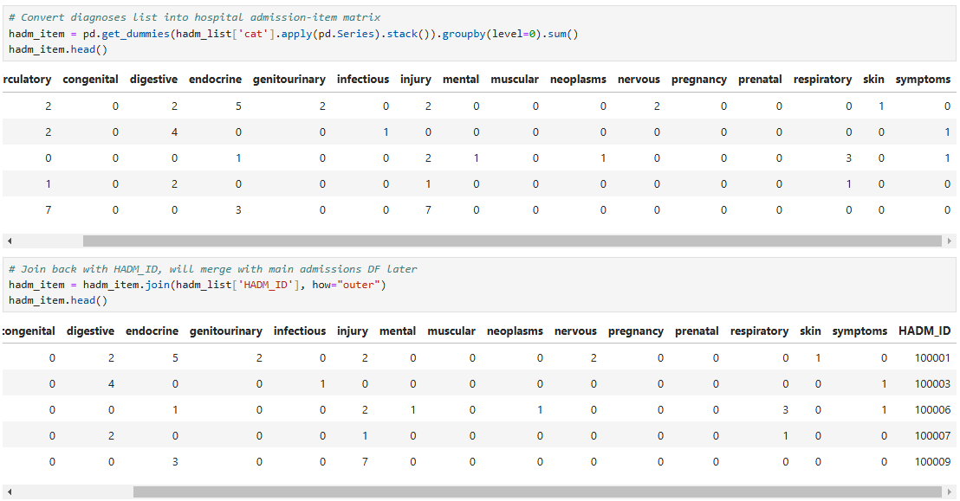
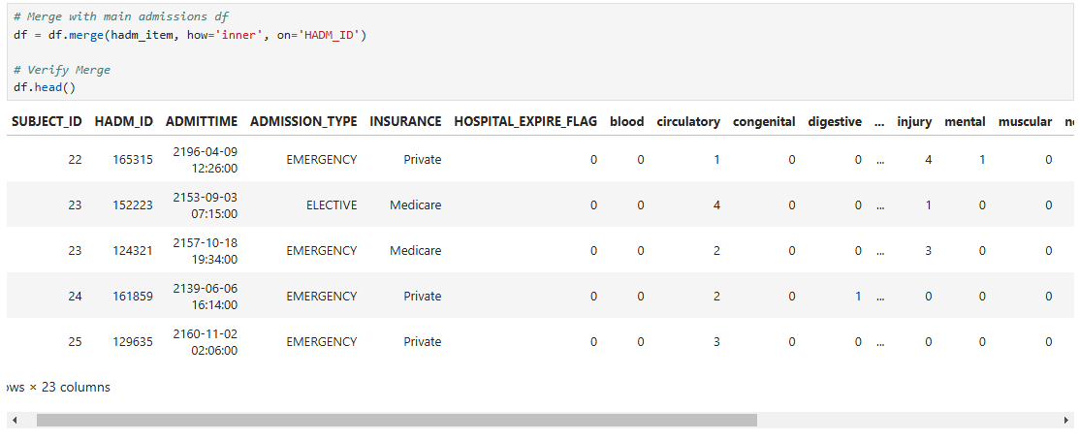
DIAGNOSES_ICD Feature Engineering

Slide 14
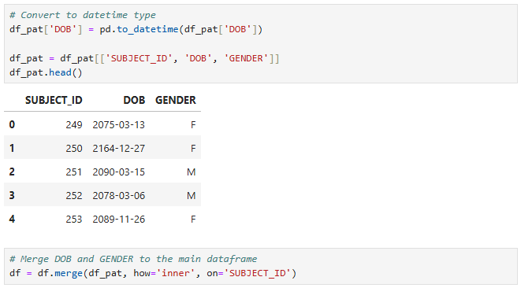
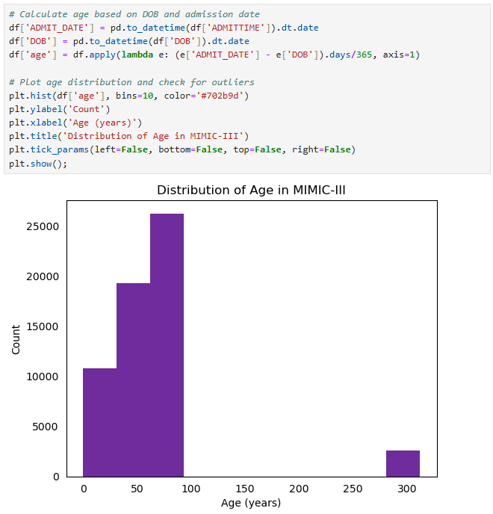
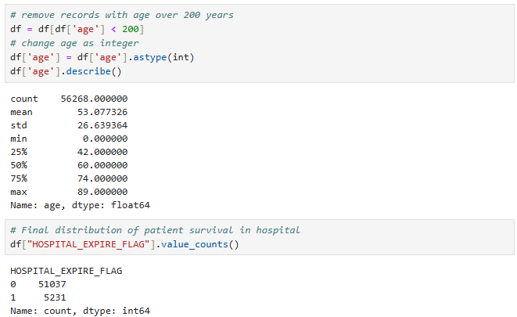
PATIENTS Data Exploration

Slide 15
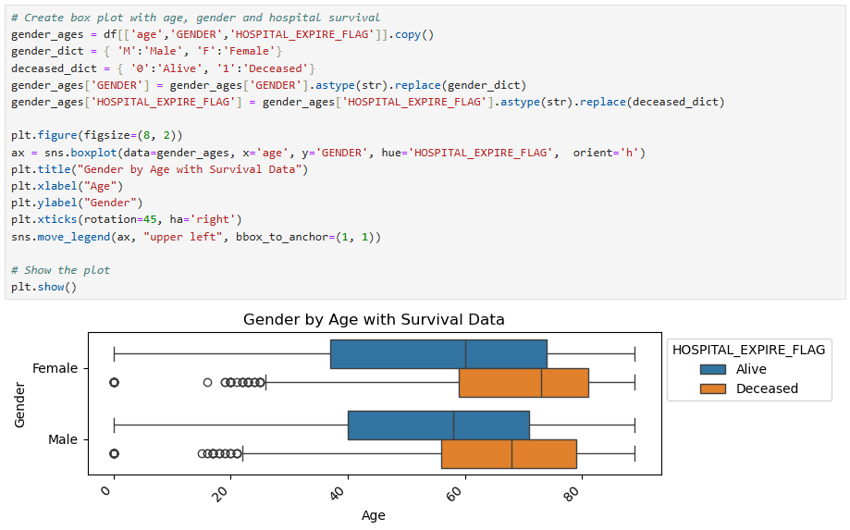
PATIENTS Feature Engineering
Data shows that the majority of in-hospital deaths have older age with no significant difference by gender

Slide 16
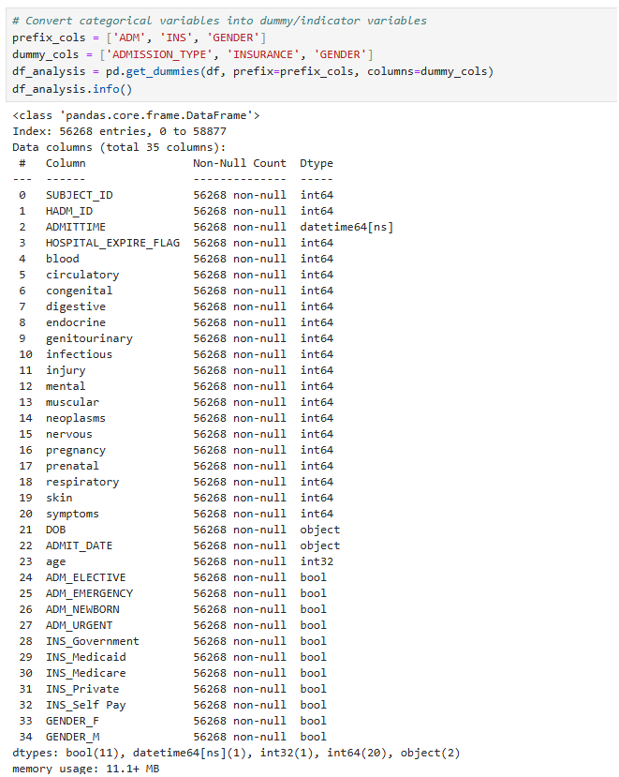
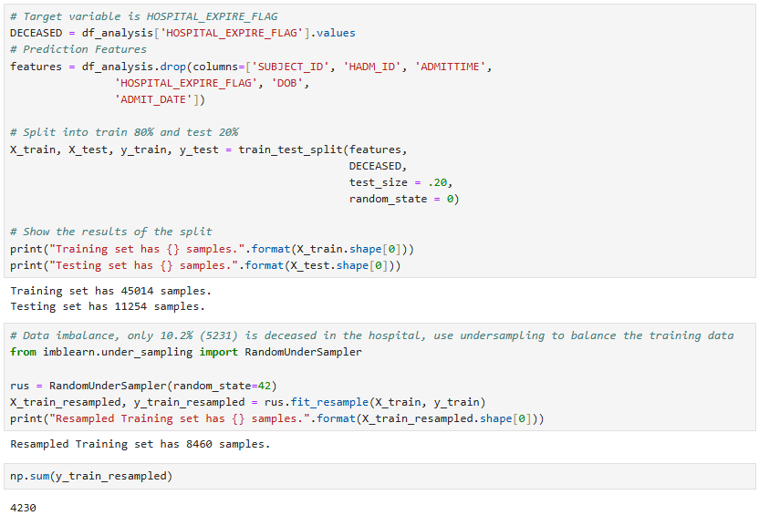
Data Preprocessing

Slide 17
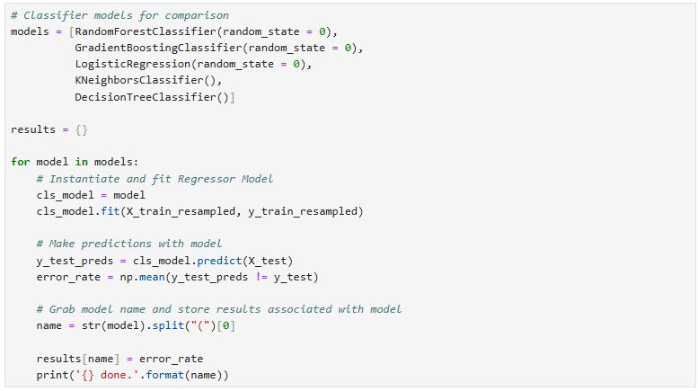
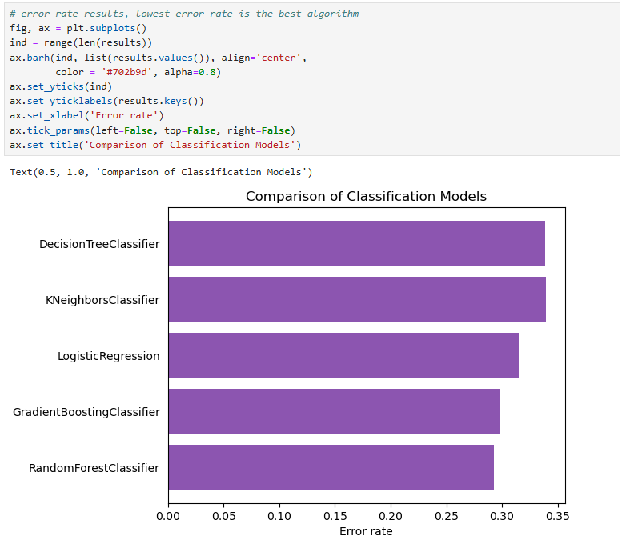
Machine Learning Algorithm (Classifiers)
Error rate is a simple calculation of the mean value of wrong prediction on test dataset
Random Forest Classifier has the lowest error rate

Slide 18
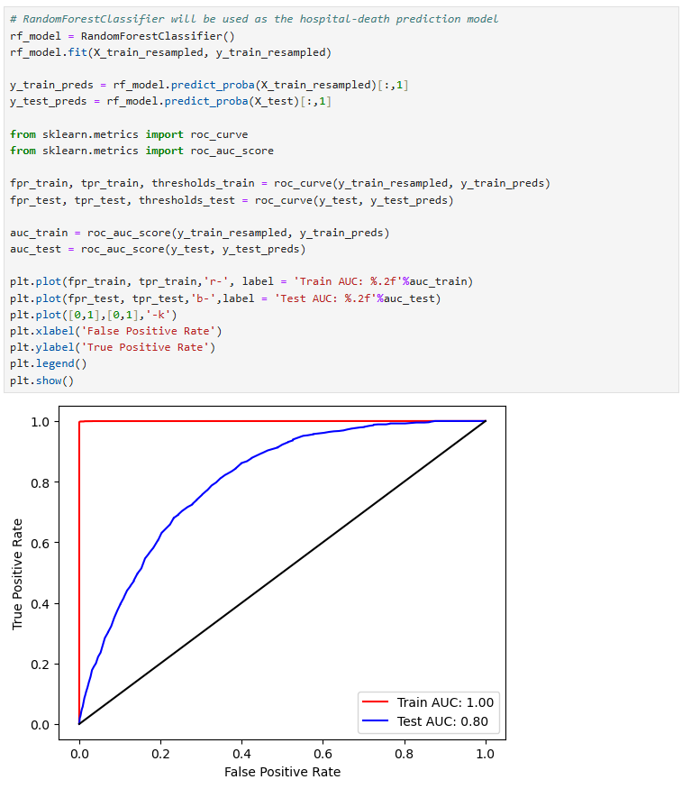
Random Forest Classifier - Performance
Perfect 1.0 AUC score for training data
Excellent 0.8 AUC score for test data

Slide 19
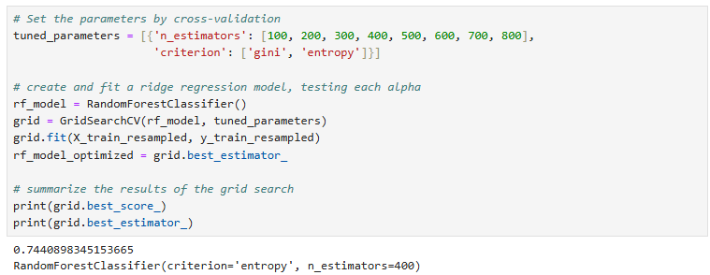
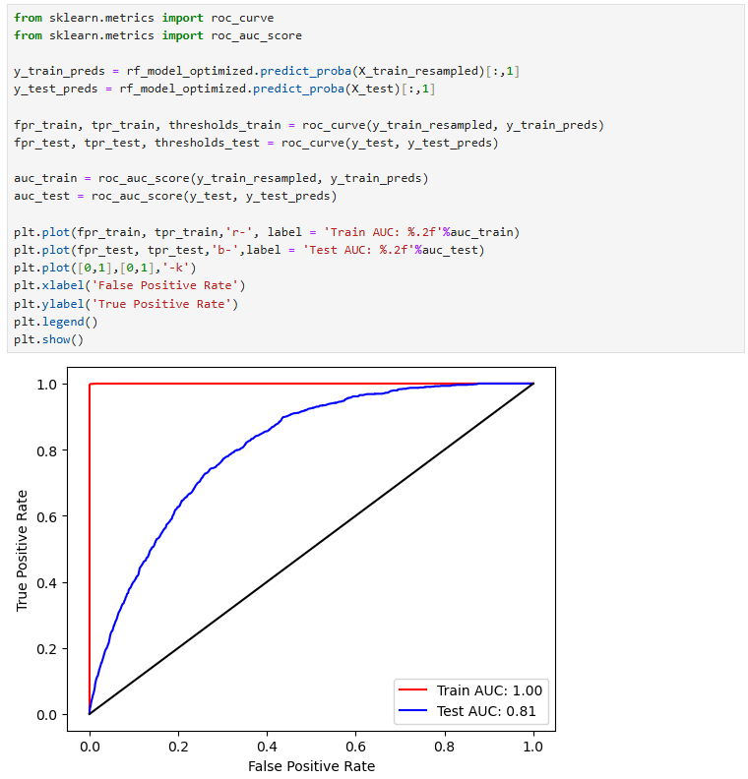
Random Forest Classifier – Fine Tuning
Use GridSearchCV to test permutation of parameters
The best estimator result: n_estimators=400 and criterion=‘entropy’
Still perfect 1.0 AUC score for training data and small improvement to 0.81 AUC score for test data

Slide 20
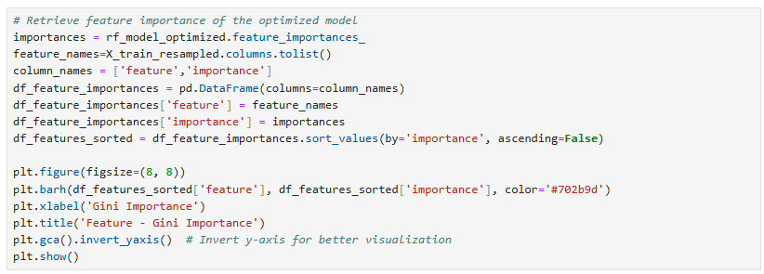
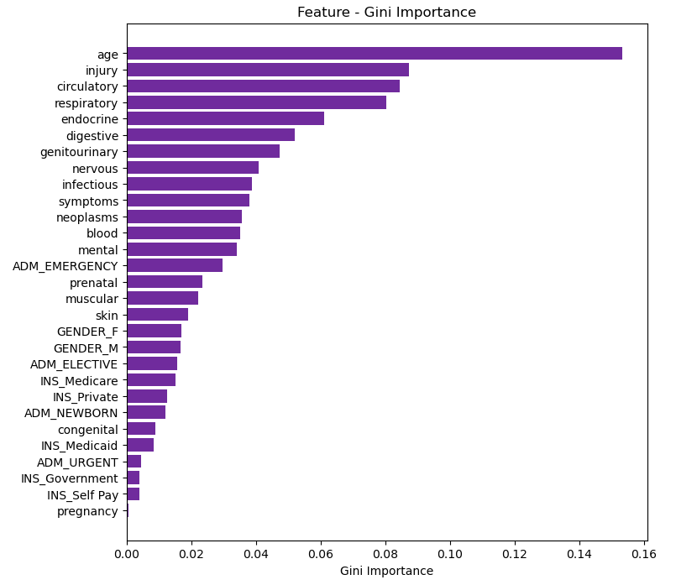
Feature Importance and Summary
Age is by far the best predictor of in-hospital death
Gender and insurance didn’t show much importance as predictor
From the diagnoses group: injury, circulatory, respiratory and endocrine made the Top 5 predictors
Random Forest Classifier is the best algorithm and has an excellent 0.81 AUC score for test data

Slide 21
Source code
Python code: https://github.com/yherwono/ai_healthcare/blob/main/MIMIC-Hospital-Death.ipynb
MIMIC III dataset: https://physionet.org/content/mimiciii/1.4/

