Slide 1

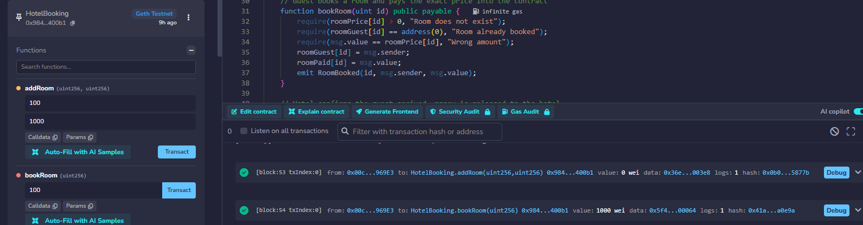
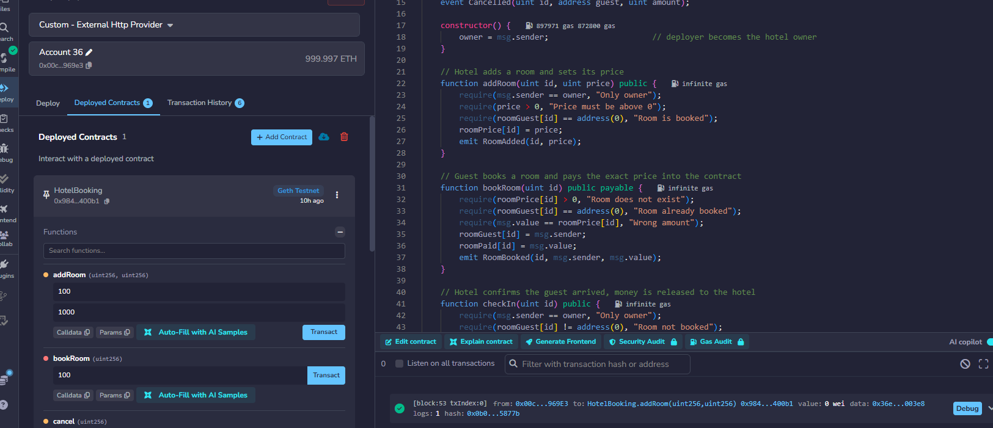
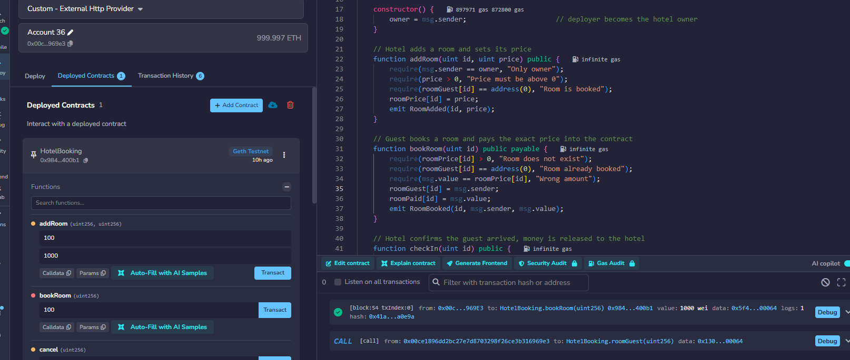
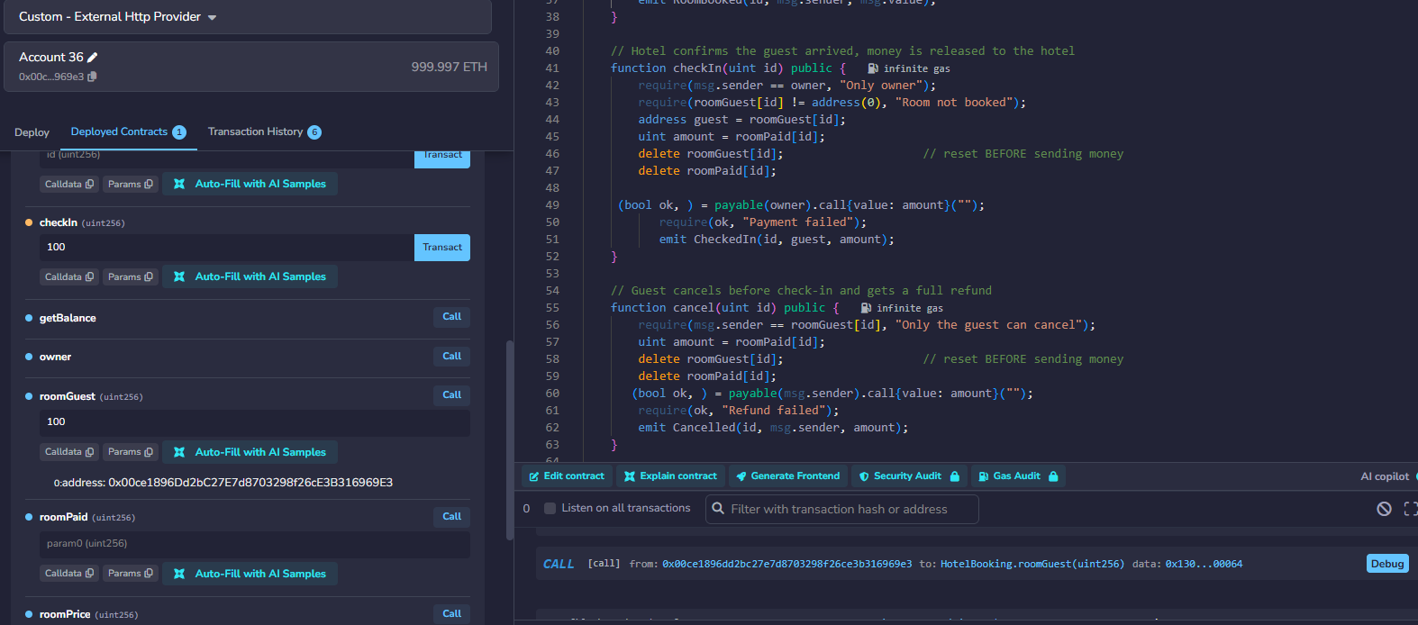
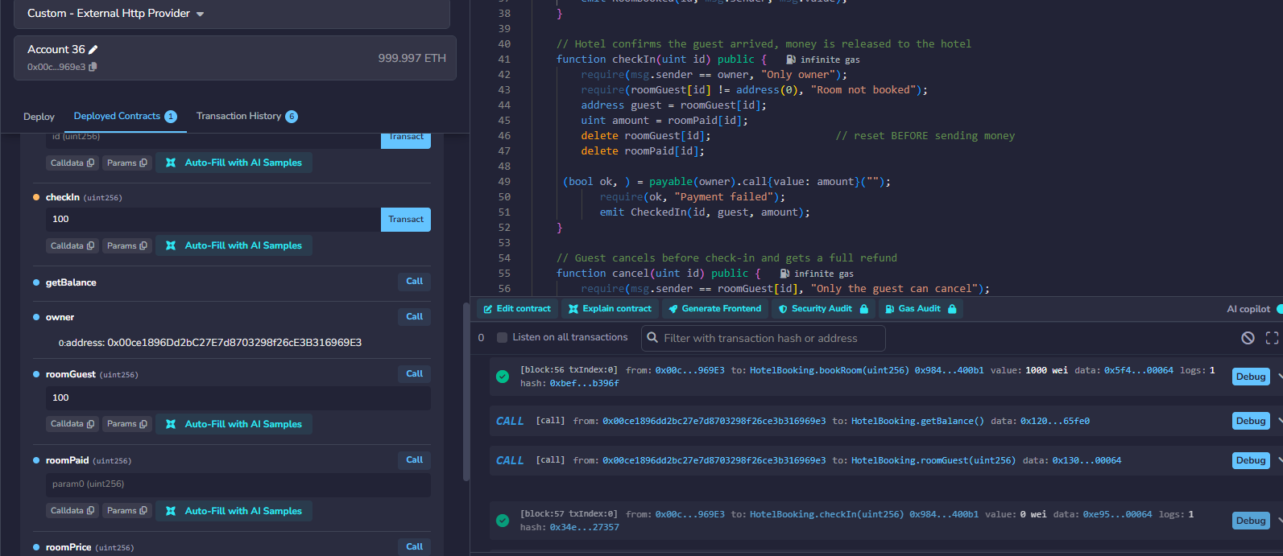
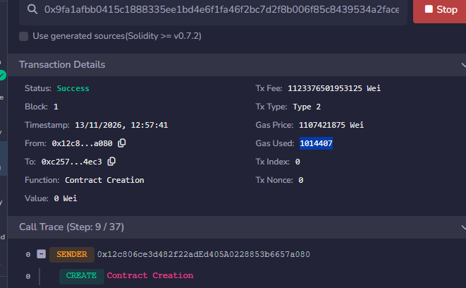
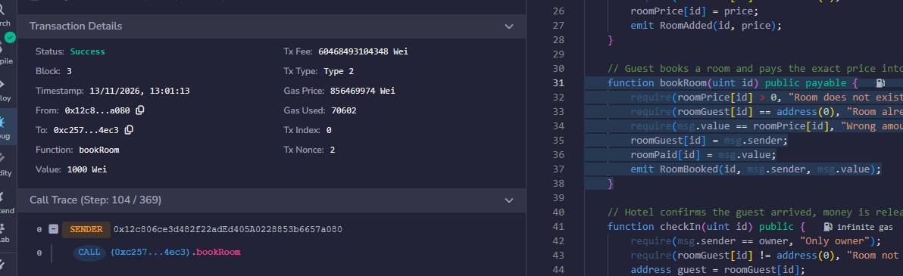
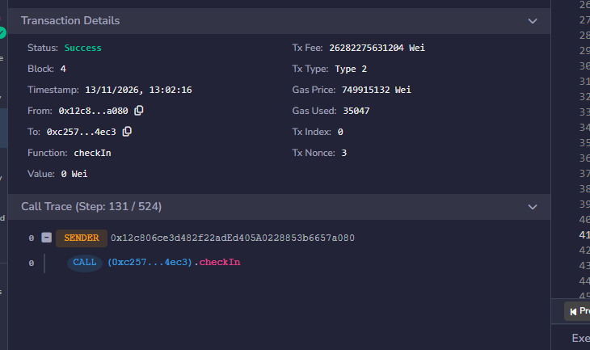

Blockchain Based Hotel Booking System Using Smart Contracts
Name: Yeison Quinteros Guaman Student ID: 2024261
Lecturer(s):Dr. Muhammad Iqbal Module: Distributed Digital Transactions
Programme Title: BSc (Hons) in Computing in IT Year: 2026
1
Introduction
4
System Architecture
8
Cryptographic Security
The purpose of the project was to design and implement a decentralized hotel booking system using blockchain technology and Ethereum smart contracts. Traditional hotel booking platforms rely on centralized databases and third-party payment providers to manage reservation and process payments while effective, these systems can introduce transaction fees delay, and trust issues between customers and service providers. Blockchain technology offers an alternative by providing a transparent, immutable service decentralized ledger where transactions can be verified without relying on intermediaries (Ethereum Foundation 2024).
This project developed a HotelBooking smart contract using Solidity and deployed it on a local Ethereum blockchain using Ganache. The solution uses a secure escrow mechanism that stores guest payments within the smart contract until the guest successfully checks into the hotel. This approach increases trust between both parties while demonstrating the practical application of blockchain technologies in the hospitality industry.
GUEST
Sender
SMART CONTRACT HotelBooking.sol (middle layer)
HOTEL
Receiver
Blockchain transactions are secured using public-key cryptography. Ethereum uses the Elliptic Curve Digital Signature Algorithm (ECDSA) to verify that only the owner of a private key can authorise a transaction. Data integrity is maintained using the Keccak-256 hashing algorithm, which links blocks together and makes unauthorised modification detectable (Ethereum Foundation, 2024).
Public blockchains provide integrity and authenticity but do not guarantee confidentiality, as transaction data can be viewed by network participants. Sensitive data should therefore not be stored directly on-chain.
1
Room registry
Maps each room ID to its price per room
Booking records
Stores guest address, room and amount paid
2
Wallet signs each transaction with the guest's private key (ECDSA)
Owner wallet receives the payment once it is released
3
Escrow balance
ETH held safely until check-in or cancellation
Status
Booked, then CheckedIn or Cancelled
Calls bookRoom() to pay into escrow, or cancelBooking() for a refund
Calls addRoom() to list rooms and confirmCheckIn() to release payment
1 bookRoom() + ETH locked 2 confirmCheckIn() pays hotel 3 cancelBooking() refunds guest
Block n-1
prev hash
Block n
prev hash
Block n+1
prev hash
Ethereum / Ganache blockchain: ECDSA-signed transactions • Keccak-256 hashed blocks • event log audit trail • gas fees
Changing one booking changes its hash and breaks every later block, so tampering is detected immediately.
2
Blockchain & Project Objectives
9
Benefits & Challenges
"Why Blockchain Instead of a Database?"
5
Testing & Results (Remix + Ganache)
A traditional database is typically controlled by a single organisation, and records can be modified by administrators. In contrast, blockchain stores transactions across a distributed network where records are immutable and transparent. Smart contracts also allow business rules to be executed automatically without requiring a trusted third party. For hotel bookings, this improves trust, accountability and transparency between guests and hotel operators (Ethereum Foundation, 2024)
Benefits
Challenges
- No commission fees for guest or hotel.
- Automatic, instant refunds.
- Tamper-proof booking records
- No double bookings.
- Increased transparency through immutable transaction records.
- Removal of third-party payment intermediaries.
- Automated trust through smart contract execution.
- Improved auditability of booking transactions.
- Gas fees and limited scalability
- GDPR conflicts with permanent data.
- Guests need crypto wallets.
- Smart-contract bugs can be costly.
- Limited scalability of public blockchain networks.
- High gas costs during periods of network congestion.
- Requirement for users to understand cryptocurrency wallets.
The main objectives of this project were:
1. Compile in Remix and deploy to Ganache
2. Room 100 created with a price of 1000 wei.
3. Guest successfully booked room and transferred funds into escrow.
4. Guest blockchain address recorded within the smart contract.
5. Check-in confirmed and payment released to hotel owner.
- Develop a smart contract using Solidity.
- Create a hotel room booking system on blockchain.
- Implement secure escrow-based payments.
- Allow hotel owners to manage rooms and pricing.
- Enable guests to make reservations securely.
- Automatically release payments after check-in.
- Test all smart contract functions using Ganache and Remix IDE.
# | Test case | Expected result | Result
1 | Deploy contract | Contract deploys; deployer becomes hotel owner | Pass
2 | Add room | Room 100 added with a price of 1000 wei | Pass
3 | Book room | Guest sends wei and funds are locked in escrow | Pass
4 | Double booking | Second booking reverts: Room already booked | Pass
5 | Confirm check-in | Hotel confirms; escrow is released to the hotel | Pass
6 | Cancel booking | Guest cancels before check-in; full refund is sent | Pass
Performance (Ganache)
Deployment cost: [1014407] gas
bookRoom(): [70602] gas
confirmCheckIn(): [35047] gas
Network: Ganache local
blockchain.
3
System Design and Implementation
10
Conclusion
The HotelBooking smart contract acts as a trusted intermediary between the guest and the hotel owner. When the contract is deployed, the deployer’s blockchain address becomes the owner of the contract through the Solidity msg.sender variable.
The smart contract contains mappings that storeroom prices, booking information and payments currently held in escrow. The hotel owner can create rooms and assign booking prices using the addRoom() function. Guest can then select and available room and reserve it by sending the exact amount required through the payable bookRoom() function.
Unlike traditional booking systems where payments are transferred immediately to the hotel, the smart contract temporarily stores the funds. This escrow mechanism ensure that payment is only released after the hotel confirms that the guest has checked in successfully. If required, the guest can cancel a booking and automatically receive a refund.
Several validation checks were implemented using Solidity’s require() statements to ensure data integrity and prevent invalid transactions. These checks verify room availability, payment accuracy and user permissions before any action can be executed.
Short Explanation:
Testing was conducted using Remix IDE and Ganache to validate the functionality of the HotelBooking smart contract. All test scenarios executed successfully, including room creation, secure booking, escrow payment storage, payment release after check-in and cancellation processing. The successful completion of all tests demonstrates that the smart contract behaved according to the project requirements.
This project demonstrated the successful implementation of a blockchain-based hotel booking application using Ethereum smart contracts. Through the combination of Solidity, Remix IDE and Ganache, the solution achieved secure room management, escrow-based payment handling and automated transaction execution. Testing confirmed that all major functions operated as expected. The project illustrates how blockchain technology can improve trust, transparency and automation within hospitality booking systems while reducing dependency on centralised intermediaries.
6
Key Contract Code
7
References
function bookRoom(uint id) public payable { require(roomPrice[id] > 0, "Room does not exist"); require(roomGuest[id] == address(0), "Room already booked"); require(msg.value == roomPrice[id], "Wrong amount"); roomGuest[id] = msg.sender; roomPaid[id] = msg.value; emit RoomBooked(id, msg.sender, msg.value);}
Ethereum Foundation (2024) Ethereum Documentation. Available at: Ethereum Developer Documentation (Accessed: 1 November 2026).
Ganache (2024) Ganache Documentation. Available at: https://trufflesuite.com/docs/ganache/ (Accessed: 2 November 2026).
Remix Project Team (2024) Remix IDE Documentation. Available at: Remix IDE Documentation (Accessed: 4 November 2026).
Solidity Team (2024) Solidity Documentation. Available at: https://docs.soliditylang.org/en/latest/ (Accessed: 6 November 2026).
Wood, G. (2014) Ethereum: A Secure Decentralised Generalised Transaction Ledger. Available at: Ethereum Yellow Paper (Accessed: 11 November 2026).
The code fragment demonstrates the booking validation process within the HotelBooking smart contract. Before confirming a reservation, the contract verifies that the room exists, checks that it has not already been booked, and validates that the correct payment amount has been provided. Once these conditions are satisfied, the guest address and payment details are recorded on the blockchain, and the funds are stored securely within the escrow mechanism.
Video: https://drive.google.com/drive/folders/1cq1OXVA0alei2CPQW-IeFFHtyNX9asiZ?usp=drive_linkvidel
Link GitHub: https://github.com/yheycko/CA1-DDT-BSc-3rd-Year-.git
Notes:
VIDEO SCRIPT (about 4 minutes)
0:00-0:30 Intro. Hi, I'm [name]. My project is a blockchain hotel booking system. Booking platforms charge 15 to 25 percent commission, hold our payments, and can suffer double bookings and slow refunds. Why not a normal database? Because it has a central authority and a single point of failure. A blockchain is decentralised, uses smart contracts and gives a transparent audit trail.
0:30-1:30 Solution and architecture. The guest is the sender, the hotel is the receiver, and the smart contract is the middle layer. The guest's payment is locked in escrow and released only when the hotel confirms check-in. The contract stores a room registry, booking records, the escrow balance and a status for each booking. For security I use ECDSA digital signatures and Keccak-256 hashing.
1:30-3:15 Demo. In Remix I compile and deploy to Ganache. As the hotel I add Room 101. As the guest I book two nights and the escrow balance rises. Booking the same room again reverts. The hotel confirms check-in and the payment is released. A second booking is cancelled and refunded. The results table shows the six tests, and the performance box shows the gas used and confirmation time.
3:15-4:00 Conclusion and future work. Benefits are lower fees, transparency and automatic refunds. Challenges are gas fees, GDPR and adoption. Future work includes a mobile app, stablecoin payments, multi-hotel support, Chainlink oracles and NFT booking tickets. Thank you.

