Slide 1
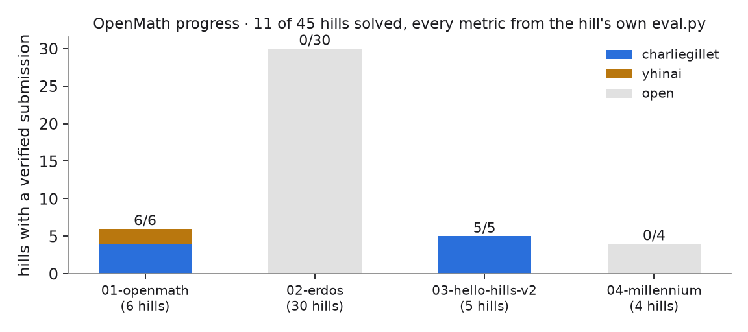
OPENMATH
Can computation become
a mathematical proof?
Eleven challenge results, exact certificates, and a clean Lean build
Yahya Alhinai
github.com/yhinai/openmath
Notes:
Frame the demo around trust. We did not merely produce scores. We preserved exact certificates, replayed official evaluators, and used Lean where formal verification added the most value.

Slide 2
FORMAL PROOF
From 1 + 1 = 2 to research certificates
FOUNDATIONS
KOBON TRIANGLES
COLLATZ DESCENT
1 + 1 = 2
93 triangles
503 / 503
From axioms and standard Lean
Published range: 93–94
Coverage: provably maximal
The first version imports nothing and defines equality, Peano numbers, and addition laws from scratch.
Lean checks exact intersections for 18 lines. Our construction matches the published lower bound; 94 remains open.
Lean's kernel checks every finite descent rule. This does not prove the Collatz conjecture.
Trust level
MatMul3 and Collatz use kernel evaluation. Kobon uses native_decide.
Notes:
Use this slide to show the progression in formal maturity. Kobon matches the known 93 lower bound with upper bound 94. Collatz provides a complete finite certificate, not a proof of the global conjecture.

Slide 3
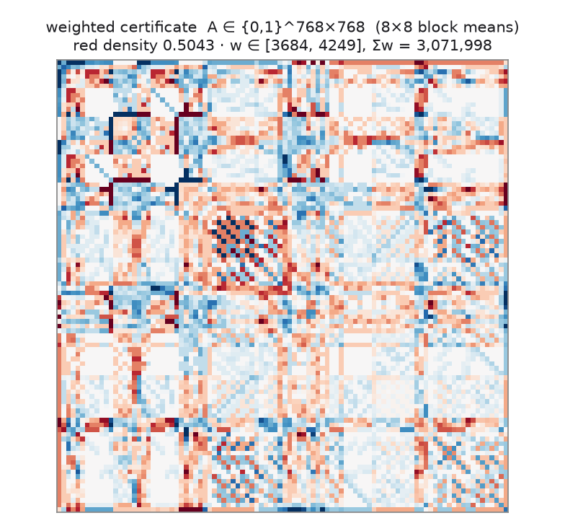
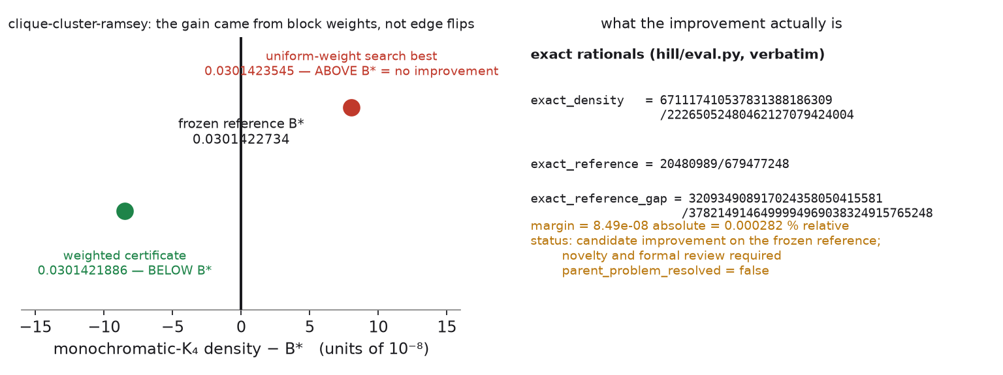
RAMSEY MULTIPLICITY
A candidate improvement measured exactly
CURRENT WEIGHTED CERTIFICATE
0.030142188577
McKay reference 0.030142273432
↓ 0.000282%
EXACT GAP AND SEARCH COMPARISON
The official evaluator confirms the exact weighted certificate. Uniform edge search remained above the reference.
Unreviewed candidate improvement; not a solution of Ramsey multiplicity.
Notes:
The figures come from this repository's current docs/figures set. They show the weighted certificate and the exact rational gap. Reference means McKay's improved 768-vertex upper-bound construction. Say candidate improvement, never world record.

Slide 4
MATRIX MULTIPLICATION
Our strongest formally verified result
MULTIPLICATIONS
SUPPORT
FORMAL CHECK
23
139
729 / 729
Best known: 23 · lower bound: 19
Next HKS: 140 · Laderman: 153
All Brent identities
The open question is whether 22 multiplications are possible.
Support 139 is the minimum across all 17,372 published HKS schemes.
Lean verifies the tensor coefficient by coefficient using exact kernel evaluation.
CONTRIBUTION
Complete database metric scan plus an exact Lean certificate. The algorithm itself was already published.
Notes:
Make the comparison explicit. Rank 23 matches the state of the art and remains above the lower bound of 19. Support 139 beats every scheme in the HKS database under this metric, including Laderman at 153.

Slide 5
EXACT CERTIFICATES
Small witnesses and long computations
GROTHENDIECK WITNESS
BUSY BEAVER CHALLENGE
1393 / 985
238,238 steps
≈ 1.414213198
Challenge budget: 250,000 · baseline: 6
2 × 2 theoretical cap: √2 ≈ 1.414213562
A complete replay verifies halting, 474 ones, and a 637-cell span.
An 86-bit rational certificate approaches the exact cap at the smallest matrix size.
BOUNDARY
The Grothendieck result does not improve the general constant. Busy Beaver is best found under this challenge budget.
Notes:
These are two different certificate stories. The Grothendieck witness nearly reaches the exact 2 by 2 cap. Busy Beaver should be compared with the challenge budget and baseline, not the unrestricted six-state Busy Beaver frontier.

Slide 6
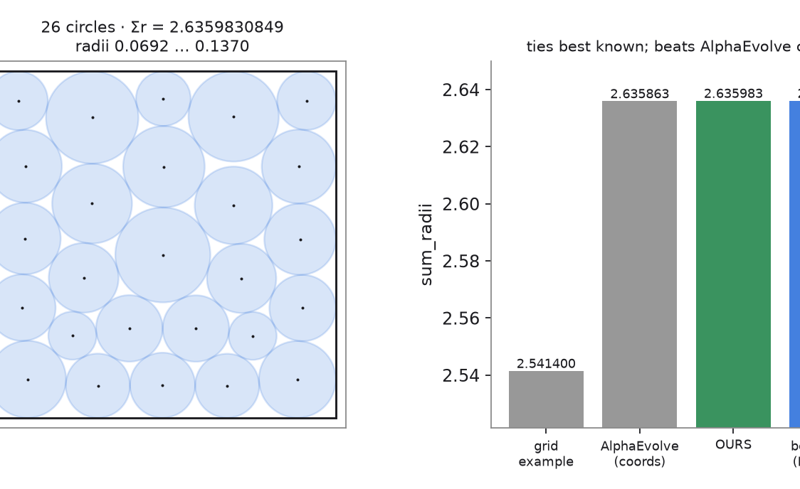
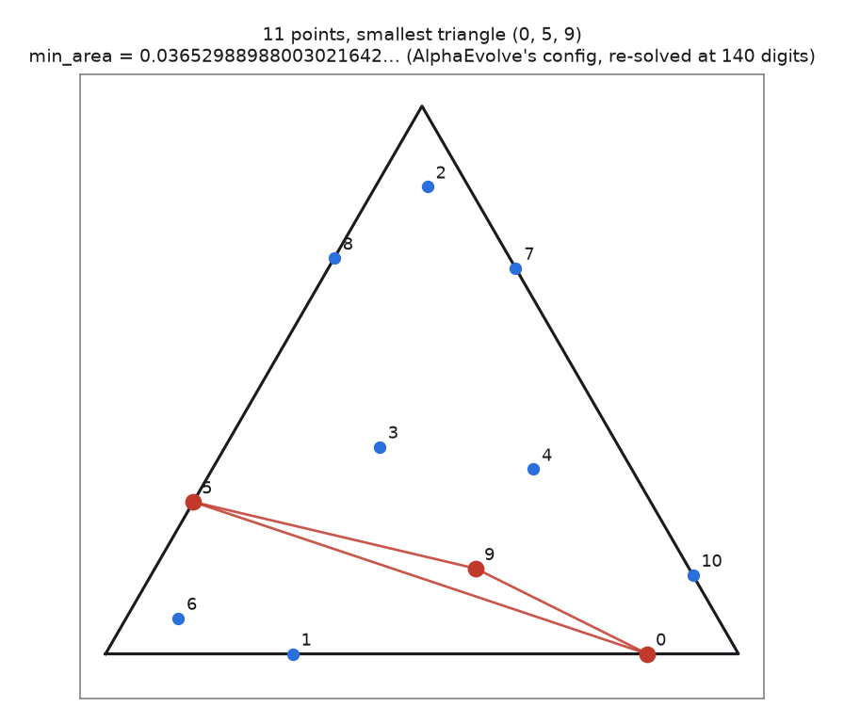
OPTIMIZATION AND SYSTEMS
Three results against their strongest fair comparison
CURRENT PACKING
CURRENT CONFIGURATION
CURRENT BENCHMARK
98×
median speedup over baseline
2.635983084918
0.03652988988
≈ 66–71 GFLOP/s
Best known: 2.635983084919
AlphaEvolve: same configuration
Current baseline: 0.720
A practical tie, 1.4 × 10⁻¹² below the published best.
High-precision reproduction, not a new configuration.
Headline uses the defensible current median; a noisy best run reached 111.30.
Figures and comparison values come from the current verified openmath results.
Notes:
Circle packing ties the best known in practice. Heilbronn reproduces AlphaEvolve's configuration. For the compute kernel, quote the median range because the host timing is noisy.

Slide 7
MODELING AND LIVE DEMO
Finish with measured gains, then prove the build
SHAKESPEARE
PARABOLA POINT CLOUD
2.0394 bpc
0.0256
Challenge baseline: 4.7616 · 57% lower
Challenge baseline: ≈ 0.058 · 2.27× better
Synthetic split; the real hidden score is unavailable.
Direct estimator, not a diffusion model.
lake clean
lake build
Clean state
Kernel checks and axiom audit
github.com/yhinai/openmath
Notes:
These comparisons are challenge baselines, not global state of the art. Say that explicitly. Then switch to the terminal and run lake clean followed by lake build. Point to MatMul3 and Collatz in the output.

