Slide 1
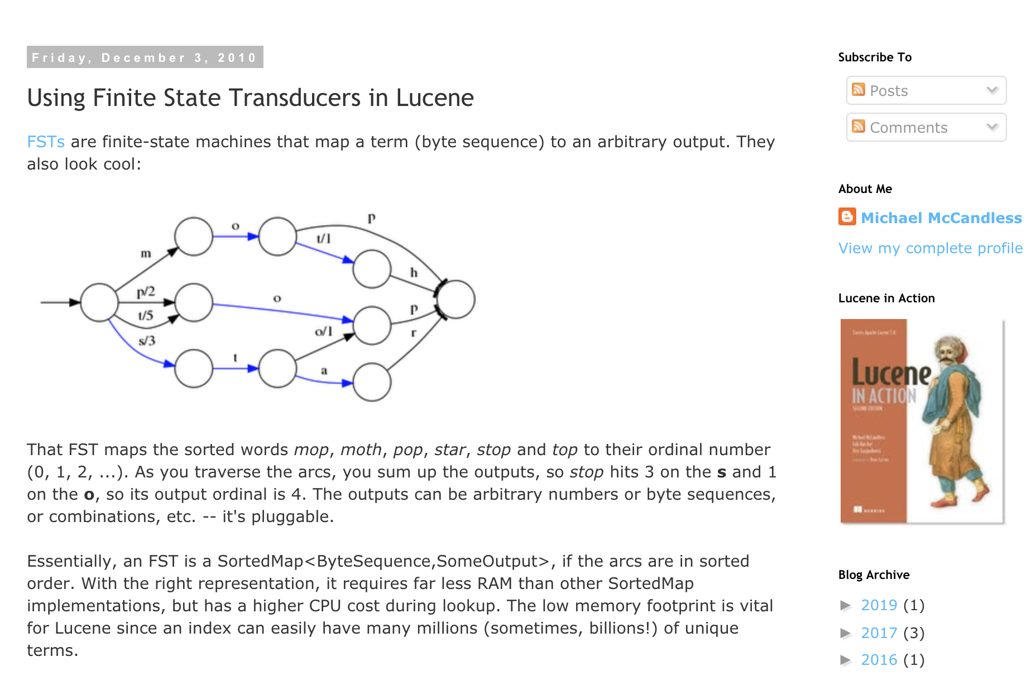

Slide 2
January, 1
Jan, 1
February, 2
Feb, 2
March, 3
Mar, 3
April, 4
Apr, 4
May, 5
June, 6
Jun, 6
July, 7
Jul, 7
August, 8
Aug, 8
September, 8
Sep, 8
October, 10
Oct, 10
November, 11
Nov, 11
December, 12
Dec,12

Slide 3
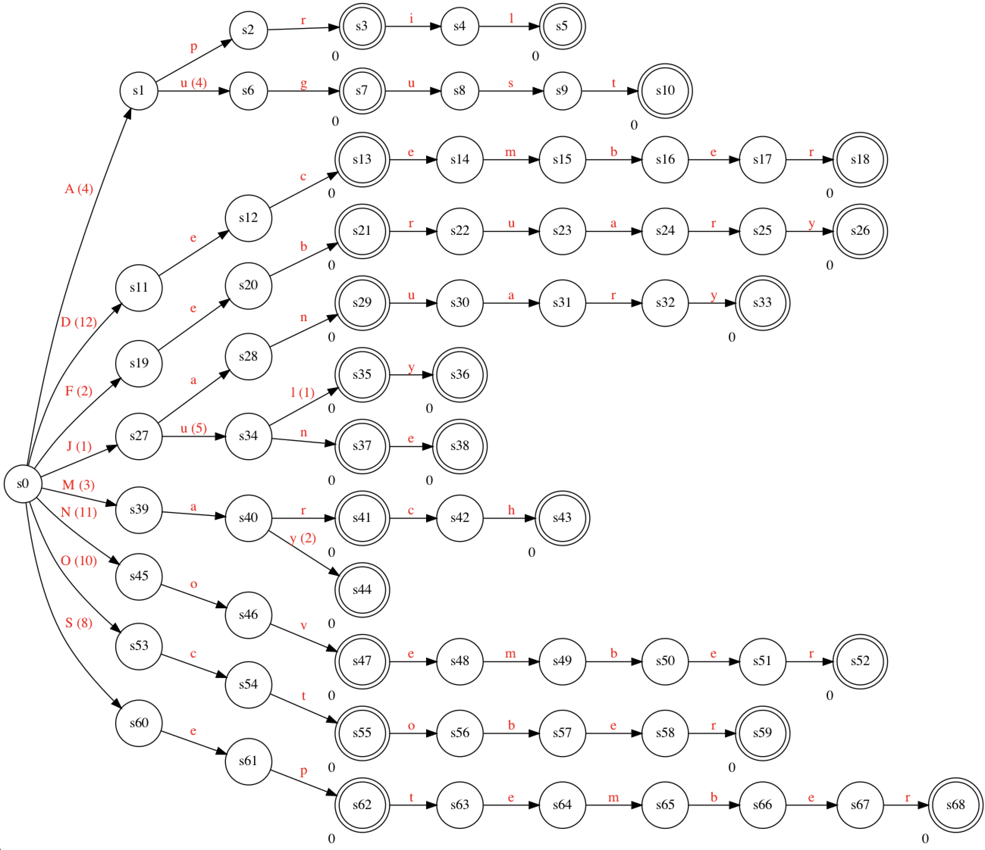
Trie
9

Slide 4
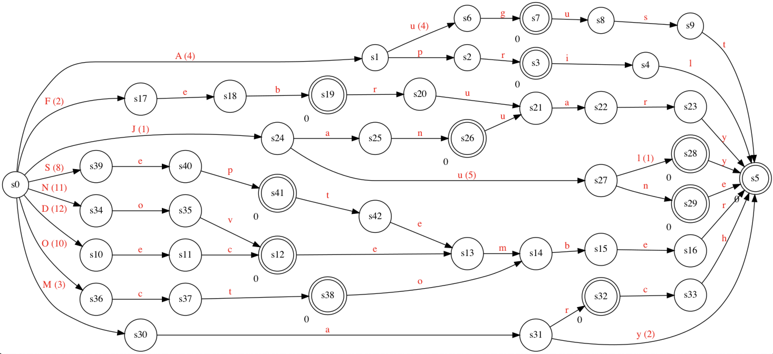
FST
9

Slide 5
Find “July” to get 7
9

Slide 6
Init val: 0
9

Slide 7

J: 1 (+1)
9

Slide 8


Ju: 6 (+5)
9

Slide 9


Jul: 7 (+1)
9

Slide 10


July: 7
9

Slide 11
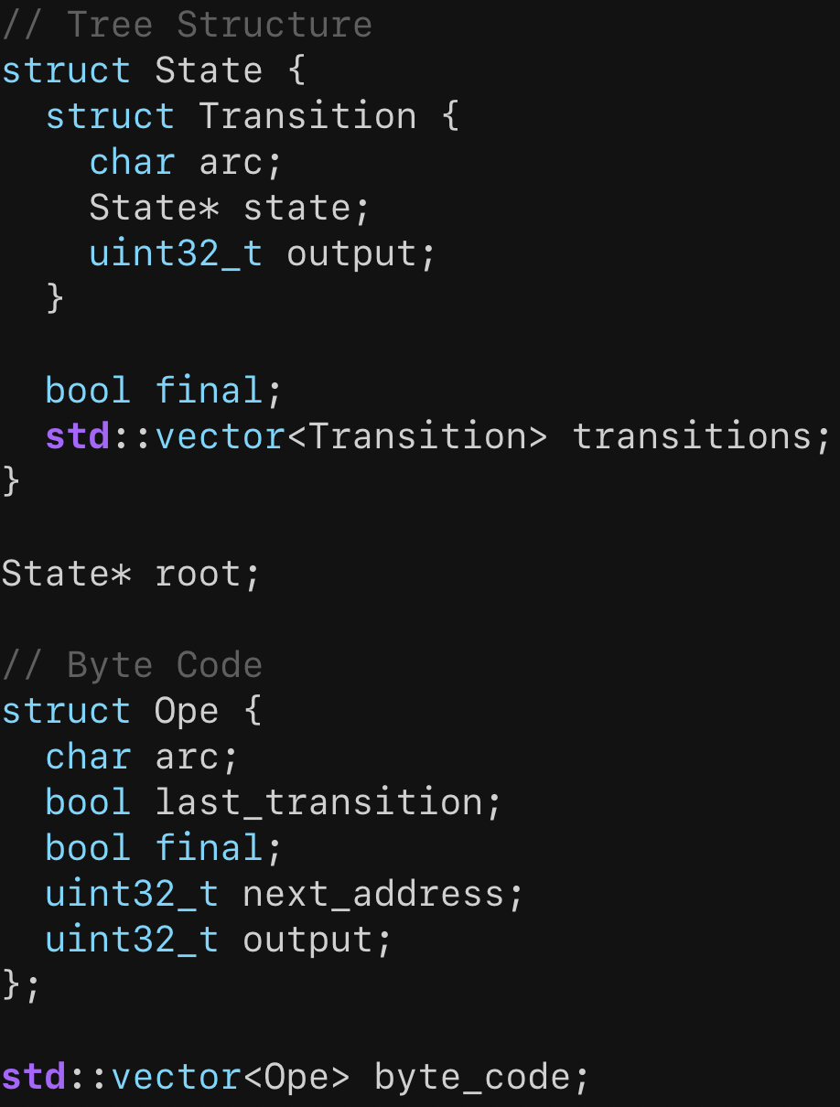


Tree Structure
Contains pointers and containers
Can’t serialize it easily to a file…
Byte Code
Just primitive values
Can directly save it to file
Zero loading time!

Slide 12
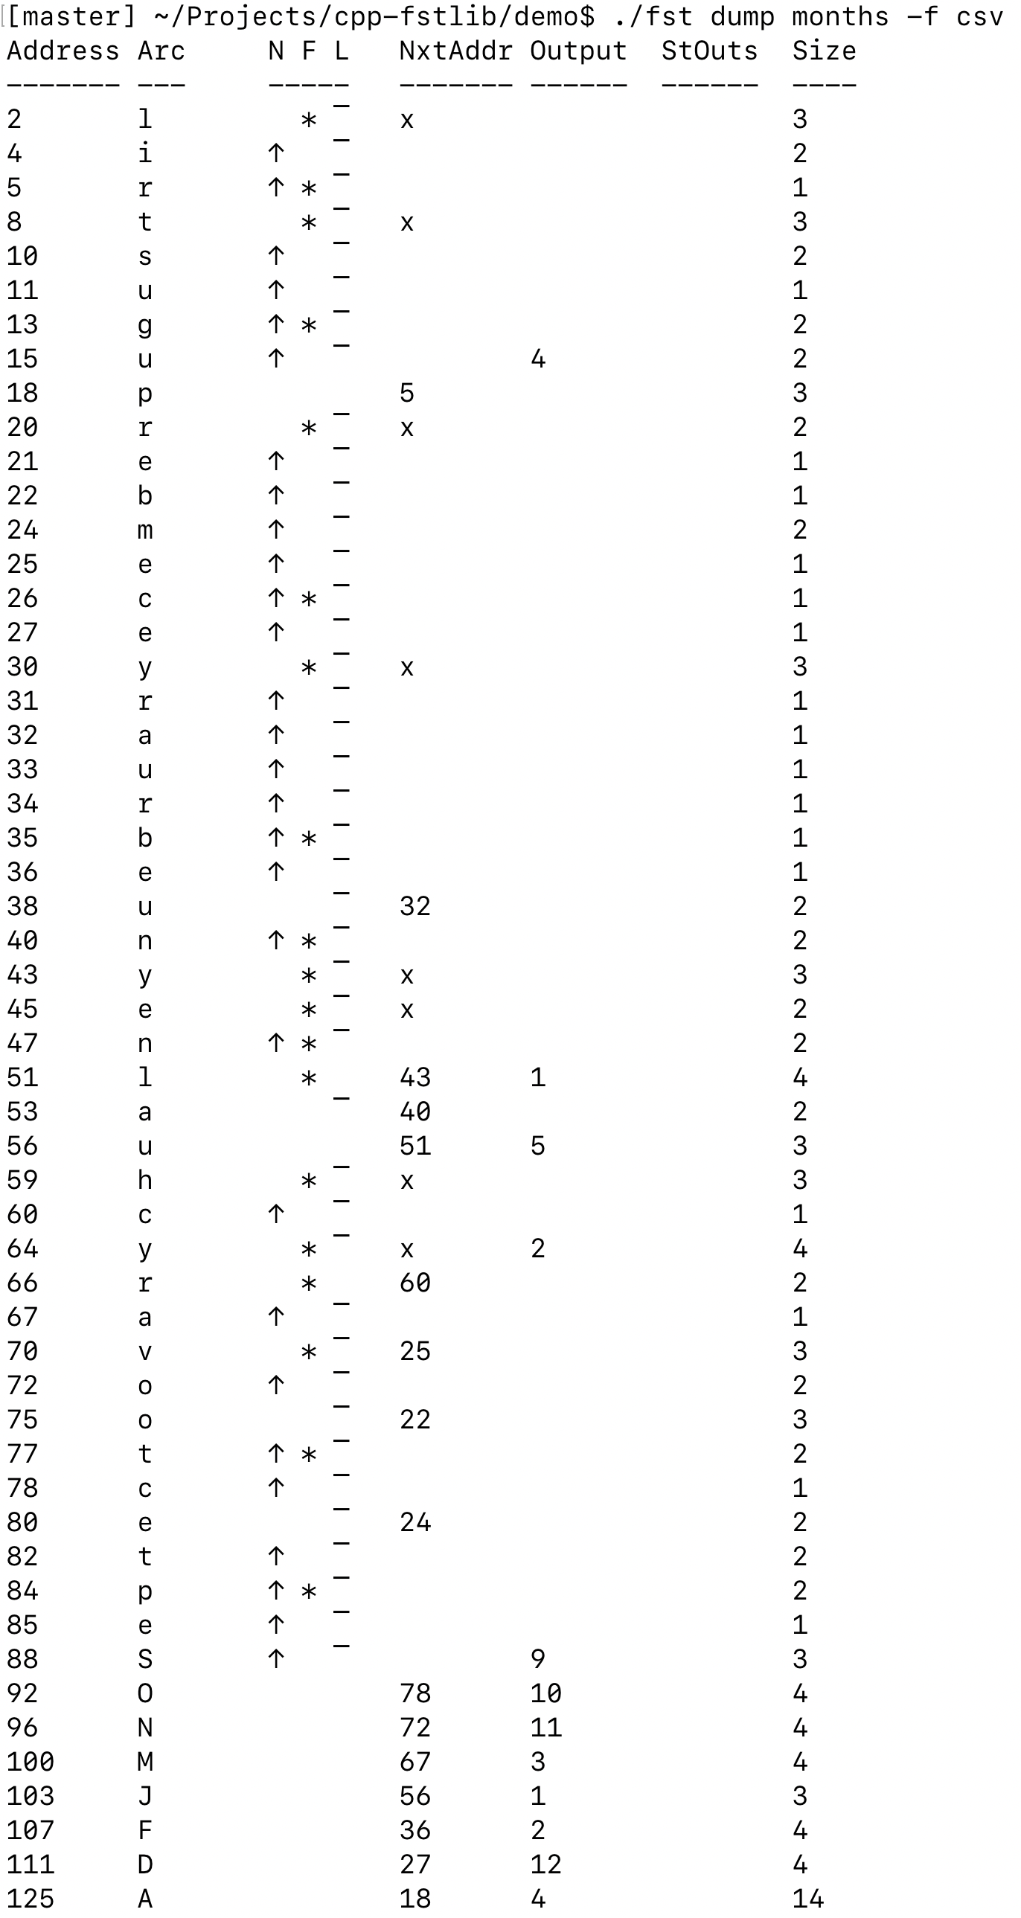
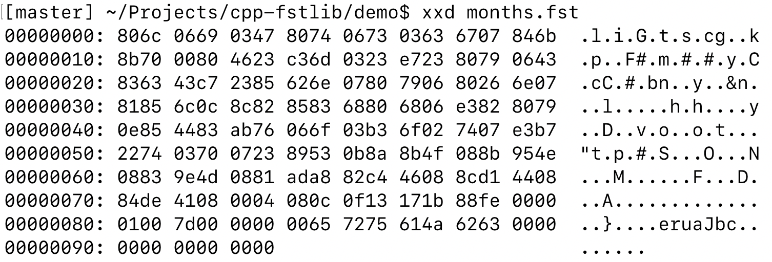

Byte code
Byte code dump
Byte code records are stored in backward order!
N: No next address. Just move to next record
F: Final state (or ‘accepted’)
L: Last transition in a state

Slide 13
FST (Finite State Transducer) library
Trie-like data structure
O(M) access like std::unordered_map
Common prefix match (‘computer programming is fun.’ returns ‘computer’, ‘computer programming’)
Read-only binary database
Zero loading time when lookup
Memory-mapped file friendly
Compact (‘/usr/shared/dict/words’: 2.4M → 1.1M)
Examples that fstlib can do, but std::unordered_map cannot effectively
Keyword extraction (‘Longest common prefix search’)
Word/phrase list dictionary for full-text search library (‘Zero loading time’, ‘Compact’)
cpp-fstlib internals
Compile a source dictionary to byte code, then interpret it when searching
Incremental direct database construction without having a complete set of states on memory
Implemented based on https://blog.burntsushi.net/transducers/. Thanks for the valuable information!

