Slide 1
Space for
School Festival
Project Proposal
Team #16
강경운, 강승구, 남궁수, 서유영, 안정복, 윤혜진

Slide 2
Contents
Intro
Background
Needs
Detailed Implementation Plan
Using Technology
Functions to be produced for each booth
Development
Development Schedule
Role Designation
Reference
Reference for image and information
Project Overview
Our goals
Services
Space for school festival

Slide 3
Intro

Slide 4


Topic
Space for School Festival
- Smart campus in Metaverse
- Can hold or enjoy school festival in VRChat platform
Festival Stage
Exhibition booth

Slide 5
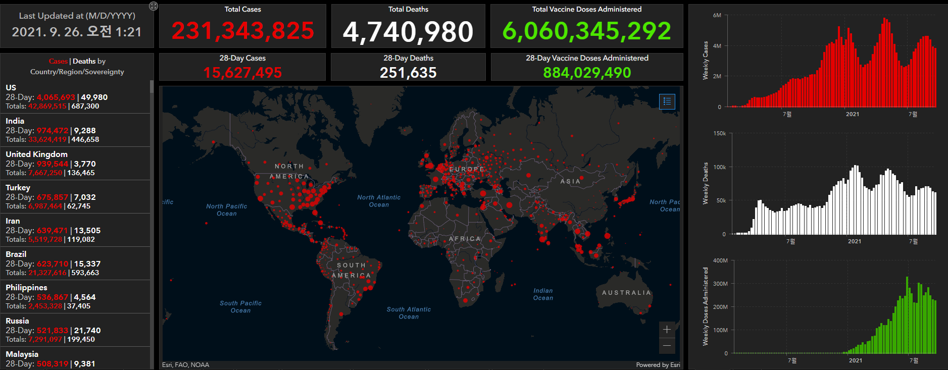
Background
Covid – 19
- Prohibition of gathering
- Increase of non-face-to-face class
- Failure of holding real school festival
- Decrease of interaction between students
Highly infectious COVID-19

Slide 6
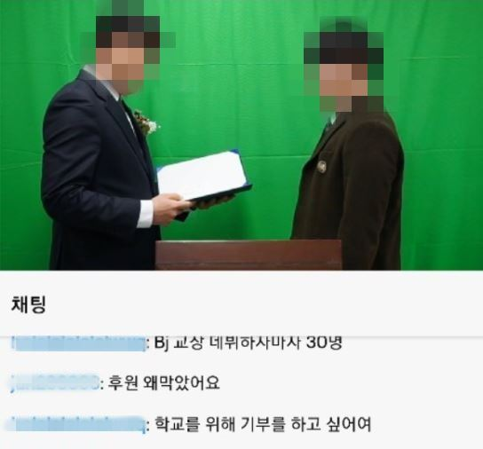
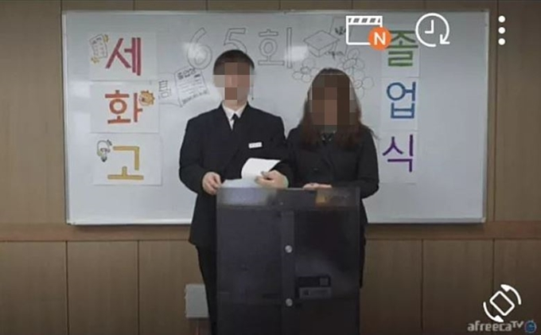
Background
Limits of existing Online School Events
- Mostly via live streaming platform
ex. Youtube, Twitch
- Just watch the live streaming Not participate like real events
- Only can chat or donate
Commencement ceremony via Twitch

Slide 7
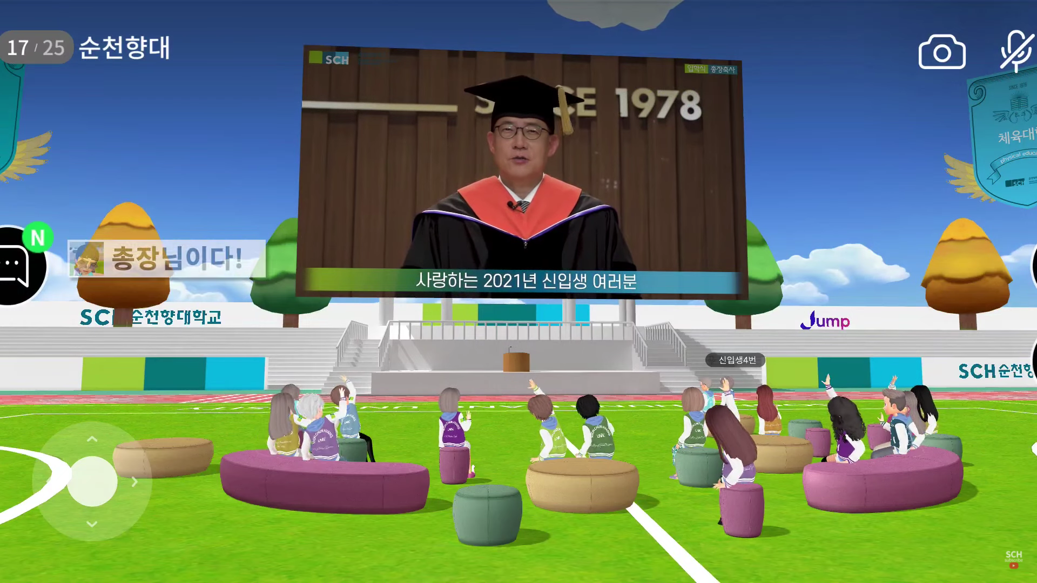
Purpose
Provide a Virtual Space
- Can communicate and interact in face-to-face
Even if they do not meet in person
- Anyone who is the member of university can easily access
Provide a Service
- Exceeds the limits of existing school festivals using live streaming platform
Metaverse entrance ceremony of Soonchunhyang university

Slide 8
Sketchup
Can enjoy school festival using VRCHAT
Screen(show the stage)
Booth setup
Behind stage
Booth setup
Stage(lighting, stage effect, louder mic, permission management, etc.)
Audience(tables, chairs, etc.)

Slide 9


Targets
Students
University

Slide 10
Project Overview

Slide 11
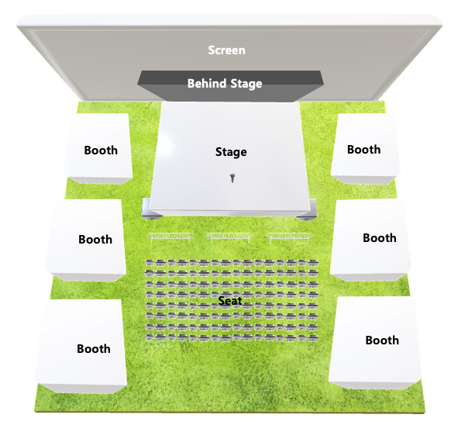
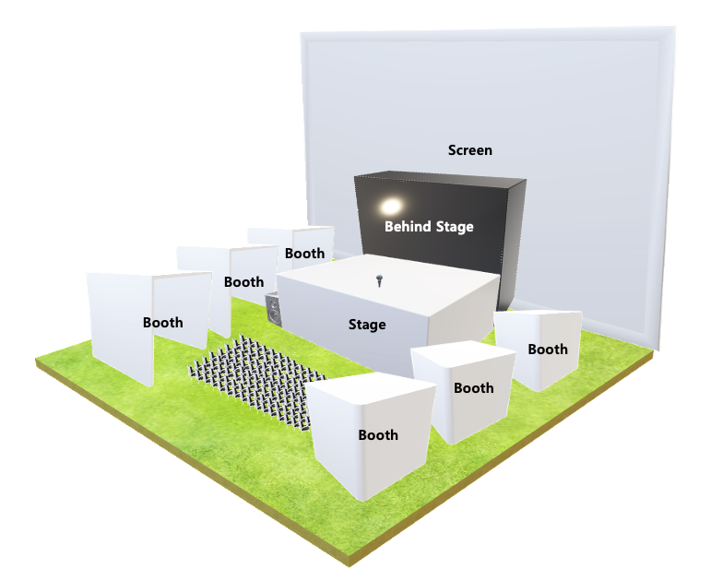
Our Goals
Front
Side
Notes:
https://www.youtube.com/watch?v=egZ4GFftsU4
유니티 홈페이지
Vrchat홈페이지

Slide 12



Services
CONTENTS
CONTENTS
CONTENTS
STAGE
SCREEN
BOOTH
Main Stage
We’re going to hold an event
There’s a raffle every certain time
Participant’s performance
Screen
Stage broadcasting
Display the schedule at both ends of the screen
Booth
Each booth will host a different event
Ex. Game booth, Giveaway booth
Behind Stage
A space to prepare for the event.
Only certain users can enter
Notes:
https://www.youtube.com/watch?v=egZ4GFftsU4
유니티 홈페이지
Vrchat홈페이지

Slide 13
Detailed Implementation Plan

Slide 14


Using Technology
Unity
Game Engine
WYSIWYG tools
Easy to build
Asset store
VRChat
Virtual reality-oriented voice chat software
Easy to custom VR objects
Notes:
https://www.youtube.com/watch?v=egZ4GFftsU4
유니티 홈페이지
Vrchat홈페이지

Slide 15
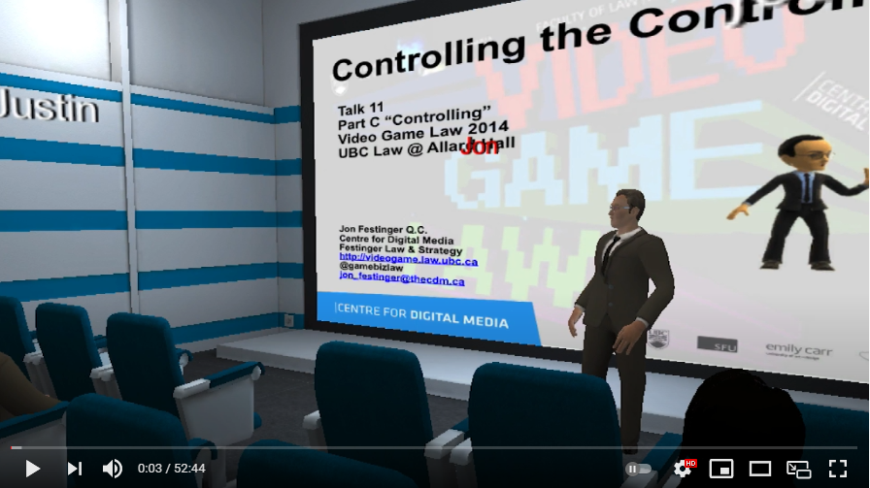

Using Technology(detail)
VR Chat
VR Chat is an open world multi-platform game that allows you to communicate with various people in the form of various avatars on various maps.
The feature is that users can create their own maps, so they can play in a space with a variety of purposes.
Picture below is the example of map for the lecture, and we will use this for the platform of our project.
Unity
Unity is the video game engine.
Maps and avatars of VR Chat can be created through the Unity Engine, so we plan to proceed with the development through Unity Engine.
Notes:
https://www.youtube.com/watch?v=egZ4GFftsU4
유니티 홈페이지
Vrchat홈페이지

Slide 16

Functions to be produced for each object
CONTENTS
SCREEN
Divide the screen into three zones
Middle screen : enlarged video of the main stage
Side screen : schedule table
CONTENTS
Audience
- Chairs and table that users can interact with.
Notes:
https://www.youtube.com/watch?v=egZ4GFftsU4
유니티 홈페이지
Vrchat홈페이지

Slide 17


Functions to be produced for each object
CONTENTS
Main Stage
Implementation of a microphone with sound amplification for progress
Implementation of objects required for performance
Implementation of objects for lottery events
CONTENTS
Behind Stage
Waiting area for people who will participate in the main stage
It is planned to be implemented to create a dramatic effect when it appears connected to the stage
Notes:
https://www.youtube.com/watch?v=egZ4GFftsU4
유니티 홈페이지
Vrchat홈페이지

Slide 18


Functions to be produced for each object
CONTENTS
Booth
Implementation of booth for various game
  For example, battle of typing speed
Implementation of booth for various events
  For example, stamping from other booths
In the future, more diverse and specific types of games and events will be developed
CONTENTS
Off-Stage Functions
Provision of information such as schedules and announcements upon entry
Photo and video shooting function
Notes:
https://www.youtube.com/watch?v=egZ4GFftsU4
유니티 홈페이지
Vrchat홈페이지

Slide 19
Development

Slide 20
Development Schedule
Proposal
Requirement specification
Design specification
Implementation
Development, Evaluation, Integration
9/26
10/24
11/14
11/14
~12/5
12/5

Slide 21
Role Designation
Development
강경운, 강승구, 남궁수, 서유영, 안정복
Assistant, Report
윤혜진

Slide 22
Reference
https://www.youtube.com/watch?v=egZ4GFftsU4
https://unity.com/
https://hello.vrchat.com/
https://www.flaticon.com/
https://coronavirus.jhu.edu/map.html
https://www.hankookilbo.com/News/Read/202001311734745958
https://www.youtube.com/watch?v=1A559Hcr90g

