Slide 1
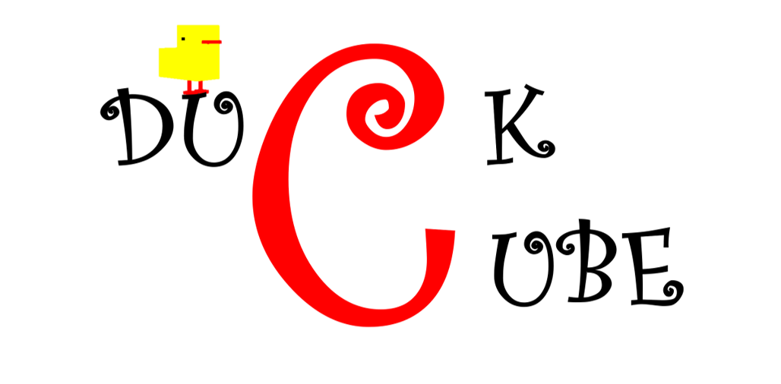
Dr. Yul-jeon Gomguk
Software
2017311666 Yoon HyeJin
2018311882 Yoon SoHee

Slide 2

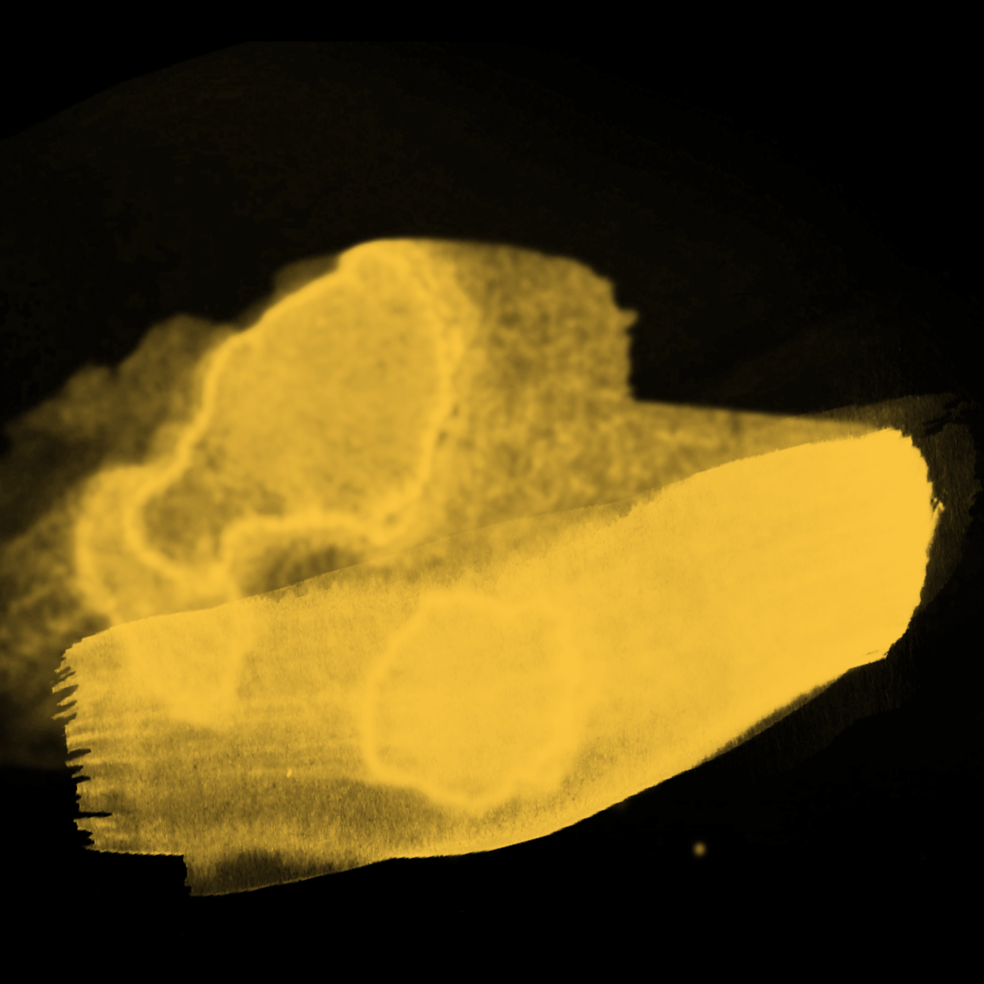
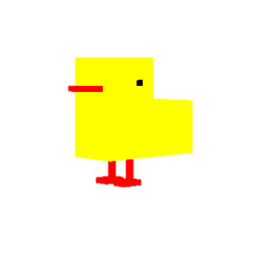
Contents
01
Introduction
02
Demo
03
Implementation

Slide 3
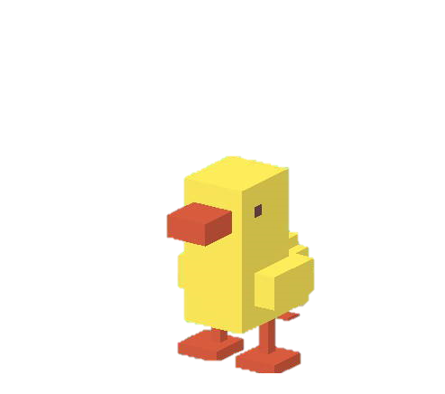
01
Introduction
Game Info
Game name: Duck Cube
Game Type: 3D Maze
Design: From ‘길 건너 친구들‘
Goal: start from blue cube, arrive to red cube

Slide 4
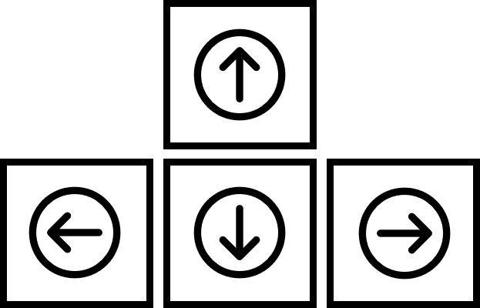



02
Demo
moving – character:
arrow key: moving
shift key: dash
space key: crying
moving – map:
a, d: map rotation
s: map reverse

Slide 5


02
Demo
Let’s Play The Game!!

Slide 6
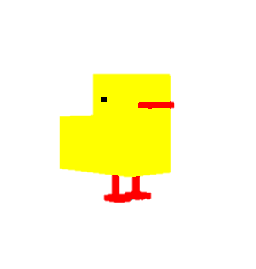
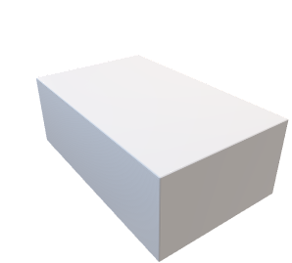
03
Implementation
Character
y
Index Buffering
2
1
5
x
0
3
4
z
divide into triangle on every side of a rectangular
Positioning in counterclockwise direction
composed of cubes
Create character using vertex that make up duck

Slide 7
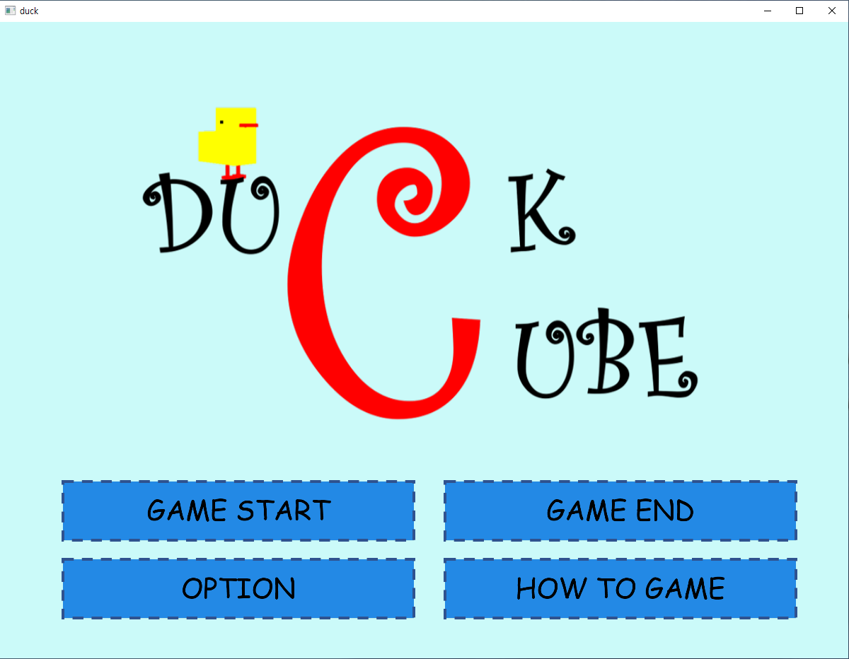
03
Implementation
GUI
“dear imgui”
Insert and position game logo and button UI

Slide 8
03
Implementation
GUI
“dear imgui”
Insert an invisible button over the game button UI

Slide 9
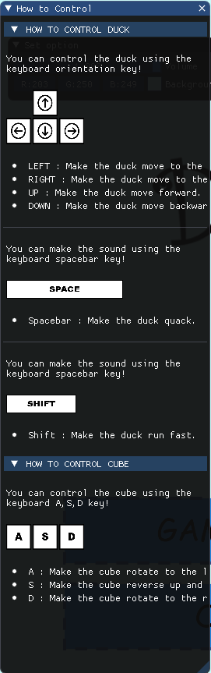
03
Implementation
GUI
“dear imgui”
Create Collapsing Header Effect

Slide 10
03
Implementation
GUI
“dear imgui”
Insert Image

Slide 11
03
Implementation
GUI
“dear imgui”
Wrap Text

Slide 12
03
Implementation
GUI
“dear imgui”
Add Bullets to Text

Slide 13
03
Implementation
GUI
“dear imgui”
Insert Seperator

Slide 14

03
Implementation
GUI
“dear imgui”
Insert slider for volume adjustment

Slide 15
03
Implementation
GUI
“dear imgui”
RGB controller for background color adjustment

Slide 16
03
Implementation
Text & Sound
“str_truetype & irrklang”

Slide 17
03
Implementation
Duck Moving
Declare boolean variables – input & wait for release

Slide 18
03
Implementation
Collision & Gravity

Slide 19
03
Implementation
Moving Map
Animation occur every (animation time)/(animation count)
Moves (pi/2 or moving distance)/(animation count) every time

Slide 20
03
Implementation
Minimap
Map rotation and sphere translating

Slide 21
Thank you

