Slide 1
Ontology Based Context Modeling and Reasoning using OWL
Xiao Hang Wang, Da Qing Zhang, Tao Gu, Hung Keng Pung
Institute for Infocom Research, Singapore
School of Computing, National University of Singapore
Sangkeun Lee IDS Lab.

Slide 2
Introduction
Context-awareness
  an important step in pervasive computing
Increasing need for developing formal context model to facilitate
  Context Representation
  Context Sharing
  Interoperability of heterogeneous systems
Center for E-Business Technology
IDS Lab. Seminar - <number>

Slide 3
Introduction: Previous Works
Various context data models
  Context Toolkit: Attribute-value Tuples
  CoolTown: Web based data model
    each object has a corresponding Web description
  Karen et al: ER and UML
  Gaia: First-order pridicates written in DAML+OIL
However,
  None of them has addressed
    Formal knowledge sharing
    Quantitative evaluation for the feasibility of context reasoning in pervasive computing environments
Center for E-Business Technology
IDS Lab. Seminar - <number>

Slide 4
Introduction: What’s in this paper?
In this paper, the authors present
  An ontology-based formal context model to address critical issues
    Formal context representation
    Knowledge sharing
    Logic based context reasoning
  Detailed design of their context model and logic based reasoning scheme
  Quantitative evaluation for context reasoning in pervasive computing
Center for E-Business Technology
IDS Lab. Seminar - <number>

Slide 5
Why Ontology Model?
Ontology
  The shared understanding of some domains
  Often conceived as a set of entities, relations, functions, axioms and instances
Reasons for developing context models based on ontology
  Knowledge sharing
    The use of context ontology enables computational entities to have a common set of concepts about context
  Logic Inference
    Context aware computing can exploit various existing logic reasoning mechanisms
  Knowledge reuse
    We can compose large-scale context ontology without starting from scratch
Center for E-Business Technology
IDS Lab. Seminar - <number>

Slide 6
CONON: The Context Ontology
Fundamental: Location, User, Activity, Computational Entity
  Skeleton of context
  Act as indices into associated information
Upper Ontology
  Context in each domain shares common concepts
  Encourages the reuse of general concepts
  Provides flexible interface for defining application-specific knowledge
Center for E-Business Technology
IDS Lab. Seminar - <number>

Slide 7
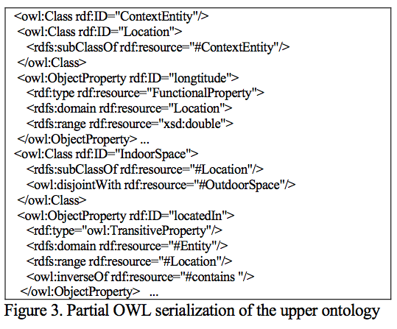
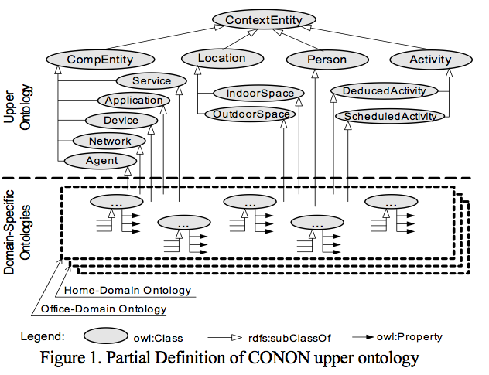
CONON Upper Ontology
Center for E-Business Technology
IDS Lab. Seminar - <number>

Slide 8
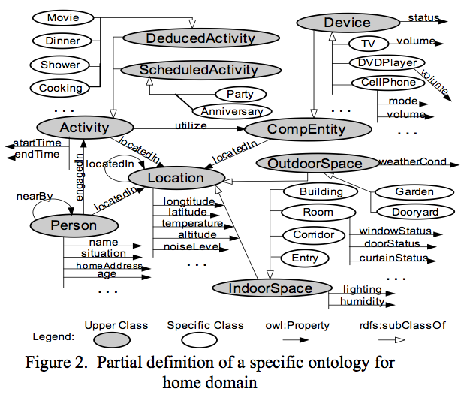
Specific Ontology for Home Domain
Center for E-Business Technology
IDS Lab. Seminar - <number>

Slide 9
Context Reasoning
The authors present a smart phone scenario
  E.g. when the user is sleeping in the bedroom or taking a shower in the bathroom, incoming calls are forwarded to voice mail box
The use of context reasoning has two folds
  Checking the consistency of context
  Deducing high-level implicit context from low-level explicit context
Two categories of context reasoning
  Ontology reasoning
  User-defined reasoning
Center for E-Business Technology
IDS Lab. Seminar - <number>

Slide 10
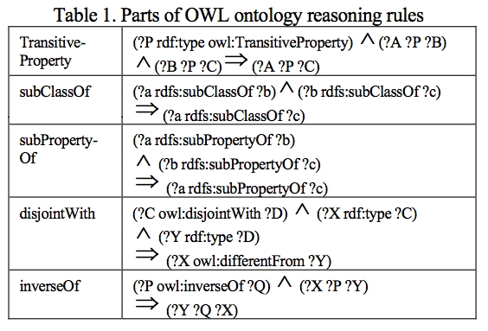
Ontology Reasoning
Center for E-Business Technology
IDS Lab. Seminar - <number>

Slide 11
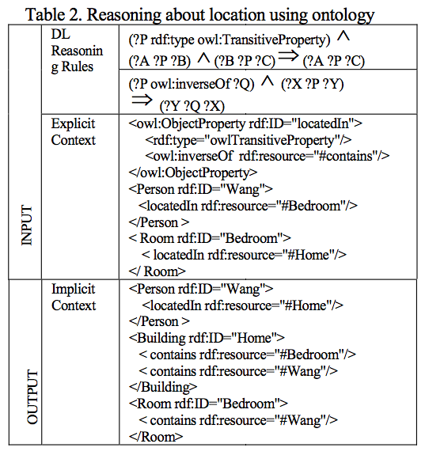
Example: Ontology reasoning
Center for E-Business Technology
IDS Lab. Seminar - <number>

Slide 12
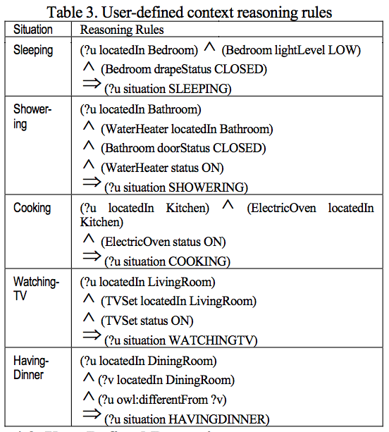
User-defined Context Reasoning
Center for E-Business Technology
IDS Lab. Seminar - <number>

Slide 13
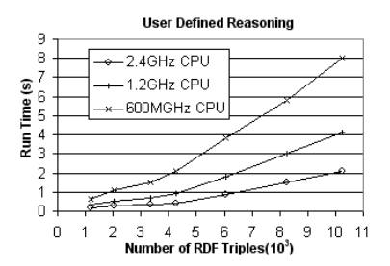
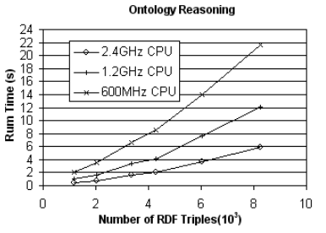
Experiment
The prototype context reasoners are built using Jena2
Center for E-Business Technology
IDS Lab. Seminar - <number>

Slide 14
Discussion
Three major factors
  Size of context information
  Complexity of reasoning rules
  CPU speed
The authors insist that it is feasible for non-time-critical applications
  For time-critical applications such as security and navigating systems
  We need to control the scale of context dataset and the complexity of rule set
  Off-line manner static complex reasoning tasks
De-coupling context processing and context usage is needed in order to achieve satisfactory performance
The design of context model should take account of scalability issue
Center for E-Business Technology
IDS Lab. Seminar - <number>

Slide 15
Questions
The major factors
  Size of context information
    Enhanced CoCA: heuristics (loading only relevant context data)
  Complexity of reasoning rules
  CPU speed: Not our concern
  How can we control the complexity of reasoning rules?
  We need to define the minimal set of rule language
    Expressively powerful enough to be used in actual context-aware system
    Guarantees acceptable performance
  Is there a way of applying only relevant reasoning rules?
  What happen if the user-defined rule becomes no longer satisfied?
  Presented system doesn’t consider
Center for E-Business Technology
IDS Lab. Seminar - <number>

Slide 16
Conclusions
OWL encoded context Ontology (CONON)
  Modeling context in pervasive computing environment
  Logic based context reasoning
  Upper Ontology + Domain-specific Ontology
Prototype implementation and Experiment
  Feasible for non-time-critical applications
  Discussion: what we need to care for time-critical applications
Center for E-Business Technology
IDS Lab. Seminar - <number>

