Slide 1


2025 제 6회 전자구조계산 여름학교 Lab Session: 환경 설정 및 패키지 설치 2025.07.14
Dr. Joonho Park & Prof. Yong-Hoon Kim
School of Electrical Engineering
Korea Advanced Institute of Science & Technology (KAIST)
y.h.kim@kaist.ac.kr

Slide 2
목 차
Linux 환경 만들기
Edison 웹 페이지
https://nano2.edison.re.kr/
JupyterLab terminal
Etc
Server, linux, WSL
패키지 설치
Atom
Siesta
QE
Version 7.4
Version 7.3 + patch
Notes:
HfSeO(amorphous)/HfSe2 interface: when O atoms are inserted at the interface through the hole in the amorphous oxide layer during plasma oxidation, HfSe2 layer under oxide layer are easily oxidized. O atoms are barrierlessly and spontaneously penetrate into the HfSe2 layer and oxidize Hf atom generating a great amount of heat while Se atoms are extracted to outside of Hf-O core.
HfSeO(amorphous)/MoS2 interface: When O atoms are dropped on MoS2 surface, they are bound to top of S atom. While O atoms are largely vibrating due to thermal energy, they are adsorbed on to amorphous oxide layer because O atoms are largely stabilized in the Hf-O network of HfO2 layer.
HfSeO(amorphous)/WSe2 interface: similar to the case of MoS2.
O atoms on the MoS2 (WSe2) surface are bound to top of S (Se) atom and cannot break Mo-S (W-Se) bond to oxidize the substrate.

Slide 3
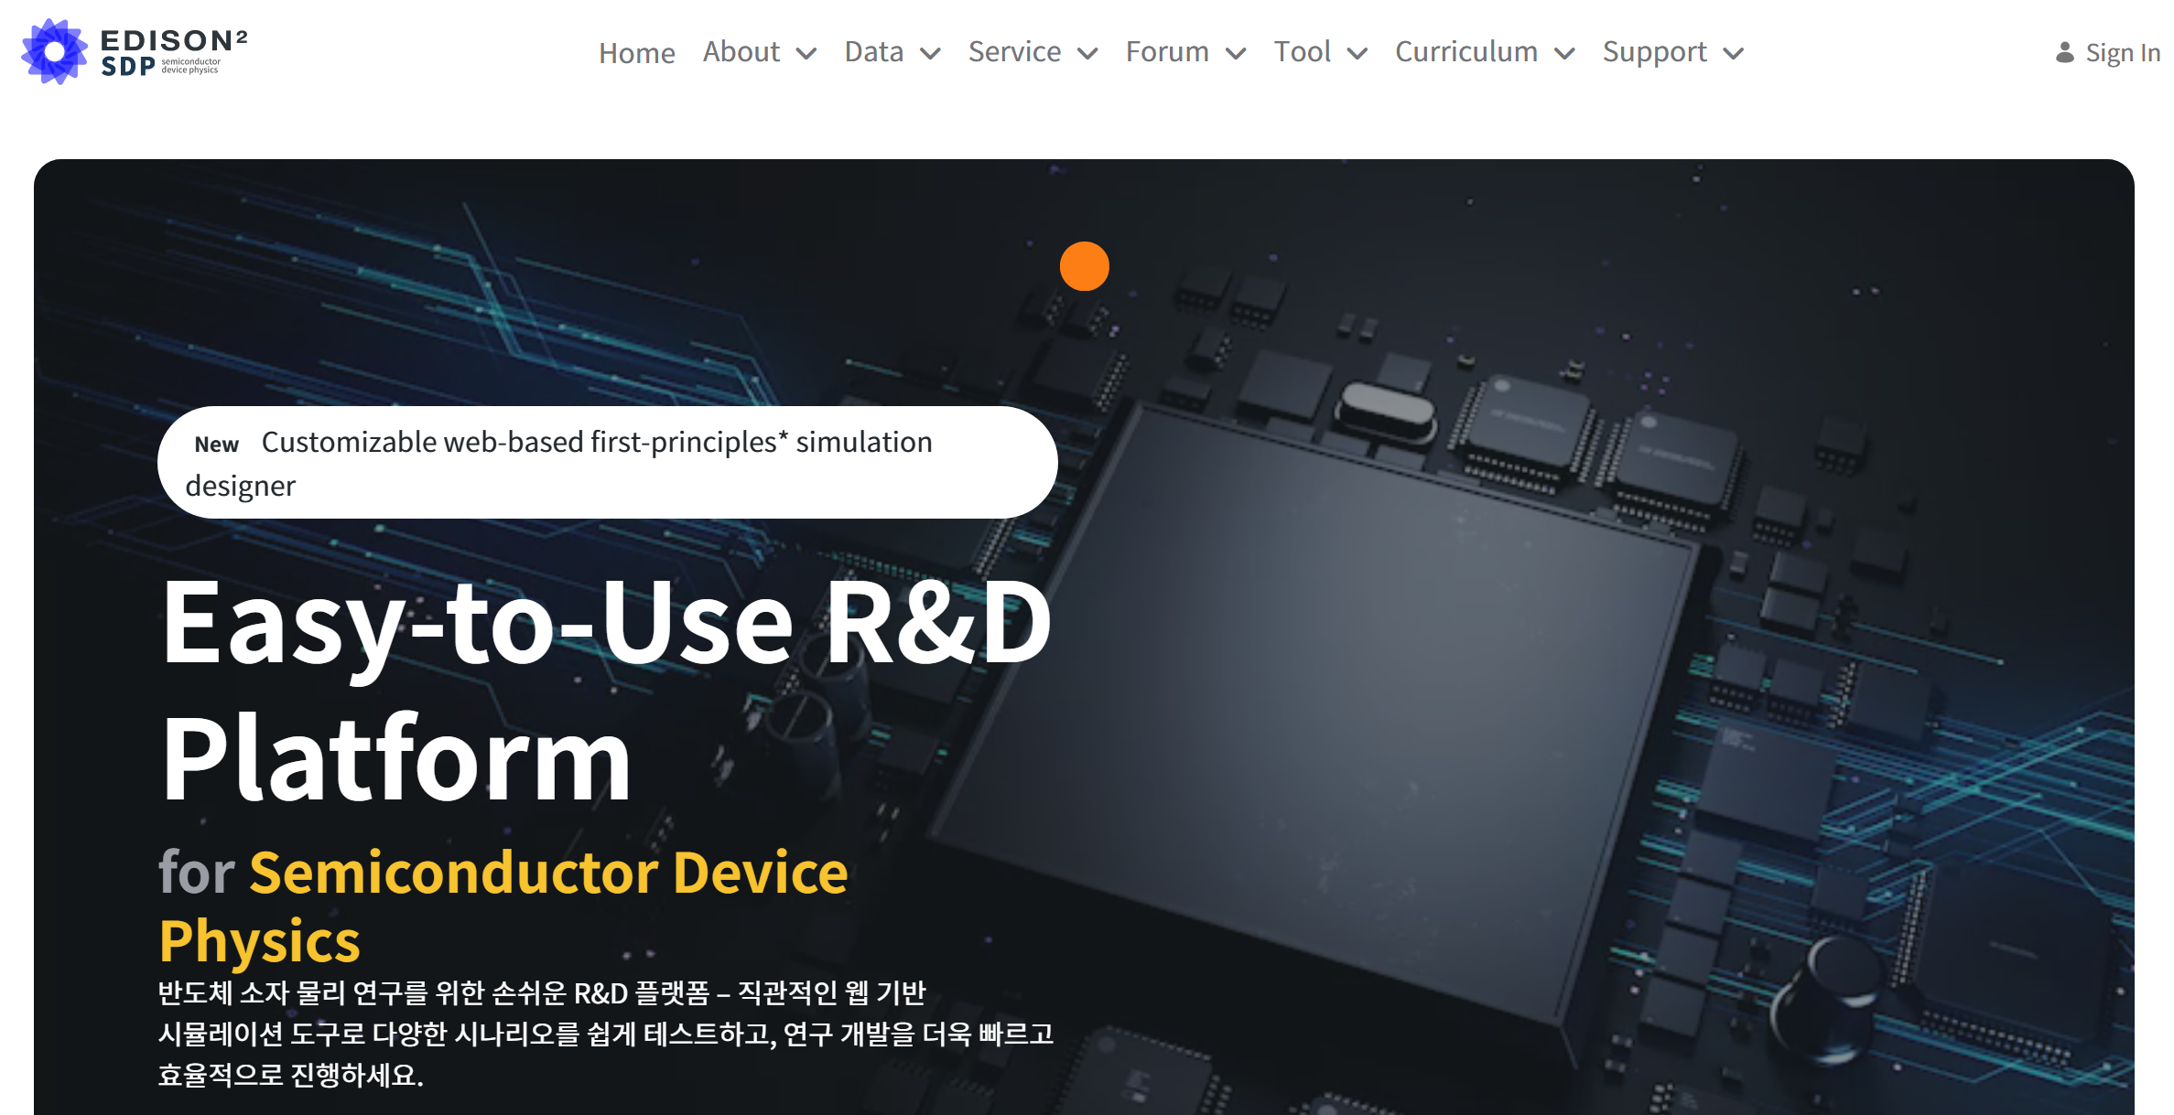
1-1 환경 설정 - Edison
Edison 웹 페이지: https://nano2.edison.re.kr/
1. 계정 만들기
Notes:
HfSeO(amorphous)/HfSe2 interface: when O atoms are inserted at the interface through the hole in the amorphous oxide layer during plasma oxidation, HfSe2 layer under oxide layer are easily oxidized. O atoms are barrierlessly and spontaneously penetrate into the HfSe2 layer and oxidize Hf atom generating a great amount of heat while Se atoms are extracted to outside of Hf-O core.
HfSeO(amorphous)/MoS2 interface: When O atoms are dropped on MoS2 surface, they are bound to top of S atom. While O atoms are largely vibrating due to thermal energy, they are adsorbed on to amorphous oxide layer because O atoms are largely stabilized in the Hf-O network of HfO2 layer.
HfSeO(amorphous)/WSe2 interface: similar to the case of MoS2.
O atoms on the MoS2 (WSe2) surface are bound to top of S (Se) atom and cannot break Mo-S (W-Se) bond to oxidize the substrate.

Slide 4
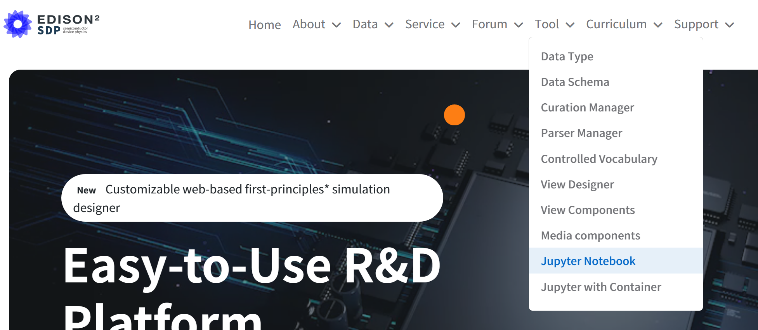
1-1 환경 설정 - Edison/JupyterLab
Edison 웹 페이지: https://nano2.edison.re.kr/
2. JupyterLab 열기
Menu:Tool/Jupyter Notebook
Notes:
HfSeO(amorphous)/HfSe2 interface: when O atoms are inserted at the interface through the hole in the amorphous oxide layer during plasma oxidation, HfSe2 layer under oxide layer are easily oxidized. O atoms are barrierlessly and spontaneously penetrate into the HfSe2 layer and oxidize Hf atom generating a great amount of heat while Se atoms are extracted to outside of Hf-O core.
HfSeO(amorphous)/MoS2 interface: When O atoms are dropped on MoS2 surface, they are bound to top of S atom. While O atoms are largely vibrating due to thermal energy, they are adsorbed on to amorphous oxide layer because O atoms are largely stabilized in the Hf-O network of HfO2 layer.
HfSeO(amorphous)/WSe2 interface: similar to the case of MoS2.
O atoms on the MoS2 (WSe2) surface are bound to top of S (Se) atom and cannot break Mo-S (W-Se) bond to oxidize the substrate.

Slide 5
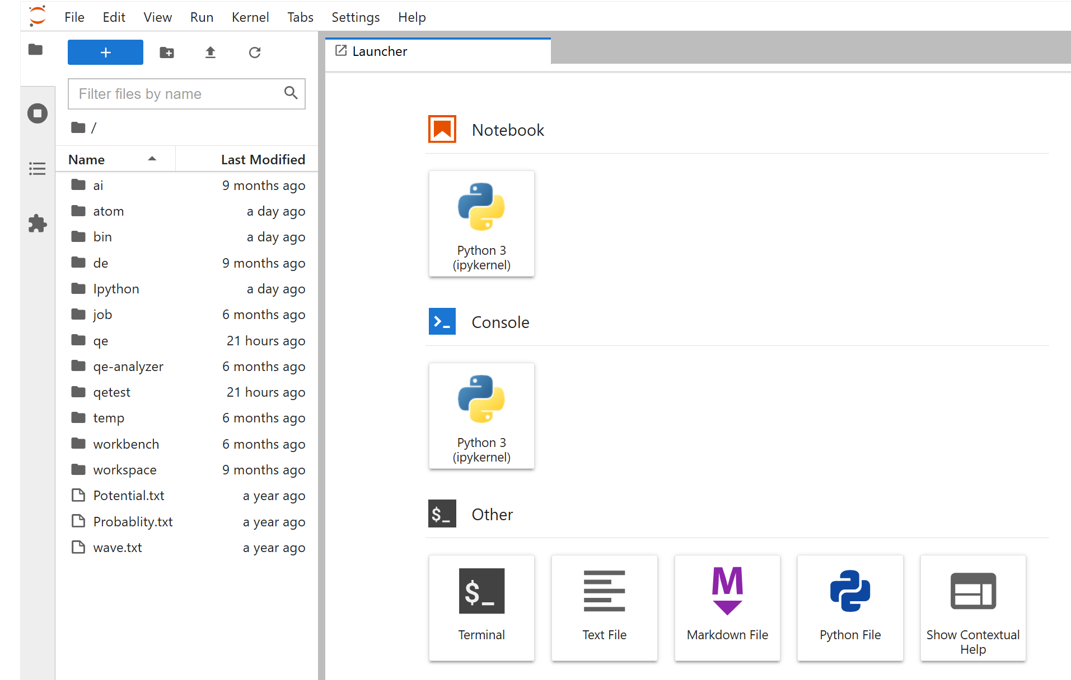
1-1 환경 설정 - Edison/JupyterLab
3. JupyterLab 실습
JupyterLab: Menu, File browser, Workspace
Menu: File/New or [ + ] icon 클릭 → New tab
Workspace: Tab으로 notebook, terminal 등이 열림
File browser: .txt, .ipynb, .csv, .png (그림파일) 등은 바로 열림
Notes:
HfSeO(amorphous)/HfSe2 interface: when O atoms are inserted at the interface through the hole in the amorphous oxide layer during plasma oxidation, HfSe2 layer under oxide layer are easily oxidized. O atoms are barrierlessly and spontaneously penetrate into the HfSe2 layer and oxidize Hf atom generating a great amount of heat while Se atoms are extracted to outside of Hf-O core.
HfSeO(amorphous)/MoS2 interface: When O atoms are dropped on MoS2 surface, they are bound to top of S atom. While O atoms are largely vibrating due to thermal energy, they are adsorbed on to amorphous oxide layer because O atoms are largely stabilized in the Hf-O network of HfO2 layer.
HfSeO(amorphous)/WSe2 interface: similar to the case of MoS2.
O atoms on the MoS2 (WSe2) surface are bound to top of S (Se) atom and cannot break Mo-S (W-Se) bond to oxidize the substrate.

Slide 6
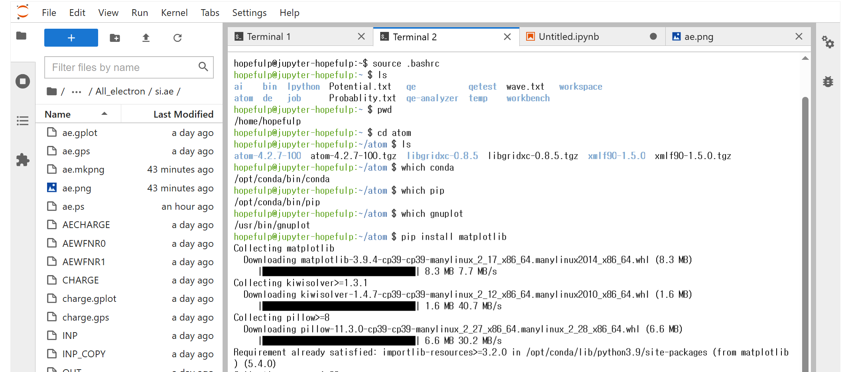
1-2 JupyterLab-Terminal
4. Terminal
Linux 사용
https://yhkimlab.github.io/YHKimLabWiki/site/other/1.1_LinuxCheatSheet/
Notes:
HfSeO(amorphous)/HfSe2 interface: when O atoms are inserted at the interface through the hole in the amorphous oxide layer during plasma oxidation, HfSe2 layer under oxide layer are easily oxidized. O atoms are barrierlessly and spontaneously penetrate into the HfSe2 layer and oxidize Hf atom generating a great amount of heat while Se atoms are extracted to outside of Hf-O core.
HfSeO(amorphous)/MoS2 interface: When O atoms are dropped on MoS2 surface, they are bound to top of S atom. While O atoms are largely vibrating due to thermal energy, they are adsorbed on to amorphous oxide layer because O atoms are largely stabilized in the Hf-O network of HfO2 layer.
HfSeO(amorphous)/WSe2 interface: similar to the case of MoS2.
O atoms on the MoS2 (WSe2) surface are bound to top of S (Se) atom and cannot break Mo-S (W-Se) bond to oxidize the substrate.

Slide 7
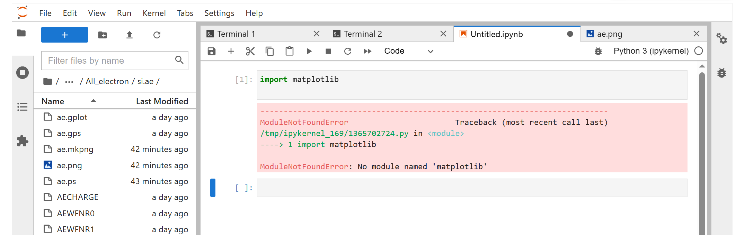
1-2 JupyterLab-ipynb
5. Jupyter notebook
Encode python script
모듈 설치는 터미널에서 pip을 이용
Notes:
HfSeO(amorphous)/HfSe2 interface: when O atoms are inserted at the interface through the hole in the amorphous oxide layer during plasma oxidation, HfSe2 layer under oxide layer are easily oxidized. O atoms are barrierlessly and spontaneously penetrate into the HfSe2 layer and oxidize Hf atom generating a great amount of heat while Se atoms are extracted to outside of Hf-O core.
HfSeO(amorphous)/MoS2 interface: When O atoms are dropped on MoS2 surface, they are bound to top of S atom. While O atoms are largely vibrating due to thermal energy, they are adsorbed on to amorphous oxide layer because O atoms are largely stabilized in the Hf-O network of HfO2 layer.
HfSeO(amorphous)/WSe2 interface: similar to the case of MoS2.
O atoms on the MoS2 (WSe2) surface are bound to top of S (Se) atom and cannot break Mo-S (W-Se) bond to oxidize the substrate.

Slide 8
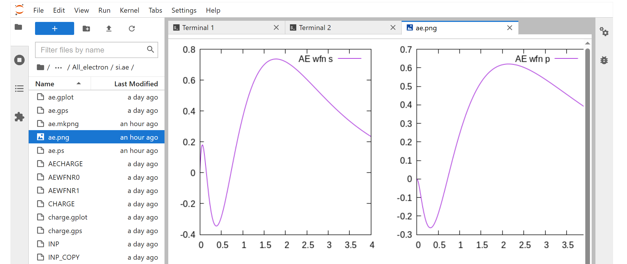
1-2 JupyterLab - png 그림 파일
5. png file
Terminal에서 작업 후 png 파일 생성시 가시화
Notes:
HfSeO(amorphous)/HfSe2 interface: when O atoms are inserted at the interface through the hole in the amorphous oxide layer during plasma oxidation, HfSe2 layer under oxide layer are easily oxidized. O atoms are barrierlessly and spontaneously penetrate into the HfSe2 layer and oxidize Hf atom generating a great amount of heat while Se atoms are extracted to outside of Hf-O core.
HfSeO(amorphous)/MoS2 interface: When O atoms are dropped on MoS2 surface, they are bound to top of S atom. While O atoms are largely vibrating due to thermal energy, they are adsorbed on to amorphous oxide layer because O atoms are largely stabilized in the Hf-O network of HfO2 layer.
HfSeO(amorphous)/WSe2 interface: similar to the case of MoS2.
O atoms on the MoS2 (WSe2) surface are bound to top of S (Se) atom and cannot break Mo-S (W-Se) bond to oxidize the substrate.

Slide 9
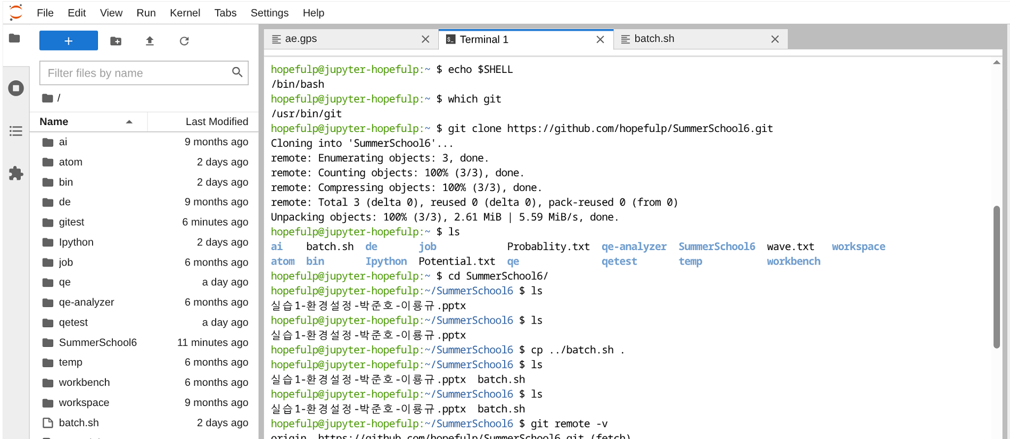
1-2 JupyterLab – Download/Upload
6. 자료 download
git clone https://github.com/yhkimlab/ESCSchool.git
매뉴얼 찾아 오른쪽 마우스로 Download
source batch.sh
Text 파일 → double click으로 열기 → 수정
7. 파일 upload
Icon 이용 파일 upload
Notes:
HfSeO(amorphous)/HfSe2 interface: when O atoms are inserted at the interface through the hole in the amorphous oxide layer during plasma oxidation, HfSe2 layer under oxide layer are easily oxidized. O atoms are barrierlessly and spontaneously penetrate into the HfSe2 layer and oxidize Hf atom generating a great amount of heat while Se atoms are extracted to outside of Hf-O core.
HfSeO(amorphous)/MoS2 interface: When O atoms are dropped on MoS2 surface, they are bound to top of S atom. While O atoms are largely vibrating due to thermal energy, they are adsorbed on to amorphous oxide layer because O atoms are largely stabilized in the Hf-O network of HfO2 layer.
HfSeO(amorphous)/WSe2 interface: similar to the case of MoS2.
O atoms on the MoS2 (WSe2) surface are bound to top of S (Se) atom and cannot break Mo-S (W-Se) bond to oxidize the substrate.

Slide 10
2-1. 패키지 설치 – Atom
Github
https://yhkimlab.github.io/YHKimLabWiki/site/
Gnuplot 파일 수정
ps 파일 대신에 png 파일로 쓰기
postscript
set terminal postscript enhanced color
set output "ae.ps“
png
set terminal pngcairo size 800,800 enhanced font 'Arial,12‘
set output "ae.png"

Slide 11
2-2. 패키지 설치 – Siesta
아나콘다 안에서 설치
https://yhkimlab.github.io/YHKimLabWiki/site/build/build_siesta_local/#3-2-anaconda
Conda install –c conda-forge siesta
/opt/conda/bin 에 설치
테스트
Download
siesta RUN.fdf

Slide 12
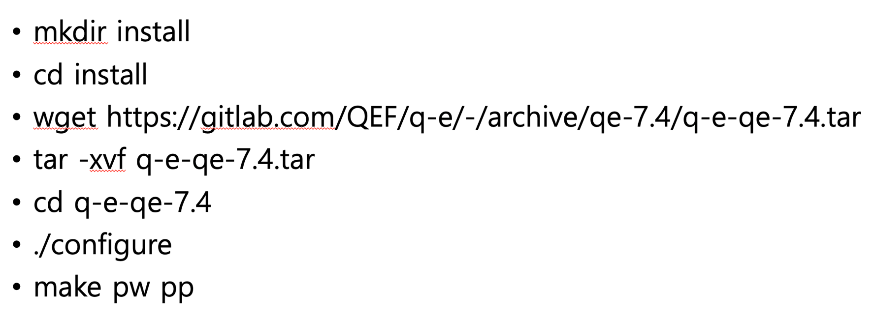
2-3. QE-7.4 설치
Bash 에서 설치
test
cd install/exercise_shin/lecture1/1.scf
bash run.sh
Modify path
RUNBIN="/home/dshin/install/q-e-qe-7.4/bin/pw.x“
"/home/dshin/” → “/home/my_id/”
"/home/dshin/” → “$HOME/”

Slide 13
2-3. QE-7.3 + patch
Bash 에서 설치
1. git clone -b qe-7.3 https://gitlab.com/QEF/q-e.git
2. git clone https://github.com/KIAS-CMT/DFT-U-V.git
3. cd DFT-U-V
4. cp qe-7.3_ehub_uv.diff ../q-e/
5. cd ../q-e
6. ./configure
7. patch -p1 < qe-7.3_ehub_uv.diff
Modify make.inc
8. FFLAGS 및 FFLAGS_NOOPT 줄 끝에 " -ffree-line-length-none"을 추가한 후 저장.
Make
9. make depend
10. make pw pp (MBD 설치 단계)

