Slide 1
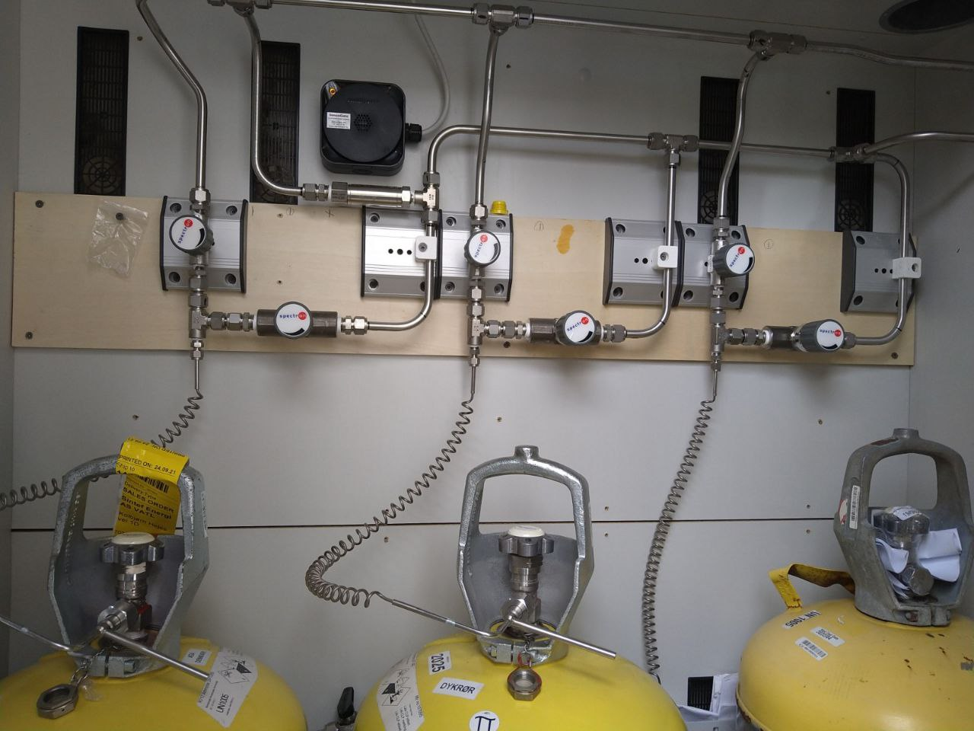
Never turn on these three valves (circled in red), cos that means the bottle(s) will be emptied out to atmosphere.
Notice that outside of this cabinet, the pipe leads to the sign: avblåsing
Open these corresponding to the bottle. Order does not matter. Check that the bottle is not empty. Ok if fully open.

Slide 2
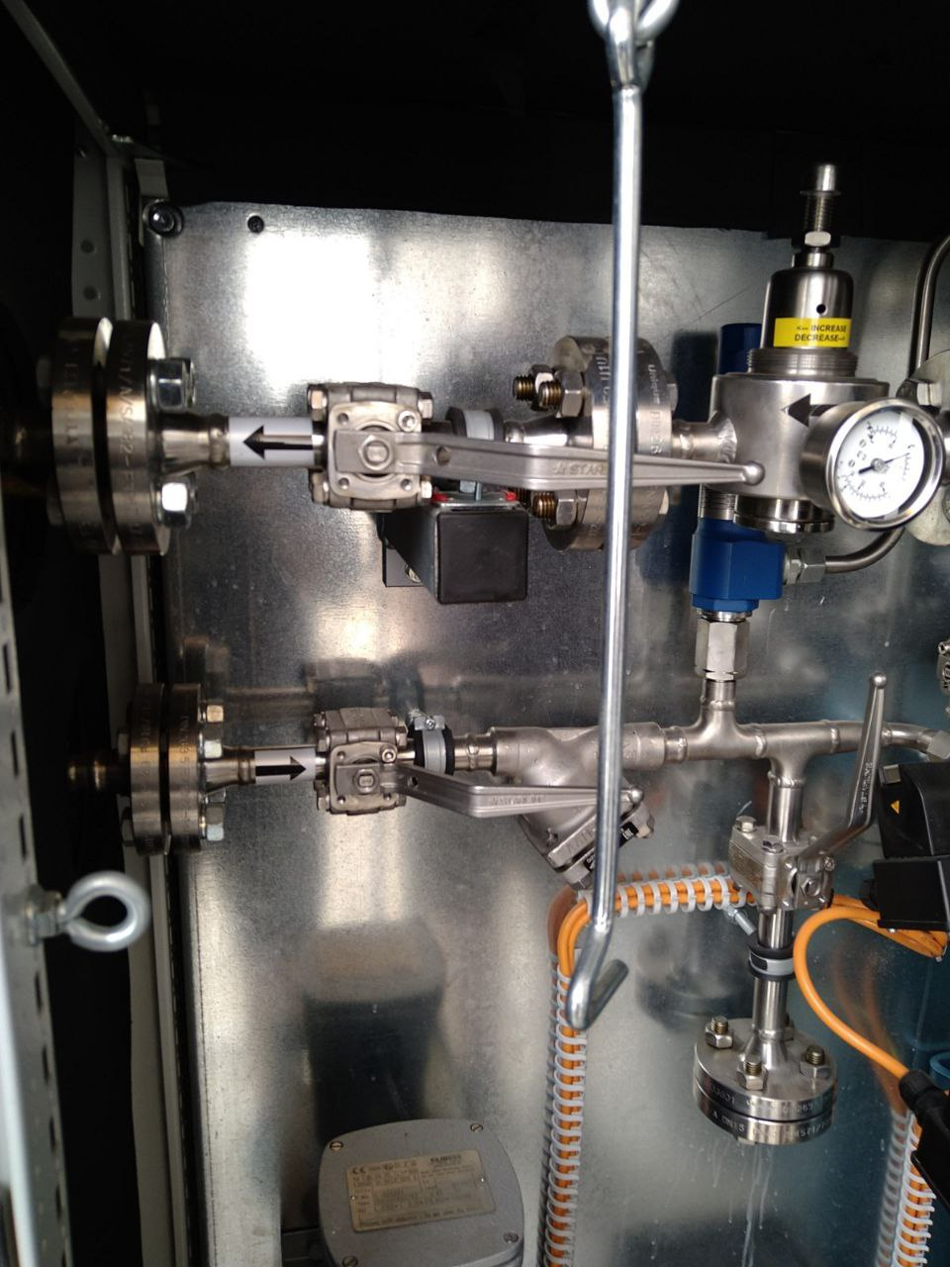
Hex key for adjusting pressure,
And key are both on top of this cabinet.
Turn on the valves circled in green
(correspond to the -> and <- arrows).
Order does not matter.
Pressure indicator.
look at the label for the direction to turn to increase/decrease pressure: b/n 5 to 7 bar (MAX).

Slide 3
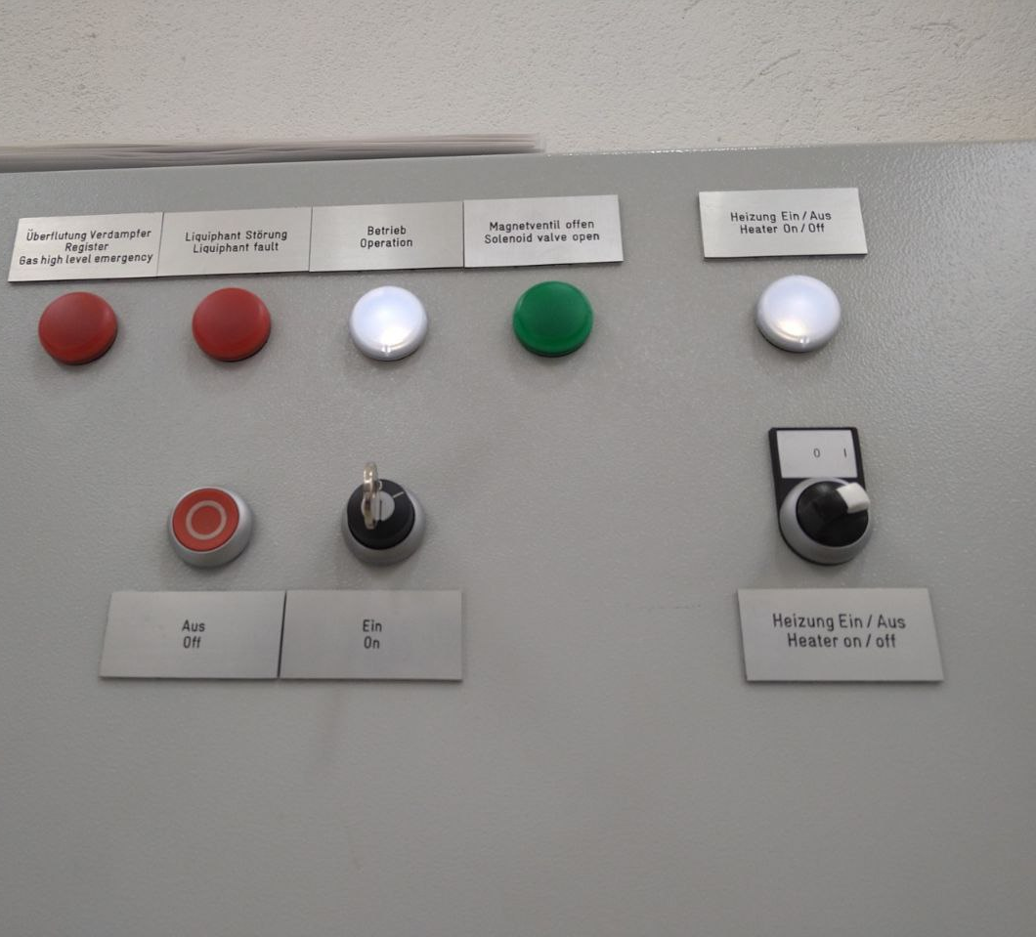
Location: control system on Norwegian 2nd floor, inside gas room.
Turn on heater.
Then, turn on the key knob.
For a very short instant, gas high level emergency will light up. But should go off almost instantly.
Wait until green light (solenoid valve open) is on (takes some time).
That is when NH3 has vaporized, and you can use the gas.
To shut down system, repeat everything in reverse.

