Slide 1
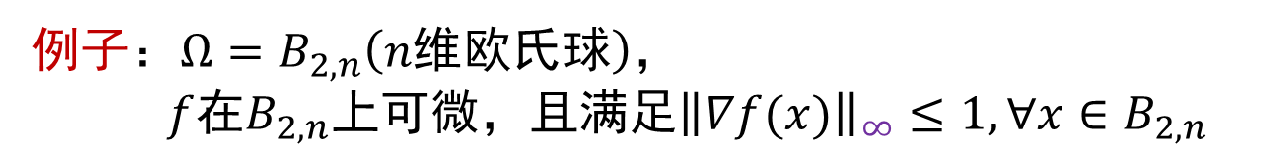
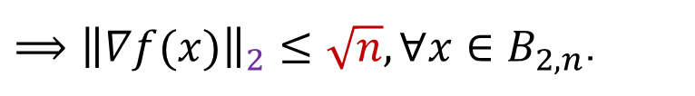
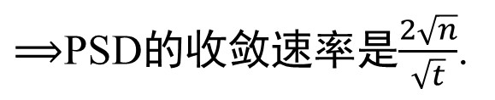

PSD的收敛速率与维数的相关性
PSD的收敛速率：$f\left(\frac{1}{t}\sum_{s=1}^{t}{x_{s}}\right)−f\left(x_{∗}\right)≤\frac{RL}{\sqrt{t}}\text{.}$
看上去，PSD的收敛速率好像与背景维数无关！
仅当$∀x∈Ω,g∈∂f(x)$，${\left\|x\right\|}_{2}$和${\left\|g\right\|}_{2}$与背景维数无关时，收敛速率才与维数无关.
例子：$Ω=B_{2,n}\left(n维欧氏球\right)，$
$f$在$B_{2,n}$上可微，且满足${\left\|∇f(x)\right\|}_{∞}≤1, ∀x∈B_{2,n}$
$⟹{\left\|∇f(x)\right\|}_{2}≤\sqrt{n}, ∀x∈B_{2,n}$.
$⟹$PSD的收敛速率是$\frac{2\sqrt{n}}{\sqrt{t}}$.

Slide 2
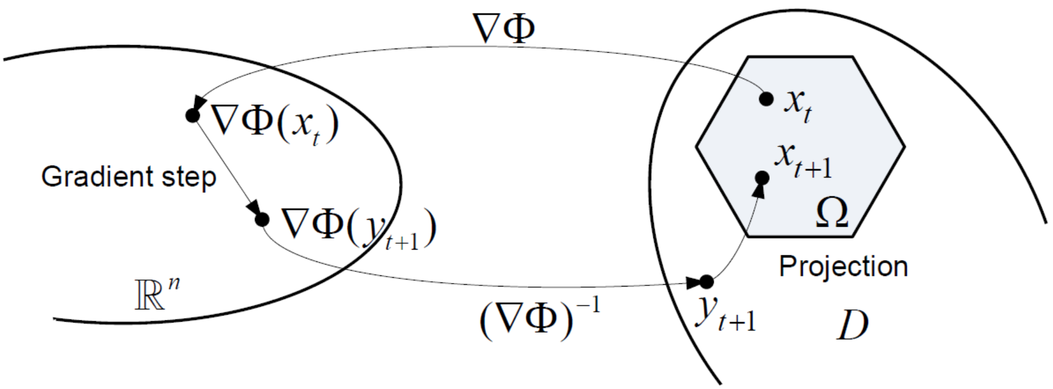






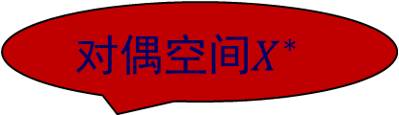

镜像下降法－动机
例子中PSD的收敛速率是$\frac{\text{2}\sqrt{n}}{\sqrt{t}}$.
MDA的收敛速率是$\frac{\sqrt{lnn}}{\sqrt{t}}$.
某些情况下，想在一个非欧空间(特别是$ℓ_{1}$空间)里执行梯度下降，以便有更小的Lipschitz常数！
原始空间$X$
对偶空间$X^{∗}$
$$x + η\left(−∇f(x)\right)$$
动机：将欧氏几何变成与待解决问题相关的几何!
动作：欧氏距离$⟶$Bregman散度
欧氏投影$⟶$Bregman投影

Slide 3
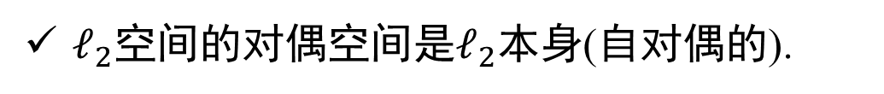
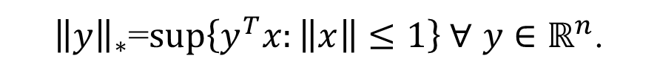
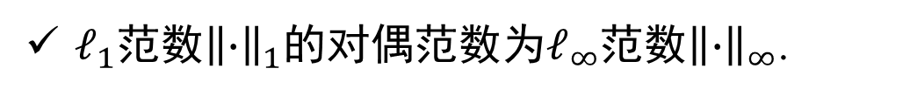
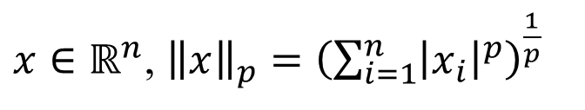
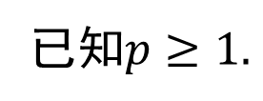


对偶空间与对偶范数
$$g_{s}^{T}\left(x−x_{s}\right)=\left\langle g_{s},x−x_{s}\right\rangle$$
定义5.5 设$\left\|∙\right\|$是$ℝ^{n}$上的某范数，那么它的对偶范数
${\left\|y\right\|}_{∗}$=$sup\left\{y^{T}x:\left\|x\right\|≤1\right\} ∀$ $y∈ℝ^{n}$.
$x∈ℝ^{n}$, ${\left\|x\right\|}_{p}={\left(\sum_{i=1}^{n}{{\left|x_{i}\right|}^{p}}\right)}^{\frac{1}{p}}$
已知$p≥1.$
例子5.6 $ℓ_{p}$空间的范数为${\left\|∙\right\|}_{p}$，其对偶空间是$ℓ_{q}$，对应范数是${\left\|∙\right\|}_{q}$，$其中\frac{1}{p}+\frac{1}{q}=1, p,q≥1$;
H$ölder$不等式： $x∈ℓ_{p}$, $y∈ℓ_{q}$，$\left|x^{T}y\right|≤{\left\|x\right\|}_{p}{\left\|y\right\|}_{q}$
$ℓ_{2}$空间的对偶空间是$ℓ_{2}$本身(自对偶的).
$ℓ_{1}$范数${\left\|∙\right\|}_{1}$的对偶范数为$ℓ_{∞}$范数${\left\|∙\right\|}_{∞}$.
Notes:
镜像下降是更一般的算法框架，包括普通梯度投影法！为此，需要引入Bregman散度代替欧氏范数；用Bregman投影代替经典投影

Slide 4
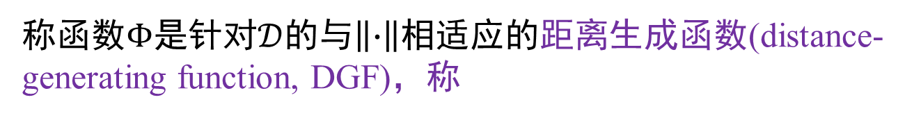
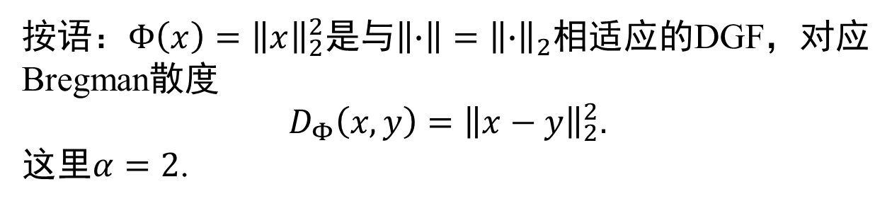


距离生成函数与Bregman散度
定义5.1 设$\left\|∙\right\|$是$ℝ^{n}\text{上的}某\text{范数}$. 如果$Φ$连续可微，并且关于$\left\|∙\right\|$是$α−$强凸的，即
$$∀\left(x∈𝒟,y∈𝒟\right): Φ\left(x\right)−\left[Φ\left(y\right)+{∇Φ\left(y\right)}^{T}\left(x−y\right)\right]≥\frac{α}{2}{\left\|x−y\right\|}_{}^{2}$$
称函数$Φ$是针对$𝒟$的与$\left\|∙\right\|$相适应的距离生成函数(distance-generating function, DGF)，称
$$D_{Φ}\left(x,y\right):= Φ\left(x\right)−\left[Φ\left(y\right)+{∇Φ\left(y\right)}^{T}\left(x−y\right)\right]$$
是由$Φ$生成的从$x$到$y$的Bregman散度/距离.
按语：$Φ\left(x\right)={\left\|x\right\|}_{2}^{2}$是与$\left\|∙\right\|={\left\|∙\right\|}_{2}$相适应的DGF，对应Bregman散度
$$D_{Φ}\left(x,y\right)={\left\|x−y\right\|}_{2}^{2}.$$
这里$α=2$.
Notes:
下次用V_x(y)代替$D_\Phi(y,x)$

Slide 5


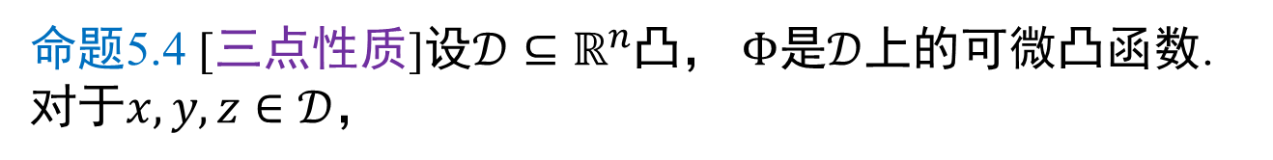
Bregman散度的性质
$$Φ\left(x\right)={\left\|x\right\|}_{2}^{2}，$$
$$2a^{T}b={\left\|a\right\|}_{2}^{2}+{\left\|b\right\|}_{2}^{2}−{\left\|a−b\right\|}_{2}^{2}$$
命题5.4 [三点性质]设$𝒟⊆ℝ^{n}$凸， $Φ$是$𝒟$上的可微凸函数. 对于$x,y,z∈𝒟$，
$${\left(∇Φ\left(x\right)−∇Φ\left(y\right)\right)}^{T}\left(x−z\right)=D_{Φ}\left(x,y\right)+D_{Φ}\left(z,x\right)−D_{Φ}\left(z,y\right).$$
证明 右边$=D_{Φ}\left(x,y\right)+D_{Φ}\left(z,x\right)−D_{Φ}\left(z,y\right)$
$=Φ\left(x\right)−Φ\left(y\right)−{∇Φ\left(y\right)}^{T}\left(x−y\right)$+$Φ\left(z\right)−Φ\left(x\right)−{∇Φ\left(x\right)}^{T}\left(z−x\right)$
$$−\left[Φ\left(z\right)−Φ\left(y\right)−{∇Φ\left(y\right)}^{T}\left(z−y\right)\right]$$
$$=−{∇Φ\left(y\right)}^{T}\left(x−y\right)+{∇Φ\left(y\right)}^{T}\left(z−y\right)−{∇Φ\left(x\right)}^{T}\left(z−x\right)$$
$$={−∇Φ\left(y\right)}^{T}\left(x−y−z+y\right)+{∇Φ\left(x\right)}^{T}\left(x−z\right)$$
$$={\left(∇Φ\left(x\right)−∇Φ\left(y\right)\right)}^{T}\left(x−z\right)$$

Slide 6
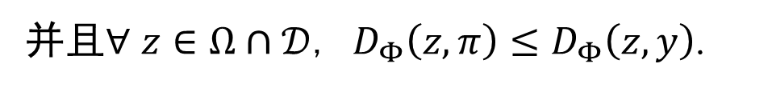
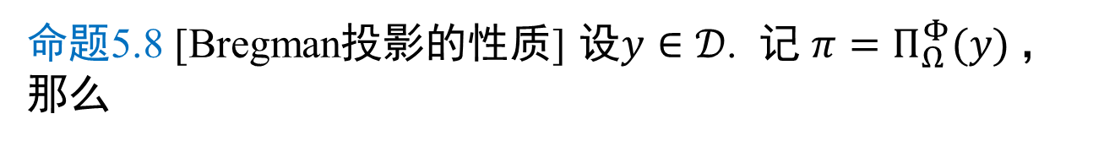
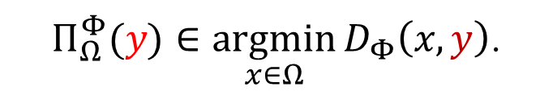
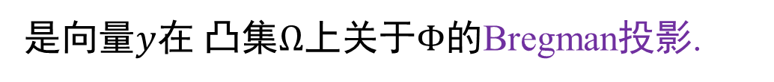

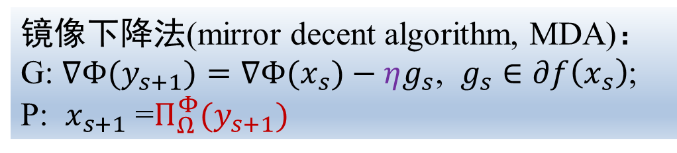
Bregman投影
定义5.7 [Bregman投影] 设$Φ$在$𝒟⊆ℝ^{n}$上是可微强凸的. 已知$y∈𝒟$. 称
$Π_{Ω}^{Φ}(y)∈\underset{x∈Ω}{argmin}{D_{Φ}\left(x,y\right)}$.
是向量$y$在 凸集$Ω$上关于$Φ$的Bregman投影.
镜像下降法(mirror decent algorithm, MDA)：
G: $∇Φ(y_{s+1})=∇Φ(x_{s})−ηg_{s}$, $g_{s}∈∂f\left(x_{s}\right)$;
P: $x_{s+1}$ =$Π_{Ω}^{Φ}(y_{s+1})$
命题5.8 [Bregman投影的性质] 设$y∈𝒟$. 记 $π=Π_{Ω}^{Φ}(y)$，那么
${\left(∇Φ\left(y\right)−∇Φ\left(π\right)\right)}^{T}\left(z−π\right)≤0,$ $∀$ $z∈Ω∩𝒟$ (*)
并且$∀$ $z∈Ω∩𝒟$, $D_{Φ}\left(z,π\right)≤D_{Φ}\left(z,y\right)$.
Notes:
C中任一点距y的Bregman投影的Bregman散度不会超过该点距y的Bregman散度

Slide 7
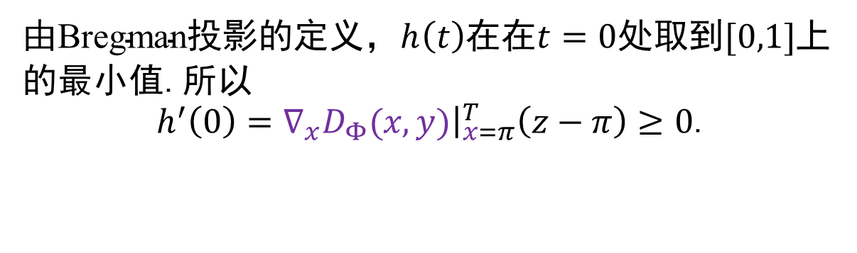

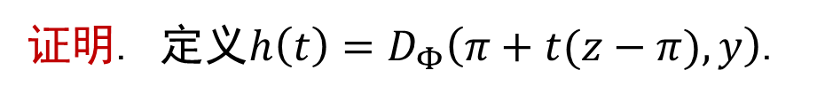
Bregman投影的性质
$$π=Π_{Ω}^{Φ}(y)$$
${\left(∇Φ\left(y\right)−∇Φ\left(π\right)\right)}^{T}\left(z−π\right)≤0,$ $∀$ $z∈Ω∩𝒟$ (*)
证明. 定义$h\left(t\right)=D_{Φ}\left(π+t(z−π),y\right)$.
由$\text{Bregman}\text{投影的}定义，h\left(t\right)$在$\text{在}t=0\text{处取到}[0,1]$上的最小值.所以
$h^{′}\left(0\right)={\left.∇_{x}D_{Φ}(x,y)\right|}_{x=π}^{T}\left(z−π\right)≥0$.
将$∇_{x}D_{Φ}(x,y)＝∇Φ\left(x\right)−∇Φ\left(y\right)$带入上式得(*).
由Bregman散度的三点性质，得
$D_{Φ}\left(π,y\right)+D_{Φ}\left(z,π\right)−D_{Φ}\left(z,y\right)={\left(∇Φ\left(π\right)−∇Φ\left(y\right)\right)}^{T}\left(π−z\right)$ $≤0$
再由$D_{Φ}\left(π,y\right)≥0$，所以$D_{Φ}\left(z,π\right)≤D_{Φ}\left(z,y\right)$.
Notes:
C中任一点距y的Bregman投影的Bregman散度不会超过该点距y的Bregman散度

Slide 8
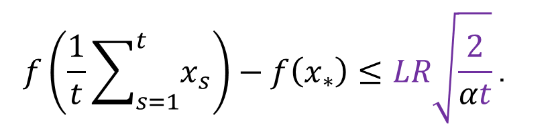
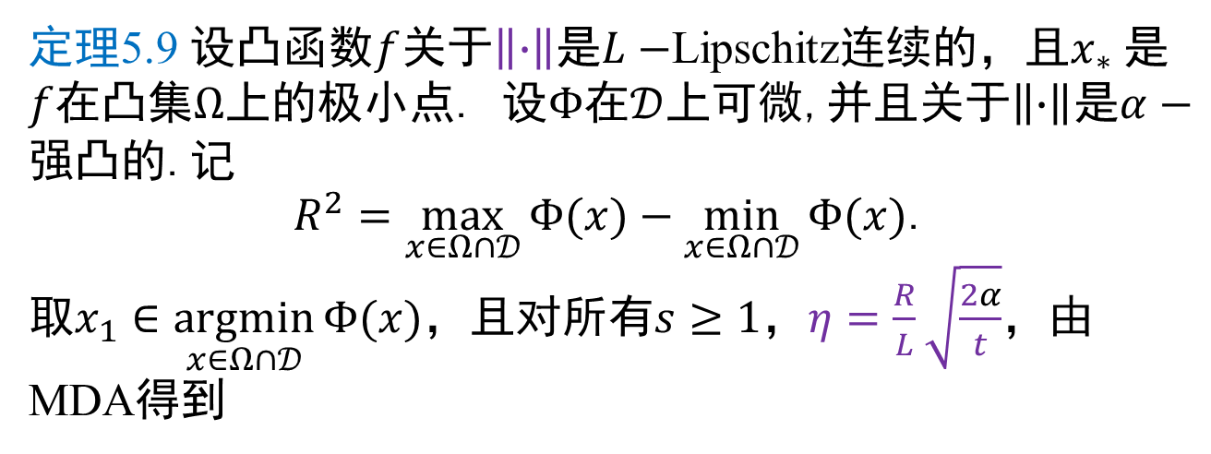
镜像下降法的复杂性
定理5.9 设凸函数$f$关于$\left\|∙\right\|$是$L−$Lipschitz连续的，且$x_{∗}$是$f$在凸集$Ω$上的极小点. 设$Φ$在$𝒟$上可微,并且关于$\left\|∙\right\|$是$α−$强凸的.记
$R^{2}=\max_{x∈Ω∩𝒟}{Φ(x)}−\min_{x∈Ω∩𝒟}{Φ(x)}$.
取$x_{1}∈\underset{x∈Ω∩𝒟}{argmin}{Φ(x)}$，且对所有$s≥1$，$η=\frac{R}{L}\sqrt{\frac{2α}{t}}$，由MDA得到
$$f\left(\frac{1}{t}\sum_{s=1}^{t}{x_{s}}\right)−f\left(x_{∗}\right)≤LR\sqrt{\frac{2}{αt}}\text{.}$$

Slide 9

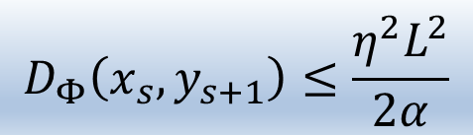
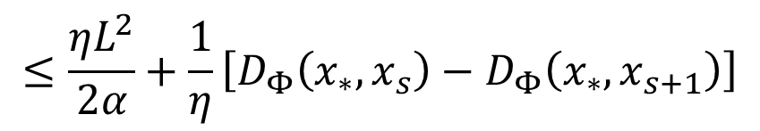
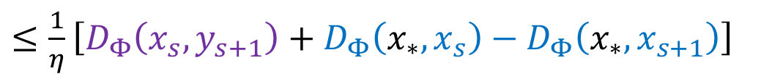
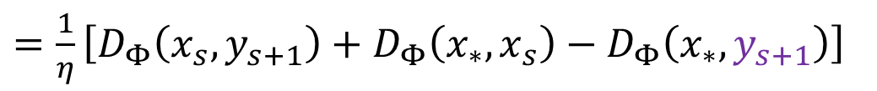
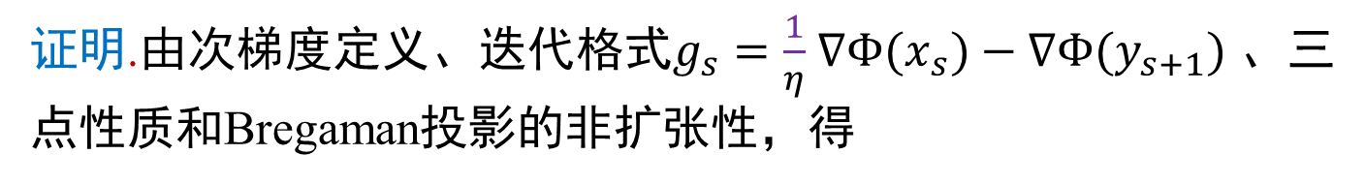
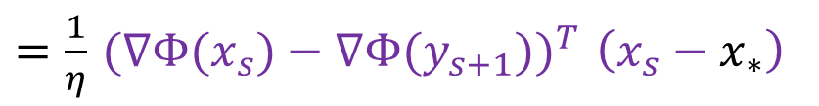
镜像下降法的复杂性(续1)
证明.由次梯度定义、迭代格式$g_{s}=\frac{1}{η}$ $∇Φ(x_{s})−∇Φ(y_{s+1})$ 、三点性质和Bregaman投影的非扩张性，得
$${f(x}_{s})−f\left(x_{∗}\right)≤{g_{s}}^{T} \left(x_{s}−x_{∗}\right)$$
$=\frac{1}{η}{ (∇Φ(x_{s})−∇Φ(y_{s+1}))}^{T} \left(x_{s}−x_{∗}\right)$
$=\frac{1}{η}\left[D_{Φ}\left(x_{s},y_{s+1}\right)+D_{Φ}\left(x_{∗},x_{s}\right)−D_{Φ}\left(x_{∗},y_{s+1}\right)\right]$
$≤\frac{1}{η}\left[D_{Φ}\left(x_{s},y_{s+1}\right)+D_{Φ}\left(x_{∗},x_{s}\right)−D_{Φ}\left(x_{∗},x_{s+1}\right)\right]$
$$≤\frac{ηL^{2}}{2α}+\frac{1}{η}\left[D_{Φ}\left(x_{∗},x_{s}\right)−D_{Φ}\left(x_{∗},x_{s+1}\right)\right]$$
$$D_{Φ}\left(x_{s},y_{s+1}\right)≤\frac{η^{2}L^{2}}{2α}$$

Slide 10

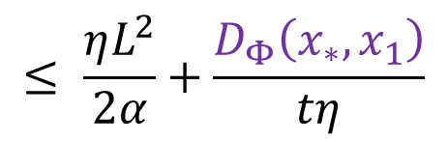
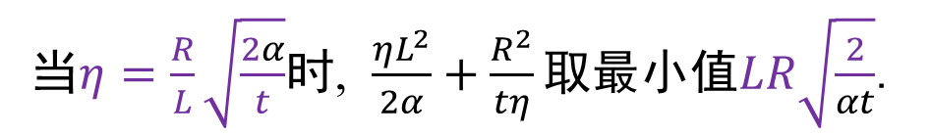
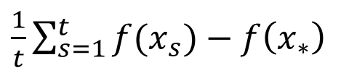
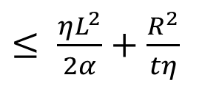
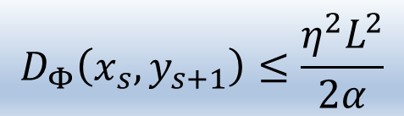
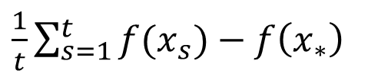
镜像下降法的复杂性(续2)
证明.
$$≤ \frac{ηL^{2}}{2α}+\frac{D_{Φ}\left(x_{∗},x_{1}\right)}{tη}$$
$\frac{1}{t}\sum_{s=1}^{t}{{f(x}_{s})}−f\left(x_{∗}\right)$
因为$D_{Φ}\left(x_{∗},x_{1}\right)=$ $Φ\left(x_{∗}\right)−Φ\left(x_{1}\right)−{∇Φ\left(x_{1}\right)}^{T}\left(x_{∗}−x_{1}\right)$
$≤Φ\left(x_{∗}\right)−Φ\left(x_{1}\right)$ $≤R^{2}$
$\frac{1}{t}\sum_{s=1}^{t}{{f(x}_{s})}−f\left(x_{∗}\right)$
$≤ \frac{ηL^{2}}{2α}+\frac{R^{2}}{tη}$
当$η=\frac{R}{L}\sqrt{\frac{2α}{t}}$时, $\frac{ηL^{2}}{2α}+\frac{R^{2}}{tη}\text{取最小值}LR\sqrt{\frac{2}{αt}}$.
$$D_{Φ}\left(x_{s},y_{s+1}\right)≤\frac{η^{2}L^{2}}{2α}$$

Slide 11
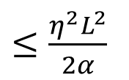


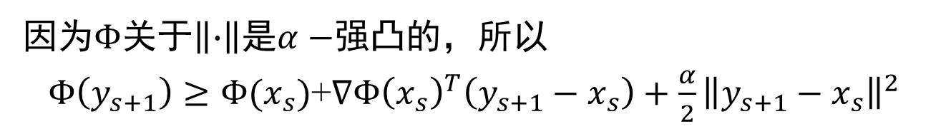
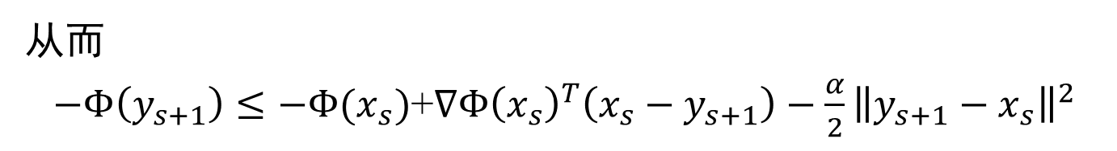
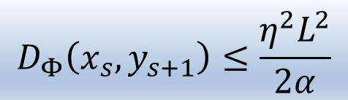
镜像下降法的复杂性(续3)
证明.
$$D_{Φ}\left(x_{s},y_{s+1}\right)=Φ\left(x_{s}\right)−Φ\left(y_{s+1}\right)−{∇Φ\left(y_{s+1}\right)}^{T}\left(x_{s}−y_{s+1}\right)$$
因为$Φ$关于$\left\|∙\right\|\text{是}α−$强凸的，所以
$Φ\left(y_{s+1}\right)≥Φ(x_{s})$+${∇Φ\left(x_{s}\right)}^{T}\left(y_{s+1}−x_{s}\right)+\frac{α}{2}{\left\|y_{s+1}−x_{s}\right\|}^{2}$
从而
$−Φ\left(y_{s+1}\right)≤−Φ(x_{s})$+${∇Φ\left(x_{s}\right)}^{T}\left(x_{s}−y_{s+1}\right)−\frac{α}{2}{\left\|y_{s+1}−x_{s}\right\|}^{2}$
$D_{Φ}\left(x_{s},y_{s+1}\right)≤{\left(∇Φ\left(x_{s}\right)−∇Φ\left(y_{s+1}\right)\right)}^{T}\left(x_{s}−y_{s+1}\right)−\frac{α}{2}{\left\|y_{s+1}−x_{s}\right\|}^{2}$
$=η{g_{s}}^{T}\left(x_{s}−y_{s+1}\right)−\frac{α}{2}{\left\|y_{s+1}−x_{s}\right\|}^{2}$
$≤η{\left\|g_{s}\right\|}_{∗}\left\|y_{s+1}−x_{s}\right\|−\frac{α}{2}{\left\|y_{s+1}−x_{s}\right\|}^{2}$
对偶范数的定义
$$D_{Φ}\left(x_{s},y_{s+1}\right)≤\frac{η^{2}L^{2}}{2α}$$
$≤\frac{η^{2}L^{2}}{2α}$

Slide 12
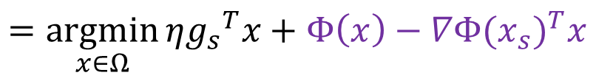
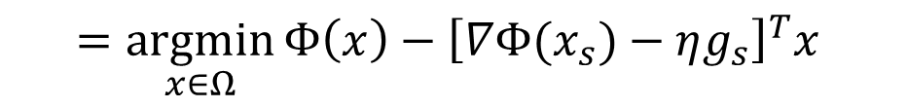
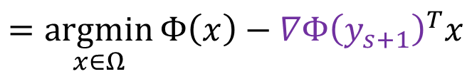
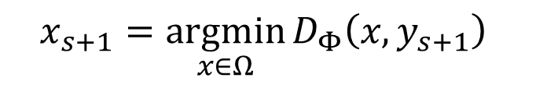
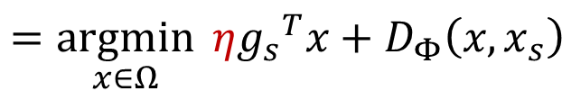
镜像下降法—广义临近梯度法
$$x_{s+1}=\underset{x∈Ω}{argmin}{D_{Φ}\left(x,y_{s+1}\right)}$$
$$=\underset{x∈Ω}{argmin}{Φ\left(x\right)−\left[Φ\left(y_{s+1}\right)+{∇Φ\left(y_{s+1}\right)}^{T}\left(x−y_{s+1}\right)\right]}$$
$$=\underset{x∈Ω}{argmin}{Φ\left(x\right)−{∇Φ\left(y_{s+1}\right)}^{T}x}$$
$$=\underset{x∈Ω}{argmin}{Φ\left(x\right)−{\left[∇Φ(x_{s})−ηg_{s}\right]}^{T}x}$$
$$=\underset{x∈Ω}{argmin}{η{g_{s}}^{T}x+Φ\left(x\right)−{∇Φ(x_{s})}^{T}x}$$
$$=\underset{x∈Ω}{argmin}{η{g_{s}}^{T}x+D_{Φ}\left(x,x_{s}\right)}$$
所以 $x_{s+1}=\underset{x∈Ω}{argmin}{f\left(x_{s}\right)+{g_{s}}^{T}(x−x_{s})+\frac{1}{η}D_{Φ}\left(x,x_{s}\right)}$

Slide 13
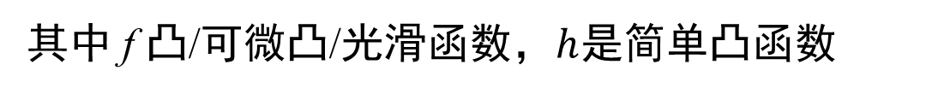

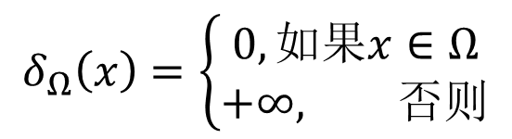
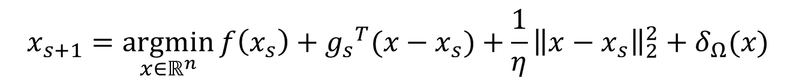
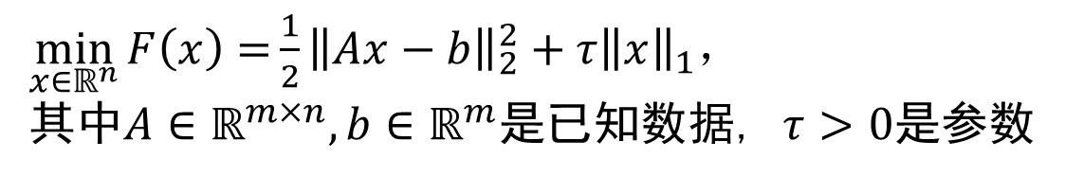
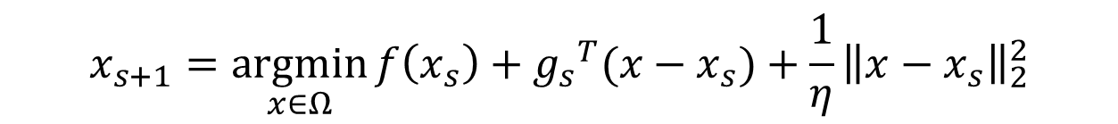
临近梯度法
$$x_{s+1}=\underset{x∈Ω}{argmin}{f\left(x_{s}\right)+{g_{s}}^{T}(x−x_{s})+\frac{1}{η}{\left\|x−x_{s}\right\|}_{2}^{2}}$$
$$δ_{Ω}\left(x\right)=\left\{\begin{aligned}0,如果x∈Ω \\ +∞, 否则\end{aligned}\right.$$
$$x_{s+1}=\underset{x∈ℝ^{n}}{argmin}{f\left(x_{s}\right)+{g_{s}}^{T}(x−x_{s})+\frac{1}{η}{\left\|x−x_{s}\right\|}_{2}^{2}}+δ_{Ω}(x)$$
$$\min_{x∈ℝ^{n}}{F\left(x\right)=f\left(x\right)+h(x)}$$
其中 f 凸/可微凸/光滑函数，$h$是简单凸函数
$$x_{s+1}=\underset{x∈ℝ^{n}}{argmin}{f\left(x_{s}\right)+{∇f(x_{s})}^{T}(x−x_{s})+\frac{1}{η}{\left\|x−x_{s}\right\|}_{2}^{2}}+h(x)$$
比如
$\min_{x∈ℝ^{n}}{F\left(x\right)=}\frac{1}{2}{\left\|Ax−b\right\|}_{2}^{2}+τ{\left\|x\right\|}_{1}$，
其中$A∈ℝ^{m×n},b∈ℝ^{m}$是已知数据, $τ>0$是参数

Slide 14
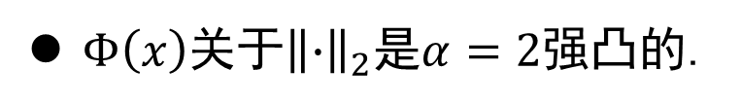
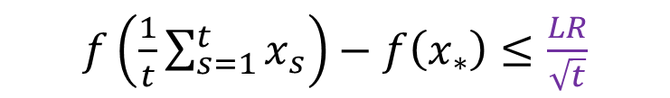







镜像下降法示例－欧氏设置
设$Φ\left(x\right)={\left\|x\right\|}^{2}，𝒟=ℝ^{n}$，$\left\|∙\right\|={\left\|∙\right\|}_{2}$
$∇Φ\left(x\right)=2x$.
$D_{Φ}\left(x,y\right)={\left\|x\right\|}^{2}−{\left\|y\right\|}^{2}−2y^{T}\left(x−y\right)$
$={\left\|x−y\right\|}^{2}$
$Φ\left(x\right)$关于${\left\|∙\right\|}_{2}$是$α=2$强凸的.
$$η=\frac{R}{L}\sqrt{\frac{2α}{t}}$$
$$f\left(\frac{1}{t}\sum_{s=1}^{t}{x_{s}}\right)−f\left(x_{∗}\right)≤LR\sqrt{\frac{2}{αt}}$$
$$η=\frac{2R}{L\sqrt{t}}$$
$f\left(\frac{1}{t}\sum_{s=1}^{t}{x_{s}}\right)−f\left(x_{∗}\right)≤\frac{LR}{\sqrt{t}}$
镜像下降法 投影次梯度法： $x_{s+1}=\underset{x∈Ω}{argmin}{{\left\|x−(x_{s}−ηg_{s})\right\|}^{2}}$
Notes:
梯度下降也可用欧氏范数的邻近法来理解

Slide 15










镜像下降法示例－$ℓ_{1}$设置-负熵函数
$\text{设 }Φ\left(x\right)=\sum_{i=1}^{n}{x_{i}lnx_{i}\text{,} 𝒟=ℝ_{++}^{n}}，$ $\left\|∙\right\|={\left\|∙\right\|}_{1}$
$∇Φ\left(x\right)={\left(1+lnx_{1},⋯,1+lnx_{n}\right)}^{}$
$y_{s+1}$= $x_{s}exp\left(−ηg_{s}\right)$
(这里的指数运算和向量乘都指逐分量)
$D_{Φ}\left(x,y\right)=\sum_{i=1}^{n}{x_{i}\ln\left(\frac{x_{i}}{y_{i}}\right)−}\sum_{i=1}^{n}{\left(x_{i}−y_{i}\right)}$
Kullback-Leibler散度
设$Ω=∆_{n}:=\left\{x∈ℝ^{n}:\sum_{i=1}^{n}{x_{i}}=1,x≥0\right\}$.
已知$y∈ℝ_{++}^{n}$，求$Π_{∆_{n}}^{Φ}\left(y\right)$
$$⟹Π_{∆_{n}}^{Φ}\left(y\right)=y/{\left\|y\right\|}_{1}$$
$$\begin{matrix}minimize & \sum_{i=1}^{n}{x_{i}\ln\left(\frac{x_{i}}{y_{i}}\right)−}\sum_{i=1}^{n}{\left(x_{i}−y_{i}\right)} \\ subject to & \sum_{i=1}^{n}{x_{i}}=1 \end{matrix}$$
$y_{s+1}$= $x_{s}exp\left(−ηg_{s}\right)$, $g_{s}∈∂f\left(x_{s}\right)$
$x_{s+1}$= $\frac{y_{s+1}}{{\left\|y_{s+1}\right\|}_{1}}$
Notes:
负熵

Slide 16









镜像下降法示例－$ℓ_{1}$设置-负熵函数(续)
$$x_{1}∈\underset{x∈Ω∩𝒟}{argmin}{Φ(x)}$$
$$⟹x_{1}=\frac{1}{n}{\left[1 1 ⋯ 1 \right]}^{T}$$
$Φ\left(x\right)$在$∆_{n}$上关于${\left\|∙\right\|}_{1}$是$1−$强凸的.
Pinsker不等式：
$∀x,y∈ ∆_{n}, D_{Φ}\left(x,y\right)=\sum_{i=1}^{n}{x_{i}\ln\left(\frac{x_{i}}{y_{i}}\right)} ≥ \frac{1}{2}{\left\|x−y\right\|}_{1}^{2}$
$R^{2}=\max_{x∈∆_{n}}{Φ(x)}−\min_{x∈∆_{n}}{Φ\left(x\right)}$
$$=\ln{n}.$$
推论 设$∆_{n}$上的凸函数$f$满足
${\left\|g\right\|}_{∞}≤L, ∀g∈∂f\left(x\right), ∀x∈∆_{n}$.
在$Φ\left(x\right)=\sum_{i=1}^{n}{x_{i}lnx_{i} }$，$η=\frac{1}{L}\sqrt{\frac{2\ln{n}}{t}}$的MDA中，
$$f\left(\frac{1}{t}\sum_{s=1}^{t}{x_{s}}\right)−f\left(x_{∗}\right)≤L\sqrt{\frac{2\ln{n}}{t}}$$
Notes:
负熵

Slide 17












镜像下降法的应用:Boosting的经验风险极小化
已知数据$\left\{\left(x_{1},y_{1}\right),⋯,\left(x_{M},y_{M}\right)\right\}$和弱分类器$\left\{f_{1},⋯,f_{M}\right\}$,其中${x_{i}∈ℝ_{}^{d}, y}_{i}∈\left\{−1,1\right\},$ $f_{j}:ℝ^{d}↦\left\{−1，1\right\}$.
$\min_{θ∈∆_{M}}{\hat{R}\left(f_{θ}\right)≔\frac{1}{m}\sum_{i=1}^{m}{exp\left(−y_{i}f_{θ}\left(x_{i}\right)\right)}}$
其中$f_{θ}\left(x_{i}\right)=\sum_{j=1}^{M}{θ_{j}f_{j}(x_{i})}$.
因为 $∇\hat{R}\left(f_{θ}\right)=\frac{1}{m}{\sum_{i=1}^{m}{exp\left(−y_{i}f_{θ}\left(x_{i}\right)\right)\left(−y_{i}\right)}F(x_{i})}$
其中$F\left(x\right)={\left(f_{1}\left(x\right),⋯,f_{M}\left(x\right)\right)}^{T}$是列向量.
那么${\left\|F(x)\right\|}_{∞}$ $≤1$.
${\left\|∇\hat{R}\left(f_{θ}\right)\right\|}_{∞}≤\frac{e}{m}{\sum_{=1}^{m}{{\left\|F(X_{i})\right\|}_{∞}}}≤$ $e$.
要误差小于$\frac{1}{m}$
取负熵函数，用MD，误差上界$e\frac{\sqrt{2\ln{M}}}{\sqrt{t}}$
$$t\sim m^{2}lnM$$
用PGD，误差上界$2e\frac{\sqrt{M}}{\sqrt{t}}$
$t\sim m^{2}$ $M$
Notes:
负熵

