Slide 1
Data Science: Machine Learning and Natural Language Processing
Professor: Patrick Houlihan
Notes:
Data Science: Machine Learning and Natural Language Processing 数据科学：机器学习和自然语言处理 Professor: Patrick Houlihan 教授：Patrick Houlihan

Slide 2
Introduction
Professor: Patrick Houlihan, PhD
Class:
When: Saturdays 7:00am-9:00am EST
April 6 and May 18extended lecture 7:00am-9:30am EST
No class on May 11, class will be held on May 12 7:00am-9:00am EST
TAs:
Beth bethxx99@hotmail.com
Notes:
Introduction 介绍 Professor: Patrick Houlihan PhD 教授：Patrick Houlihan 博士 Class: 课程： When: Saturdays 7:00am-9:00am EST 时间：每周六上午7:00-9:00（美国东部时间） April 6 and May 18 extended lecture 7:00am-9:30am EST 4月6日和5月18日课程延长至7:00-9:30（美国东部时间） No class on May 11, class will be held on May 12 7:00am-9:00am EST 5月11日不上课，课程改到5月12日上午7:00-9:00（美国东部时间） TAs: 助教： Beth bethxx99@hotmail.com

Slide 3


Introduction
Expectations
My Background
Syllabus Review
Required Installations
What is Natural Language Processing?
Python
Natural Language Toolkit (NLTK)
Notes:
Introduction 介绍 Expectations 期望 My Background 我的背景 Syllabus Review 课程大纲回顾 Required Installations 所需安装 What is Natural Language Processing? 什么是自然语言处理？ Python Python Natural Language Toolkit (NLTK) 自然语言工具包（NLTK）

Slide 4
Expectations
Familiar with a programming language, i.e. R, Java, Matlab
Previous experience with Python a plus, though NOT a show stopper
Lots of data wrangling as text can be quite messy
Professor and TAs are here to help
Effort and Grade are directly correlated
You get out of the class what you put in
Notes:
Expectations 期望 Familiar with a programming language i.e. R Java Matlab 熟悉一种编程语言，如R、Java、Matlab Previous experience with Python a plus though NOT a show stopper 有Python经验更好，但不是必需的 Lots of data wrangling as text can be quite messy 需要大量的数据清理，因为文本可能非常混乱 Professor and TAs are here to help 教授和助教在这里帮助你 Effort and Grade are directly correlated 努力与成绩直接相关 You get out of the class what you put in 你从课程中获得的与你投入的成正比

Slide 5
Professor Background
Spent 15+ years in semiconductors
Altera
Nvidia
Last 10 years been surrounded by big data
Dissertation:
Forecasting Asset Price Direction Through Sentiment
Publications:
Risk Premium of Social Media Sentiment
Can Sentiment Analysis and Options Volume Anticipate Future Returns?
Leveraging a call-put ratio as a trading signal
Leveraging Social Media to Predict Continuation and Reversal in Asset prices
Founded financial data analytics company – SentiQuant
Currently Senior Vice President, Data Science at Publicis Media
Notes:
Professor Background 教授背景 Spent 15+ years in semiconductors 从事半导体行业15年以上 Altera Nvidia Last 10 years been surrounded by big data 过去10年与大数据为伴 Dissertation: 博士论文： Forecasting Asset Price Direction Through Sentiment 通过情感预测资产价格方向 Publications: 出版物： Risk Premium of Social Media Sentiment 社交媒体情感的风险溢价 Can Sentiment Analysis and Options Volume Anticipate Future Returns? 情感分析和期权交易量能否预测未来收益？ Leveraging a call-put ratio as a trading signal 利用买卖比率作为交易信号 Leveraging Social Media to Predict Continuation and Reversal in Asset prices 利用社交媒体预测资产价格的延续和反转 Founded financial data analytics company – SentiQuant 创立了金融数据分析公司SentiQuant Currently Senior Vice President Data Science at Publicis Media 现任Publicis Media数据科学高级副总裁

Slide 6
Syllabus Review
Class attendance consists of 10%
Homework 20%
Midterm 30%
Final (comprehensive) 40%
Notes:
Syllabus Review 课程大纲回顾 Class attendance consists of 10% 课堂出勤占10% Homework 20% 作业占20% Midterm 30% 期中考试占30% Final (comprehensive) 40% 期末考试（综合）占40%

Slide 7
References
https://web.stanford.edu/~jurafsky/
Natural Language Processing with Python (https://www.nltk.org/book/)
Notes:
References 参考资料 https://web.stanford.edu/~jurafsky/ Natural Language Processing with Python (https://www.nltk.org/book/) 用Python进行自然语言处理

Slide 8
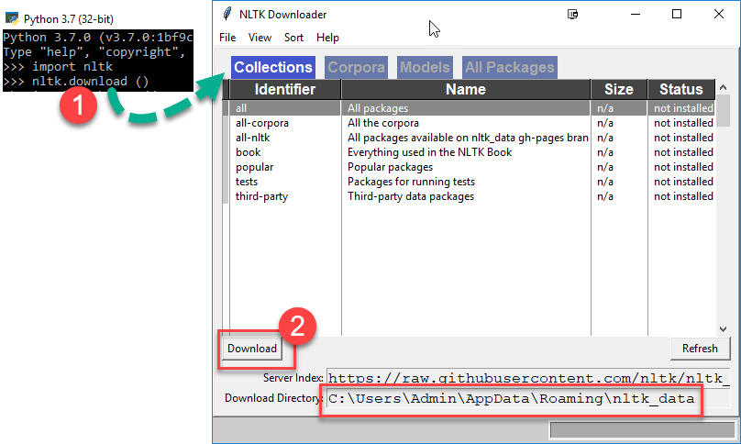
Required Installations
Python 3.X version
https://www.anaconda.com/download/
NLTK download and Install
Notes:
Required Installations 所需安装 Python 3.X version Python 3.X 版本 https://www.anaconda.com/download/ NLTK download and Install 下载并安装NLTK

Slide 9
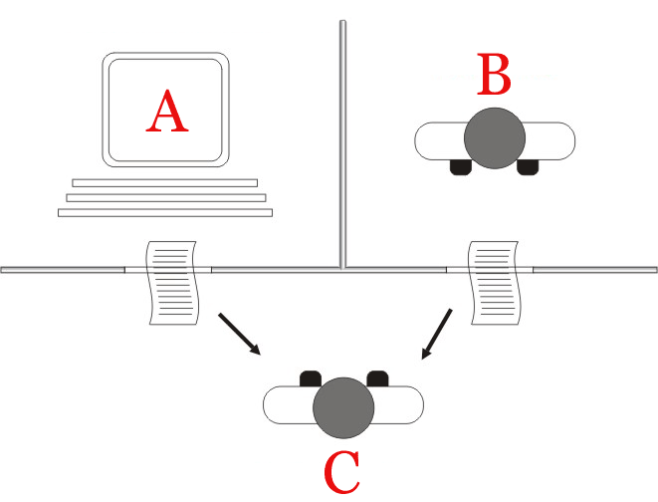
What is Natural Language Processing?
Interaction between computers and human (natural) languages
Understanding – Process meaning of spoken/typed words
Generation – Expression into natural (human) language i.e. English
Processing of vast amounts of natural language data (text)
Brief History
Started in 50’s
Alan Turing
Turing test
Test of intelligent behavior
Notes:
What is Natural Language Processing? 什么是自然语言处理？ Interaction between computers and human (natural) languages 计算机与人类（自然）语言的交互 Understanding – Process meaning of spoken/typed words 理解——处理口语/打字词的含义 Generation – Expression into natural (human) language i.e. English 生成——以自然（人类）语言表达，例如英语 Processing of vast amounts of natural language data (text) 处理大量自然语言数据（文本） Brief History 简史 Started in 50’s 始于50年代 Alan Turing 艾伦·图灵 Turing test 图灵测试 Test of intelligent behavior 智能行为测试

Slide 10
Applications of Natural Language Processing
Language Modeling
Predict next word based on previous words
Speech Recognition
Mapping acoustical signals to a natural language
Word Associations
Determine synonyms and related words for a word or phrase
Sentiment Analysis
Determine tone or mood of author or entire society
Text Classification
Predict categorical associations of text
Topical Extraction
Determine main topic/theme of a body of text
Notes:
Applications of Natural Language Processing 自然语言处理的应用 Language Modeling 语言建模 Predict next word based on previous words 根据前面的词预测下一个词 Speech Recognition 语音识别 Mapping acoustical signals to a natural language 将声学信号映射到自然语言 Word Associations 词汇联想 Determine synonyms and related words for a word or phrase 确定单词或短语的同义词和相关词 Sentiment Analysis 情感分析 Determine tone or mood of author or entire society 确定作者或整个社会的语气或情绪 Text Classification 文本分类 Predict categorical associations of text 预测文本的分类关联 Topical Extraction 主题提取 Determine main topic/theme of a body of text 确定文本主体的主要话题/主题

Slide 11
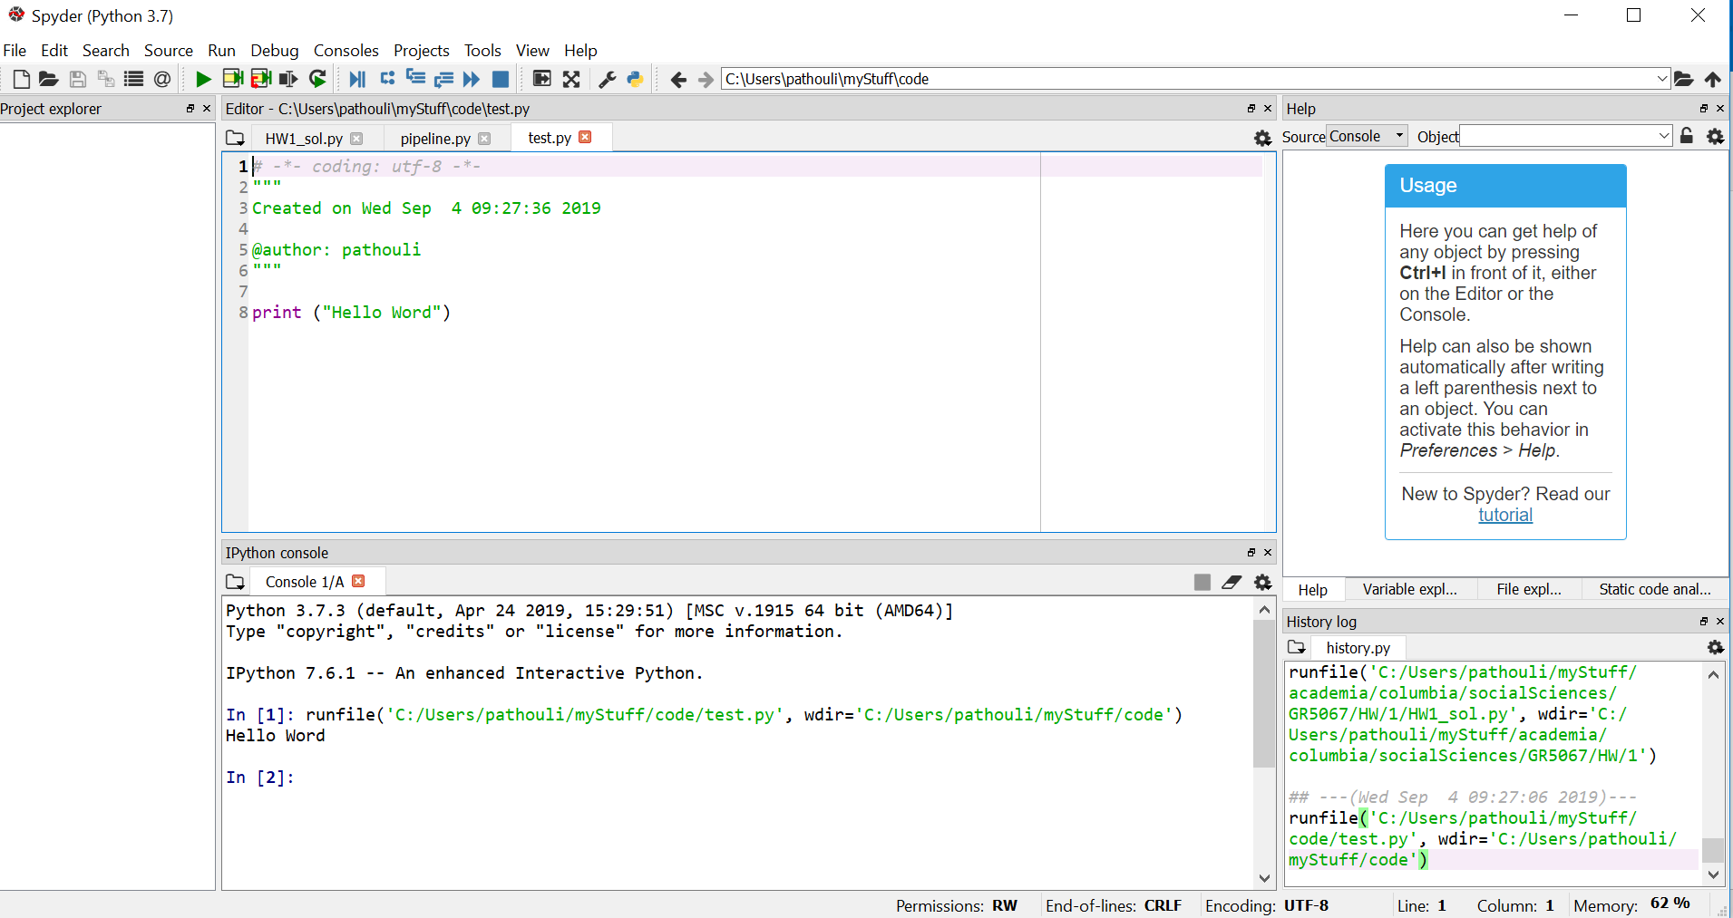
Python
Big emphasis on Python (not of Serpentes Suborder) programming language
Python Programming Language
Code – instructions in a program
Syntax – valid structures and commands
Output – Messages printed by program
Shell – Interpreter
Integrated Development Environment (IDE) – Software to write and test software
Notes:
Python Python Big emphasis on Python (not of Serpentes Suborder) programming language 重点强调Python（不是蛇亚目）编程语言 Python Programming Language Python编程语言 Code – instructions in a program 代码——程序中的指令 Syntax – valid structures and commands 语法——有效的结构和命令 Output – Messages printed by program 输出——程序打印的消息 Shell – Interpreter Shell——解释器 Integrated Development Environment (IDE) – Software to write and test software 集成开发环境（IDE）——编写和测试软件的软件

Slide 12
Python Syntax
Python uses indentation
Variables
Variables are case sensitive, myVar is different than myvar
Do:
Start variable name with a letter
Don’t:
No whitespace
Begin with a number
Use operator symbols like – between words
BLOCK 1
BLOCK 2
BLOCK 3
BLOCK 2, CONTINUATION
BLOCK 1, CONTINUATION
Notes:
Python Syntax Python语法 Python uses indentation Python使用缩进

Slide 13
Python Math Commands
Command name | Description
abs(value) | absolute value
ceil(value) | rounds up
cos(value) | cosine, in radians
floor(value) | rounds down
log(value) | logarithm, base e
log10(value) | logarithm, base 10
max(value1, value2) | larger of two values
min(value1, value2) | smaller of two values
round(value) | nearest whole number
sin(value) | sine, in radians
sqrt(value) | square root
To use some of these you need to import the math library → from math import *
Notes:
Variables 变量 Variables are case sensitive myVar is different than myvar 变量区分大小写，myVar和myvar是不同的 Do: 应做： Start variable name with a letter 以字母开头命名变量 Don’t: 不应做： No whitespace 不使用空格 Begin with a number 不以数字开头 Use operator symbols like – between words 不在单词之间使用操作符号，如-“

Slide 14
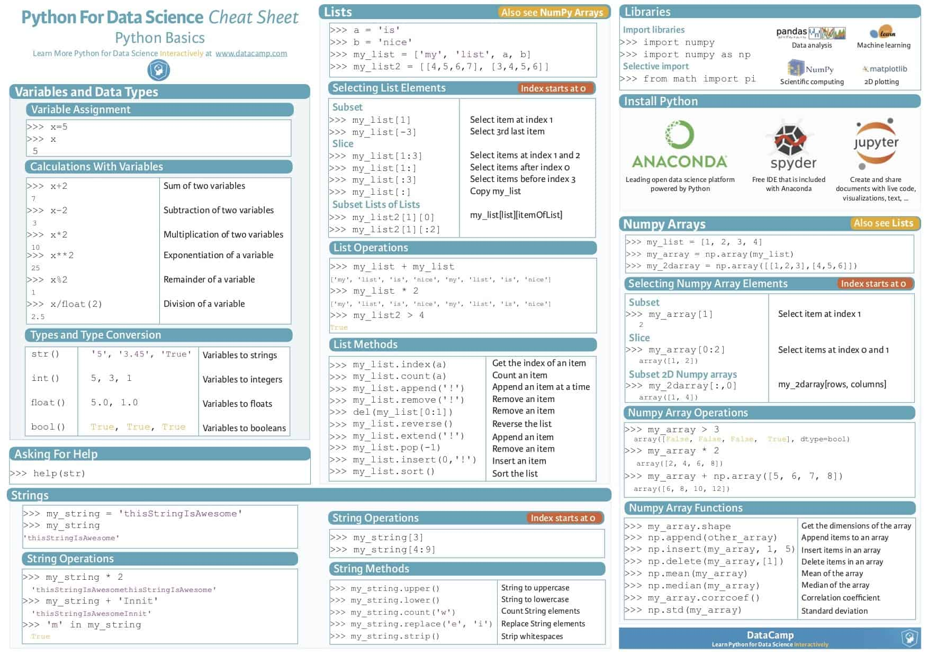
Python
Notes:
Python Math Commands Python数学命令 Command name 命令名称 Description 描述 abs(value) 绝对值 ceil(value) 向上取整 cos(value) 余弦值（弧度） floor(value) 向下取整 log(value) 自然对数 log10(value) 以10为底的对数 max(value1 value2) 两值中的较大值 min(value1 value2) 两值中的较小值 round(value) 四舍五入 sin(value) 正弦值（弧度） sqrt(value) 平方根 To use some of these you need to import the math library à from math import * 要使用这些命令中的一些，需要导入数学库，例如 from math import *

