Slide 1
Gin
go get -u github.com/gin-gonic/gin

Slide 2
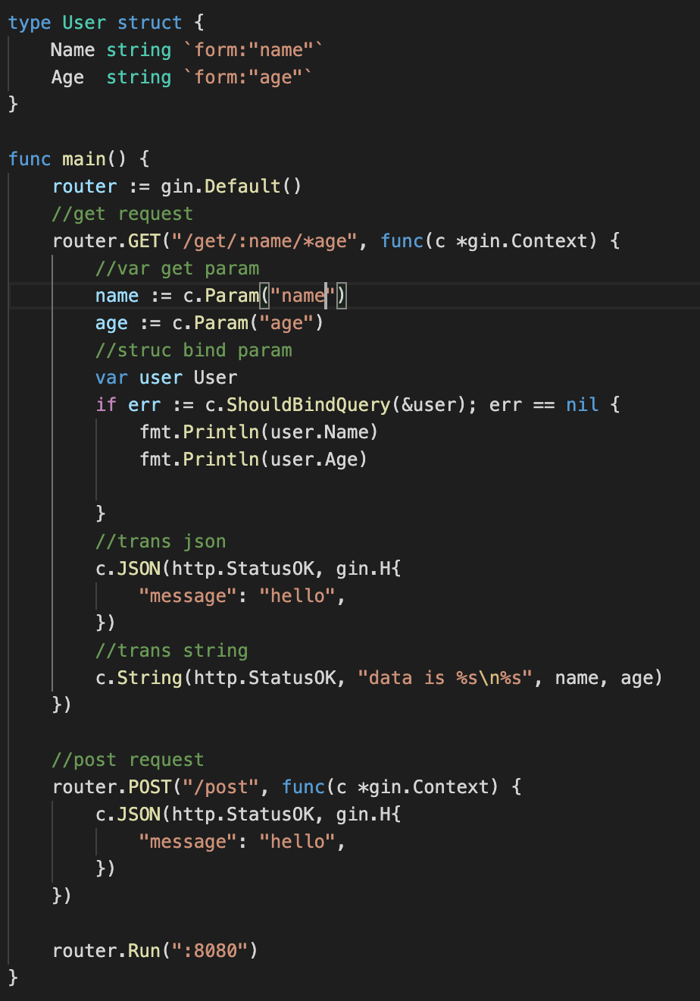
request get
Notes:
package main
import (
"fmt"
"net/http"
"github.com/gin-gonic/gin"
)
type User struct {
Name string `form:"name"`
Age string `form:"age"`
}
func main() {
router := gin.Default()
//get request
router.GET("/get/:name/*age", func(c *gin.Context) {
//var get param
name := c.Param("name")
age := c.Param("age")
//struc bind param
var user User
if err := c.ShouldBindQuery(&user); err == nil {
fmt.Println(user.Name)
fmt.Println(user.Age)
}
//trans json
c.JSON(http.StatusOK, gin.H{
"message": "hello",
})
//trans string
c.String(http.StatusOK, "data is %s\n%s", name, age)
})
//post request
router.POST("/post", func(c *gin.Context) {
c.JSON(http.StatusOK, gin.H{
"message": "hello",
})
})
router.Run(":8080")
}

Slide 3
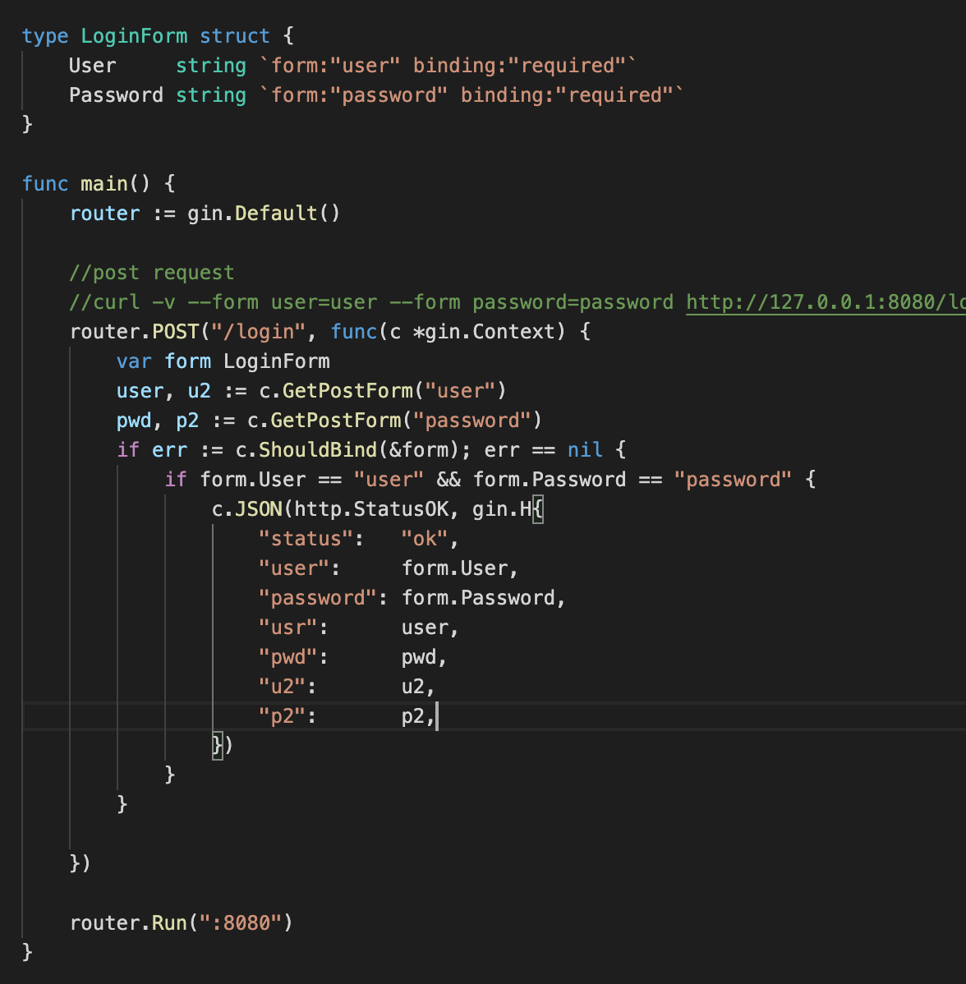
request - post
Notes:
package main
import (
"net/http"
"github.com/gin-gonic/gin"
)
type LoginForm struct {
User string `form:"user" binding:"required"`
Password string `form:"password" binding:"required"`
}
func main() {
router := gin.Default()
//post request
//curl -v --form user=user --form password=password http://127.0.0.1:8080/login
router.POST("/login", func(c *gin.Context) {
var form LoginForm
user, u2 := c.GetPostForm("user")
pwd, p2 := c.GetPostForm("password")
if err := c.ShouldBind(&form); err == nil {
if form.User == "user" && form.Password == "password" {
c.JSON(http.StatusOK, gin.H{
"status": "ok",
"user": form.User,
"password": form.Password,
"usr": user,
"pwd": pwd,
"u2": u2,
"p2": p2,
})
}
}
})
router.Run(":8080")
}

Slide 4
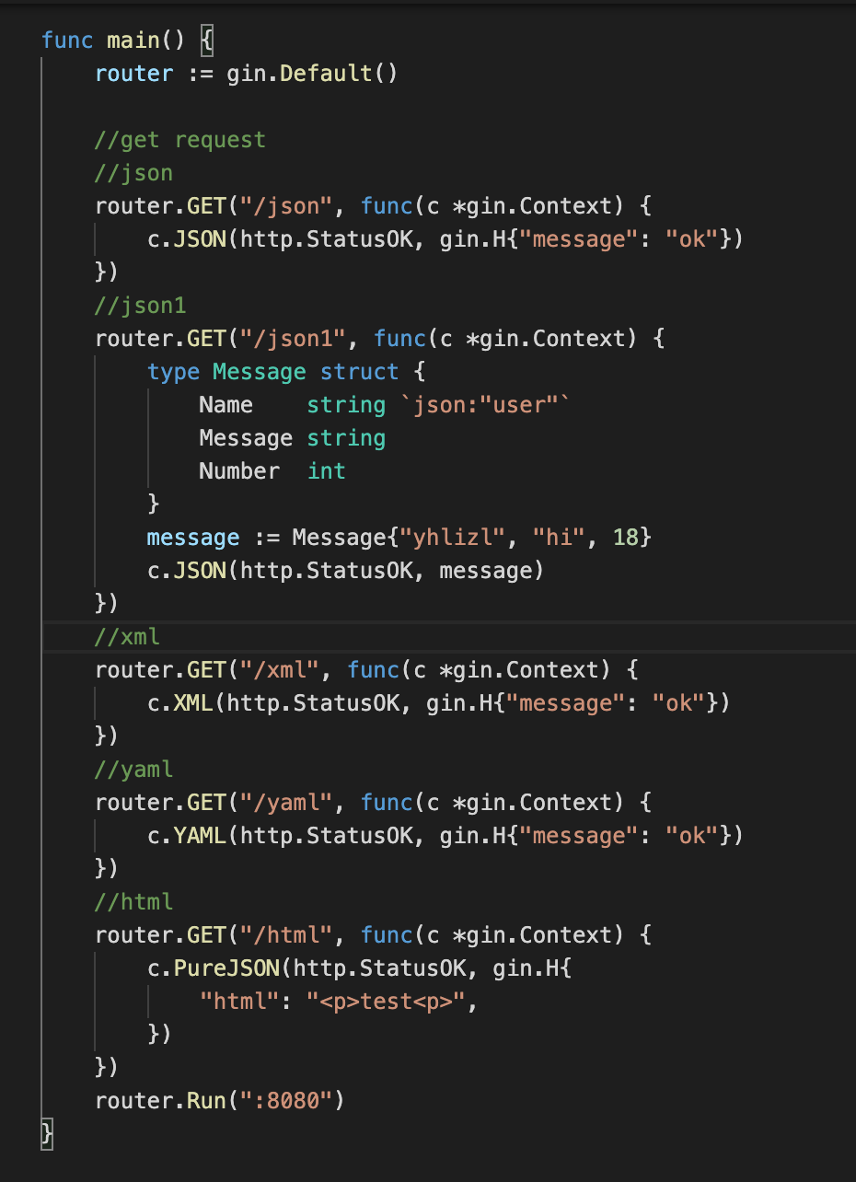
Request response -json/xml/yaml
Notes:
package main
import (
"net/http"
"github.com/gin-gonic/gin"
)
func main() {
router := gin.Default()
//get request
//json
router.GET("/json", func(c *gin.Context) {
c.JSON(http.StatusOK, gin.H{"message": "ok"})
})
//json1
router.GET("/json1", func(c *gin.Context) {
type Message struct {
Name string `json:"user"`
Message string
Number int
}
message := Message{"yhlizl", "hi", 18}
c.JSON(http.StatusOK, message)
})
//xml
router.GET("/xml", func(c *gin.Context) {
c.XML(http.StatusOK, gin.H{"message": "ok"})
})
//yaml
router.GET("/yaml", func(c *gin.Context) {
c.YAML(http.StatusOK, gin.H{"message": "ok"})
})
//html
router.GET("/html", func(c *gin.Context) {
c.PureJSON(http.StatusOK, gin.H{
"html": "<p>test<p>",
})
})
router.Run(":8080")
}

Slide 5
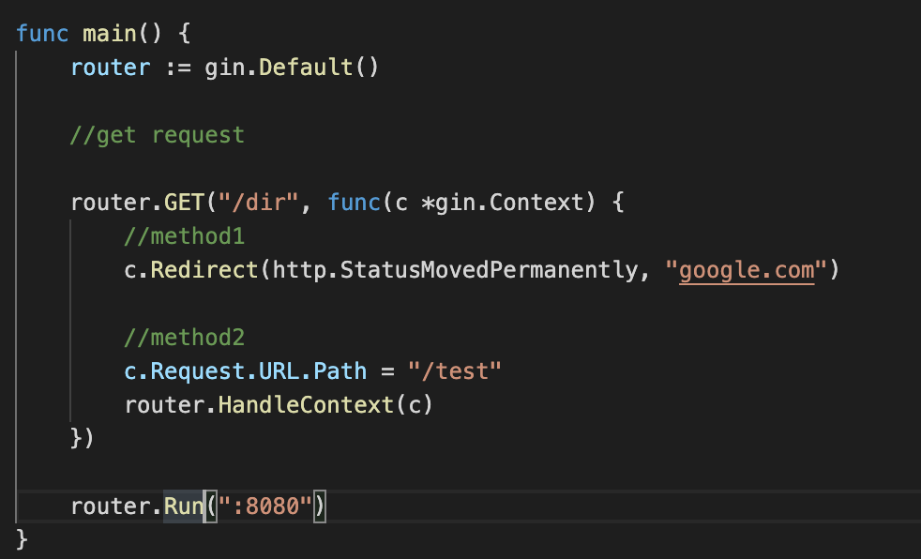
Router redirection
Notes:
package main
import (
"net/http"
"github.com/gin-gonic/gin"
)
func main() {
router := gin.Default()
//get request
router.GET("/dir", func(c *gin.Context) {
//method1
c.Redirect(http.StatusMovedPermanently, "google.com")
//method2
c.Request.URL.Path = "/test"
router.HandleContext(c)
})
router.Run(":8080")
}

Slide 6
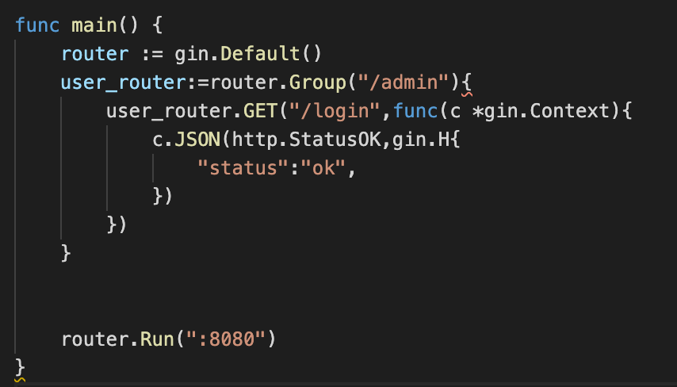
Router group
Notes:
package main
import (
"net/http"
"github.com/gin-gonic/gin"
)
func main() {
router := gin.Default()
user_router:=router.Group("/admin"){
user_router.GET("/login",func(c *gin.Context){
c.JSON(http.StatusOK,gin.H{
"status":"ok",
})
})
}
router.Run(":8080")
}

Slide 7
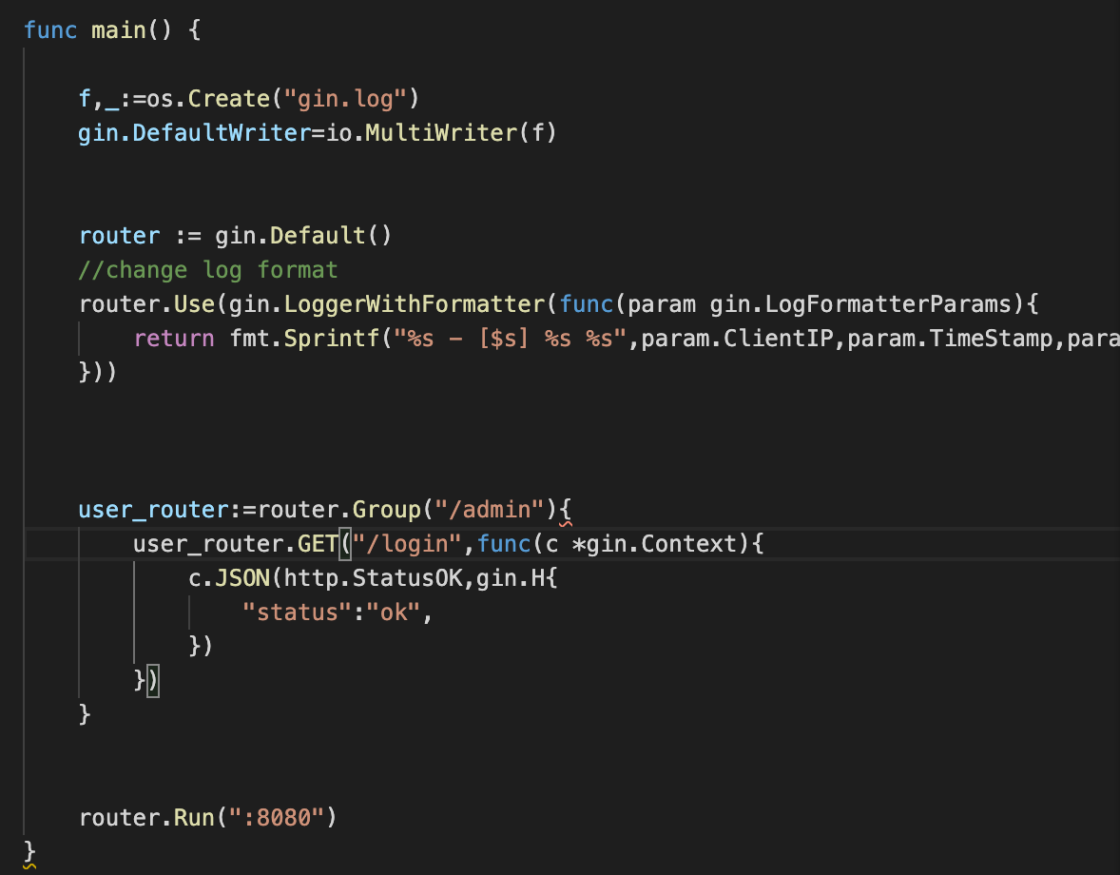
log
Notes:
package main
import (
"net/http"
"github.com/gin-gonic/gin"
)
func main() {
f,_:=os.Create("gin.log")
gin.DefaultWriter=io.MultiWriter(f)
router := gin.Default()
//change log format
router.Use(gin.LoggerWithFormatter(func(param gin.LogFormatterParams){
return fmt.Sprintf("%s - [$s] %s %s",param.ClientIP,param.TimeStamp,param.Method)
}))
user_router:=router.Group("/admin"){
user_router.GET("/login",func(c *gin.Context){
c.JSON(http.StatusOK,gin.H{
"status":"ok",
})
})
}
router.Run(":8080")
}

Slide 8
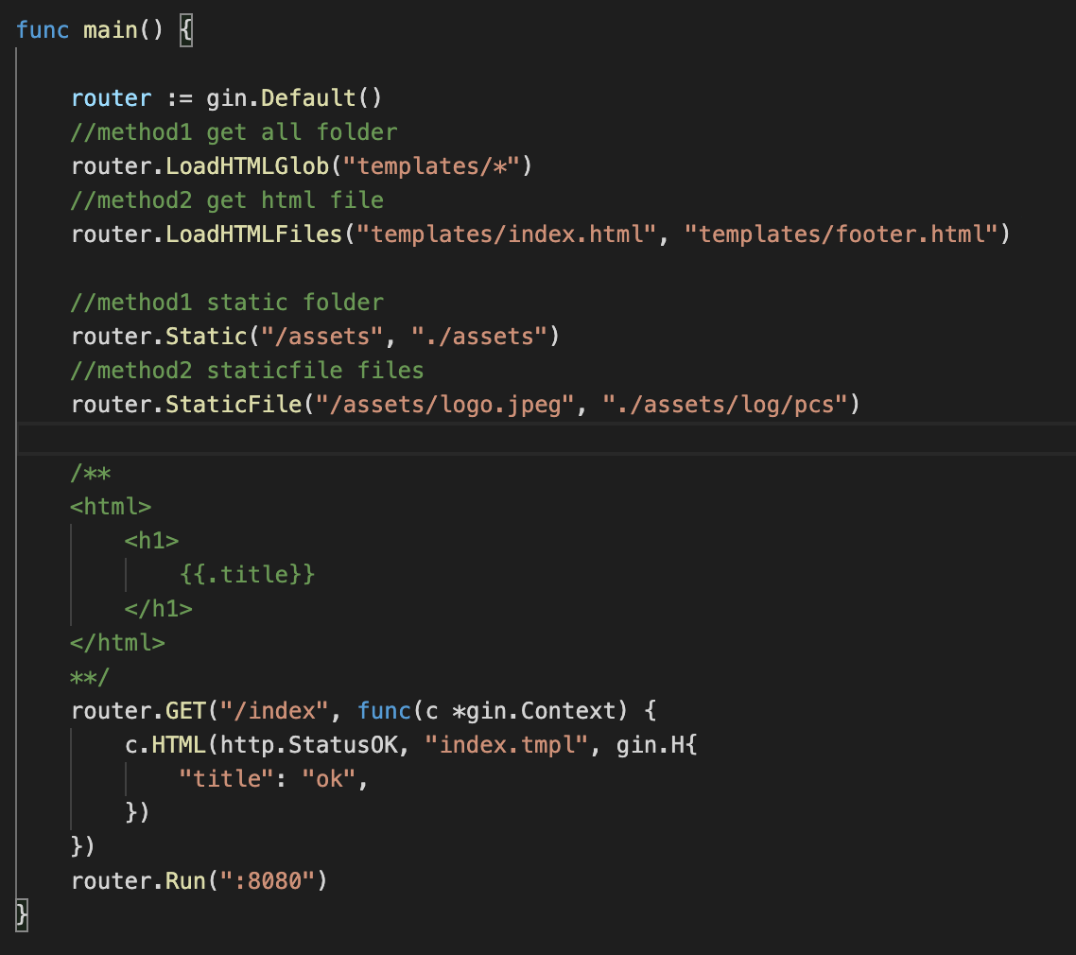
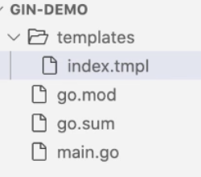
Template render
Notes:
package main
import (
"net/http"
"github.com/gin-gonic/gin"
)
func main() {
router := gin.Default()
//method1 get all folder
router.LoadHTMLGlob("templates/*")
//method2 get html file
router.LoadHTMLFiles("templates/index.html", "templates/footer.html")
//method1 static folder
router.Static("/assets", "./assets")
//method2 staticfile files
router.StaticFile("/assets/logo.jpeg", "./assets/log/pcs")
/**
<html>
<h1>
{{.title}}
</h1>
</html>
**/
router.GET("/index", func(c *gin.Context) {
c.HTML(http.StatusOK, “index.tmpl”, gin.H{ㄋ
"title": "ok",
})
})
router.Run(":8080")
}

Slide 9
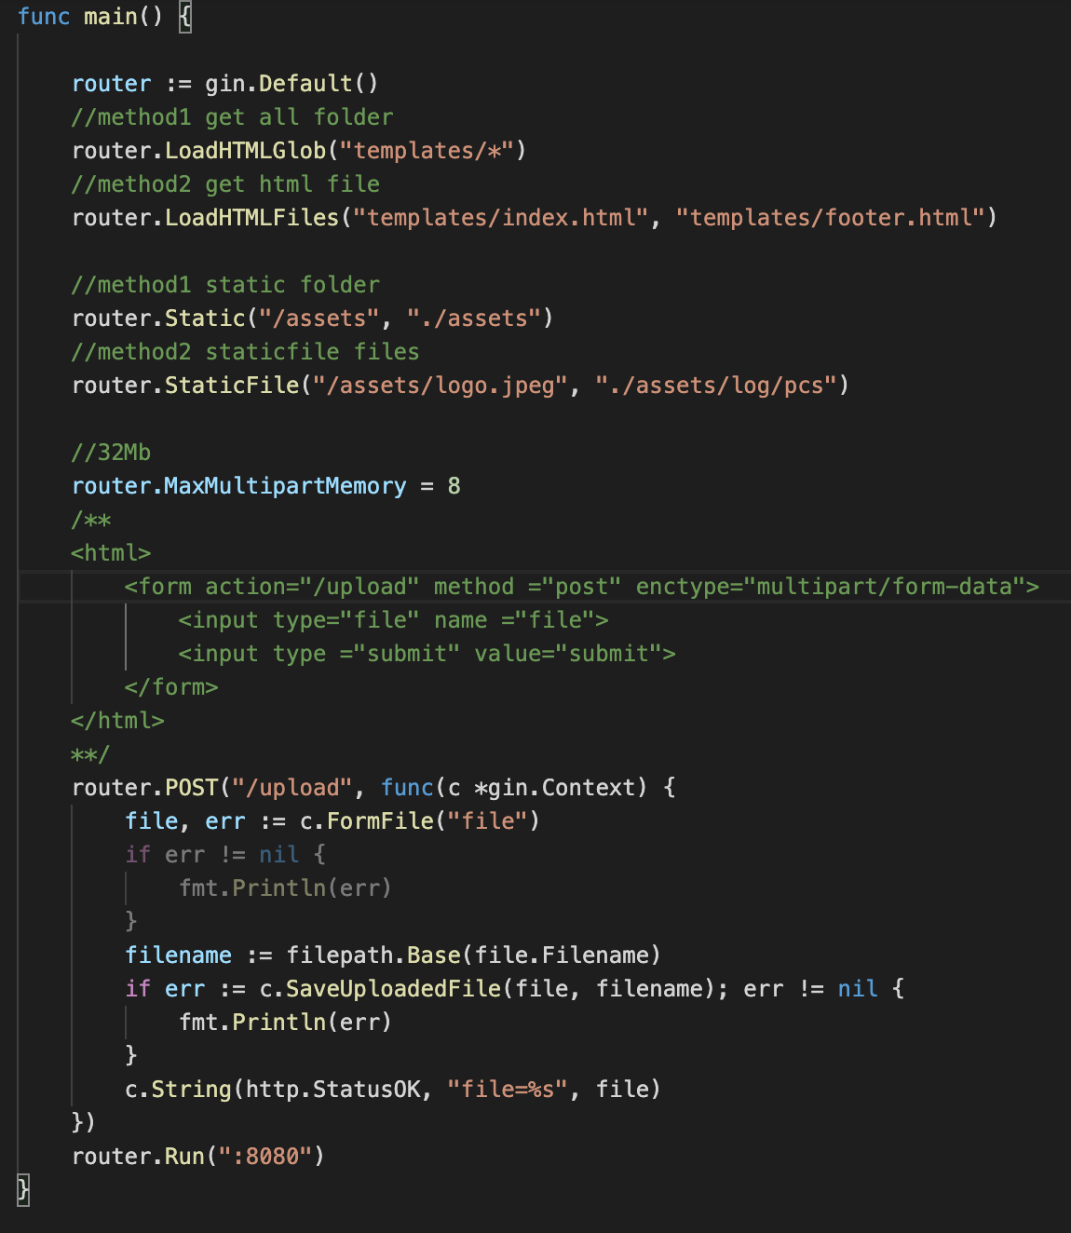
Form handler files
Notes:
package main
import (
"fmt"
"net/http"
"path/filepath"
"github.com/gin-gonic/gin"
)
func main() {
router := gin.Default()
//method1 get all folder
router.LoadHTMLGlob("templates/*")
//method2 get html file
router.LoadHTMLFiles("templates/index.html", "templates/footer.html")
//method1 static folder
router.Static("/assets", "./assets")
//method2 staticfile files
router.StaticFile("/assets/logo.jpeg", "./assets/log/pcs")
//32Mb
router.MaxMultipartMemory = 8
/**
<html>
<form action="/upload" method ="post" enctype="multipart/form-data">
<input type="file" name ="file">
<input type ="submit" value="submit">
</form>
</html>
**/
router.POST("/upload", func(c *gin.Context) {
file, err := c.FormFile("file")
if err != nil {
fmt.Println(err)
}
filename := filepath.Base(file.Filename)
if err := c.SaveUploadedFile(file, filename); err != nil {
fmt.Println(err)
}
c.String(http.StatusOK, "file=%s", file)
})
router.Run(":8080")
}

Slide 10
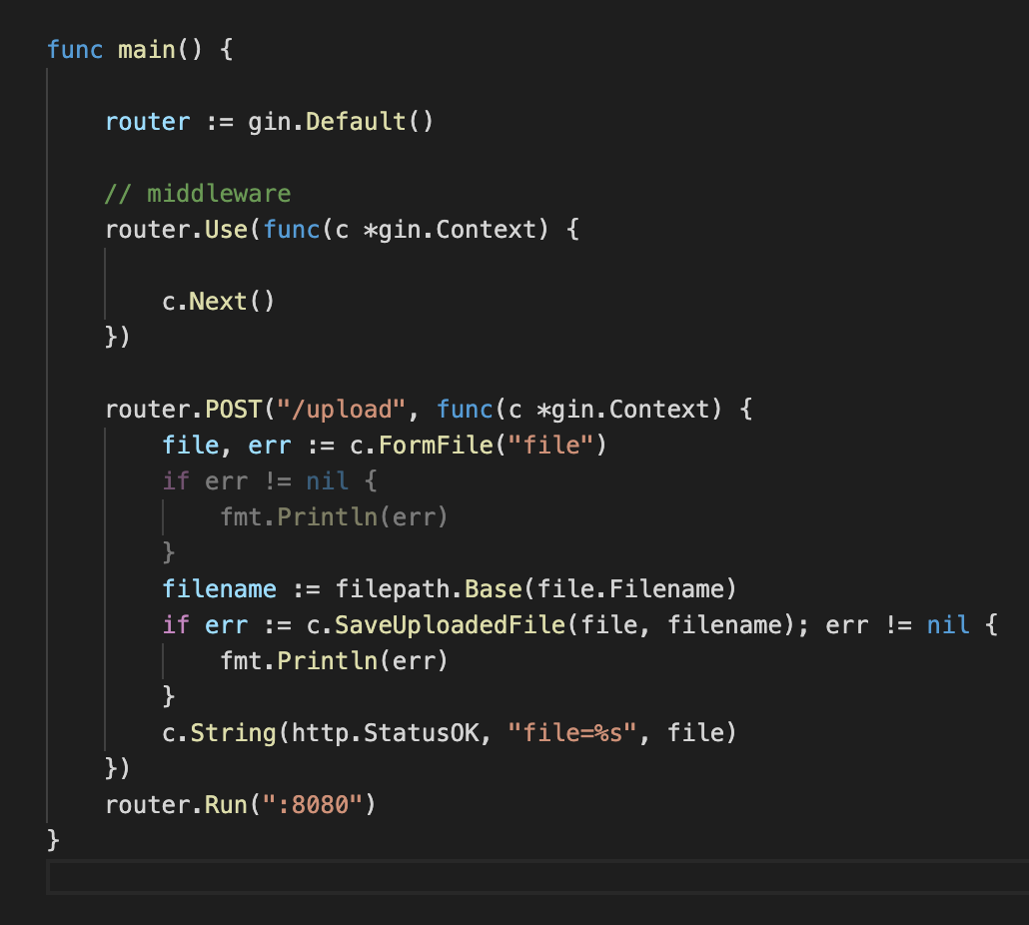
Middleware
Notes:
package main
import (
"fmt"
"net/http"
"path/filepath"
"github.com/gin-gonic/gin"
)
type UserForm struct {
Name string `form:"name" binding:"required"`
Age string `form:"age" binding:"required"`
}
func main() {
router := gin.Default()
// middleware
router.Use(func(c *gin.Context) {
c.Next()
})
router.POST("/upload", func(c *gin.Context) {
file, err := c.FormFile("file")
if err != nil {
fmt.Println(err)
}
filename := filepath.Base(file.Filename)
if err := c.SaveUploadedFile(file, filename); err != nil {
fmt.Println(err)
}
c.String(http.StatusOK, "file=%s", file)
})
router.Run(":8080")
}

Slide 11
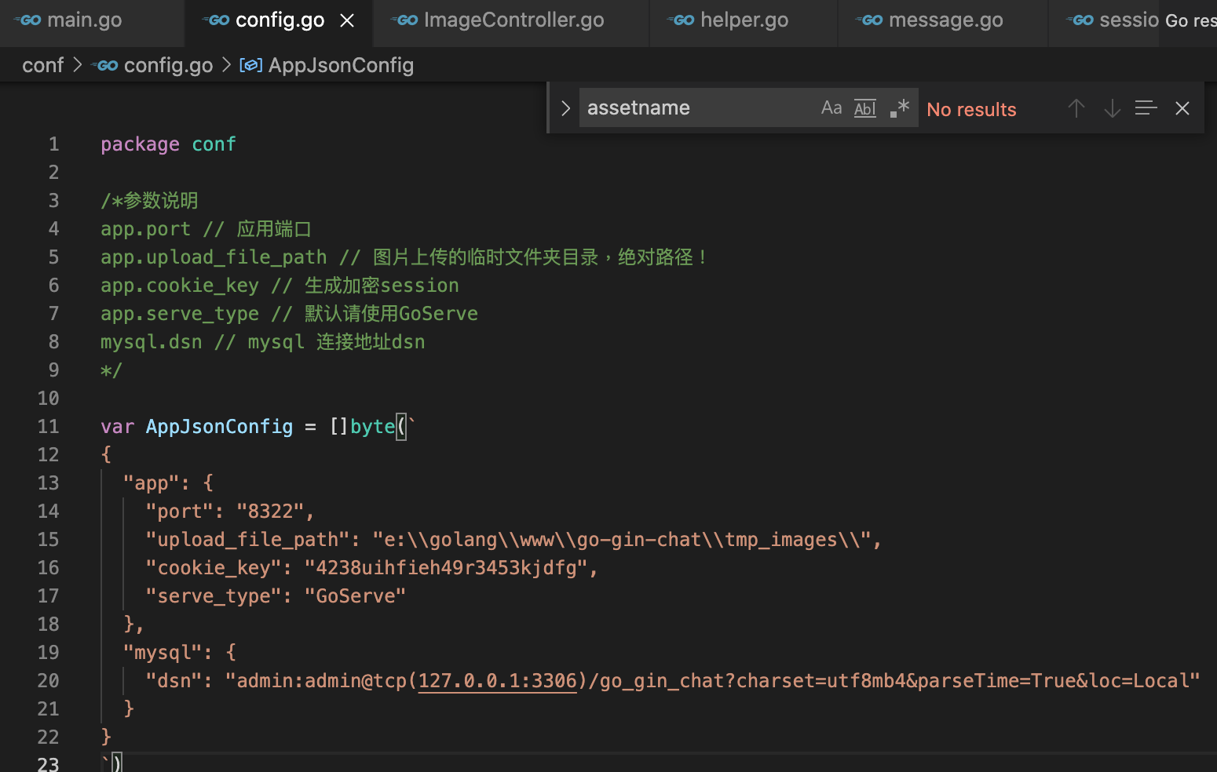
Config 用法
"github.com/spf13/viper”
"go-gin-chat/conf"
viper.SetConfigType(“json”) // GET TYPE OF CONFIG
//READ CONFIG if err := viper.ReadConfig(bytes.NewBuffer(conf.AppJsonConfig)); err != nil {
if _, ok := err.(viper.ConfigFileNotFoundError); ok {
// Config file not found; ignore error if desired
log.Println("no such config file")
} else {
// Config file was found but another error was produced
log.Println("read config error")
}
log.Fatal(err) // }
//GET CONFIG port := viper.GetString(`app.port`)
Notes:
package main
import (
"bytes"
"go-gin-chat/bindata"
"go-gin-chat/conf"
"go-gin-chat/models"
"go-gin-chat/routes"
"html/template"
"log"
"strings"
"github.com/gin-gonic/gin"
"github.com/spf13/viper"
)
func init() {
viper.SetConfigType("json") // 设置配置文件的类型
if err := viper.ReadConfig(bytes.NewBuffer(conf.AppJsonConfig)); err != nil {
if _, ok := err.(viper.ConfigFileNotFoundError); ok {
// Config file not found; ignore error if desired
log.Println("no such config file")
} else {
// Config file was found but another error was produced
log.Println("read config error")
}
log.Fatal(err) // 读取配置文件失败致命错误
}
models.InitDB()
}
func main() {
// 关闭debug模式
gin.SetMode(gin.ReleaseMode)
port := viper.GetString(`app.port`)
router := routes.InitRoute()
// router.LoadHTMLGlob("views/*")
//加载模板文件
t, err := loadTemplate()
if err != nil {
panic(err)
}
router.SetHTMLTemplate(t)
log.Println("监听端口", "http://127.0.0.1:"+port)
router.Run(":" + port)
// http.ListenAndServe(":"+port, router)
}
//加载模板文件
func loadTemplate() (*template.Template, error) {
t := template.New("")
for _, name := range bindata.AssetNames() {
if !strings.HasSuffix(name, ".html") {
continue
}
asset, err := bindata.Asset(name)
if err != nil {
continue
}
name := strings.Replace(name, "views/", "", 1) //这里将templates替换下，在控制器中调用就不用加templates/了
t, err = t.New(name).Parse(string(asset))
if err != nil {
return nil, err
}
}
return t, nil
}

Slide 12
SESSION 使用
"github.com/gin-contrib/sessions"
"github.com/gin-contrib/sessions/cookie"
//先聲明加密 store := cookie.NewStore([]byte(viper.GetString(`app.cookie_key`)))
Route.Use(sessions.Session(“mysession”,store))
//每個gin.HandlerFunc session := sessions.Default(c)
session.Set("uid", info)
session.Save()
Notes:
package session
import (
"go-gofram-chat/models"
"net/http"
"strconv"
"github.com/gin-contrib/sessions"
"github.com/gin-contrib/sessions/cookie"
"github.com/gin-gonic/gin"
"github.com/spf13/viper"
)
func EnableCookieSession() gin.HandlerFunc {
store := cookie.NewStore([]byte(viper.GetString(`app.cookie_key`)))
return sessions.Sessions("go-gin-chat", store)
}
// 注册和登陆时都需要保存seesion信息
func SaveAuthSession(c *gin.Context, info interface{}) {
session := sessions.Default(c)
session.Set("uid", info)
// c.SetCookie("user_id",string(info.(map[string]interface{})["b"].(uint)), 1000, "/", "localhost", false, true)
session.Save()
}
func GetSessionUserInfo(c *gin.Context) map[string]interface{} {
session := sessions.Default(c)
uid := session.Get("uid")
data := make(map[string]interface{})
if uid != nil {
user := models.FindUserByField("id", uid.(string))
data["uid"] = user.ID
data["username"] = user.Username
data["avatar_id"] = user.AvatarId
}
return data
}
// 退出时清除session
func ClearAuthSession(c *gin.Context) {
session := sessions.Default(c)
session.Clear()
session.Save()
}
func HasSession(c *gin.Context) bool {
session := sessions.Default(c)
if sessionValue := session.Get("uid"); sessionValue == nil {
return false
}
return true
}
func AuthSessionMiddle() gin.HandlerFunc {
return func(c *gin.Context) {
session := sessions.Default(c)
sessionValue := session.Get("uid")
if sessionValue == nil {
c.Redirect(http.StatusFound, "/")
return
}
uidInt, _ := strconv.Atoi(sessionValue.(string))
if uidInt <= 0 {
c.Redirect(http.StatusFound, "/")
return
}
// 设置简单的变量
c.Set("uid", sessionValue)
c.Next()
return
}
}

