Slide 1
Node.js

Slide 2
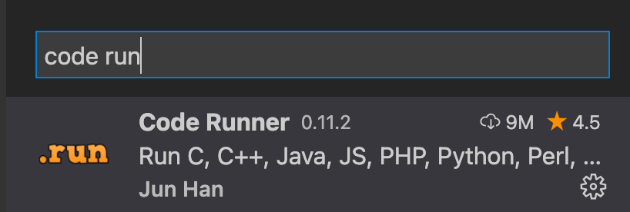
Node install
Node –version
也可以用node app.js 運行
Notes:
不用侷限在網頁瀏覽器
抓這個套件
Npm是node.js 的管理器

Slide 3
Module wrpper
Module wrapper function
在每一個 JavaScript 檔案中所寫的程式碼，都會被 Node.js 用 module wrapping function 封裝起來。這個 function 長得像下面這樣：
(function(exports, require, module, __filename, __dirname){
// 我們寫的程式碼
})
Notes:
底線是兩個

Slide 4
Self made modules
Test1.js Function hi(name){
console.log(“hi,” +name)
} console.log(module)
Module.exports.hi=hi
console.log(module)
====
App.js let test1=require(“./test1”)
cosole.log(test1)
Test1.hi(“yhlizl”)

Slide 5
Node Built-in Modules
https://nodejs.org/dist/latest-v14.x/docs/api/
const path = require(“path”)
let newpath= path.join(__dirname,”test”)

Slide 6
Node server
Const http = require(“http”)
Const server = http.createServer((req,res)=>{
if (req.url==“/”){
res.writeHead(200,{‘Content-Type’:’text/html’})
res.write(“<h1> hi hi hi hi html </h1>”)
res.end()
}else{
res.write(“hi”)
res.end()
}
});
Server.listen(8080,()=>{
})

Slide 7
NPM
Stands for node package manage
www.npmjs.com
Npm init
package.json=>scripts add script with script
For example : “nmon”:”nodemon app.js”
Notes:
Script can use npm run nmon == npm run nodemon app.js

Slide 8
Express
Download => npmjs.com seach express
Npm install express nodemon
Fist program : const express = require(“express”)
const app = express()
app.get(“/”,(req,res)=>{
//res.send(“hi my name is yuhao”)
res.sendFile(__dirname+”/index.html”)
})
app.listen(3000,()=>{
console.log(“running”)
})
Notes:
Nodemon 熱起
Send 可以直接送json object 就變成api res.send({name:”test”})

Slide 9
Routine for all
App.get(“*”,(req,res)=>{
Res.send(“cannont find what you want”)
})
Routine for pattern
App.get(“get/:item”,(req,res)=>{
Res.send(“get:”,req.params.item)
})
Notes:
Routine for all 藥罪下面

Slide 10
Post handling
Const bodyParser=require(“body-parser”)
//middleware
App.use(bodyParser.urlencoded({extended:true}))
App.post(“/postthing”,(req,res)=>{
consol.log(req.body)
let {name,pwd}=req.body
})

Slide 11
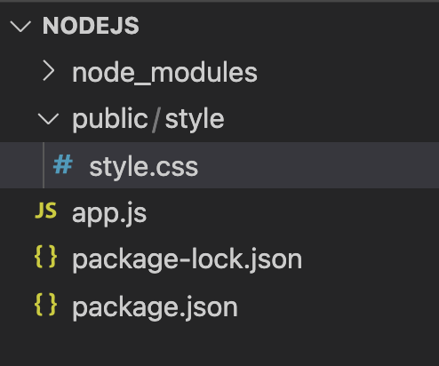
Static file
App.use(express.static(“public”))

Slide 12
ejs
Const ejs=require(“ejs) //embedded js
Res.render(“index.ejs”,object for your params)
Params use <%= params %>
Need to type in js=>
<% for (let i=0;i<10;i++) { %>
<h1><%=i. &><h1>
<% } %>
==server side rendering==

