Slide 1
Tensor flow 2.0

Slide 2
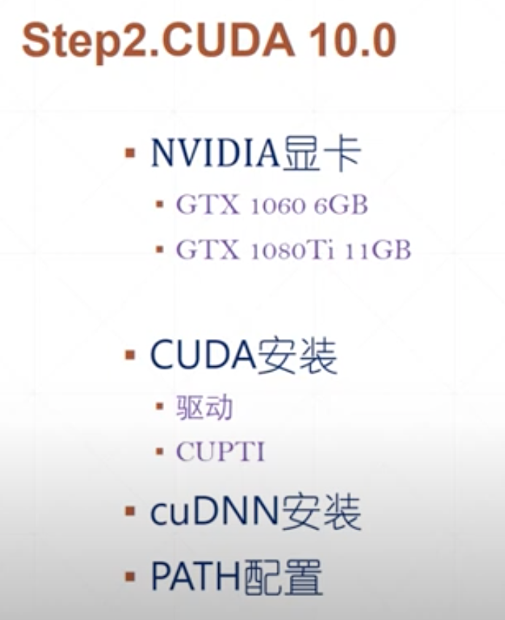
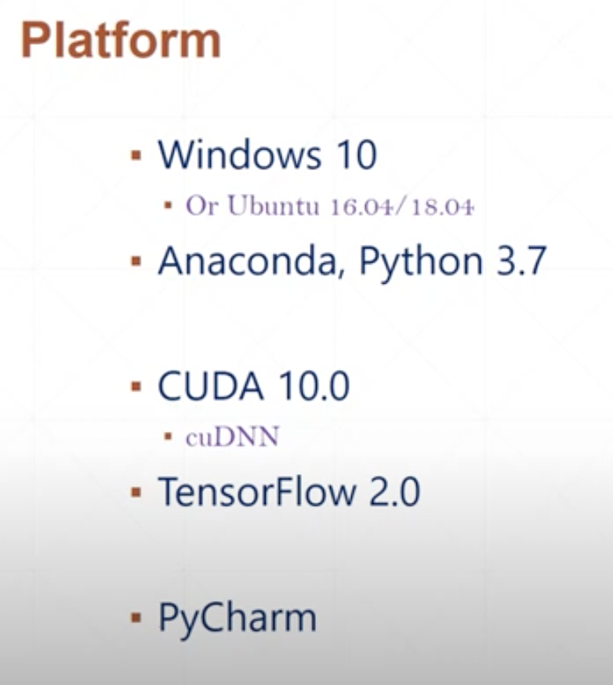

Slide 3
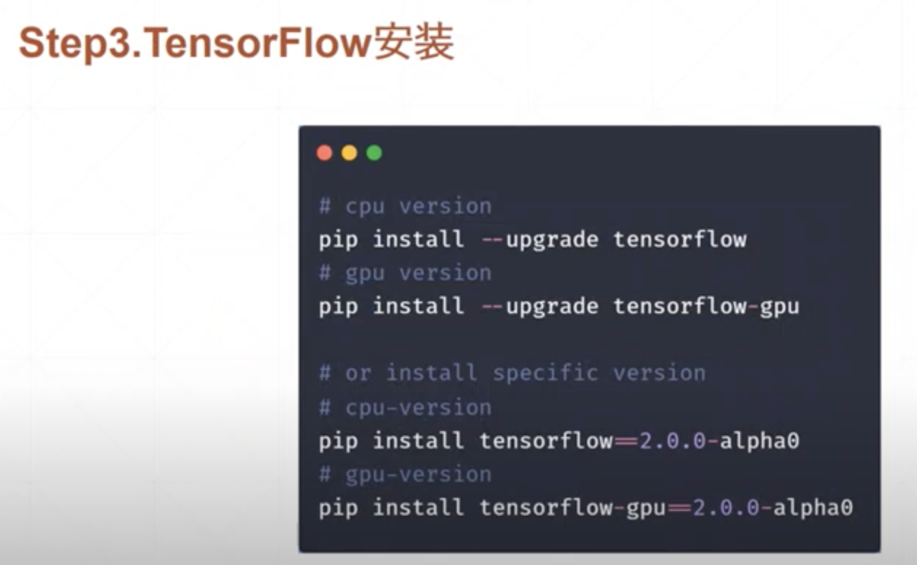

Slide 4
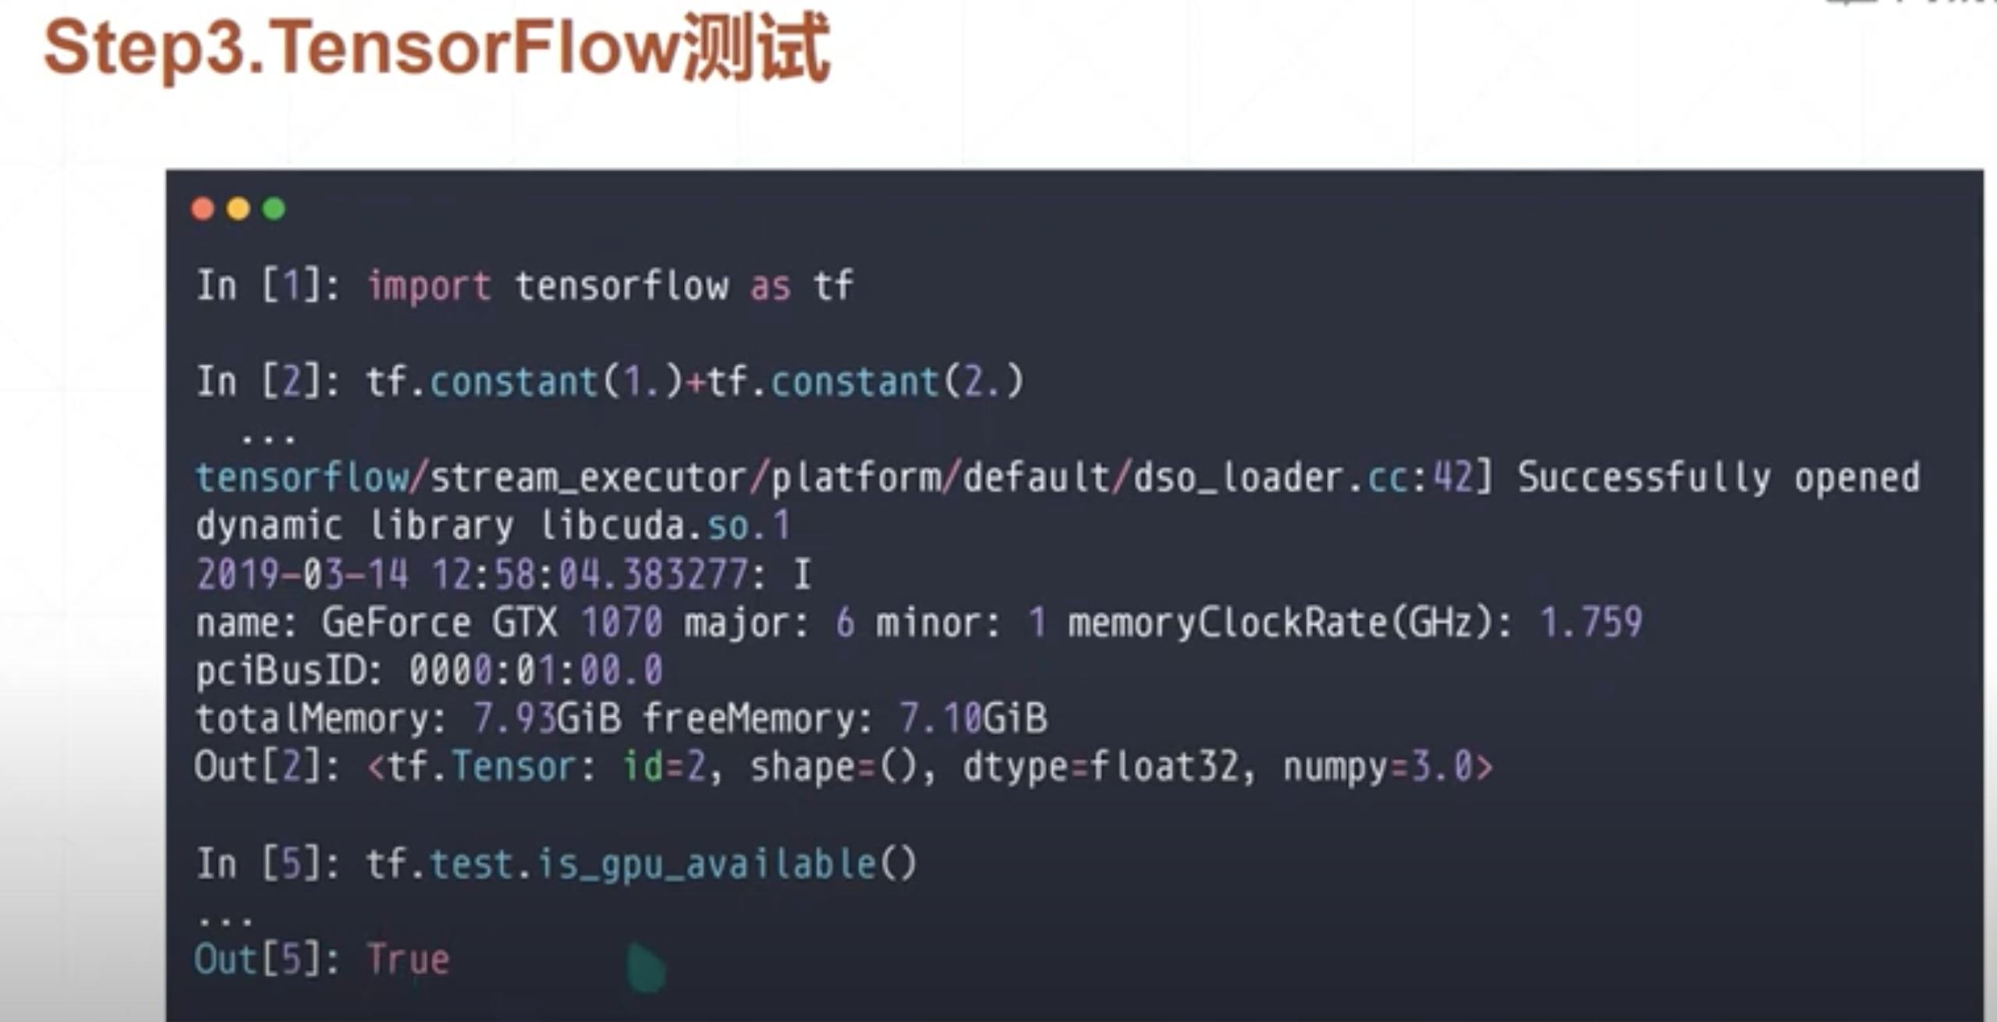
Python check
Cmd: Where ipython //檢查路徑
Cmd: ipython //start python ide

