Slide 1
COMP3021
Programming Assignment 3 (PA3)
JesonMor - multithread version

Slide 2
Overview
PA3 is an extension of PA1, adopting multithreading techniques on the text-version Jeson Mor game.

Slide 3
Players
Human Player vs. Computer Player
HumanPlayer
Move pieces according to human inputs
ConsolePlayer extends HumanPlayer
Has the same functionalities as PA1, e.g. move pieces by input “a1->b3”
New Feature: Perform Actions
Undo the last move of human player
Show move history
Thread control

Slide 4
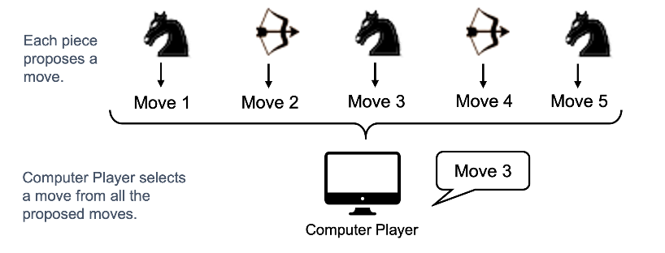
Players
Human Player vs. Computer Player
ComputerPlayer
Move pieces according to a predefined strategy automatically
Each piece belonging to ComputerPlayer is an independent thread
When computer player tries to make a move:
Each piece thread should independently propose one move according to a predefined behavior of that piece.
The player gathers all the proposed moves and choose one according to the player’s strategy.

Slide 5
Piece of ComputerPlayer
Each piece of ComputerPlayer is an independent thread.
Each piece can be:
Paused:
The paused piece does not propose any move when it’s the turn of HumanPlayer to make a move.
Resumed:
The paused piece can be resumed, which means it can propose a move when it’s the turn of HumanPlayer to make a move.
When game starts all pieces are at resumed state (i.e. they can propose move)
Terminated:
The terminated piece is similar to paused piece which does not propose move.
The terminated piece cannot be resumed.

Slide 6
Strategy
Strategy is with respect to ComputerPlayer
Two strategies:
Strategy.RANDOM:
Randomly choose one from the proposed moves of its pieces
Strategy.SMART
Choose the move wisely.
The strategy will need to implemented so that the ComputerPlayer is able to win the game against a random ComputerPlayer.

Slide 7
Behavior
Strategy is with respect to Pieces belonging to ComputerPlayer
Four behaviors:
Behavior.RANDOM:
Piece randomly proposes a move from its available moves
Behavior.GREEDY:
Piece proposes a move that is most likely to win.
Behavior.BLOCKING:
Piece prefers to propose a move that blocks an enemy’s knight
Behavior.CAPTURING:
Piece prefers to propose a move that captures an enemy’s piece

Slide 8

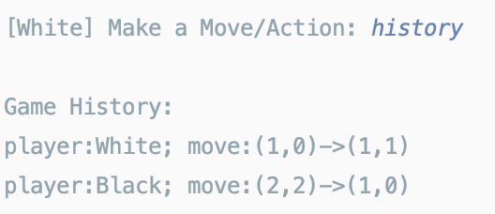
Action
Action can be performed when it’s HumanPlayer’s turn.
Run action in the player’s console
ShowHistoryAction
Show the current move history

Slide 9

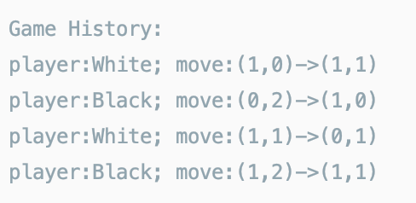
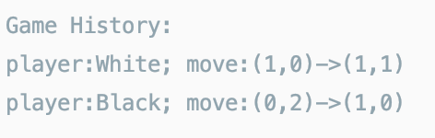
Action
UndoAction
Undo the last move of HumanPlayer.
Before undo: (player:White is HumanPlayer)
After undo

Slide 10
Action
PausePieceAction
Pause one piece
ResumePieceAction
Resume one piece
TerminatePieceAction
Terminate one piece

Slide 11
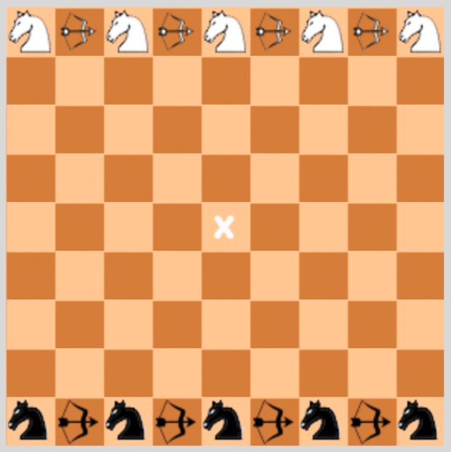
Critical Region
Two more configuration:
CriticalRegionSize
CriticalRegionCapacity
Critical Region Size
The number of rows in the middle of game board
Critical Region Capacity
The max number of Knights of each player that can be simultaneously inside the critical region.
CriticalRegionSize=3

Slide 12
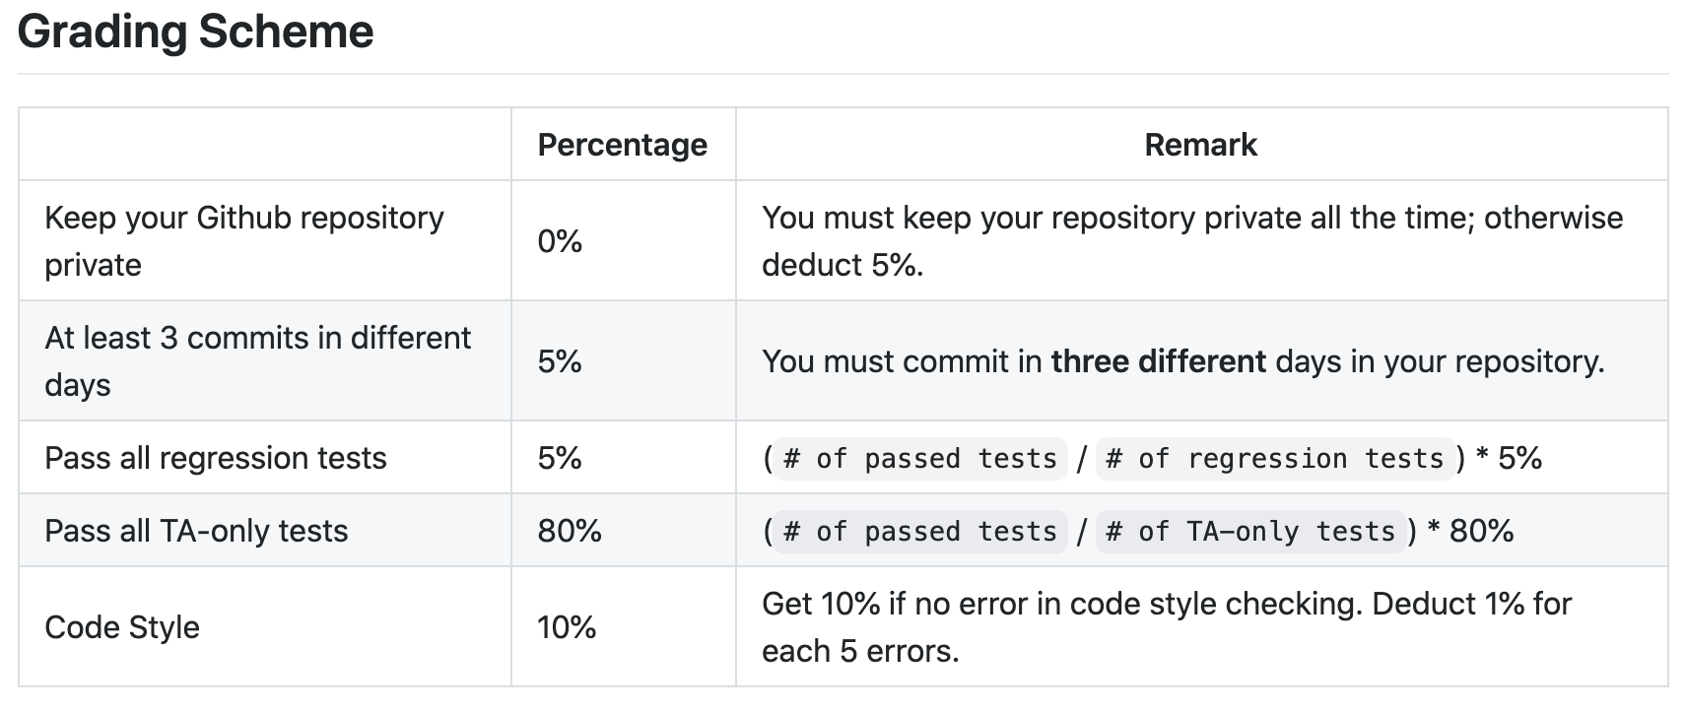
Tests & Grading
Since PA3 is an extension of PA1, we provide PA1 regression tests for you to check your implementation in terms of functionalities of PA1.
Tests for PA3 functionalities are TA-only.

Slide 13
Submission
PA3 Deadline: 10 Dec. 2020, 23:55
Your submission is a zip file including:
The IntelliJ project.
github_url.txt file containing the url of your private repository.
Submit to CASS PA3

Slide 14
COMP3021
Lab 10: multithreading and synchronization

Slide 15
Why we need multithreading
We want our program do two tasks simultaneously
Draw GUI and respond to user events (main thread of JavaFX)
Background computation
E.g. In Microsoft Word,
A thread to respond when you are typing words
A thread to do spell checking, word counting,…
Otherwise, the GUI could be frozen
E.g., Chrome not responding when downloading webpage resources

Slide 16
How to implement multithread (General, NOT limited to GUI)
Extending the Thread class (not preferred),
Passing the thread constructor an object which implements the Runnable interface
Regular class
Anonymous class
Lambda

Slide 17
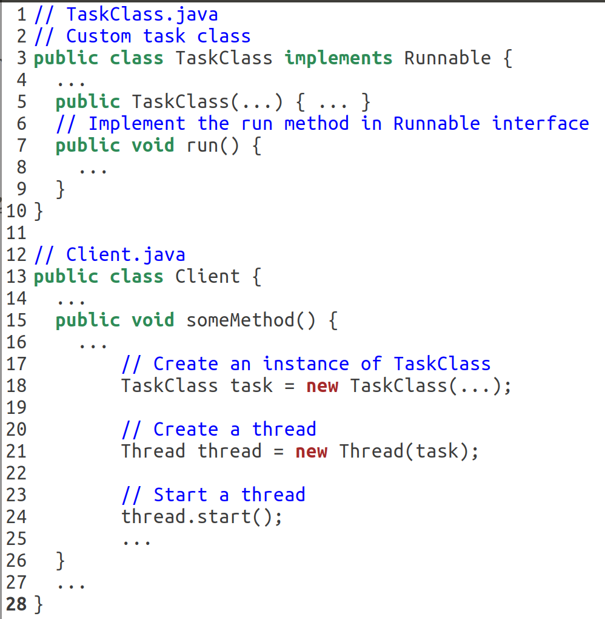
1. Creating a regular class that implements Runnable
run() method defines what task each thread will do
Create a new thread and let it start

Slide 18
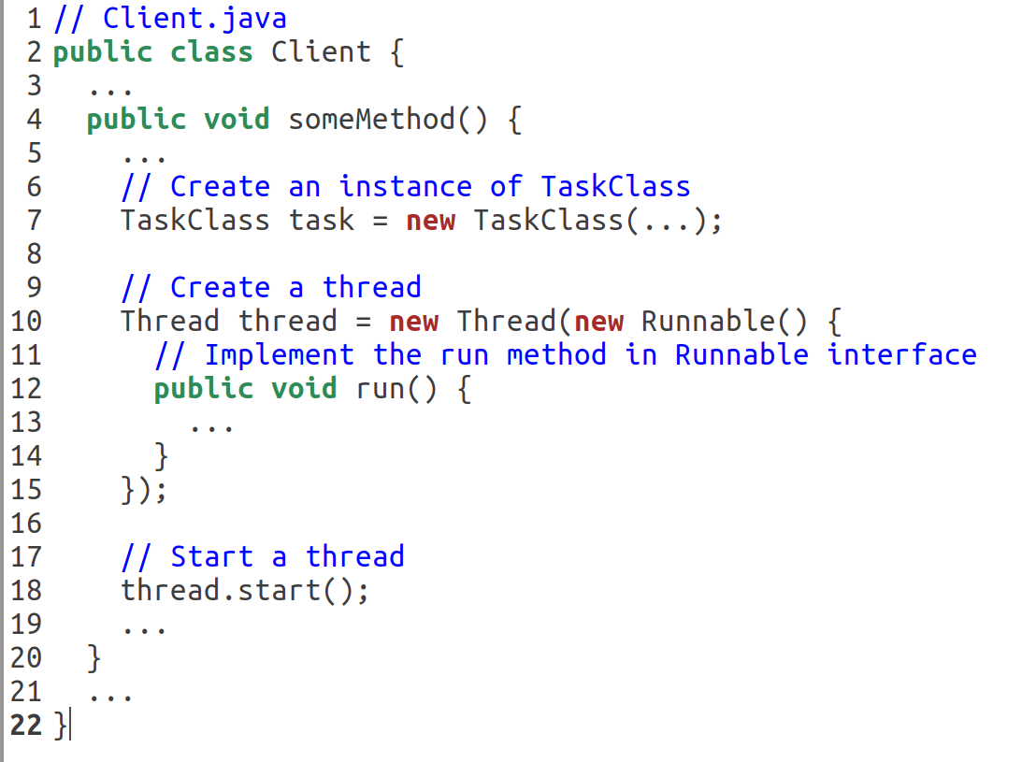
2. Anonymous class
Create a new thread using Anonymous class

Slide 19
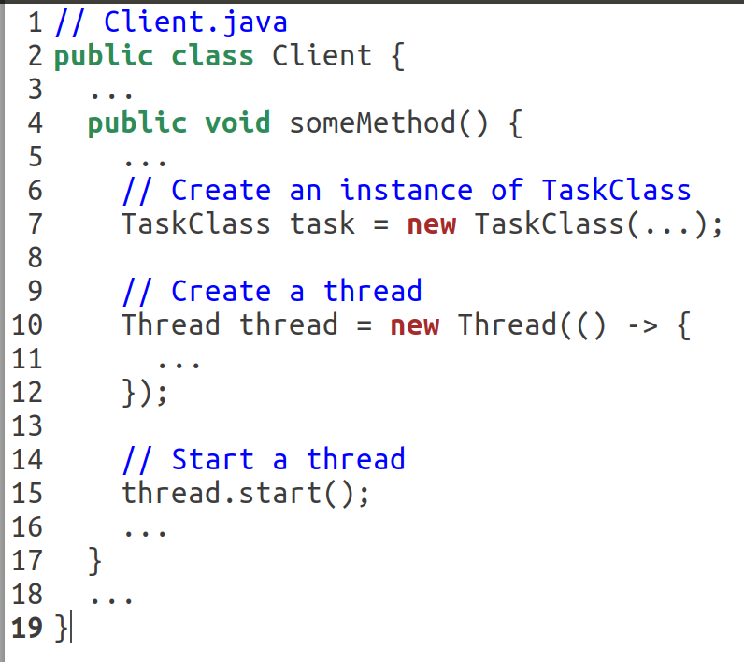
3. Lambda expression
Create a new thread using Anonymous class

Slide 20
What we will do in today’s lab
Round Robin String Merge
Each thread has an ID and its own string.
Threads take turns (sorted by id) to append a char in its string in the shared result string.
Thread
Id = 0
“hl”
Append ‘l’
Append ‘h’
hello!
hello
hel
hell
he
Thread
Id=1
“eo”
Append ‘o’
h
Append ‘e’
Append ‘l’
Append ‘!’
Thread
Id=2
“l!”

Slide 21
Tips
Synchronize Threads
You need to synchronize all threads to make sure they append char one by one in the order of their IDs.
If your implementation is correct, the merged result should be deterministic in different executions.
You can any technique to synchronize threads, including but not limited to:
synchronized keywords
wait()/notify()/notifyAll()
ReentrantLock
Condition
Semaphore
BlockingQueue
…
Make sure all threads can exit after the merge is done.

Slide 22
Submission
Grading:
1 point: pass all given tests
1 point: attend lab zoom meeting at least 15 minutes
Deadline: Nov 17 23:55.
Zip your IntelliJ project and submit to CASS lab10

