Slide 1
COMP3021 Lab11
Generics & bounded generic types

Slide 2
Fill in the time slot for PA2 GUI demo
The PA2 GUI demo: Nov 21 - 22 (this weekend).
Please fill in the timeslot in the online table below by Nov 20

Slide 3
Generics
Generics enable types (classes and interfaces) to be parameters when defining classes, interfaces and methods.
A way to re-use the same code with different inputs.
The difference from the formal parameters:
Formal parameters: inputs are values.
Type parameters: inputs are types.

Slide 4
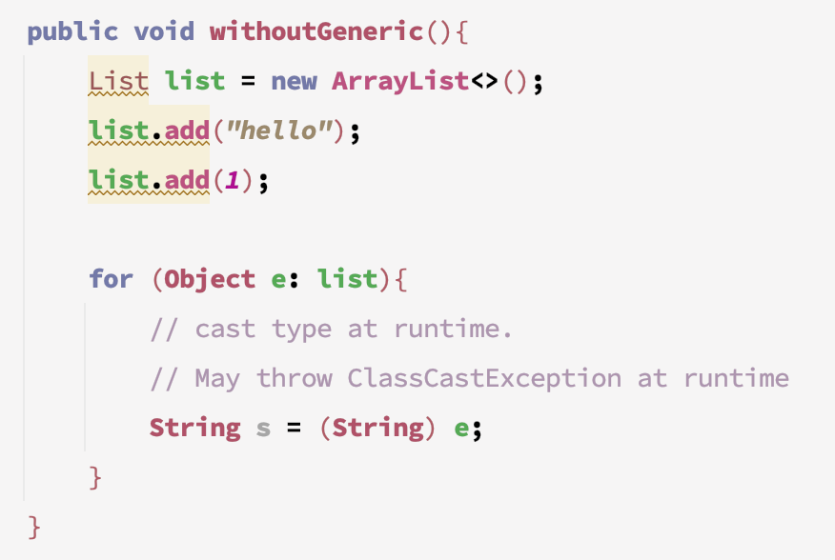
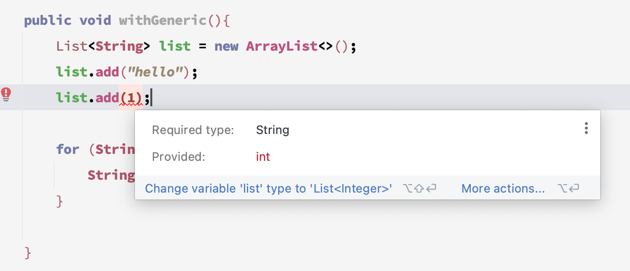
Benefits
Provide a stronger type checks at compile time.
A Java compiler applies strong type checking to generic code and issues errors if the code violates type safety

Slide 5
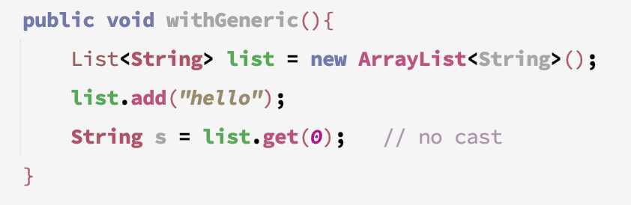
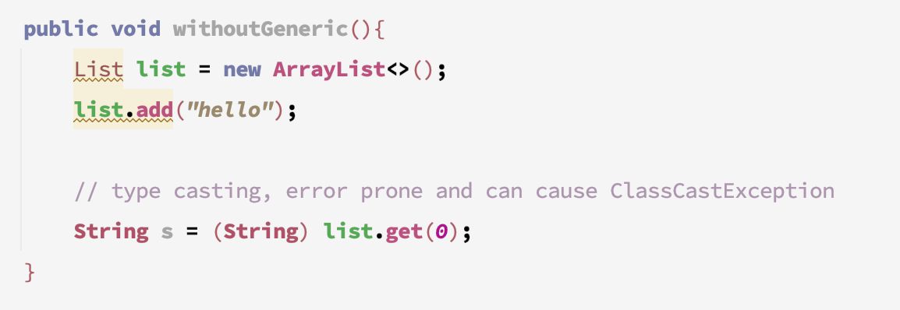
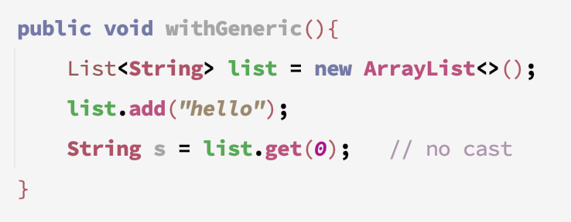
Benefits
Avoid type casting
With Generics
Without Generics
With Generics (After Java 7)

Slide 6
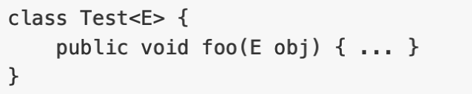
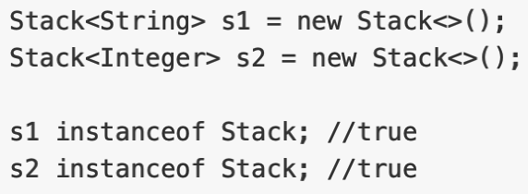
Generic Class
Defining a generic class
A generic class is shared by all its instances regardless of its actual type.

Slide 7
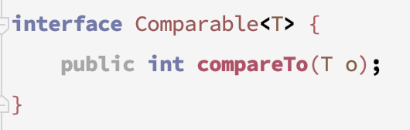
Generic Interface
Define a generic interface

Slide 8
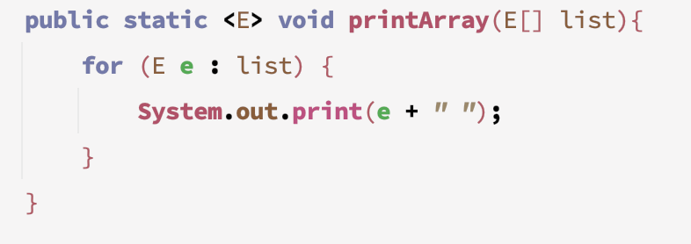
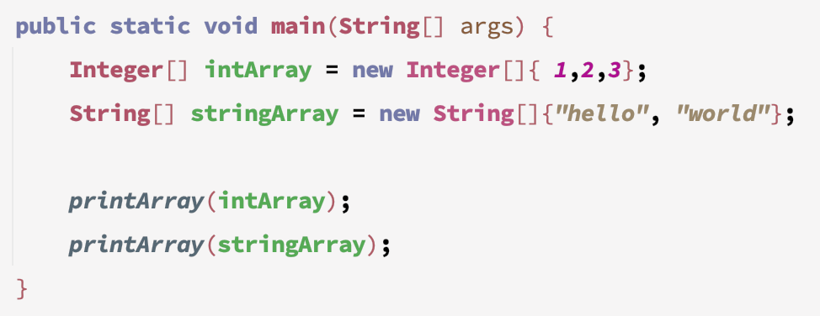
Generics Method
Generic methods are written with a single method declaration but can be called with arguments of different types.
The type parameter should be placed before the return type
Generic methods can have more than 1 type parameter, separated by commas in method signature

Slide 9
Bounded Generics
We can restrict the types that can be accepted by a method.
For example, we can specify that we accept the type and all its subclasses (using the extends keyword).

Slide 10
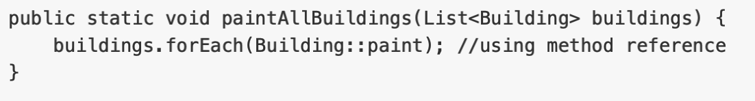
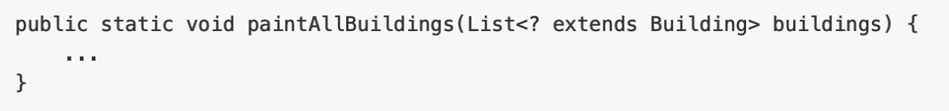
Wildcards and Generic Inheritance
Generic type inheritance
Suppose Building is the parent of House
List<Building> is NOT the parent of List<House>!
We can use wildcards to solve this problem

Slide 11
Wildcards and Generic Inheritance
Wildcards allow us to use generic types as polymorphic types
Some examples:
ArrayList<Object> is a subclass of ArrayList<?>
ArrayList<Integer> is a subclass of ArrayList<? extends Number>
ArrayList<Number> is a subclass of ArrayList<? extends Number>
ArrayList<?> is a subclass of ArrayList<? extends Object>
List<? extends Integer> is a subtype of List<? extends Number>

Slide 12
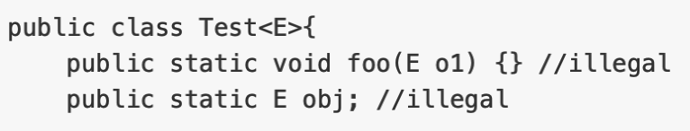
Restrictions on Generic Types
Cannot instantiate a generic type (e.g. new E()), since we don't know how much memory to allocate
Cannot create array of generic type (e.g. new E[100]) for the same reason
Exception classes cannot be generic
Generic type parameter of a class is not allowed in static context

Slide 13
Lab Outcome & Submission
Import the Lab 11 project to IntelliJ
Finish the TODOs
Make sure your implementation can pass the provided test cases
Zip and submit `src` folder to CASS (deadline: 23:55 Nov 24)

