Slide 1
COMP3021 Lab Review

Slide 2
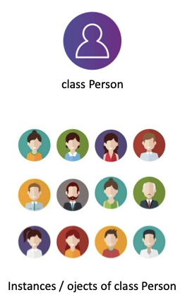
Lab 3: Classes, objects
A class is a user defined prototype from which objects are created.
It represents the set of properties or methods that are common to all objects of one type.

Slide 3
Lab 4: Strings & StringBuilder
String: Once created, a String object cannot be modified
String str1 = "abc";
String str2 = "abc";
str1 == str2 // true, “==” tracks if they refer to the same object
str1.equals(str2) // true, checks if the two strings have the same characters
StringBuilder: A class for mutable sequence of characters.
StringBuilder sb = new StringBuilder(); // creates an empty builder
sb.append("olleh"); // adds the string "olleh" into the builder
sb.reverse(); // reverses the sequence internally

Slide 4
Lab 5: Inheritance & polymorphism
An important concept in OOP
Superclass and subclass
A subclass overrides a superclass method when the method signature is the same

Slide 5
Lab 6: Abstract classes, interfaces, private/default interface methods & nested classes
An interface is a class-like construct that contains constants and abstract methods
A class can only extend one class but can implement multiple interfaces.
An abstract class have 0 or more abstract methods
Abstract methods can only be declared in an abstract class.

Slide 6
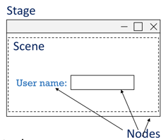
Lab 7: GUI programming & JavaFX
Stage: (a window) contains all the objects of a JavaFX application
Scene: represents the physical contents of a JavaFX application
Node: a visual/graphical object of a scene graph

Slide 7
Lab 8: Event driven programming
In event-driven programming, code is executed upon activation of events such as user actions (e.g. key presses and mouse clicks)
To do this, we create a listener class, and call the handler method in the listener when the event is triggered.

Slide 8
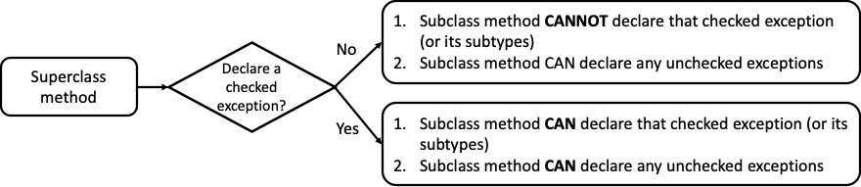
Lab 9: Exceptions, file i/o & local var inference
Exceptions indicate unexpected events or errors in the program.
Checked exceptions: Are checked at compilation time
Unchecked exceptions: Not checked at compilation time

Slide 9
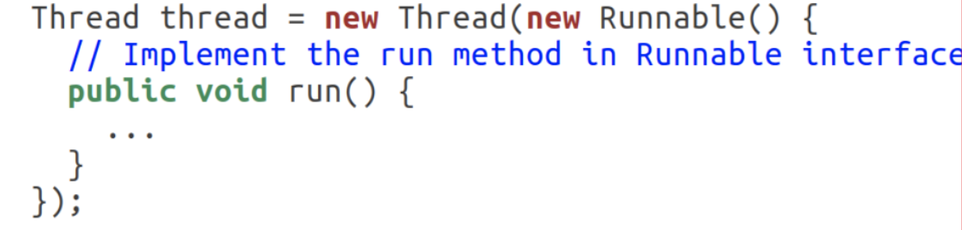
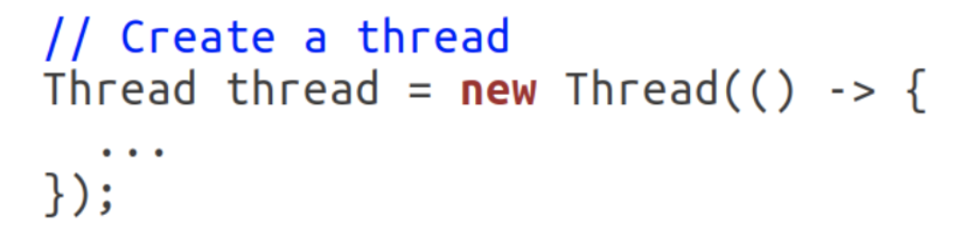
Lab 10: Multithreading & synchronization
How to implement multithread
Regular class implements Runnable
Anonymous class
Lambda

Slide 10
Lab 11: Generics & bounded generic types
Generics enable types (classes and interfaces) to be parameters when defining classes, interfaces and methods.
We can restrict the types that can be accepted to be certain class and its subclasses.
We can use wildcards to use generic types as polymorphic types

Slide 11
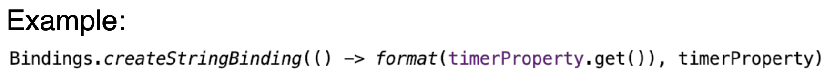
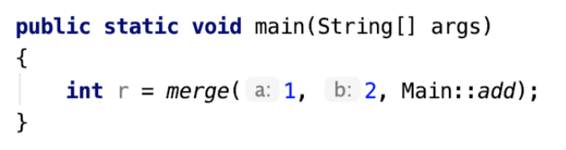
Lab 12: Lambda expressions, function objects & high-order functions
A Java lambda expression is a function which can be created without belonging to any class. It can be passed around as if it were an object and executed on demand.
You can use the :: operator to get a function object from an existing method.

Slide 12
Common mistakes

Slide 13
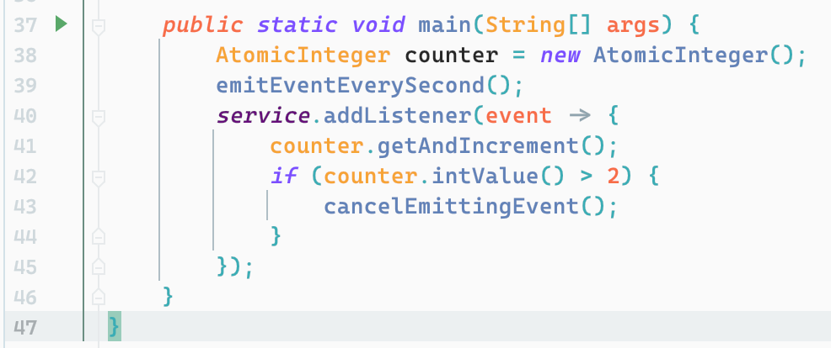
Event Emitting and Listening
Lab8 Task: use event listener to stop timer after three events.
Listener.onEvent()
Tick Tick
Emit Event Every 1 sec
Event Dispatch Service
Set<Listener> listeners
Service.emitEvent(event)
Listener.onEvent()
Listener.onEvent()

Slide 14
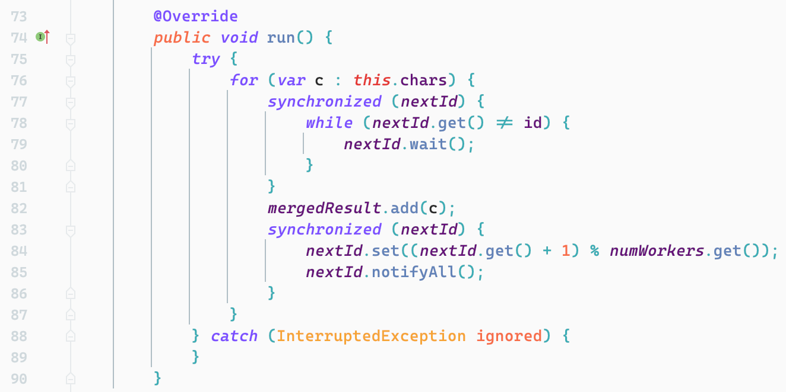
Thread Sychronization

Slide 15
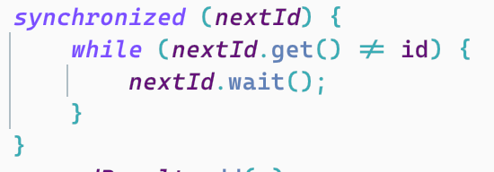
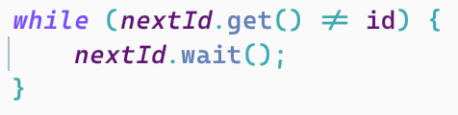
Wait()/Notify()/NotifyAll()
They are methods of objects, i.e. each object have its own wait()/notify()/notifyAll() method.
Notify() of object A will not awake another thread waiting on object B.
Calling wait()/notify()/notifyAll() has prerequisite:
Current thread must hold the lock of the object before calling its wait()/notify()/notifyAll() methods
Correct
Wrong

Slide 16
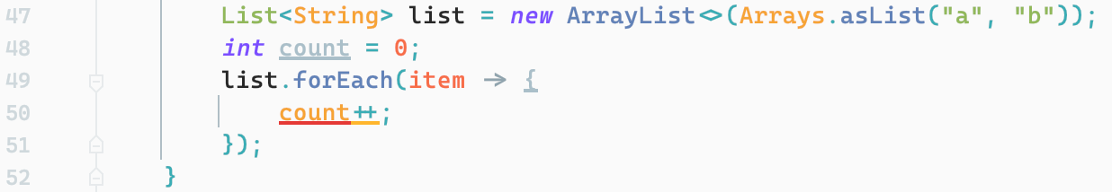
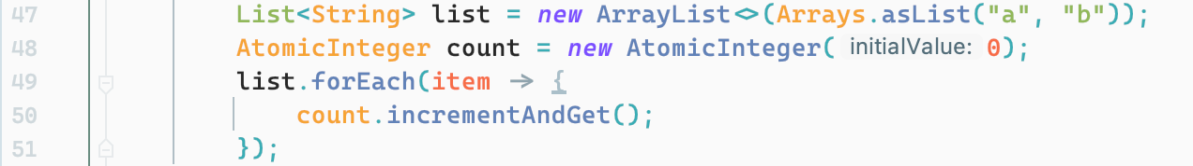
Effectively Final Variables
Lambda expressions can only used effectively final variables from outside scope.
Value stored in the variable “count” may be changed, so “count” variable is NOT effectively final.
Value stored in the variable “count” will NOT be changed, so “count” variable is effectively final.
But we can still change the content of the object.

