Slide 1
COMP3021 Lab 2
Wuqi Aaron ZHANG
wuqi.zhang@connect.ust.hk

Slide 2
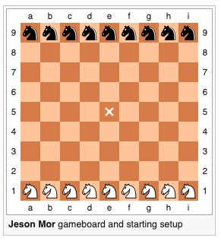
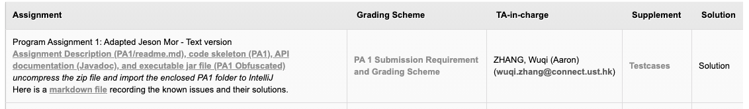
Programming Assignment 1 (PA1)
Adapted, text version of Jeson Mor, with additional rules.
Released at GitHub:
https://github.com/CastleLab/COMP3021-2020Fall-PA1-Student-Version

Slide 3
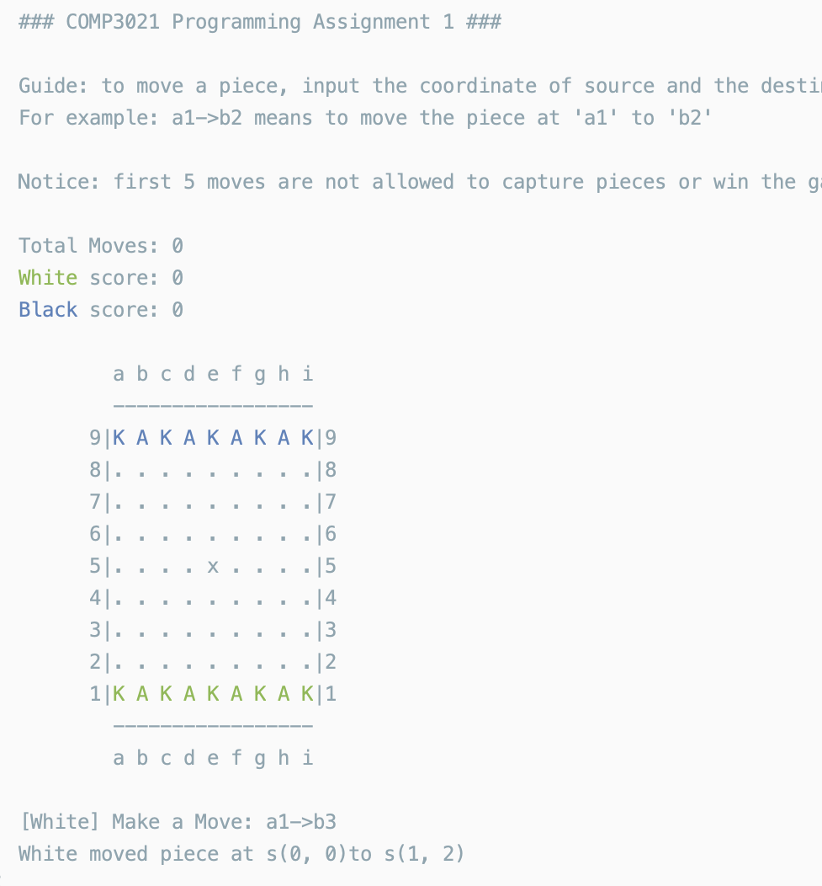
PA1: Obfuscated Version
We provide an obfuscated version of PA1 for your reference.
You can
Understand the functionality
Get familiar with the rules of pieces
…
Requirements for printing/text-display
No requirements
We will not test your print in the console

Slide 4
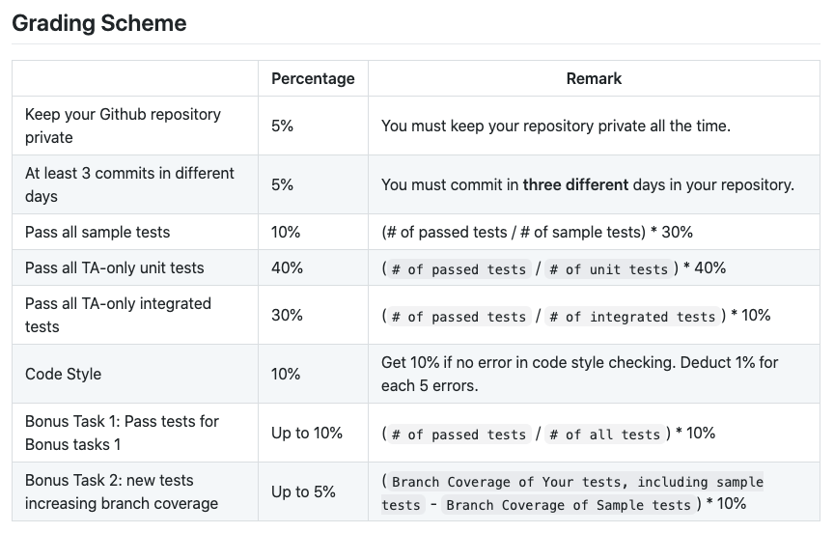
PA1: Grading Scheme
GitHub (10%)
Tests (80%)
Sample tests
TA unit tests
TA integrated tests
Code Style (10%)
Bonus 1 (up to 10%)
Bonus 2 (up to 5%)
Maximum 100%

Slide 5
PA1: Have Questions?
Frequently Asked Questions Section:
https://github.com/CastleLab/COMP3021-2020Fall-PA1-Student-Version/blob/master/FAQ.md
Email to TAs
Make an appointment of zoom meeting with TA through email.

Slide 6
PA1: Submission
Submit on CASS (not Canvas)
Your submission should be a zip file, including
Your Java project. (please maintain the initial project structure)
An github_url.txt which contains the URL of your private GitHub repository. (later you will be asked to add TAs’ accounts as collaborators)
Deadline:
5 Oct. 2020, 23:55.
No late submission is accepted.

Slide 7
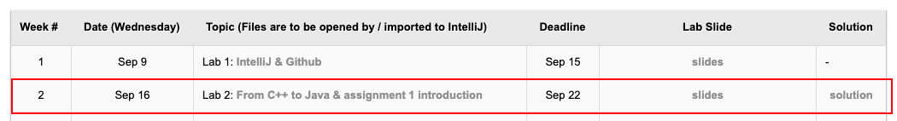
Lab2: From C++ to Java
Materials can be downloaded at course website. https://course.cse.ust.hk/comp3021/#labs

Slide 8
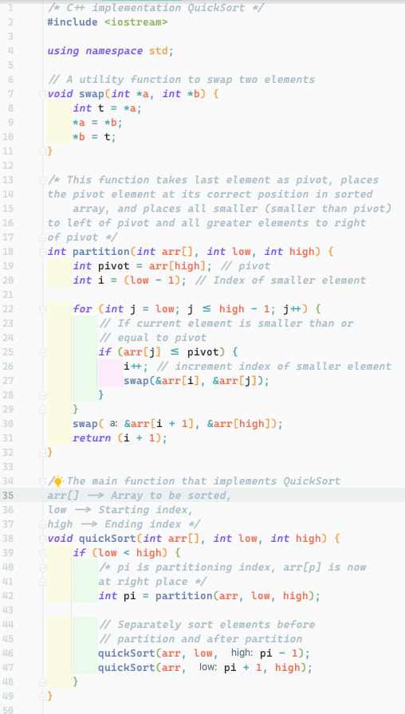
Lab2: Task
Convert C++ program to Java program
You are provided a C++ program doing Quick Sort.
Your task is to
Implement the Java version of Quick Sort
Pass the provided tests

Slide 9
Lab2: Project Structure
Decompress the downloaded “lab2.zip” and import the project in IntelliJ IDEA.
“main.cpp” contains the C++ implementation of Quick Sort
“src/Main.java” is where you should write Java code to implement Quick Sort.
We have prepared code skeleton for you, you only need to implement “quickSort” method.
You can declare other methods of classes as you wish.
“test/QuickSortTests.java” is tests for quick sort which your implementation should pass.

Slide 10
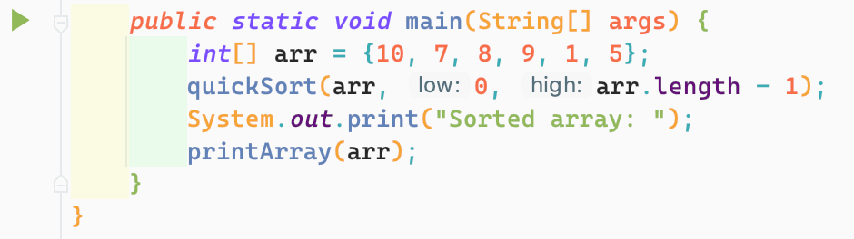
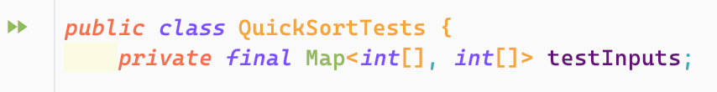
Lab2: Run & Test
To run the Java main method, click the green icon in the left of main method.
To run the tests, click the green icon in the left of the “QuickSortTests” class.

Slide 11
Lab2: Submission
Submit your “Main.java” to CASS by 22 Sep. 2020, 23:55.
You will get 1 mark if you attend the lab for at least 15 minutes.
You will get 1 mark if your code pass the provided tests. (no other tests anymore)
NOTE: When submitting to CASS, choose Lab2. DO NOT submit to Assignment 1 (PA1)

