Slide 1
COMP3021 Lab 3
Classes, Objects

Slide 2
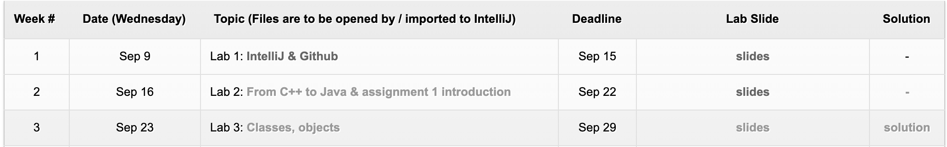
Lab 3 Materials
Download today’s lab material from Course Website
https://course.cse.ust.hk/comp3021/#labs
Lab 3 material: A “Lab3” project containing a src directory, a readme.md and a uml.png

Slide 3

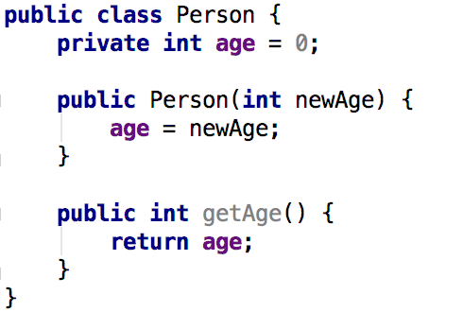

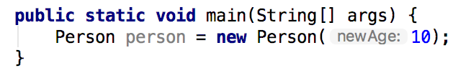
Classes and Objects
Class
Object
class Person
Instances / ojects of class Person

Slide 4

Static Methods and Variables
Like C++ (COMP2012)
Static methods and variables belong to a class, not a specific object
They can be called via the class name
All instances of a class share the same copy of static variables
Shared

Slide 5
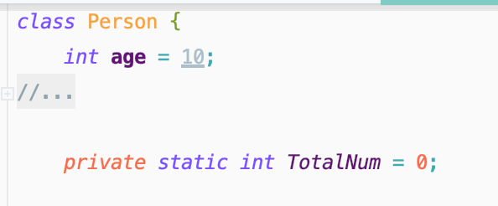
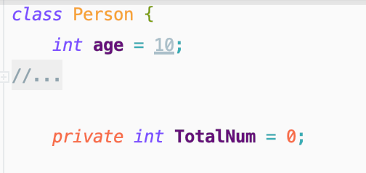
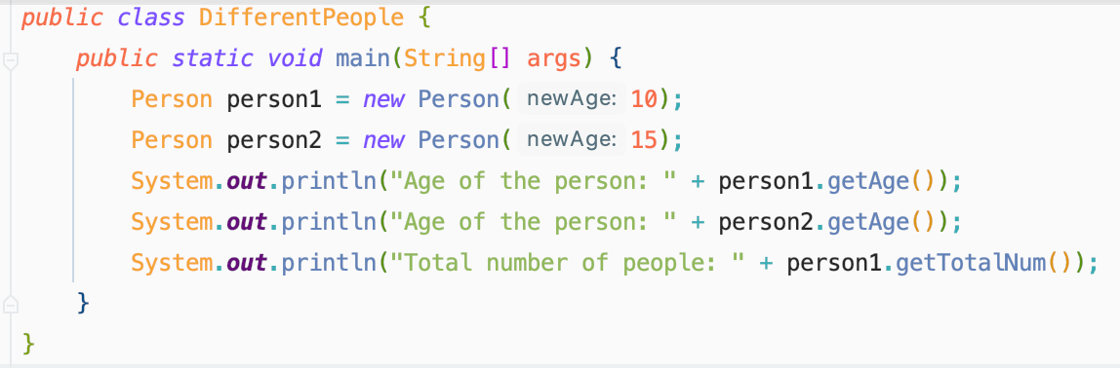
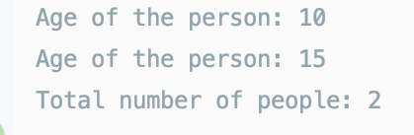
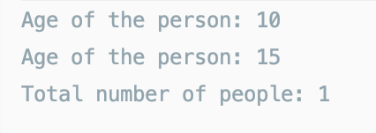
Example of static variables

Slide 6
Field Initialization
Instance initialization block
Static initialization block
Class & object initialization with inheritance (For later reference after inheritance)

Slide 7
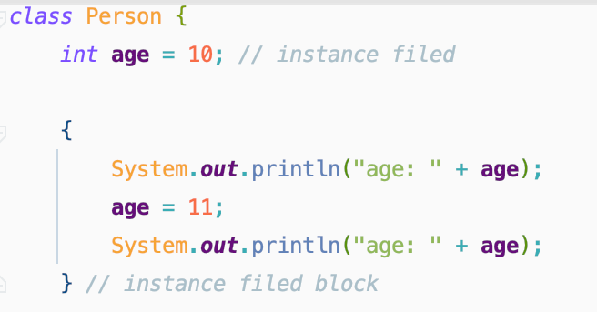
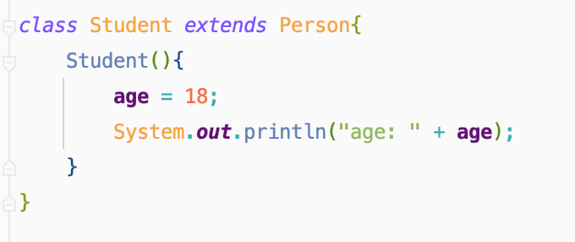
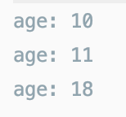

Instance Initialization Block (IIB)
Executed every time when an object of this class is created
An instance initialization is executed in the following relative order:
All data fields initialized to default values (0, false, or null)
Field initializers and IIBs executed according to order of appearance
Body of constructor executed after the body of its superclass constructor
Output

Slide 8
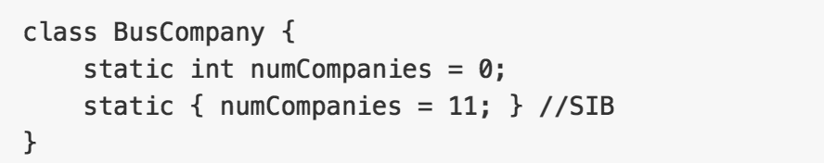
Static Initialization Block (SIB)
Executed only once when the class is initialized by JVM
An SIB is executed in the following relative order:
All static data fields initialized to default values (0, false, or null)
Static field initializers and SIBs executed according to order of appearance

Slide 9
Class & Object Initialization with Inheritance
Class initialization (only once)
Every static data field initialized to default value (0, false, or null)
Superclass' static field initializers/SIBs evaluated in order of appearance
The class’ static field initializers/SIBs evaluated in order of appearance
Object instantiation (0 or more times)
Superclass' instance field initializers/IIBs evaluated in order of appearance
Body of superclass’ constructor executed
The class' instance field initializers/IIBs evaluated in order of appearance
Body of the class’ constructor executed

Slide 10
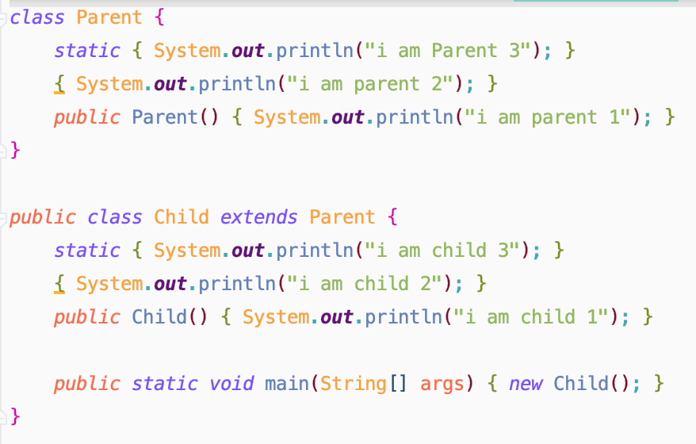
What is the initialization order with inheritance
What is the order of output?
Entry point
Code is available in readme.md

Slide 11
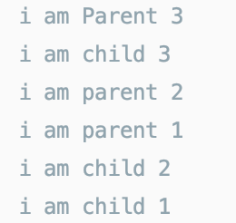
What is the initialization order with inheritance
Answer

Slide 12
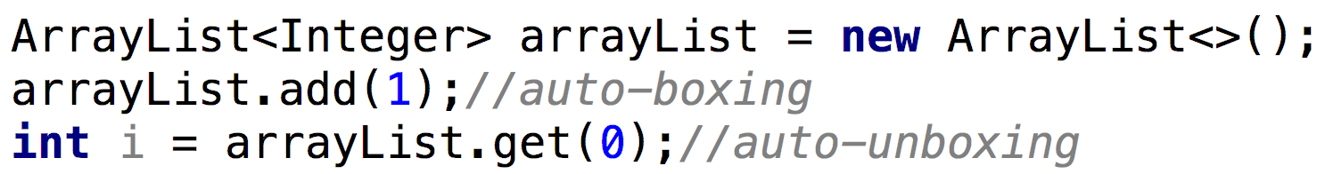
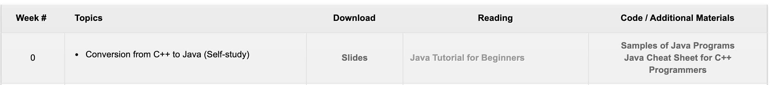
Wrapper Class
Java provides wrapper classes to wrap primitive types *
This is useful when you would like to use classes in java.util (e.g., ArrayList) for primitive types
Auto-boxing is the automatic conversion that the Java compiler makes between the primitive types and their corresponding object wrapper classes.
* In case some students are new to JAVA, the beginner tutorial is provided in course website.

Slide 13

Unit test and JUnit (Basic)
Unit test
To isolate each part of a program and test the correctness of individual parts
JUnit
A framework for Unit test in Java
User Guidance: here

Slide 14
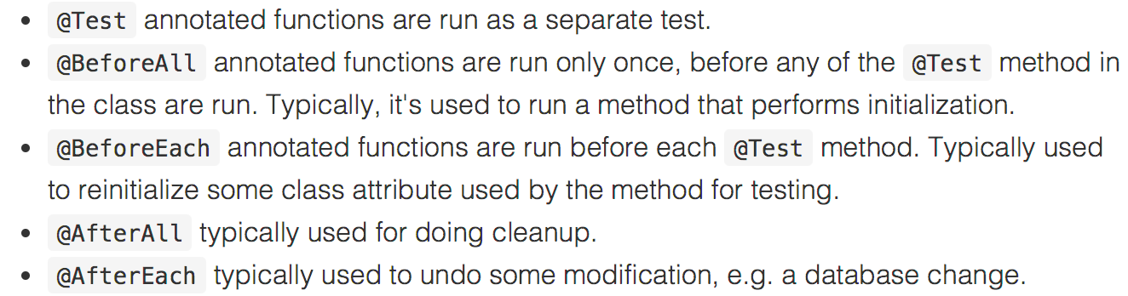
Unit test and JUnit (Basic)
JUnit
Useful annotations (More annotations can be found here)

Slide 15
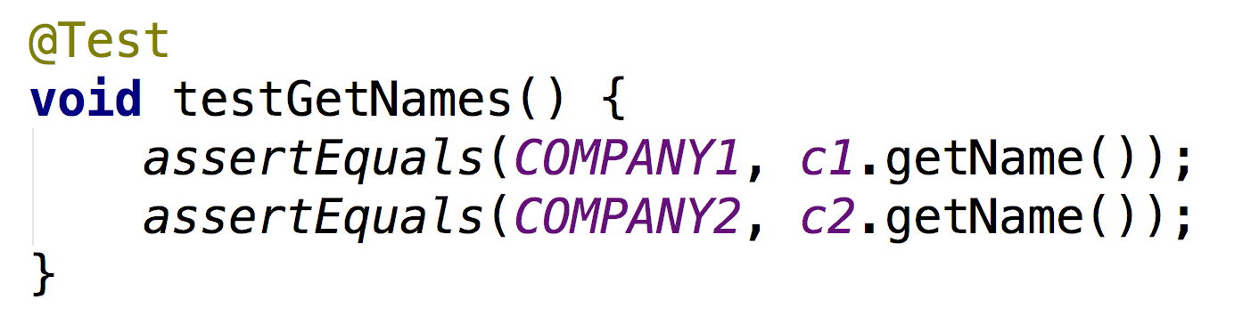
Unit test and JUnit (Basic)
JUnit
Assertions: Evaluate whether the methods under test behave as expected
Pass: The methods under test behave as expected
Fail: The methods under test do not behave as expected
Different assertions in JUnit
assertEquals, assertTrue, assertFalse

Slide 16
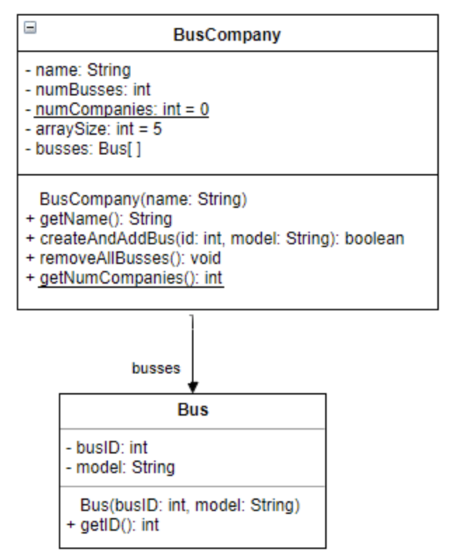
Lab 3 Implement Your Classes
You need to figure out whether variables / methods should be static!
Implement two classes as specified by the UML (Class Diagram)
Define the variables (attributes)
Define and implement the methods
Your implementation should pass all the given test cases
More specifications of the classes are in the README.md

Slide 17
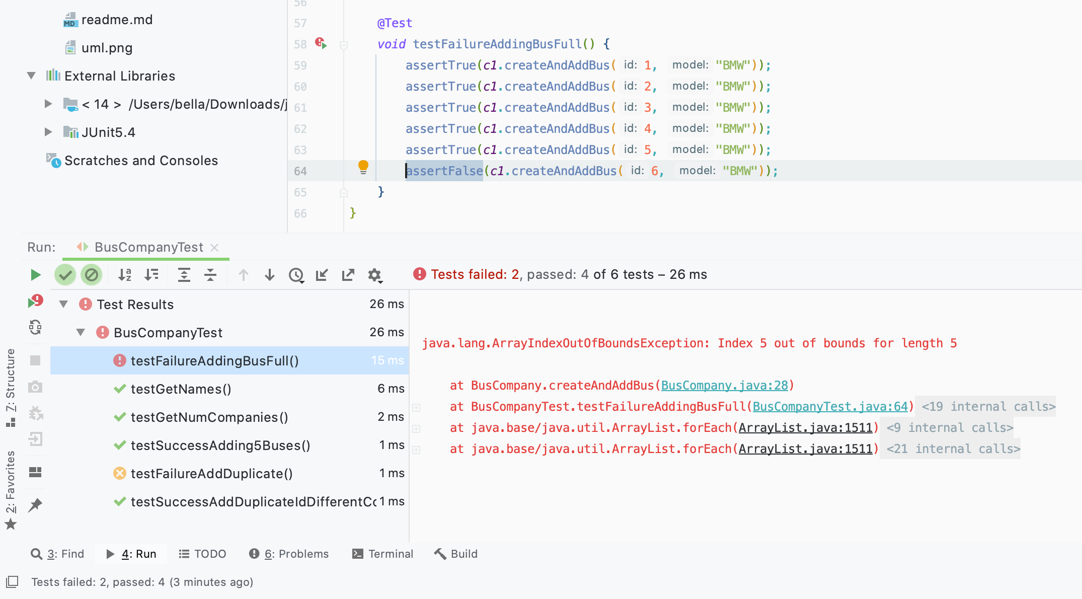
Demo: Test failed
You may use tests to guide the implementation of 2 classes.

Slide 18
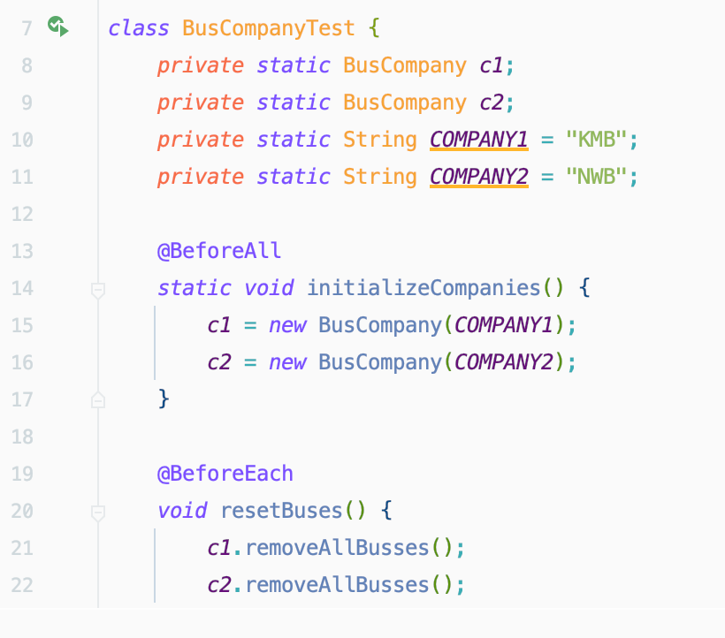
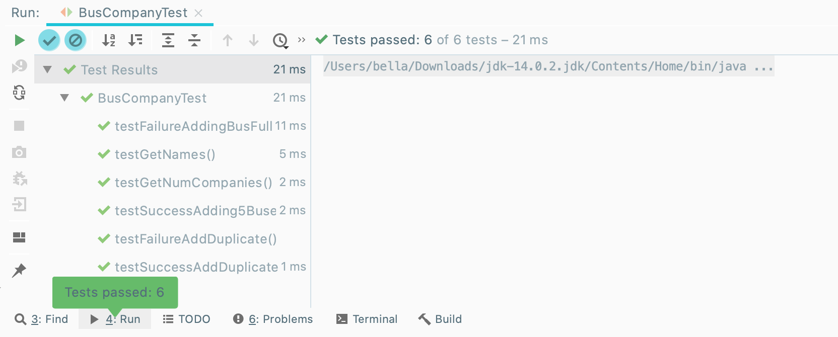
Demo: Passing the test cases
After your implementation, all the 6 provided test cases should pass

Slide 19
Submission
Open the Lab 3 project to IntelliJ
Implement the 2 classes as specified by the UML
Make sure your implementation can pass all our provided test cases
Submit a zip file containing
Bus.java
BusCompany.java
A screenshot of your project showing all tests are passed.
NOTE: When submitting to CASS, choose Lab3. Deadline is 23:55 Sep 29.
DO NOT submit to Assignment 1. Deadline is 23:55 OCT 5.

Slide 20
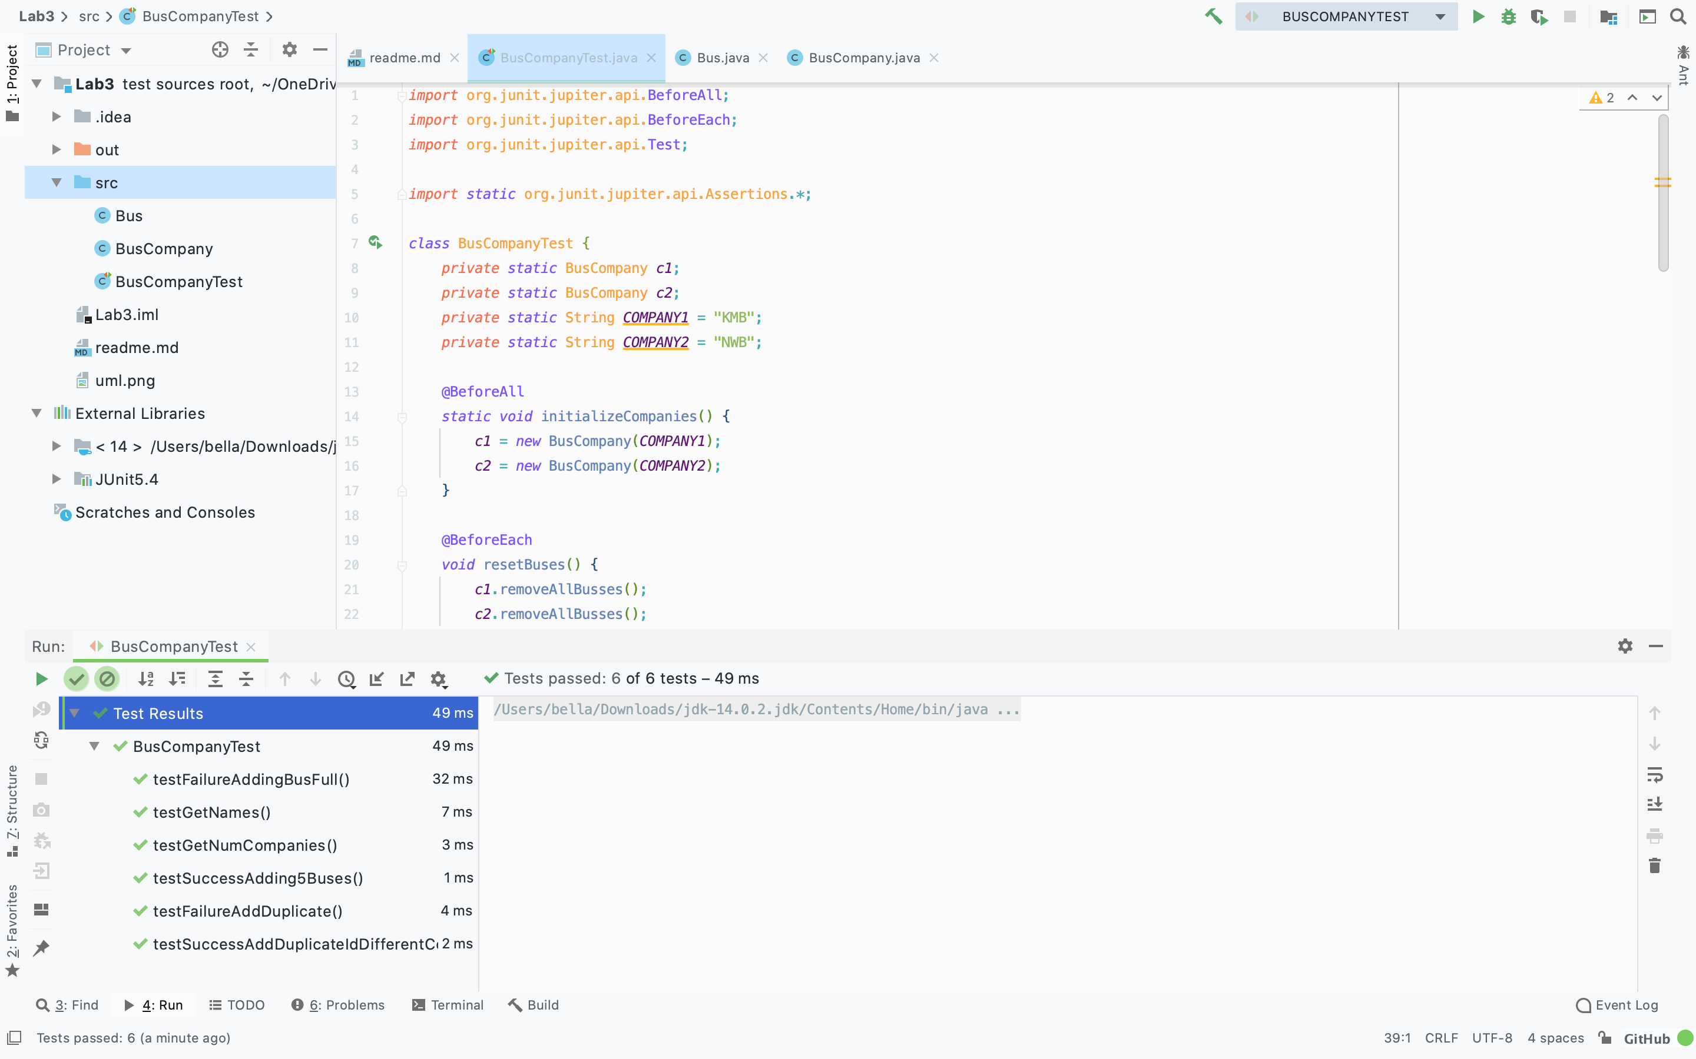
Example of screenshots

