Slide 1
COMP3021
Lab 5: Inheritance, Polymorphism

Slide 2
Preparation
Download the lab5 materials from our course web page
When unzipped, you have a folder containing:
A readme file
A diagram picture
A “src” folder

Slide 3



Inheritance
An important concept in OOP
Superclass and subclass
Example:
class Animal { } //superclass of Human and Student
class Human extends Animal { } //subclass of Animal, superclass of Student
class Student extends Human { } //subclass of both

Slide 4
operator: instanceof
object instanceof Class
Return boolean value
Example:
Animal a = new Animal();
Human h = new Human();
Student s = new Student();
System.out.println(h instanceof Animal); //true
System.out.println(h instanceof Human); //true
System.out.println(h instanceof Student); //false

Slide 5
Superclass constructors
Superclass constructors are NOT inherited.
They can be invoked:
Explicitly: call super(…) at the beginning of the subclass constructor to invoke a superclass constructor
Or implicitly: the superclass’s no-args constructor is invoked by default
Make sure the superclass does have a no-args constructor
If there is a constructor with args, the no-args constructor needs to be written explicitly

Slide 6
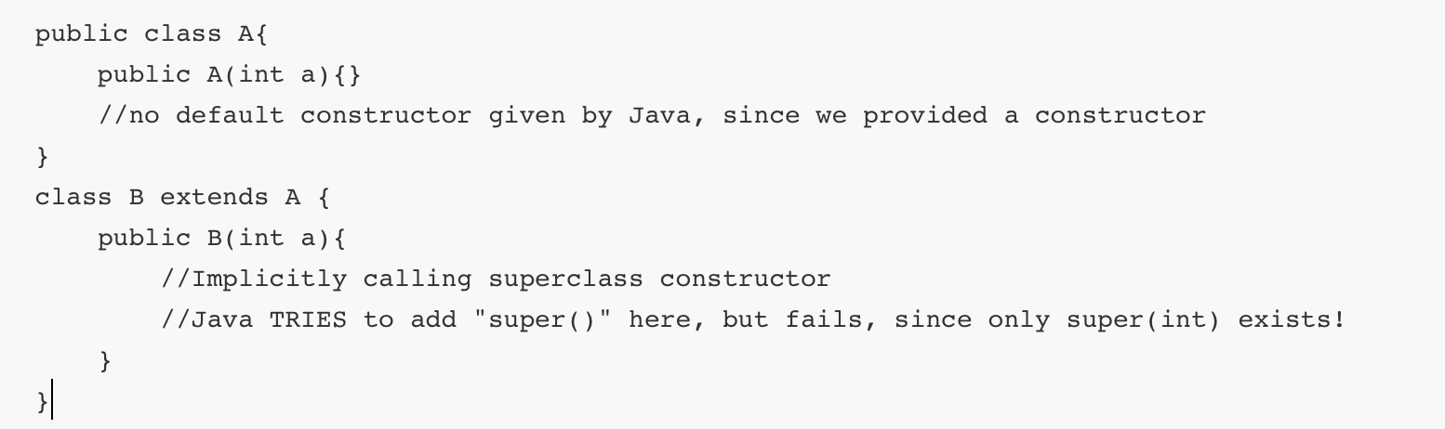
Example: Superclass constructors

Slide 7
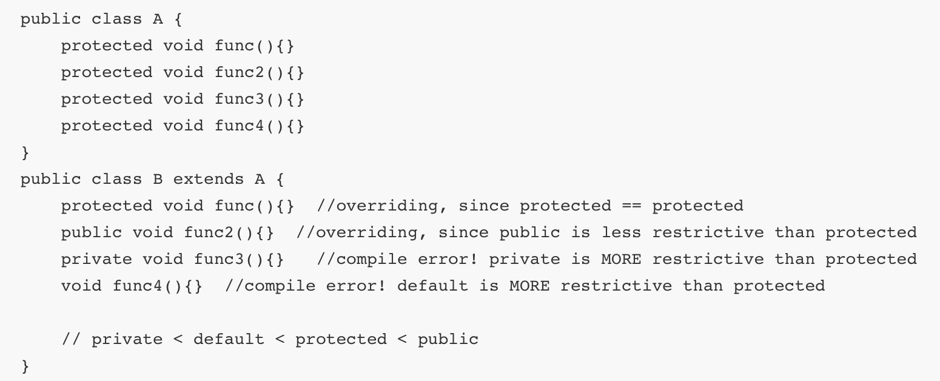
Override
A subclass overrides a superclass method when
the method signature is the same,
and the access rights not more restrictive than original.

Slide 8
Static method
Static methods cannot be overridden
It can be Inherited
You can implement a method with same signature
Static method of superclass will be hidden

Slide 9
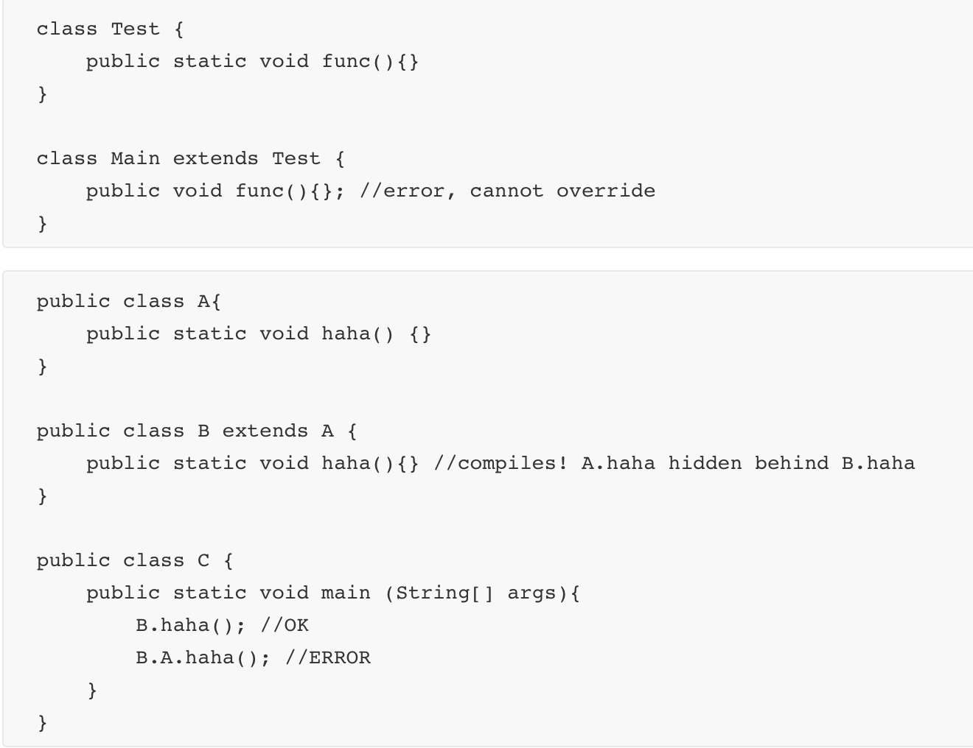
Example of Inherited static method
Call B’s haha(), not A’s

Slide 10
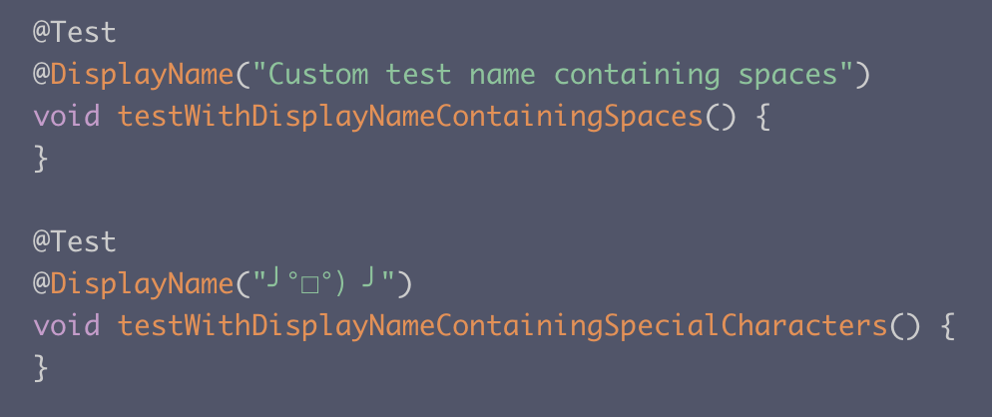
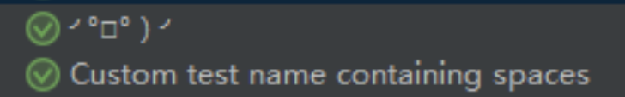
Junit label
We already learn
@Test
@BeforeEach
@BeforeAll
…
Two more:
@DisplayName
show custom names instead of the method name
@Disabled
Skip this test

Slide 11
Submission
Implement the three classes required in readme
Pass the provided JUnit tests
Submit a ZIP file containing Person.java, Student.java, and Teacher.java to CASS
NOTE:
When submitting to CASS, choose Lab5. DO NOT submit to Assignment 1.
Deadline is 23:55 Oct 13.

