Slide 1
COMP3021 Lab6

Slide 2
Lab6 Materials
Download today’s lab materials from our course website
https://course.cse.ust.hk/comp3021/#labs

Slide 3
Outline
Interface
Abstract class
Nested class

Slide 4
Interface
An interface is a class-like construct that contains constants and abstract methods (prior to Java 8)
Java 8 adds support of default methods and static methods
Java 9 adds support of private interface methods

Slide 5
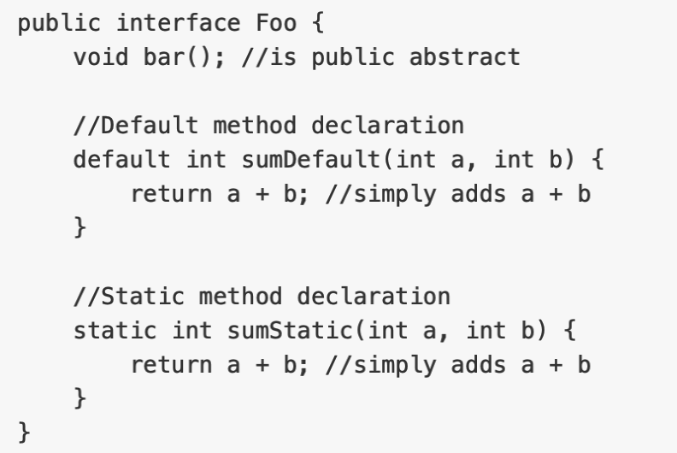
Default interface methods
Java 8 introduced default interface methods.
The implementation in a default method will be used when a concrete class does not override the method.

Slide 6
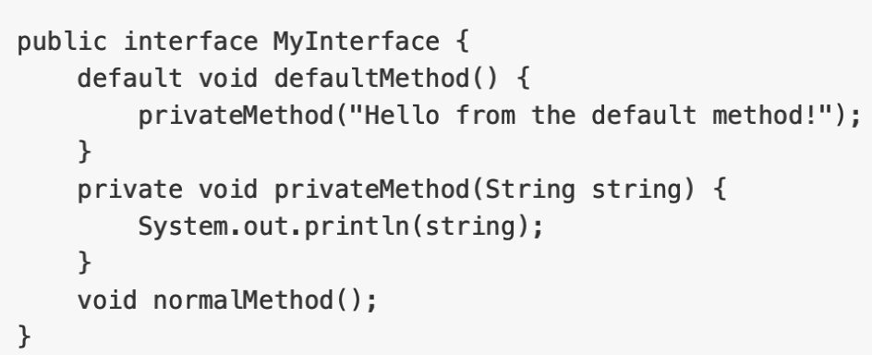
Private interface methods
Java 9 introduced private interface methods, which can be used as helper functions within the interface
Can not be abstract
Can only be used inside the interface (hence the term private)
Private non-static methods can't be used inside private static methods

Slide 7
Some Notes on Interface
Contains only public static final variables, even if you don't write the keywords
No constructors; you can't instantiate an interface.
A class can only extend one class but can implement multiple interfaces

Slide 8
Abstract Classes
An abstract class is a class explicitly declared with the abstract modifier
An abstract class have 0 or more abstract methods
An abstract method is a method declared with the abstract modifier, and no method body.
Abstract methods can only be declared in an abstract class.

Slide 9
Notes on Abstract Class & Abstract Methods
Cannot be instantiated with “new”
Cannot have private abstract methods (because nobody can see it, and nobody can implement it)
CAN have constructors (which are invoked when subclass constructor is invoked)
Subclass can be abstract even if superclass is concrete
Subclass can override a method from its superclass, and define it as abstract

Slide 10
Nested Class
A nested class is a class defined inside a class.
Static nested classes
Non-static nested classes (inner classes)

Slide 11
Static nested classes
Static nested classes belong to the enclosing class, not an object
Static nested classes can only access static members of the enclosing class.
You don't need an instance of the enclosing class to create an instance of the static nested class.
The enclosed and enclosing class have private level access to each other

Slide 12
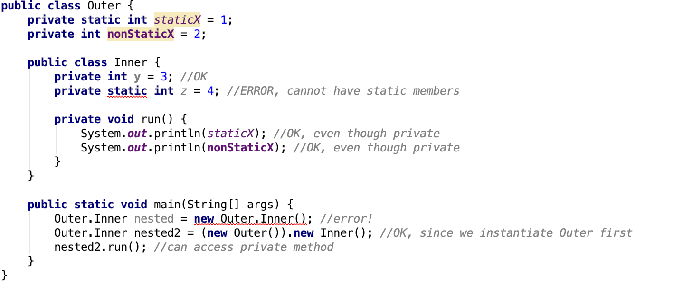
Inner Class
Inner classes are non-static nested classes.
They belong to an instance of the outer class
Inner classes can access both static and non-static members of the outer class
You need to instantiate the outer class before you can instantiate the inner class
Inner classes cannot have static members

Slide 13
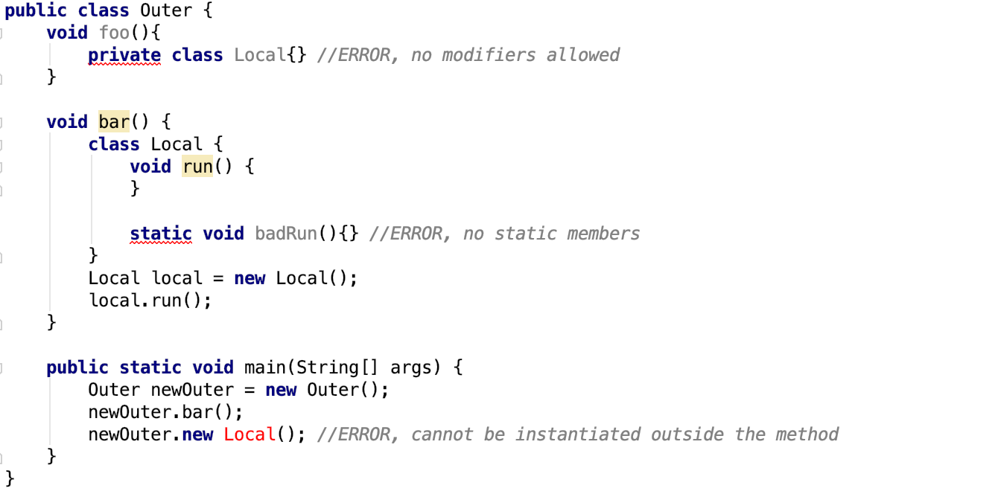
Local Class
Local classes are a special type of inner class defined inside a method or scope block.
Share the same properties with inner class
They cannot have access modifiers in their declaration
If you want to invoke the methods of local inner class, you must instantiate this class inside the method

Slide 14
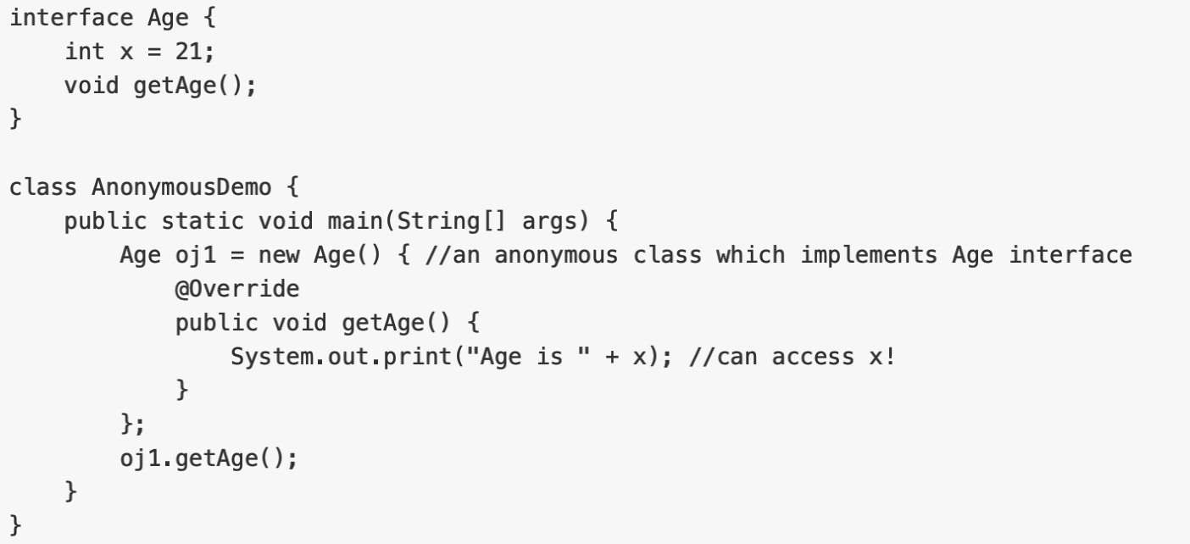
Anonymous Class
An anonymous class is a local class that has no name
Anonymous classes can be used to:
Create an object which implements an interface
Create an object which extends a class

Slide 15
Anonymous Class & Other Inner Class
Anonymous classes can only implement 1 interface at a time, normal classes >= 0
Anonymous classes can either extend a class or implement an interface, but not both
Anonymous classes can't have explicitly defined constructors (since you don't have access to the class name)

Slide 16
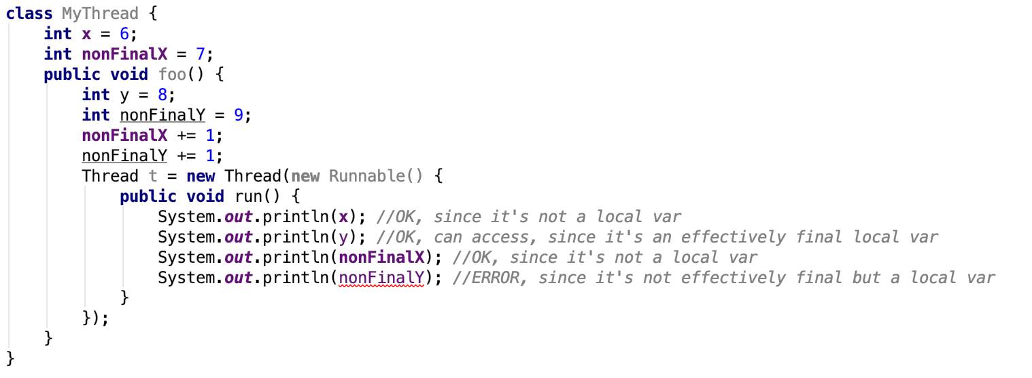
Anonymous Class & Local Variables
Anonymous classes have access to the members of its enclosing class
Anonymous classes cannot access local variables in its enclosing scope that are not declared as final or effectively final
Effectively final: a variable whose value is never changed again

Slide 17
Lab 6 Task
Implement a prefix calculator in text version.
(+ 1 2) means “1 + 2”
(* 2 (- 5 9)) means “((5 – 9) * 2)”
Refer to the provided “diagram.png” figure which shows the project structure, implement the TODOs in the code skeleton.

Slide 18
Submission
Import the Lab 6 project to IntelliJ
Finish the TODOs
Make sure your implementation can pass our provided test cases
Zip the IntelliJ project and submit the zip file to CASS
NOTE: The deadline is 23:55 Oct 20. Please choose “Lab 6” when you submit.

