Slide 1
COMP3021
Lab 7 GUI programming & JavaFX

Slide 2
Preparation
Download the lab7 materials from our course web page

Slide 3
About Programming Assignment 1
The grade of PA1 has been released.
The TA-only-tests and solution have been released.
Appeal period deadline: Oct 24, 23:55.

Slide 4
About Programming Assignment 2
The workload is heavy, so you may get start ASAP! (DDL: Nov 7 23:55)
Add TAs email accounts as cooperators at GitHub before DDL.
You are encouraged to ask questions by creating issues on GitHub.
There will be no test provided for PA2, so you can add/modify variables/methods even marked with TODOs to suit your implementation.
We will only check GUI demo specifications.

Slide 5
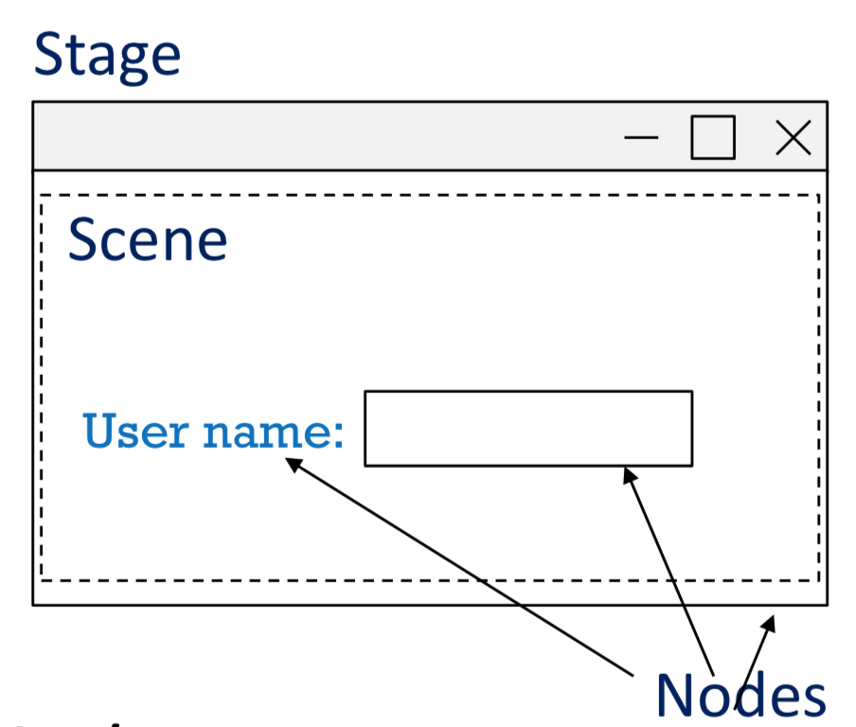
JavaFX
The latest framework for GUI programs
Three basic structure
Stage: (a window) contains all the objects of a JavaFX application
Scene: represents the physical contents of a JavaFX application
Node: a visual/graphical object of a scene graph
Geometrical (Graphical) objects (2D and 3D) − Circle, Rectangle, Polygon, etc.
UI Controls − Button, Checkbox, Choice Box, Text Area, etc.
Containers (Layout Panes) − Border Pane, Grid Pane, Flow Pane, etc.
Media elements − Audio, Video and Image Objects, etc.
* You can know more from here.

Slide 6
Four Steps to Construct an GUI
1. Define a class that extends abstract class Application
2. Override the abstract start method inherited from Application
3. In the overriding start method
Build a scene graph
Construct a scene with the root node of the scene graph
Set up the stage
4. Define a main method and launch the application

Slide 7
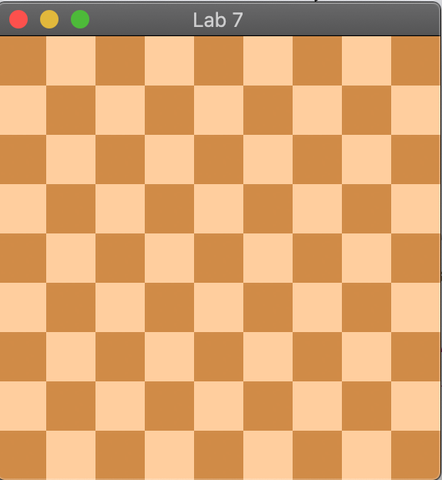
Today’s lab
Build a simple GUI program
Draw a chessboard
Input: size of board

Slide 8
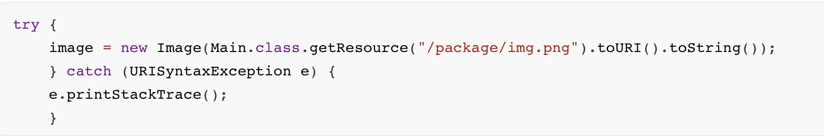
Some tips: Load images
You need use javafx.scene.image.Image class to load image.
Method 1:
Method 2:
Doc can be found here.

Slide 9
Some tips: Draw images
You may need to get the graphics context object of the canvas to draw images

Slide 10
Submission to CASS
Submit the followings to CASS
The Main java file (with boardSize = 9)
Two screenshots, one for 9x9 chessboard, one for 4*4 chessboard. Put the screenshots in one single PDF/Word file.
NOTE:
When submitting to CASS, choose Lab7.
Deadline is 23:55 Oct 27.

