Slide 1
COMP3021 Lab8

Slide 2
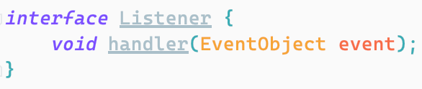
Event-Driven Programming
In event-driven programming, code is executed upon activation of events such as user actions (e.g. key presses and mouse clicks)
To do this, we create a listener class, and call the handler method in the listener when the event is triggered.
Event Emitter
Event triggered
Emit event to all registered listeners.
A piece of code (in event handler) is executed in response

Slide 3
Registering Event Handlers
Using regular classes
Using anonymous classes
Using lambda expressions

Slide 4
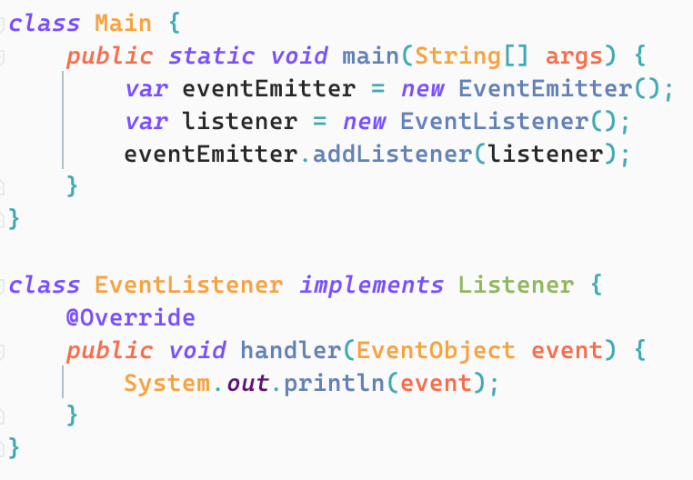
Registering Event Handlers
Using regular classes

Slide 5
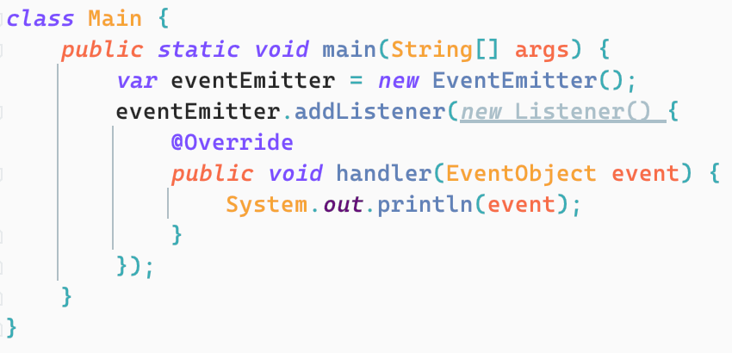
Registering Event Handlers
Using anonymous classes

Slide 6
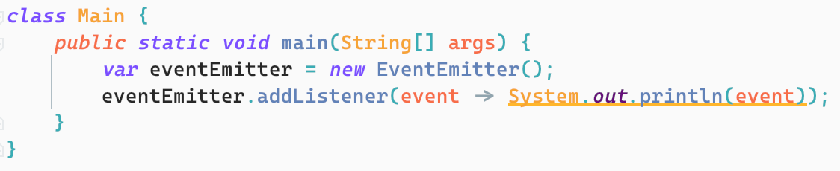
Registering Event Handlers
Using lambda expressions

Slide 7
Event Emitter
Event emitter is a class which maintains a set of registered listener.
When the event happens, event emitter broadcast the event to all registered listeners.
Listener
Broadcast
Event Emitter
Event happens
Listener
Listener

Slide 8
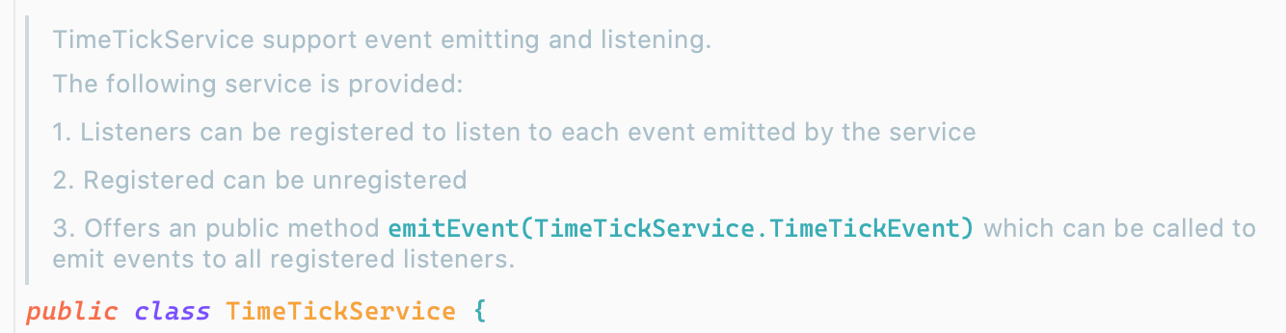
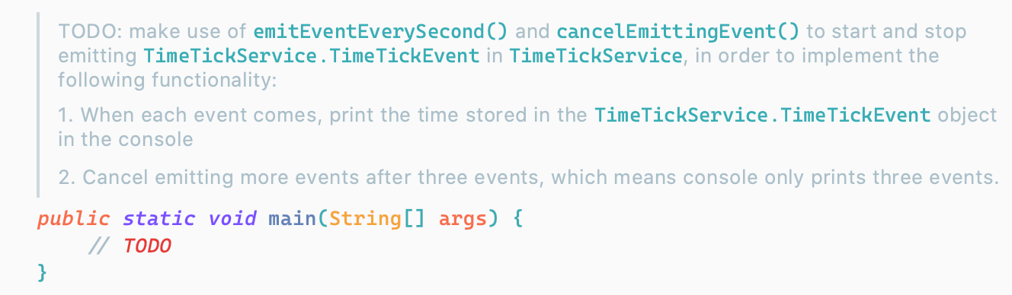
What You Need to Do
1. Implement a simple event emitter
2. Use the event emitter, listen to events emitted in this class and perform a time ticking task.

Slide 9
Lab Outcome & Submission
Open the Lab 8 project in IntelliJ
Finish the TODOs
Make sure your implementation can meet the specification in JavaDoc and pass the provided tests.
Submission:
your implemented project
Screenshot of console of main method to show your printing as specified in JavaDoc of main method.
Submit a zip file which contains your IntelliJ project and 1 screenshot together.
Deadline: 3 Nov. 23:55

