Slide 1
COMP3021 Lab 9
Exceptions, File I/O & Local var inference

Slide 2
Lab 9 Materials
Download today’s lab material from Course Website
https://course.cse.ust.hk/comp3021/#labs

Slide 3
Outline
Exceptions
File IO
Local Variable Type Inferences
Lab Task

Slide 4
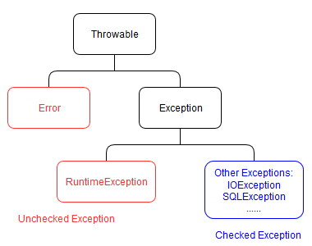
Exceptions
Exceptions in Java indicate unexpected events or errors in the program. There are 2 types of exceptions:
Checked exceptions
Are checked at compilation time
Need to be caught or included in the method declaration by “throws” (otherwise compilation error)
Unchecked exceptions
Not checked at compilation time
All Unchecked exceptions are objects or subclasses of
RuntimeException class.

Slide 5
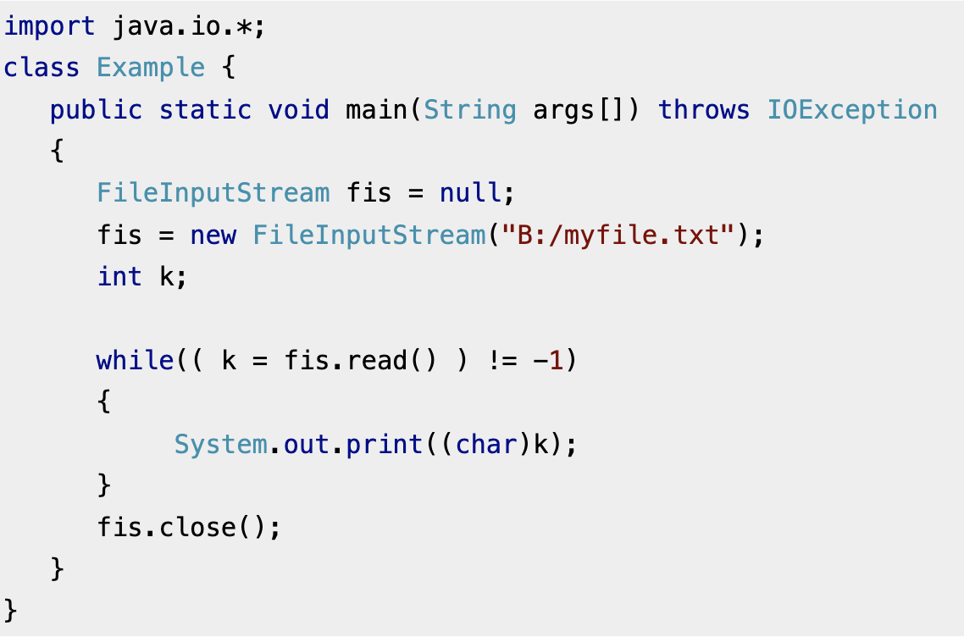
Checked exceptions - Example
Method 1: Declare the exception using throws keyword.

Slide 6
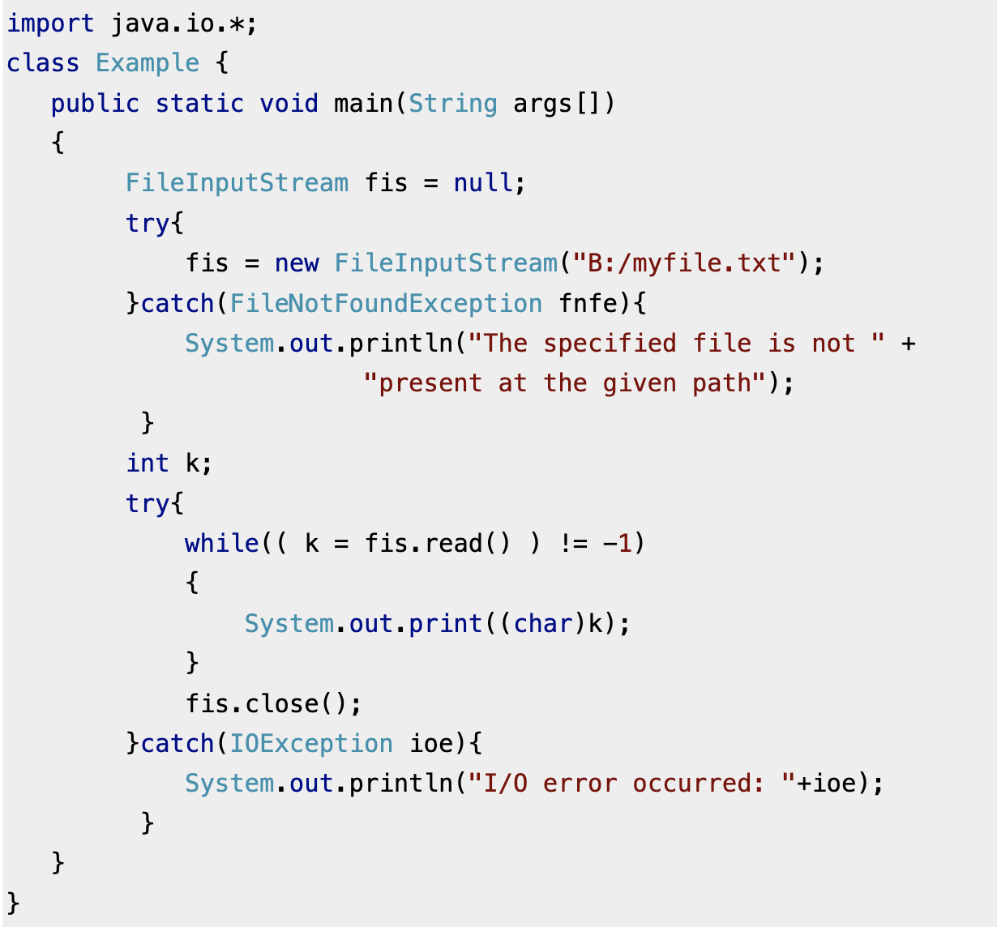
Checked exceptions - Example
Method 2: Handle them using try-catch blocks.

Slide 7
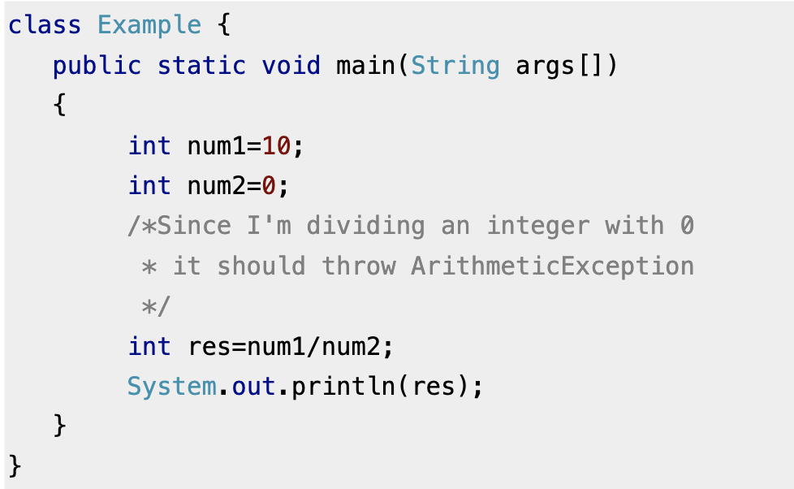
Unchecked exceptions - Example
If you compile this code, it would compile successfully however when you will run it, it would throw ArithmeticException.

Slide 8
Exceptions and Overridden Methods
Overriding methods in a subclass must respect the exceptions declared by the overridden methods in the superclass:
Subclass method CANNOT declare that checked exception (or its subtypes)
Subclass method CAN declare any unchecked exceptions
Declare a checked exception?
No
Superclass method
Subclass method CAN declare that checked exception (or its subtypes)
Subclass method CAN declare any unchecked exceptions
Yes
Note: There is a code example in readme.md

Slide 9
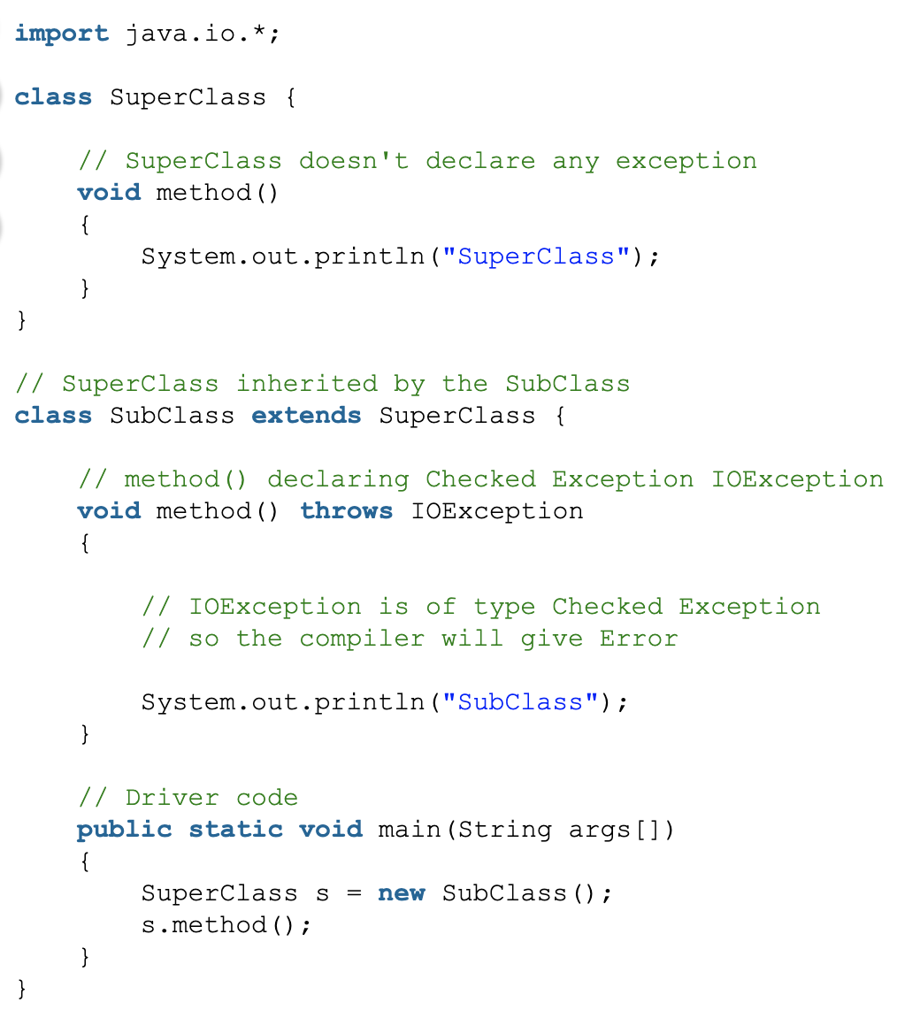
If The Super class doesn’t declare a checked exception while Sub class declare a checked exception

Slide 10
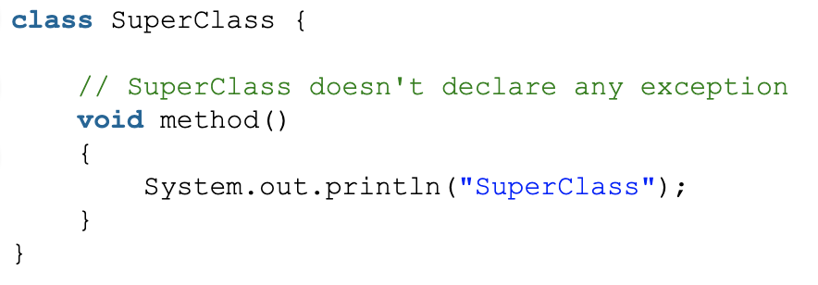
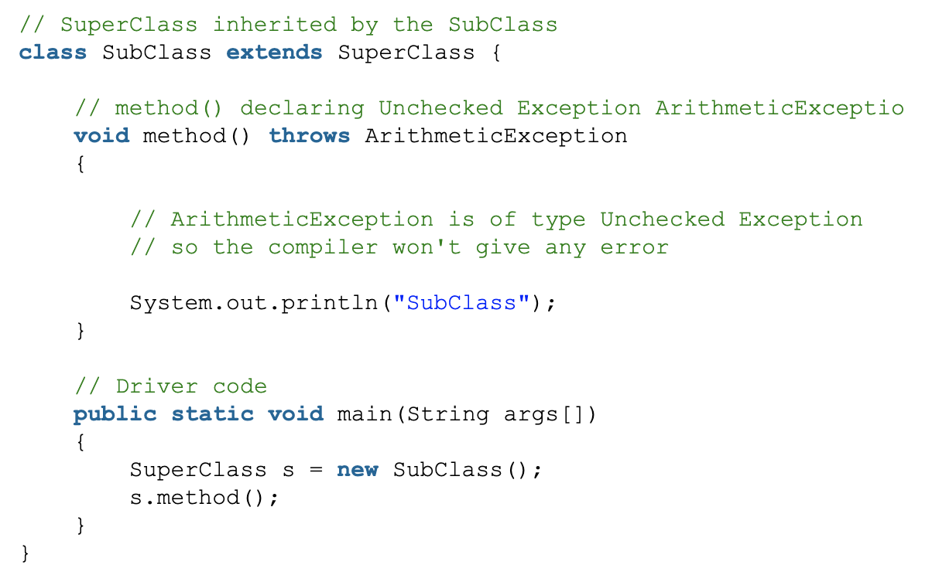
If The Super class doesn’t declare a checked exception while Sub class declare an unchecked exception

Slide 11
File IO
Write to a file
Create a writer: PrintWriter writer = new PrintWriter(file);
Write to a file: writer.println(“hello”);
Close the writer: writer.close();
Read from a file
Create a reader: Scanner reader = new Scanner(file);
Read from a file: reader.nextLine();
Close the reader: reader.close();

Slide 12
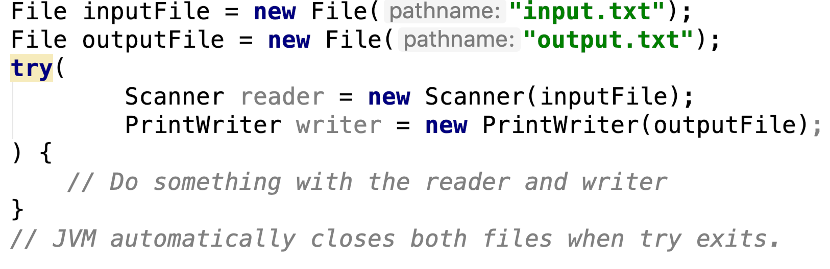
Try with Resources
The try-with-resources statement is a try statement that declares one or more resources.
It ensures that each resource (any object that implements java.lang.AutoCloseable) is closed at the end of the statement.

Slide 13
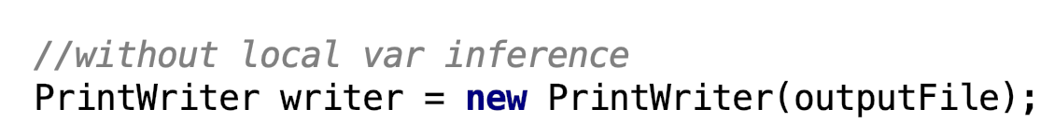
Local Variable Inference
In Java 10, local variables can be declared with var and java compiler will infer the type automatically.

Slide 14
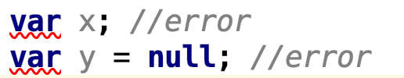
Local Variable Type Inferences
Var is only used for local variables and cannot be used in fields or method signatures
Var cannot be initialized with null or used without initialization
Notes:
Local variables are declared in methods, constructors, or blocks.

Slide 15
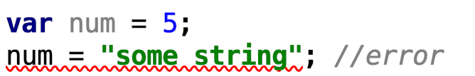
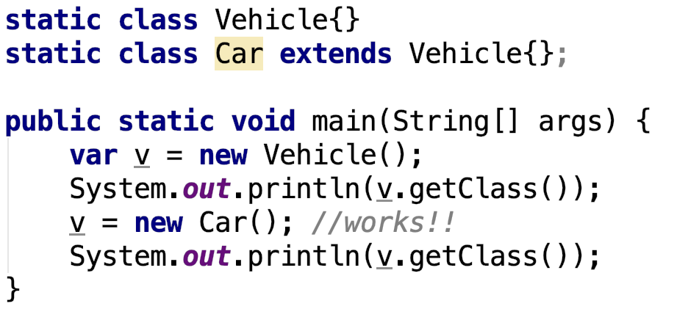
Local Variable Type Inferences
You cannot re-assign a var variable to a different type.
You can use a subtype where a supertype is expected.

Slide 16
Lab 9
Implement two methods (createBoard and loadBoard) and properly handle/throw the exceptions as specified.
Your Implementation needs to pass all the provided test cases.
Take a screenshot of the entire IntelliJ screen to show all tests have been passed.
Submit your implemented project to CASS before the deadline (23:55 Nov 10).
NOTE: When submitting to CASS, choose Lab9.

