Slide 1
ToonShader

Slide 2
Contents
Shader?
HLSL?
Vertex, Pixel?
Vertex Shader Code
Pixel Shader Code
Shader

Slide 3
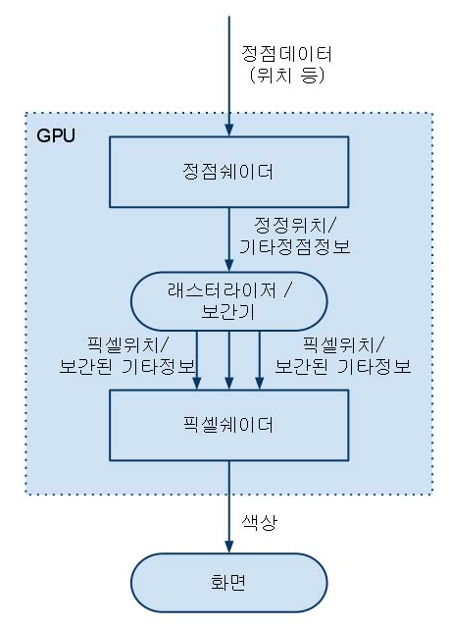
Shader?
쉐이더란 화면에 출력할 픽셀의 위치와 색상을 계산하는 함수

Slide 4
HLSL?
High level shader language
C -> CPU
HLSL -> GPU

Slide 5
Vertex, Pixel?
정점과 픽셀

Slide 6
Vertex Shader Code
정점 쉐이더 코드
float4x4 gWorldViewProjectionMatrix;
float4x4 gInvWorldMatrix;
float4 gWorldLightPosition;
VS_OUTPUT vs_main( VS_INPUT input )
{
VS_OUTPUT output;
output.mPosition = mul(input.mPosition,gWorldViewProjectionMatrix );
float3 objectLightPosition = mul(gWorldLightPosition,gInvWorldMatrix);
float3 lightDir = normalize(input.mPosition.xyz - objectLightPosition);
output.mDiffuse = dot(-lightDir,normalize(input.mNormal));
return output;
}
struct VS_INPUT
{
float4 mPosition : POSITION;
float3 mNormal: NORMAL;
};
struct VS_OUTPUT
{
float4 mPosition : POSITION;
float3 mDiffuse : TEXCOORD1;
};

Slide 7
Pixel Shader Code
픽셀 쉐이더 코드
float4 ps_main(PS_INPUT input) : COLOR
{
float3 diffuse = saturate(input.mDiffuse);
diffuse = ceil(diffuse * 5) / 5.0f;
return float4( gSurfaceColor * diffuse.xyz, 1);
}
float3 gSurfaceColor;
struct PS_INPUT
{
float3 mDiffuse : TEXCOORD1;
};

