Slide 1
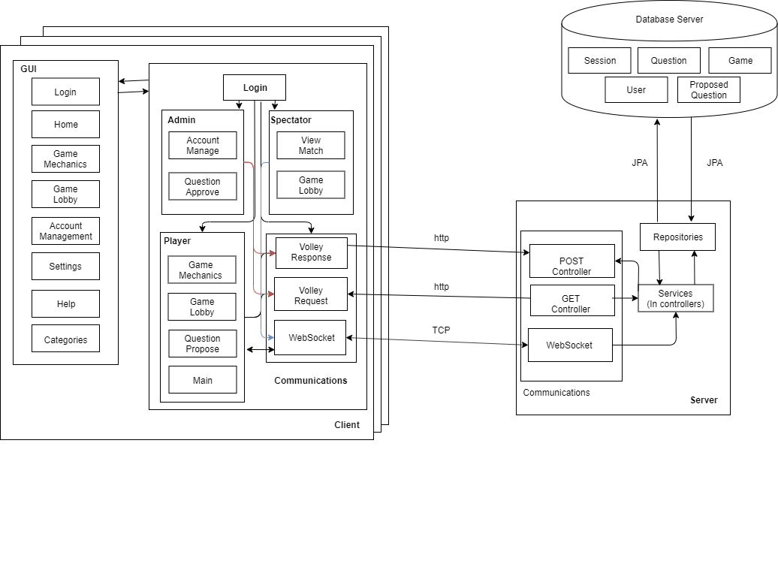
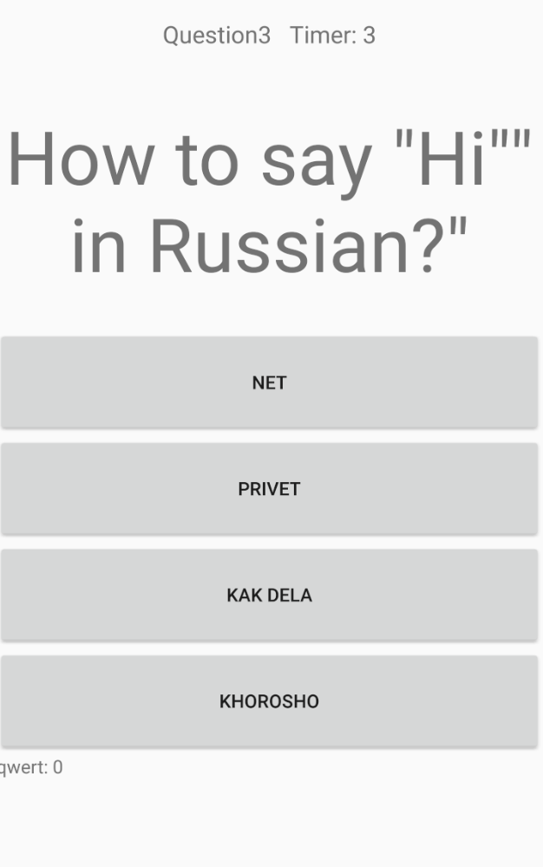
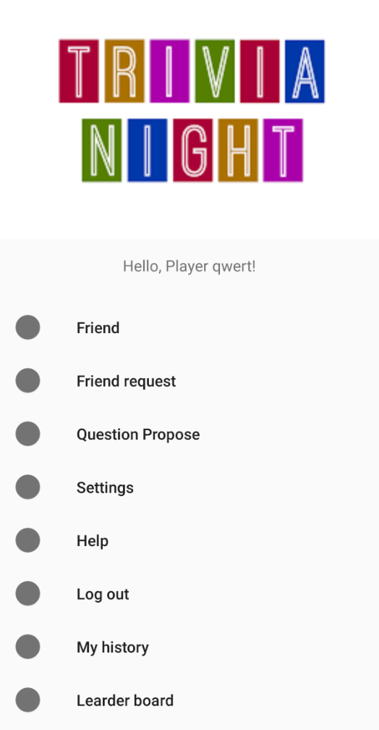
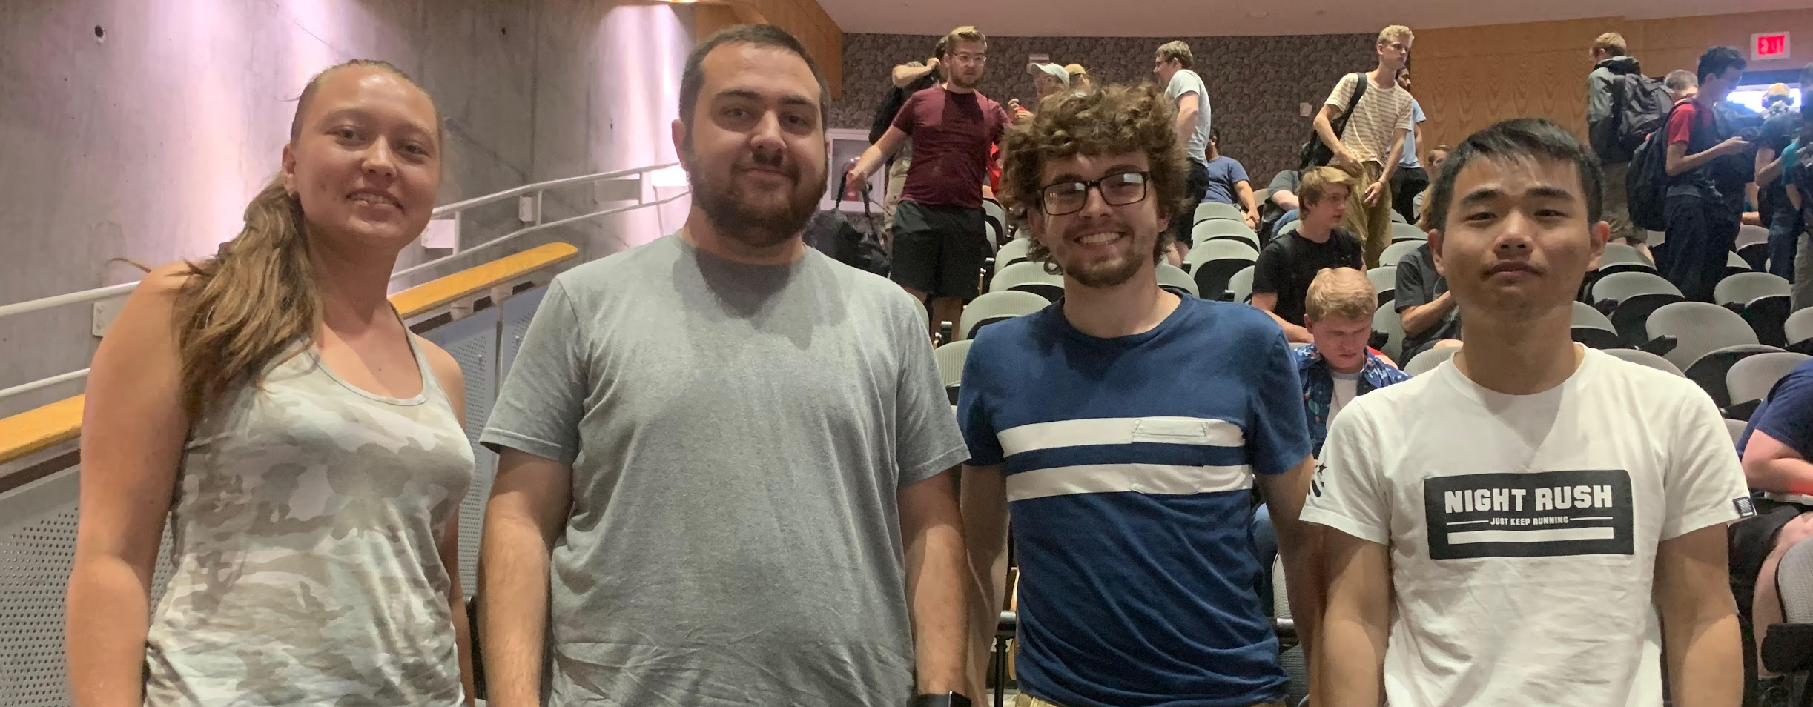
Trivia
Game
Chandler Hagen Mariya Karasseva
Yuhao Peng Alex Richardson
COM S 309 FALL 2019
Project Description:
Designed for trivia lovers to challenge themselves, play against other players and have fun with friends.
Users:
Administrators - manages player accounts and questions
Players - plays a trivia game
Spectators - views games of other players
User Interfaces:
User can create account or sign into existing account
Select from singleplayer or multiplayer
If multiplayer, wait in lobby for people to ready up
Play game with score presented to you at the end.
Module Interfaces:
Websockets: Constant
connection to server with methods OnOpen, OnMessage, and OnClose
HTTP Requests REST api: One time messages between Client and server with POST, GET, and DELETE methods
Design Decisions:
Have game be run on clientside to deal with synchronization issues
Handle the lobbies and scoring with websockets
Define different users and their roles upon login
What went wrong:
Lack of knowledge
Time constraint
What went right:
Team communication
Hard work
Lessons learned:
Start early, ask questions,
Do what you are excited about
Mariya - MIS (Sr.) Chandler - SE (Jr.)
Alex - SE (Jr.) Yuhao - CS (Jr.)

