Slide 1
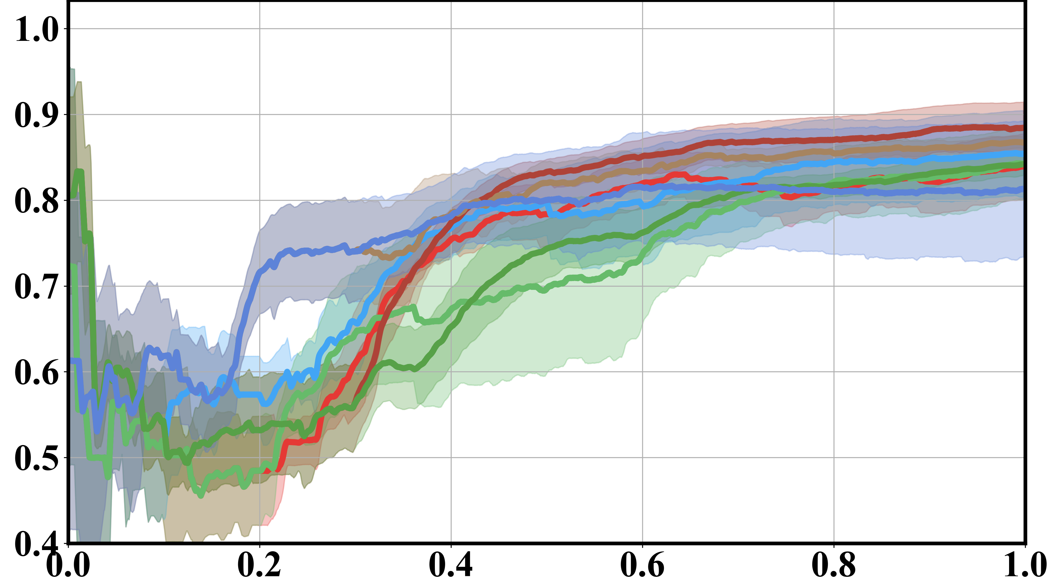
Fig. 10 - a
(a) Success Rate

Slide 2
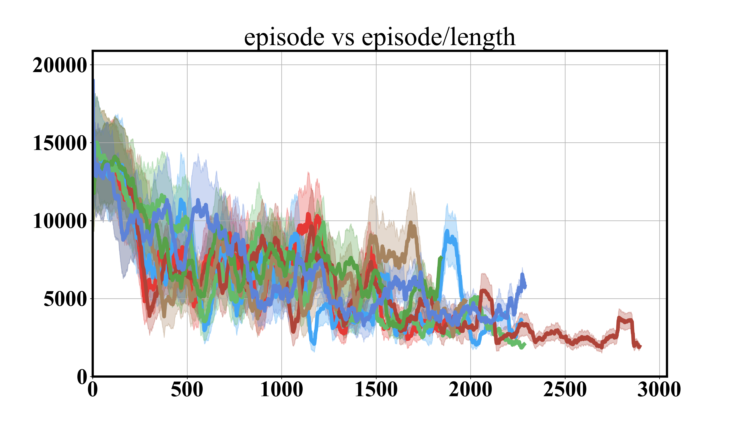
Fig. 10 - b
(b) Episode Length

Slide 3
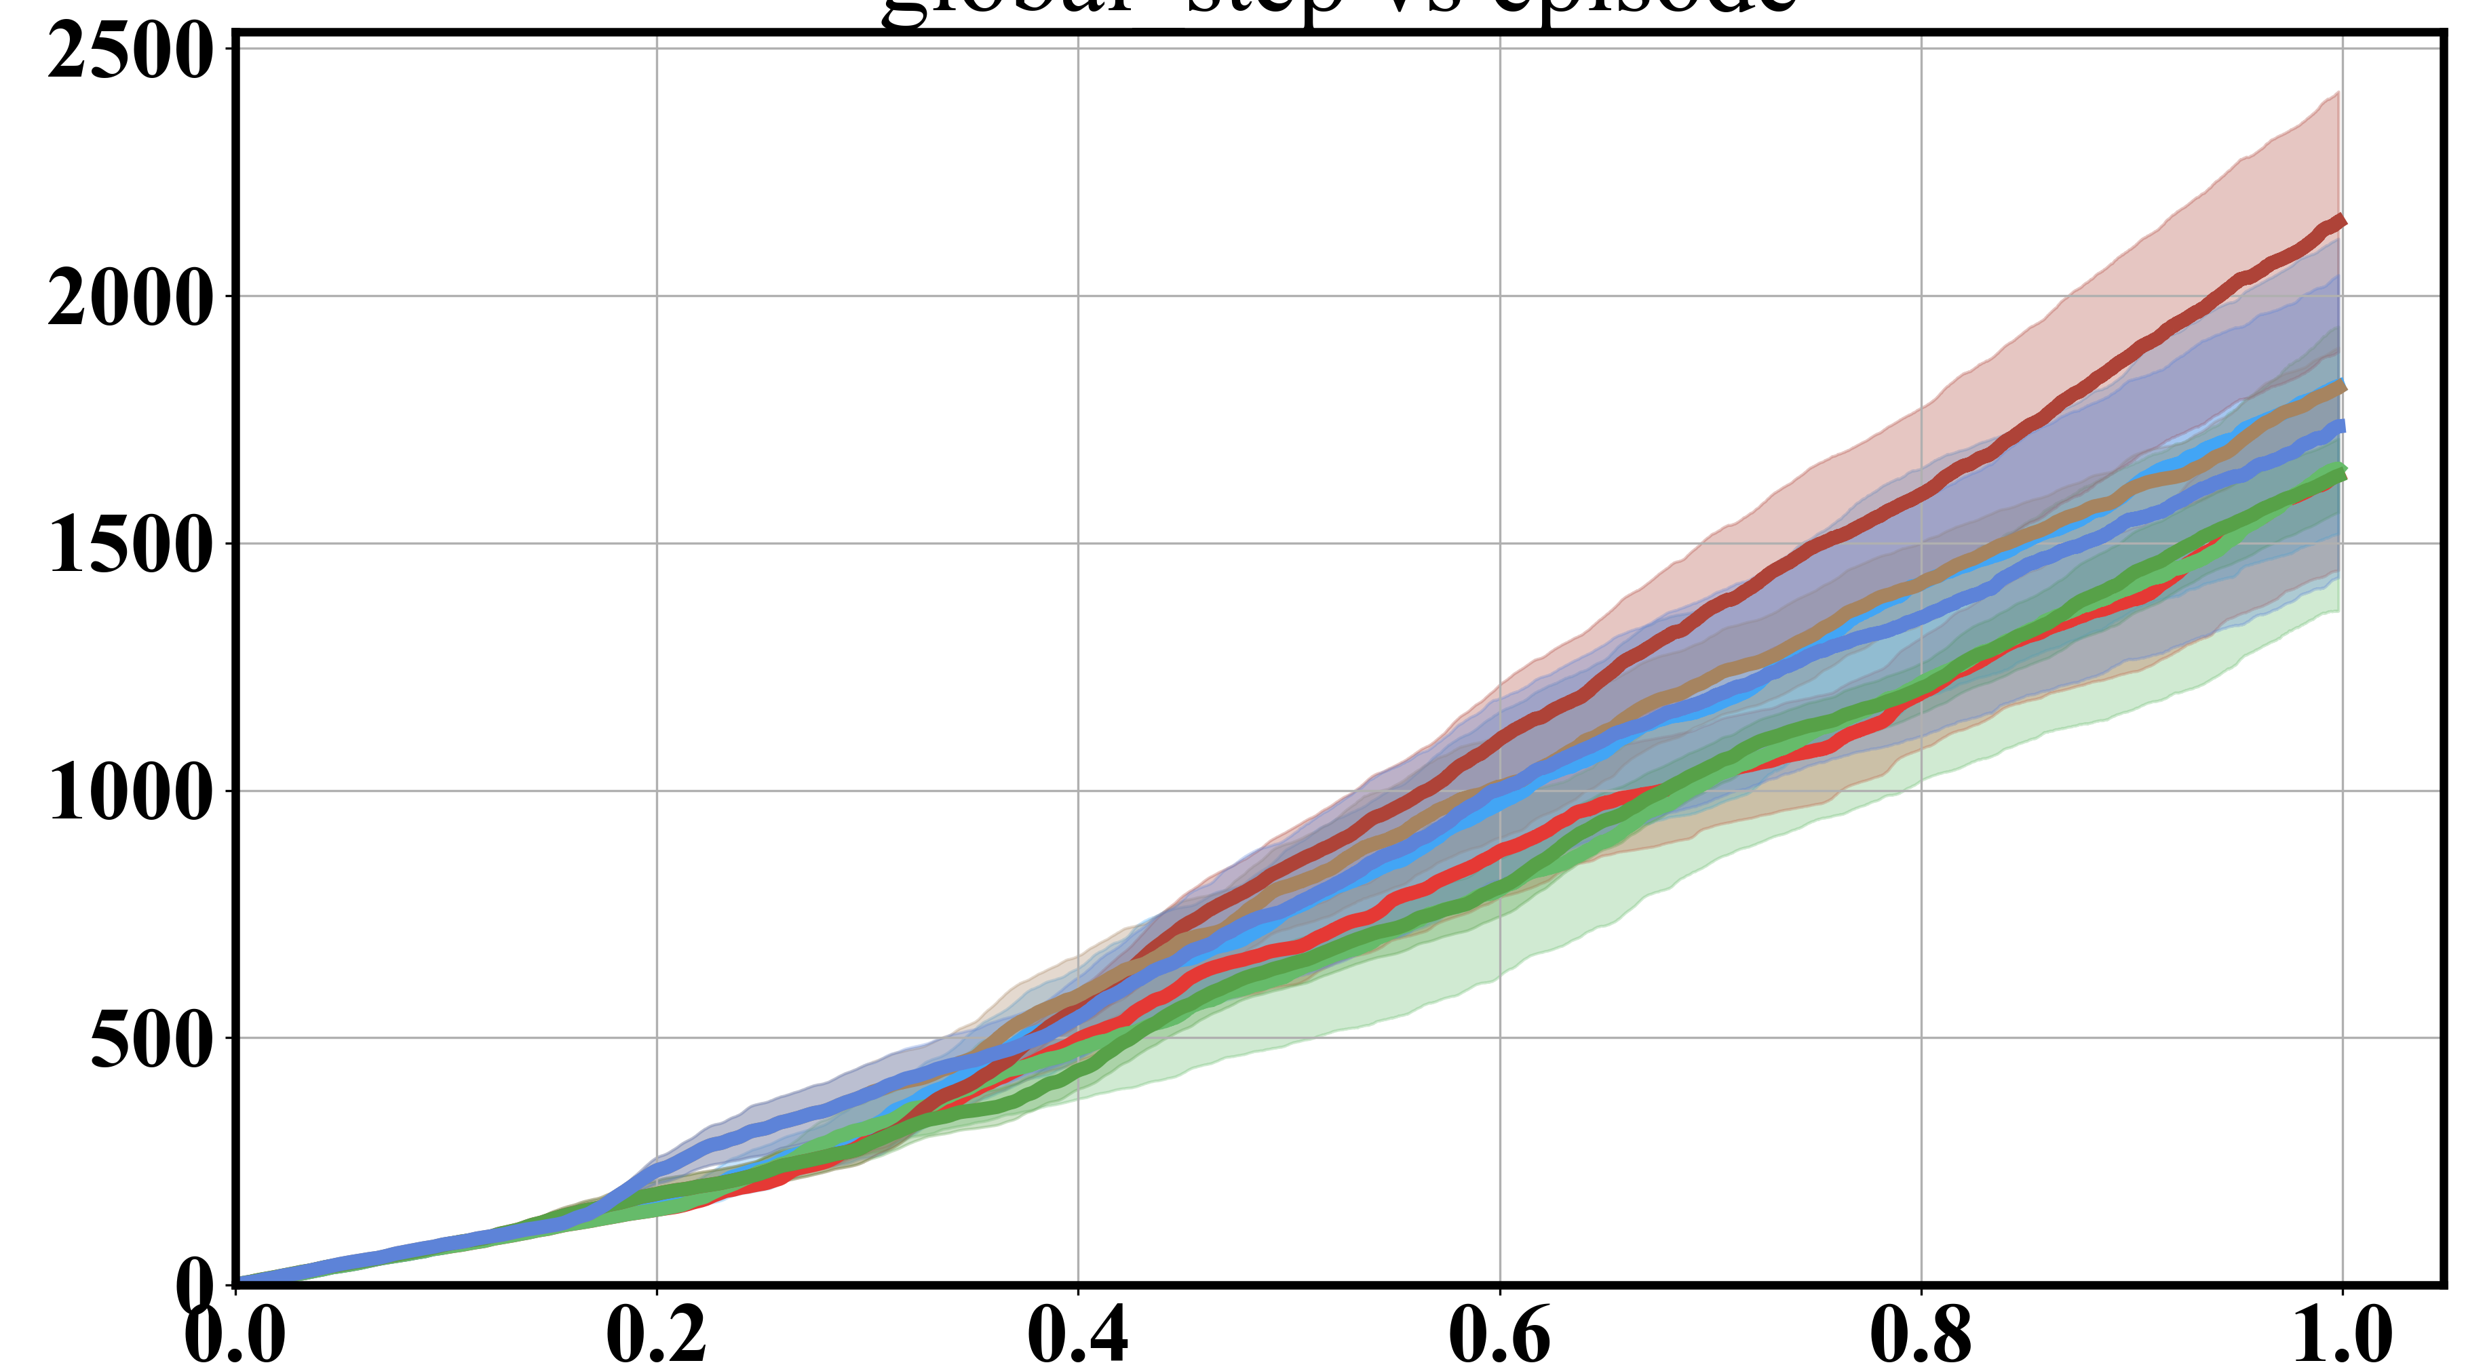
Fig. 10 - c
(c) No. of Episodes Completed

Slide 4
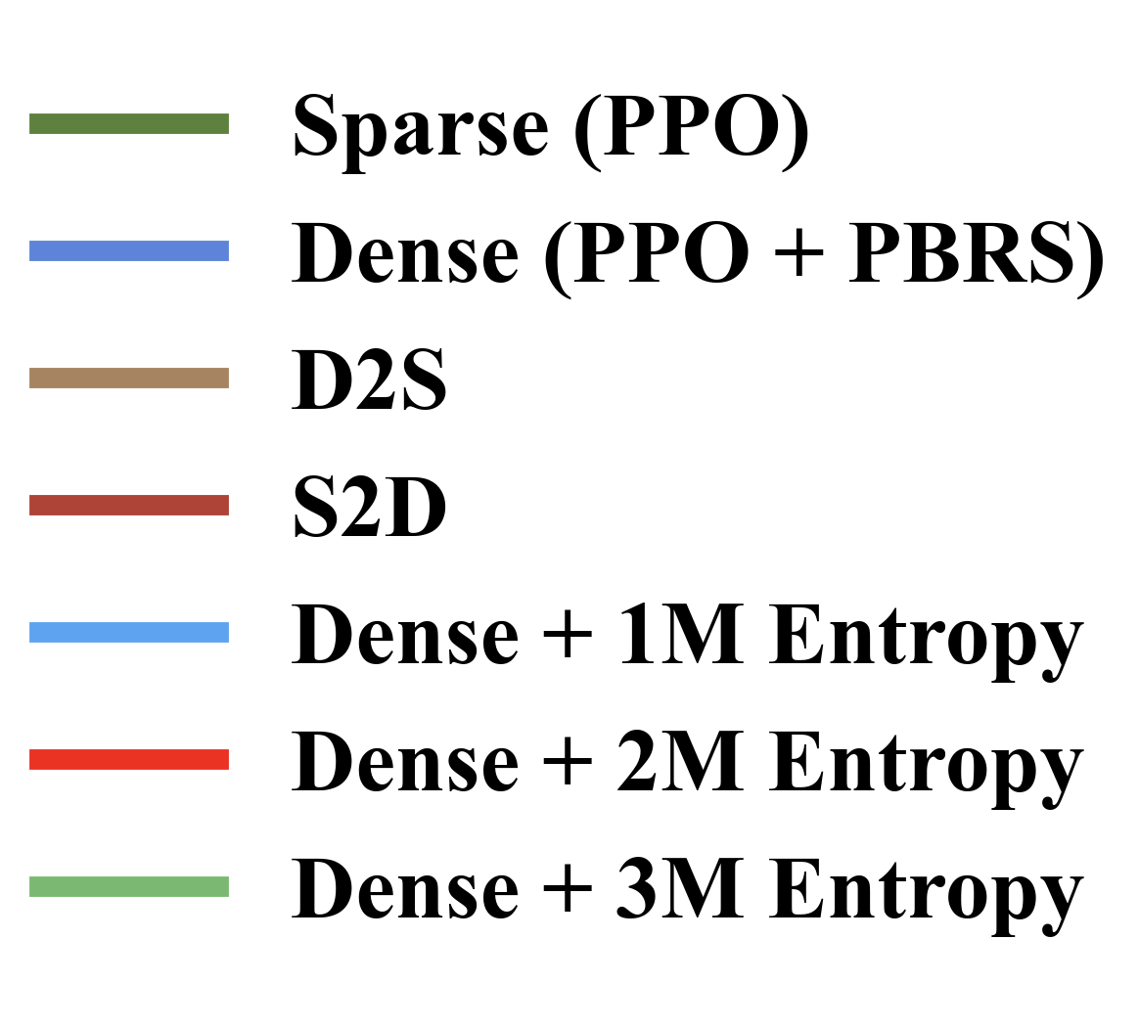
Fig.10
(a) Success Rate
(b) Episode Length
(c) No. of Episodes Completed

Slide 5
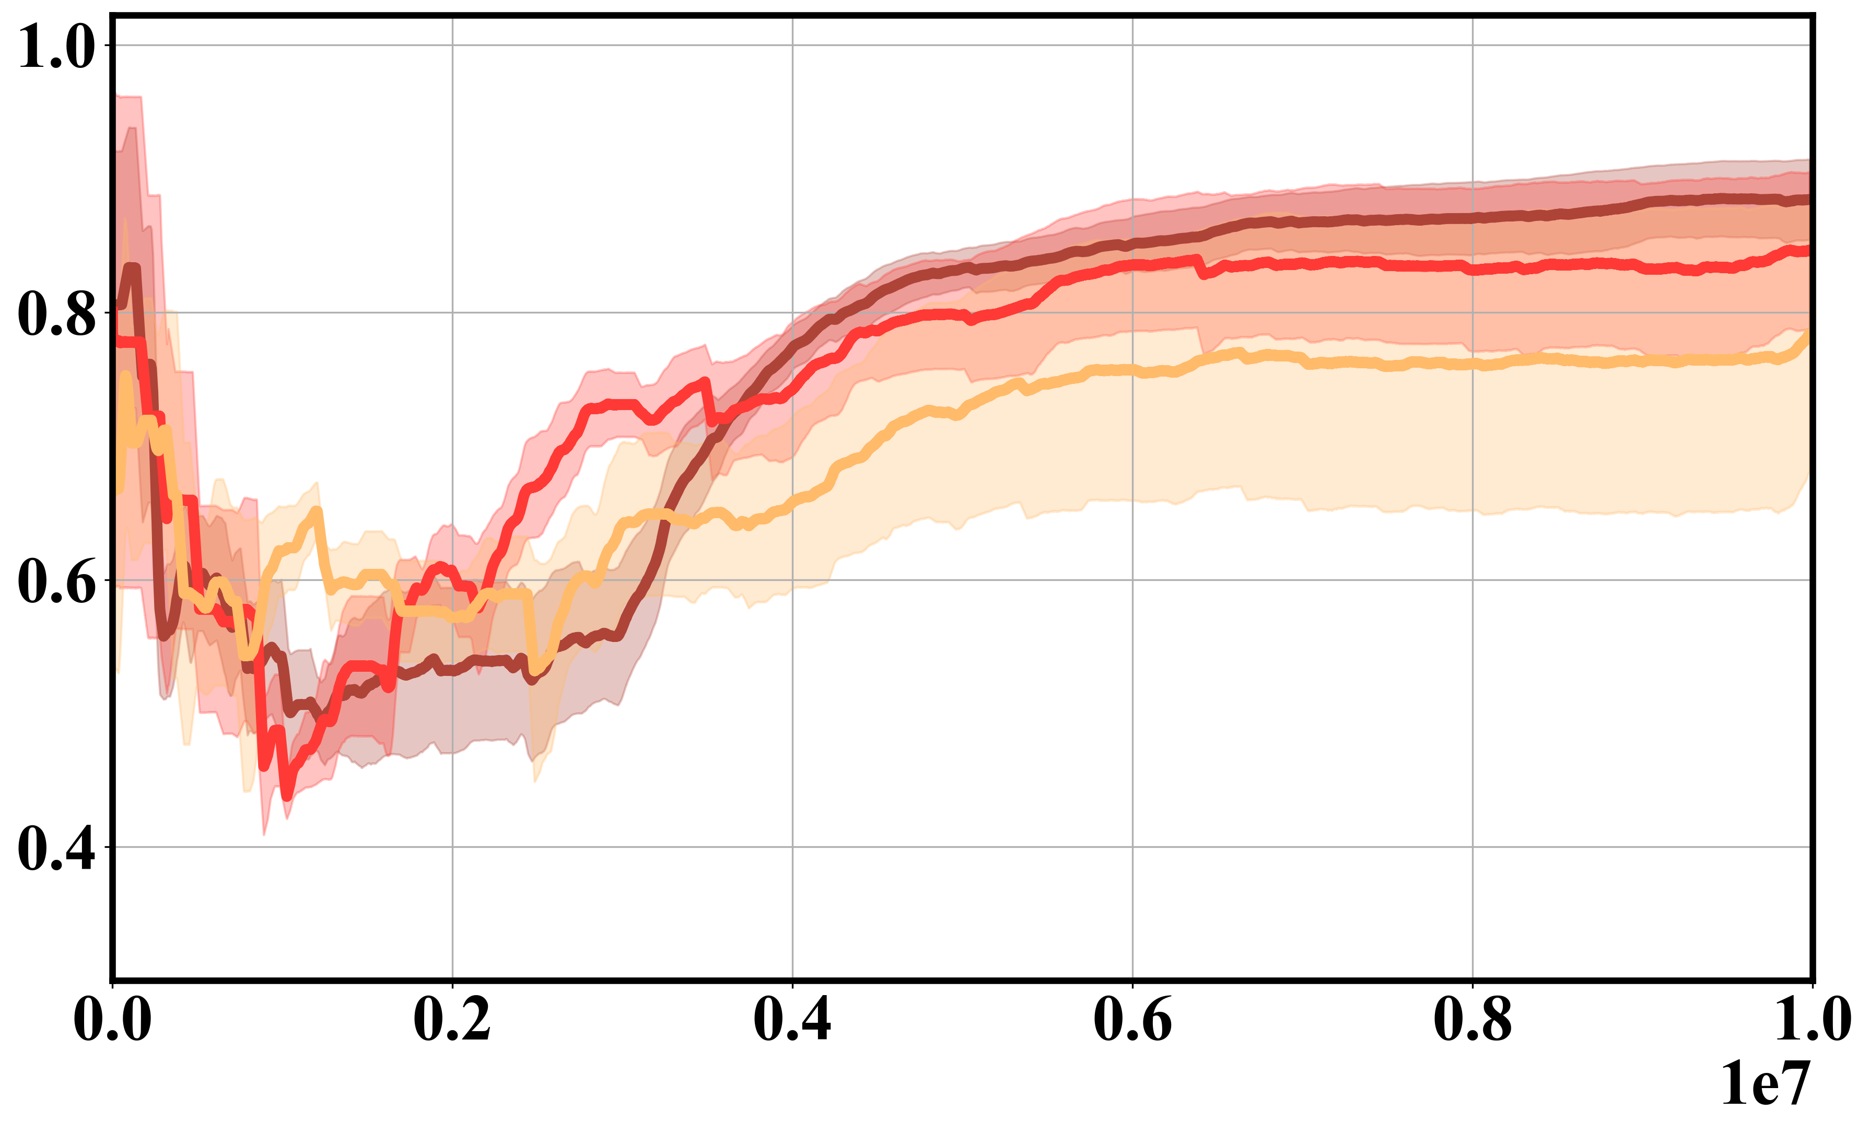
Fig. 11 - a
Global Step vs. Success Rate
(a)

Slide 6
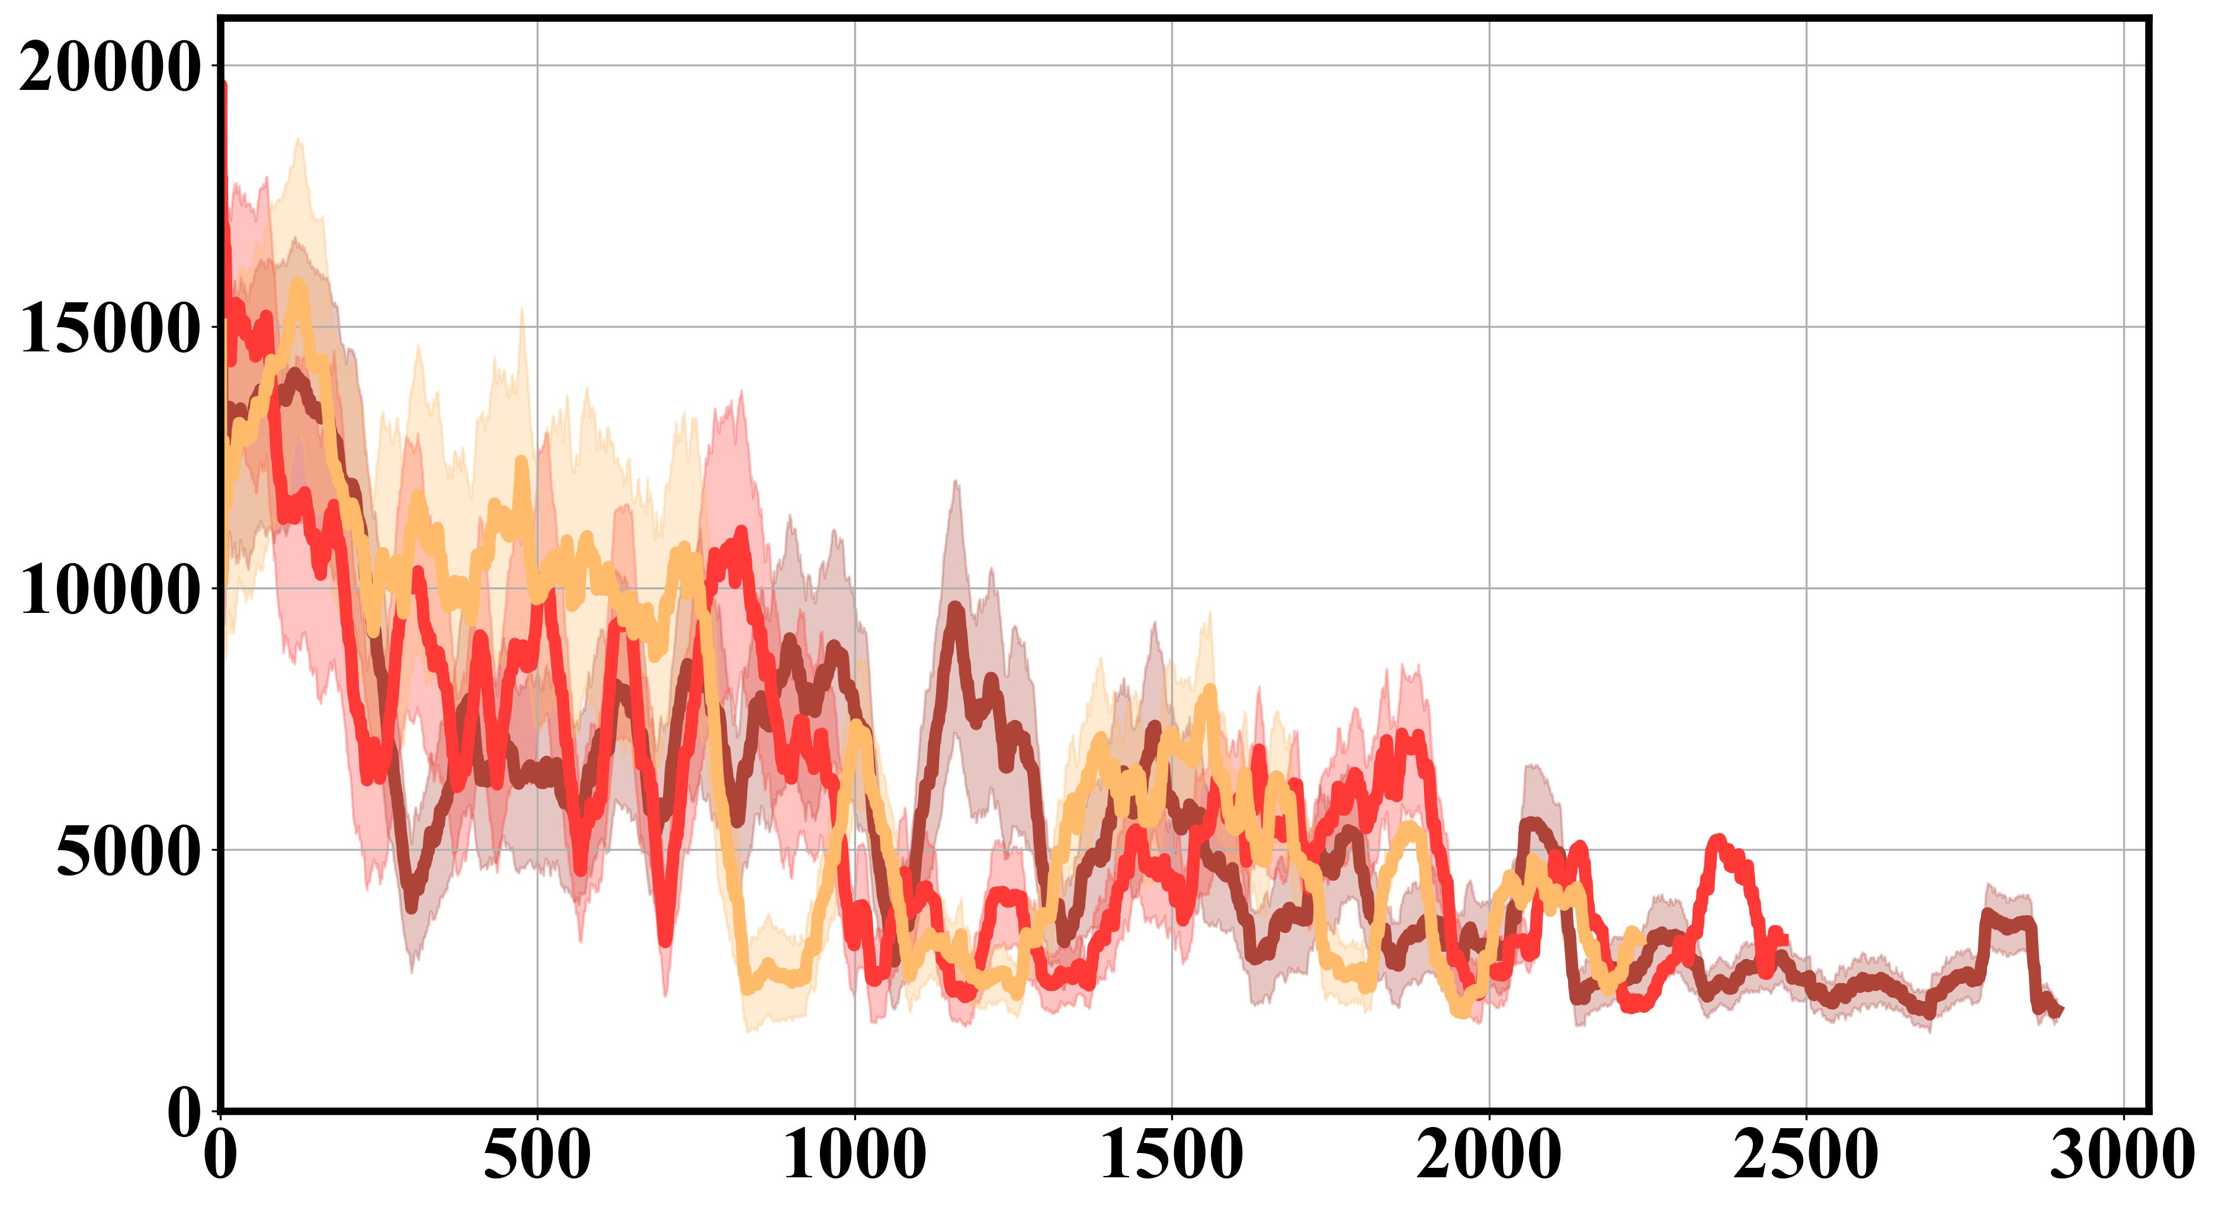
Fig. 11 - b
Episode vs. Episode Length
(b)

Slide 7
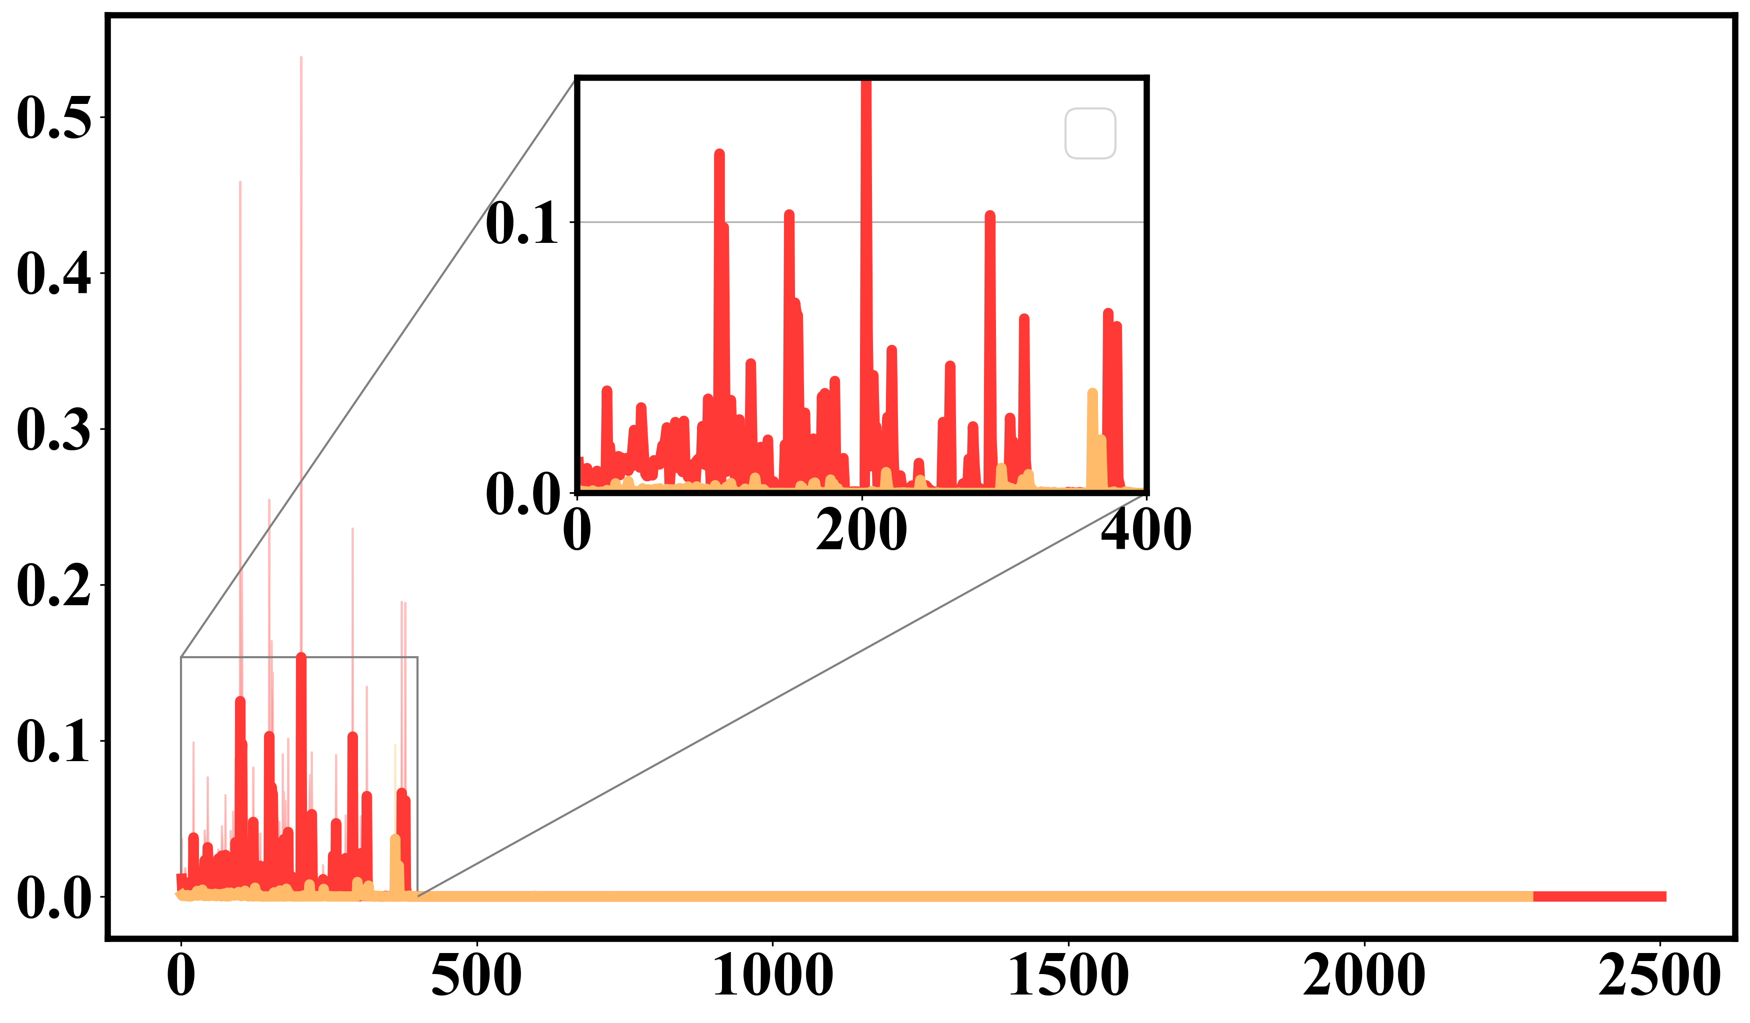
Fig. 11 - c
Episode vs. Scaled Mean Intrinsic Rewards
(c)

Slide 8
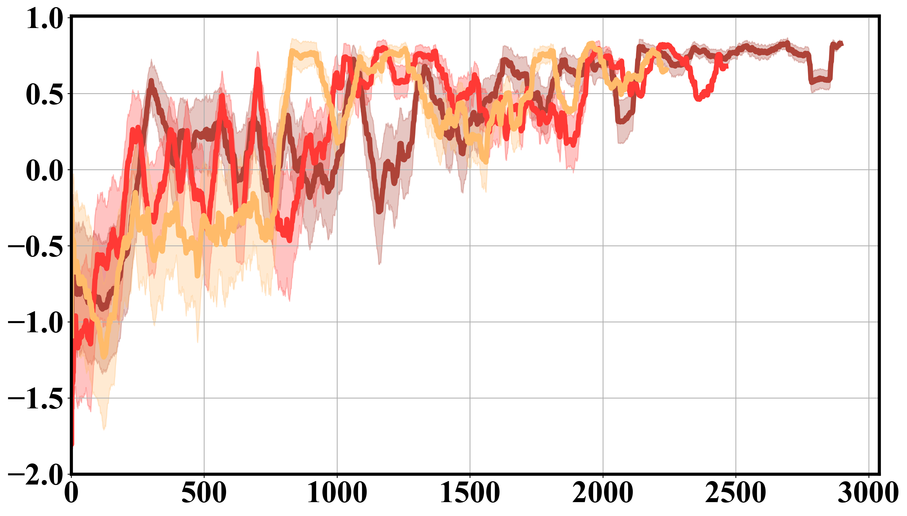
Fig. 11 - d
Episode vs. Episode Reward
(d)

Slide 9
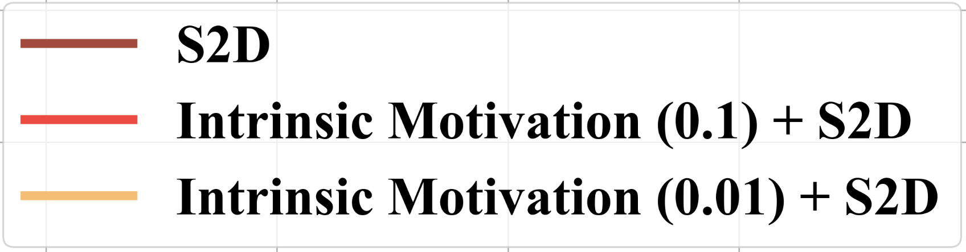
Global Step vs. Success Rate
Episode vs. Episode Length
(a)
(b)
Episode vs. Scaled Mean Intrinsic Rewards
Episode vs. Episode Reward
(c)
(d)

