Slide 1
ChaosProbe
Measuring Placement-Sensitive Resilience under Chaos
A pre-registered, layered study in Kubernetes
A single score is blind to placement
Placement moves a real kernel mechanism — that does not reach the user
Where it does reach users is availability under node failure — predictably
Yvo Hu · MSc Thesis Defense · University of Amsterdam
Supervisor: [TODO] · Examiner: [TODO] · 2026

Slide 2
The Operator's Decision
Pack the services onto few nodes, or spread them across many?
Pack — the locality literature
• Locality lowers inter-service latency — co-located calls stay
node-local (NetMARKS reports up to 37% faster responses)
• Schedulers from Borg to Medea encode this as resource fit
Spread — the availability literature
• Services in distinct failure domains survive the loss of any
one node (Medea topology spread)
• Co-location invites resource contention (Bubble-Up, Quasar)
What does today's tooling tell this operator?
• The Kubernetes scheduler scores nodes on resource fit, not fault isolation — it answers a different question
• Chaos-engineering tools answer the resilience question — but collapse the outcome into a single aggregate score
• Whether that score can even discriminate between placements — signal vs run-to-run noise — is unexamined
The research gap
Two bodies of practice — placement and chaos engineering — have never been connected. Nobody has measured AT WHICH LAYER a placement effect appears under a given fault class, whether it reaches the user-visible outcome, and whether an aggregate score can see it at all. If placement moves a kernel mechanism but not the user outcome, a single score is the wrong instrument — and placement advice derived from it is unreliable.

Slide 3
Research Question
A fault-class × measurement-layer study — not a placement ranking
Under which chaos fault classes does pod placement measurably affect mechanism-level behaviour and user-visible outcomes in a Kubernetes microservice application — and when do aggregate resilience scores obscure those effects?
An effect can appear at three layers — they need not agree:
Placement is manipulated by two orthogonal knobs:
(a) Aggregate score
one resilience number
f — cross-node dependency-edge fraction (packing f=0 → spreading f=1)
(b) Kernel / network mechanism
conntrack, kube-proxy SLO
r — replication degree (packed vs anti-affine)
(c) User-visible outcome
route latency + error rate
+ two interventional arms: NodeLocal DNSCache (executed) and kube-proxy mode (de-scoped to ipvs, not run).
Reliability first (H5): if a single score could rank placements reliably, the layered design would be a refinement. Because its availability layer cannot in this regime, the layered design is what produces the findings.

Slide 4
Pre-Registration & Provenance
The methodological backbone — removing the freedom to choose tests after seeing the data
Frozen before collection
• Hypotheses, smallest effect sizes of interest (SESOIs),
per-cell sample sizes, and the analysis CODE were frozen
and deposited BEFORE any confirmatory data was collected
• Frozen pre-registration deposited at its freeze commit
(DOI 10.5281/zenodo.20690836, commit 20097c1)
• Each member carries a registered effect-size / reliability
bar — Holm-significance is necessary, not sufficient
• The one non-blind deviation (D3) is logged in full in the
deviations log — disclosed, not hidden
Provenance-gated replication
• Independent single-commit sessions are the unit of
analysis — no pooling across code versions
• Every session gated by doctor --strict: clean tree,
scenario-hash present, runMetadata present, git.dirty=false
• Deposit-before-analysis: each campaign's raw data is
deposited under a DOI before its analysis is written
• Every quoted number traces to an archived, hash-stamped
run (artifact-manifest.json, SHA-256 per file)
This converts “we observed placement effects” into the more honest “here is exactly which effects survive a strict bar, and which do not.”

Slide 5
ChaosProbe — The Framework
Contribution 1: a placement-aware, pre-registered, provenance-gated chaos-evaluation method
Placement solver
Cross-layer probers
Cross-node fraction
Layered scorecard
drives the two knobs (f, r) by deployment-level nodeSelector mutation
Prometheus mechanism metrics, route latency (dependent vs control), EndpointSlice availability snapshots
computed from the Neo4j dependency graph + the realized placement
availability / mechanism / user-tail sub-scores — not one number
↓ driving and reading off-the-shelf infrastructure ↓
LitmusChaos + ChaosCenter
Prometheus + Locust
Neo4j 5
Online Boutique
fault execution
metrics & load
graph storage
system under test
What the candidate did vs what the tooling did
Authored: the placement solver and two-knob design; the three-layer measurement design with its dependent-vs-control route confound check; the cross-node-fraction metric and EndpointSlice trough; the layered scorecard; the pre-registration, doctor --strict gate, discard-not-patch rule, deposit-before-analysis protocol; and every analysis script. Integrated off-the-shelf: LitmusChaos, Prometheus/Locust, Neo4j, and the Online Boutique application execute the science — they do not define it.

Slide 6
Three-Layer Measurement Design
60s steady state → 120s fault active → 60s recovery — read at every layer
Layer | What is measured | How
Aggregate score | Layered resilience scorecard (mean of probe success %), reported with bootstrap CIs | LitmusChaos resilience probes + 5 Rust cmdProbes
Kernel / network mechanism | UDP-conntrack drop, kube-proxy SLO p99, CoreDNS p99, CPU throttle (SIG-Scalability) | Prometheus PromQL, churn-prober
User-visible outcome | HTTP route p95 latency + error rate, split dependent-vs-control route; east-west p95 | kubectl exec → wget/python3, 3.5s interval
Availability (node-drain) | EndpointSlice trough = fraction of app-ready endpoints lost when the node drains | K8s EndpointSlice snapshots
The instrument
• 6 continuous probers run as background threads
through all three phases
• Recovery split: deletion→scheduled (d2s) vs
scheduled→ready (s2r)
• Cross-node fraction f computed pre-chaos
from the dependency graph + placement
• The layered scorecard separates the layer
that carries signal from the one that does not
— rather than averaging them into one number
Why three layers, not one score
A single aggregate score's failure modes compound rather than cancel. Under churn it is NOISY — the availability layer it leans on has little reproducible between-condition signal. Under node-drain it is ABSENT — the drain takes down the infrastructure the probes depend on, every probe returns Unknown, and the score is undefined exactly when the availability outcome is most dramatic. So availability is read directly from EndpointSlice troughs.

Slide 7
Campaigns & Hypotheses
Three pre-registered campaigns, each deposited under a DOI before analysis
Campaign | Fault class | Design | Sess. | Tests | DOI
C1 dose-response | churn (pod-delete) | complete-block f∈{0,.25,.5,.75,1}, r=1, 5×3 iters | 8 | H1, H4, H5 | 20690737
C2 replication rescue | node failure (drain) | r∈{1,3} × mode (packed/anti-affine), 3 cells | 24 | H3 | 20726729
C3 placement + DNS | churn (pod-delete) | f∈{0,1} × dnsCache off/on, 7 matched pairs | 14 | H2 | 20748970
H | Claim | Registered bar
H1 | Dose-response of the east-west tail | monotone increase, ≥ 15% SESOI (f=0→1)
H2 | Placement-dependence + DNS intervention | spread>packed drop AND DNS shrinks ≥50%
H3 | Replication rescue under node-drain | r×mode interaction + anti-affine rescue margin
H4 | Placement frontier (descriptive) | non-dominated set under frozen margins
H5 | Layered scorecard reliability | availability AND mechanism ICC ≥ 0.5
H6 | Direction transfer (iptables mode) | not attempted — cluster ran ipvs, de-scoped
Faults & cluster
Two fault classes:
• CHURN (pod-delete)
single replica gone
• NODE FAILURE (drain)
placement-dependent
blast radius
Cluster: 8×2-vCPU/
4-GiB workers,
K8s v1.28.6, ipvs

Slide 8
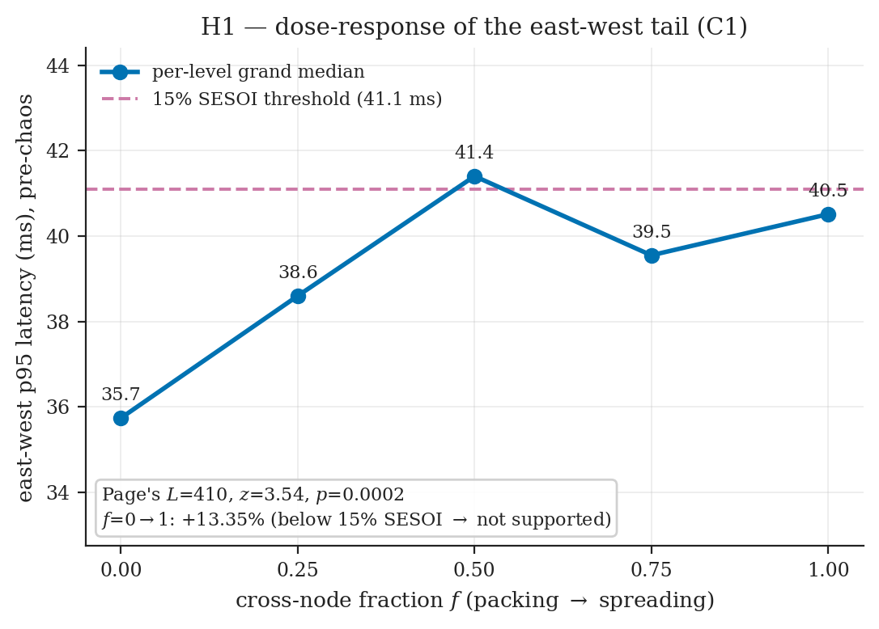
H1 — Dose-Response of the East-West Tail
Bar: east-west p95 rises monotonically in f, by ≥ 15% (f=0→f=1)
Result — trend detected, but below the SESOI
• Page's L trend test: L = 410, z = 3.54, p = 0.0002
• Per-level median p95 (ms):
35.74 / 38.60 / 41.40 / 39.55 / 40.51
• f=0 → f=1 effect: +13.35%
• Medians rise, then plateau/dip at f=0.75
H1 NOT SUPPORTED — below the 15% SESOI
Disclosed deviation (D3, non-blind)
The registered pre-window UDP-slope taint flags every iteration at f=0.25 and f=0.5 — zero complete blocks, so Page's L is uncomputable and H1 is unrunnable as registered. The taint is withdrawn on protocol-independent grounds (it gates DNS/UDP, a different protocol from the TCP/gRPC outcome). This is the study's one outcome-aware deviation — logged in full.

Slide 9
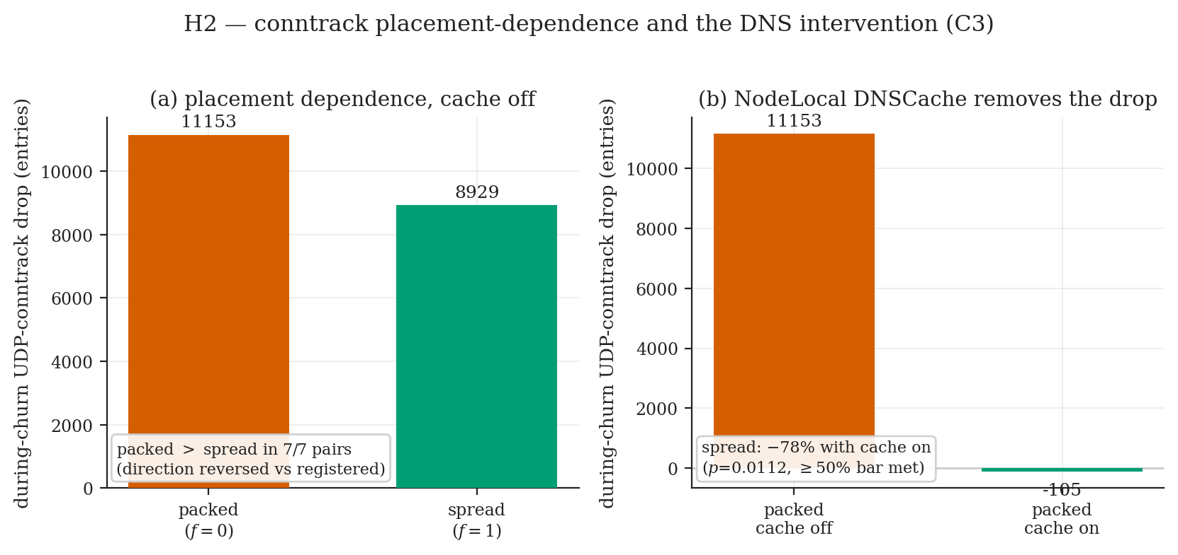
H2 — Placement-Dependence and the DNS Intervention
Bar (both must pass): (a) spread > packed conntrack drop AND (b) DNS cache shrinks it ≥ 50%
Result
(a) Placement — REVERSED:
packed > spread in 7/7 pairs
(packed 11153, spread 8929; p=0.99)
(b) DNS mechanism — PASSES:
78.0% median shrink (all 7 pairs 61–85%)
packed drop also → ≈0 with cache on
CONJUNCTION = FALSE — H2 not supported
The reversal sharpens the mechanism
Co-locating a service's replicas on one node CONCENTRATES the per-node conntrack churn when pod-delete hits that node — a larger drop than spreading the same replicas. The DNS cache removes the drop under BOTH placements, so the floodable pool is the general per-node DNS/UDP conntrack churn, not specifically cross-node DNS. Placement does matter for conntrack — significantly, but with the opposite sign to the prediction. The DNS cache is the one actionable lever the study confirmed.

Slide 10
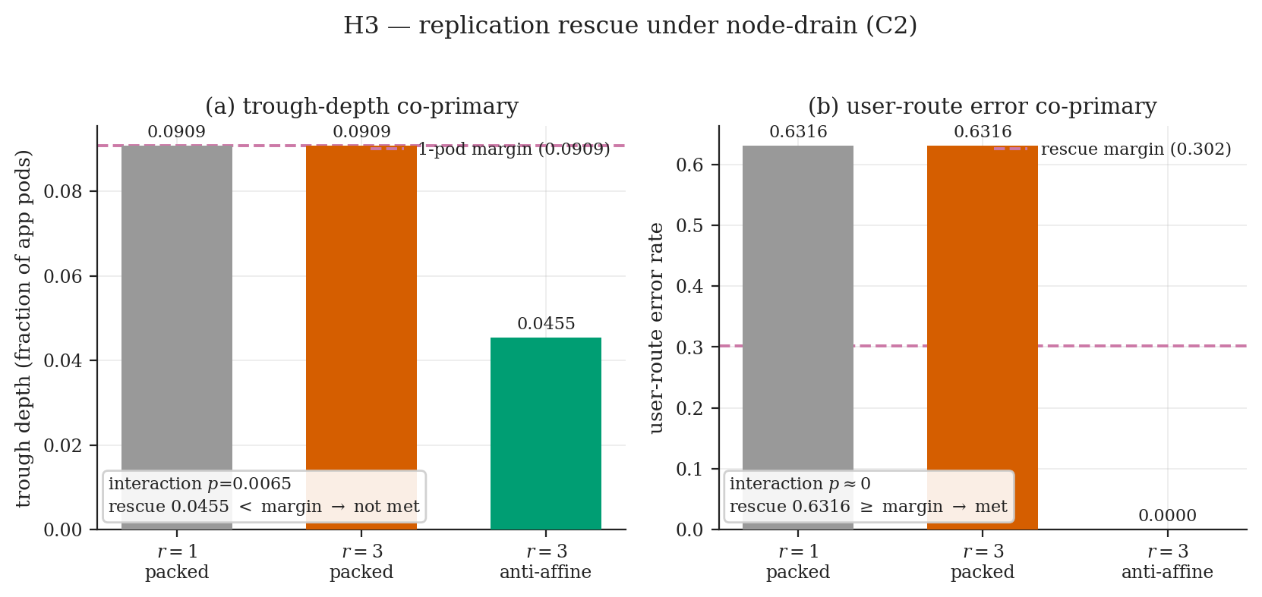
H3 — Replication Rescue under Node-Drain
Bar: r×mode interaction + anti-affine rescue clears its margin + packed r=3 ≈ r=1
co-primary | r1 | r3-pk | r3-anti | vs bar
trough depth | 0.091 | 0.091 | 0.046 | interaction p=.0065; rescue < .091 margin → not met
user-route error | 0.632 | 0.632 | 0.000 | p≈0; rescue ≥ .302 → MET; TOST in band
CONJUNCTION = FALSE — but by construction
The error face rescues
Anti-affine r=3 fully rescues the user-route error (0.632 → 0.0) — strong, significant directional support. The depth face cannot adjudicate: under round-robin spread, draining one node costs r=1 only ≈1 pod, so the r=1 depth (0.091) EQUALS the one-pod margin it must beat. The metric's dynamic range coincides with the bar — a measurement-design limit surfaced honestly, reported exactly as registered (not retuned). The design-fix slide shows the rescue is real once this artifact is removed.

Slide 11
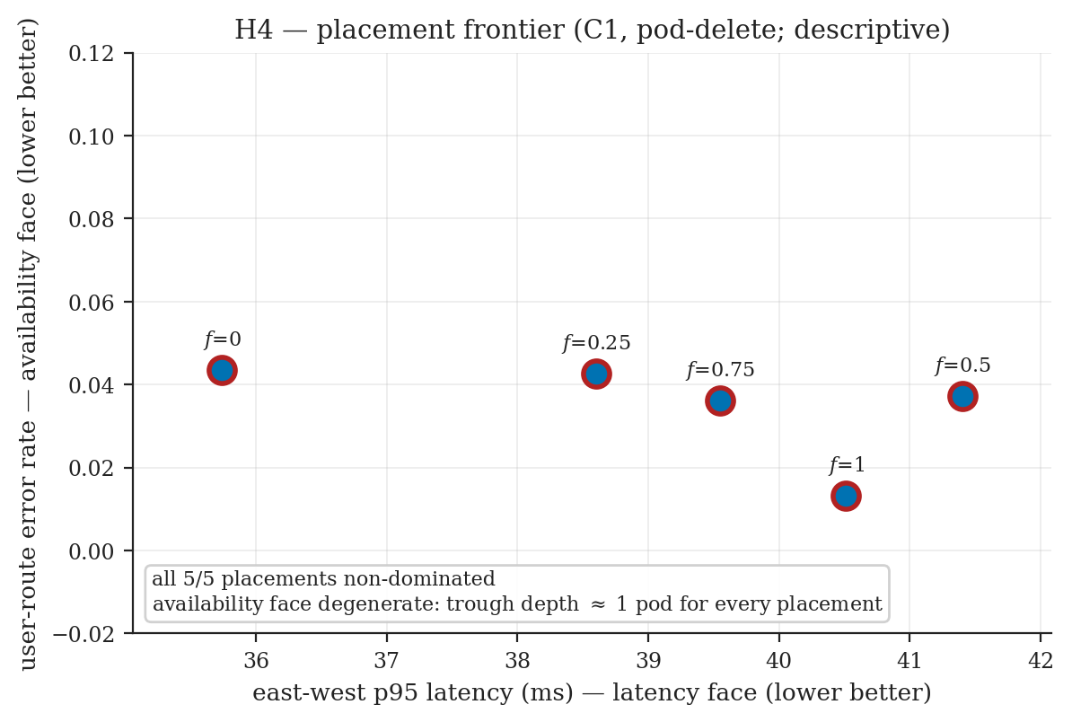
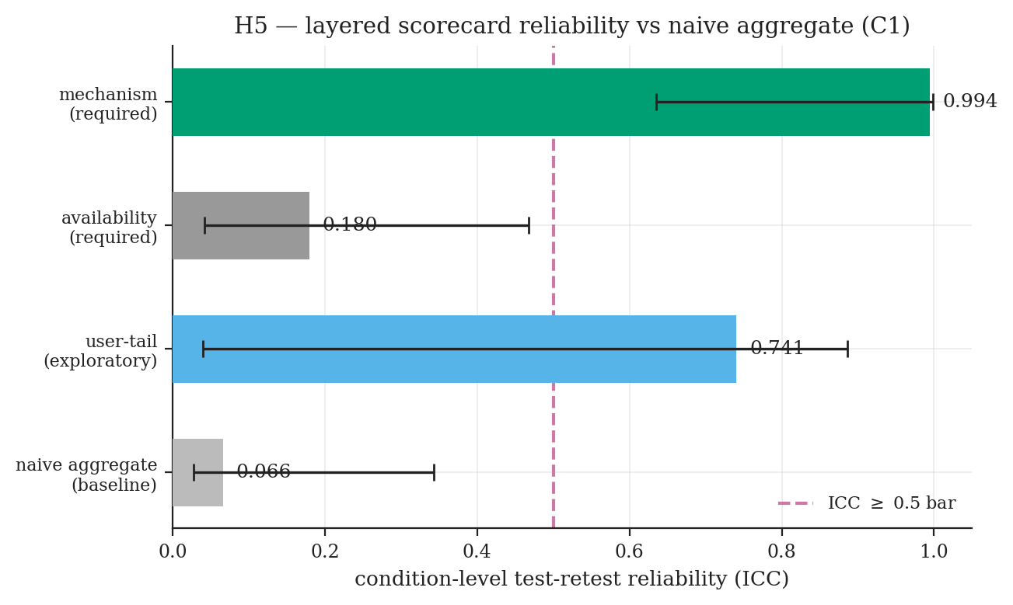
H4 & H5 — Frontier and Scorecard Reliability
The availability axis is dead under pod-delete — and that is diagnostic, not a method failure
H5 — layered scorecard reliability
H4 — frontier (descriptive): degenerate
• All 5/5 placements non-dominated
• Latency face varies (35.7–41.4 ms — the H1 signal)
• Availability face DEGENERATE: pod-delete removes
one pod, so trough depth ≈ 1 pod for every placement
• The trade-off the frontier was designed to reveal is
not realizable from this data
sub-score | ICC | ≥0.5?
availability (required) | 0.180 | no
mechanism (required) | 0.994 | yes
naive aggregate baseline | 0.066 | —
Required conjunction FAILS (availability ICC < 0.5). But the mechanism layer is far more reliable than a single aggregate (0.994 vs 0.066) — the headline reliability result.

Slide 12
The Confirmatory Family — Holm Capstone
The four confirmatory hypotheses corrected together at α = 0.05
hyp | primary test | input p | Holm-adj p | supported?
H1 | dose-response (Page's L) | 0.0002 | 0.0008 | no — effect < SESOI
H2 | placement + DNS | 0.98875 | 0.98875 | no — placement reversed
H3 | replication rescue | 0.0065 | 0.0195 | no — rescue margin unmet
H5 | layered scorecard ICC | 0.2501 | 0.5002 | no — availability ICC < 0.5
Family verdict: No confirmatory hypothesis is supported. Two primaries (H1's trend, H3's interaction) survive Holm — but Holm-significance is necessary, not sufficient. Every member also fails its registered effect-size / reliability bar.
The central finding: a real mechanism, rigorously bounded in reach
The consistent positive thread across all three campaigns is the MECHANISM: the UDP-conntrack reconvergence signature is real and individually significant every time it is measured — placement-dependent under churn (H2), interacting with replication under node-drain (H3's error face), and the one scorecard layer with near-perfect test-retest reliability (H5, mechanism ICC 0.994). What does NOT hold, at the pre-registered bar, is that this mechanism translates into the user-visible placement, availability, and dose-response advantages the hypotheses predicted. Once pod-delete at r=1 is understood as a churn fault, the bound is the expected shape: during the kill window the single replica is simply gone, and every dependent request fails identically whether services are packed or spread.

Slide 13
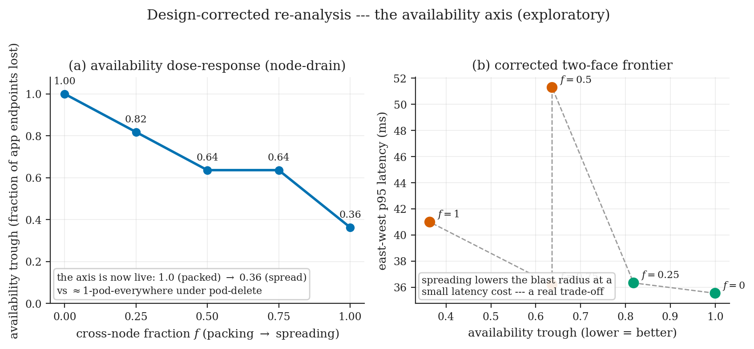
Design-Corrected Re-Analysis (Exploratory)
The availability-axis tests were construction-limited — node-drain makes the axis live
The fault, not the finding: pod-delete at r=1 removes the only replica — trough ≈ 1 pod for EVERY placement. That made H3's depth un-passable, H4's frontier degenerate, and H5's availability ICC a measurement of noise.
What the correction shows
• C4: node-drain dose-response, 8 sessions,
criteria pre-declared before data examined
• Availability trough now 1.00 (packed) → 0.36
(spread) — a LIVE axis, a real trade-off
• H3: user error 0.63 → 0 + significant interaction
(p=0.0065); depth halves but knife-edge — the
robust evidence is the interaction, not the threshold
• H5 availability ICC under drain is 1.0 BY
CONSTRUCTION — large signal, not a retest estimate
Honest scope: this does NOT re-open the frozen confirmatory verdicts. It shows H3's not-supported and H4's degenerate results were partly construction artifacts whose underlying effects are real once availability can move — exploratory, outside the Holm family, deposited to the same bar.

Slide 14
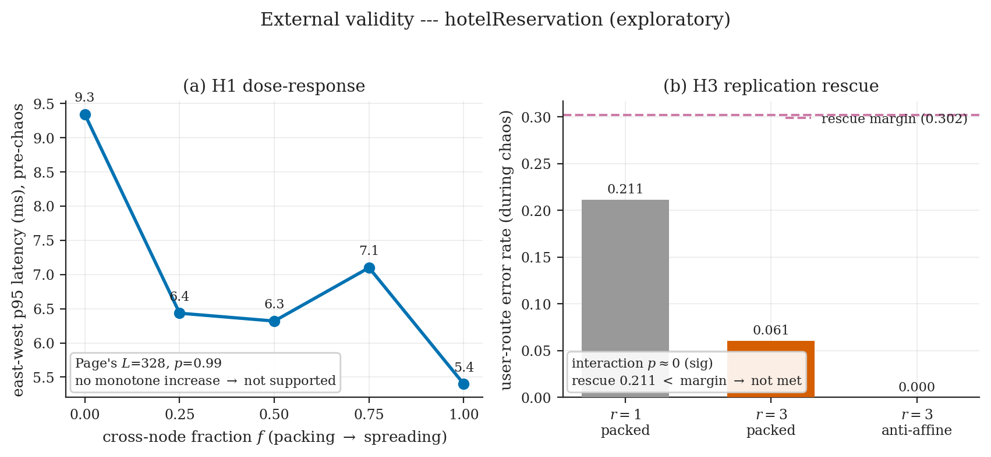
External Validity — A Second Workload
Exploratory replication on DeathStarBench hotelReservation (deep gRPC/Consul fan-out)
study | registered bar | hotel outcome
H1 dose-response | monotone, ≥15% SESOI | Page's L p=0.99 — NO increase
H3 repl. rescue | interaction + margins | CONJUNCTION = False
Both arms corroborate online-boutique
• 32 sessions, all doctor --strict clean
• H1: no dose-response (tight 5–9 ms band,
if anything a mild decrease)
• H3: significant r×mode interaction, anti-affine
directionally best — but here NEITHER margin is
cleared (depth 0.044, error 0.212), a broader
miss than online-boutique's clean error rescue
A second, structurally different workload reproduces both the below-SESOI dose-response and the conjunction-false rescue verdict: the mechanism (spreading shrinks the blast radius, speeds recovery) is robust on both applications; the strong placement and margin-clearing claims hold on neither. The strongest available evidence the finding is not an artifact of one topology. (DOI 10.5281/zenodo.20792129)

Slide 15
Threats to Validity
The boundary of every claim — stated, not hidden
What bounds the claims
• Single-replica baseline — pod-delete at r=1 is a pure
churn fault; production runs multiple replicas. The
design-fix (node-drain) addresses the availability axis
• One workload — partly addressed: hotelReservation
replicates both placement-bearing arms
• Virtualized cluster — Vagrant/libvirt KVM; bare-metal
I/O may differ. Conntrack is K8s-version-pinned (v1.28.6)
• IPVS only — the iptables-mode direction-transfer
comparison (H6) was de-scoped before collection
• One non-blind deviation (D3) — outcome-aware taint
withdrawal; disclosed in full, sensitivity check available
What protects the claims
• Pre-registration fixes the SESOIs against a measured
noise floor BEFORE collection — no test-after-seeing-data
• Holm correction across the confirmatory family
• doctor --strict gate on every session; discard-not-patch
• Deposit-before-analysis under DOIs; every number traces
to a hash-stamped archived run
• Dependent-vs-control route split controls the user layer
for run-level confounds
• A second workload corroborates the central finding

Slide 16
Conclusion & Future Work
Chaos evaluation of placement needs layered measurement, pre-registration, and provenance — not a single score
Three contributions
1. A pre-registered, provenance-gated measurement
methodology (ChaosProbe) — reusable, outcome-
independent
2. A positively-established, precisely-bounded mechanism
— real conntrack signature, DNS cache removes it,
does not reach the user at the registered bar
3. A reproducible campaign protocol with DOI-deposited
artifacts (deposit-before-analysis)
Key findings
• H1: aggregate score blind; dose-response below SESOI
• H2: placement moves conntrack (reversed sign); DNS
cache is the actionable lever
• H3: anti-affine rescues the user-error face under drain
• H5: mechanism ICC 0.994 vs naive 0.066 — audit a
score's reliability before trusting it to rank
• Design-fix: availability bites users under node failure
— predictable from the dependency graph
Future work
• Replicate the family on different INFRASTRUCTURE (managed cluster, iptables/nftables proxy, bare metal)
• A rescue margin the depth face can express (relative to realized r=1 depth, or integrated depth×duration)
• Apportion the conntrack drop: kernel TCP teardown vs kube-proxy's UDP-only cleanup (composition probe)
• Integrate the cross-node fraction into a scheduler as a scoring plugin
A single score is blind to placement (H1). Placement acts at the mechanism layer (H2) without reaching the user (H3); where it does reach users is availability under node failure — predictably, from the dependency graph (design-fix). A real mechanism, rigorously bounded in reach.

Slide 17
Thank You
Questions?
3
46
0
0.994
pre-registered campaigns
doctor-strict sessions
hypotheses supported (mechanism real)
mechanism ICC vs 0.066 naive
Raw data, pre-registration, and analysis code deposited under DOIs · every number traces to an archived run

