Slide 1
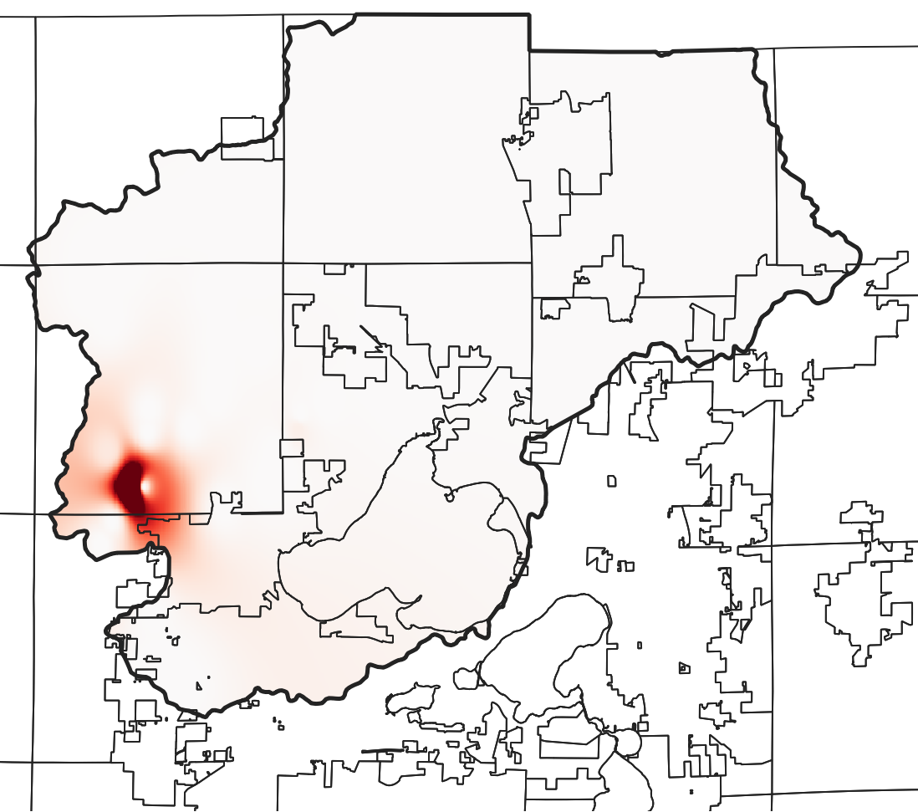
Excess P (tonne)
43.293° N
>1
43.206° N
0.5
43.118° N
43.031° N
0
89.602° W
89.486° W
89.365° W
89.247° W

