Slide 1
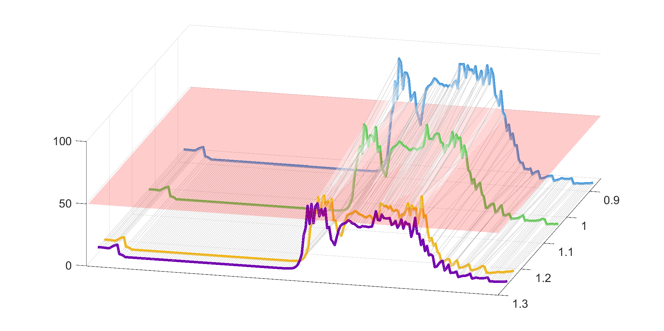
Environmental cost (USD/kg P)
0
6.6
13.2
19.8
Conc. of Chl-a (mg/m³)
Economic Cost (million USD)
Apr.
May
Jun.
Jul.
Aug.
Sep.
Oct.

Slide 2
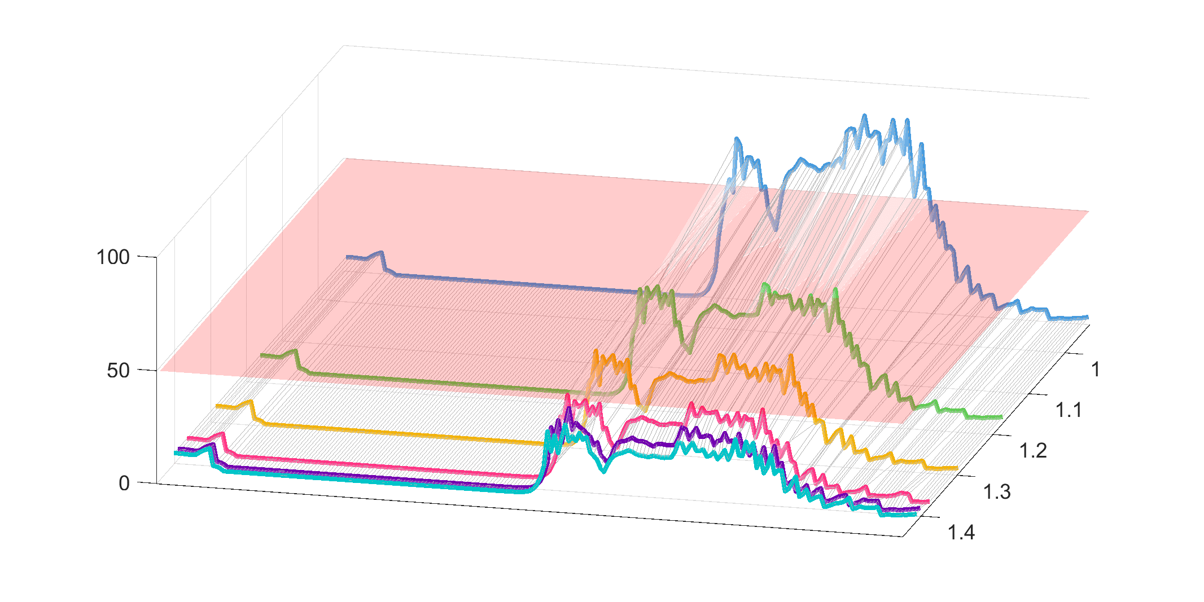
Environmental cost (USD/kg P)
0
6.6
13.2
33
46.2
66
Conc. of Chl-a (mg/m³)
Economic Cost (million USD)
Apr.
May
Jun.
Jul.
Aug.
Sep.
Oct.

Slide 3
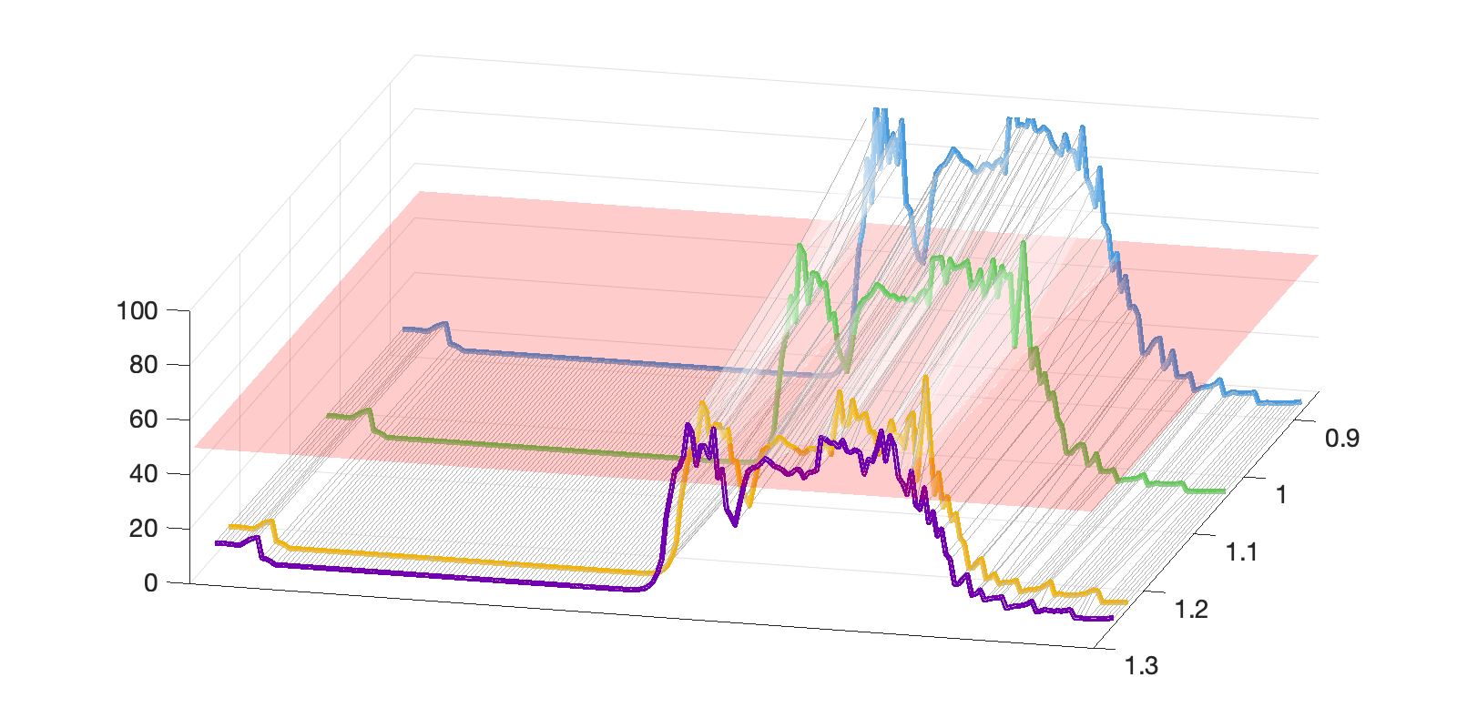
Environmental cost (USD/kg P)
0
6.6
13.2
19.8
Conc. of Chl-a (mg/m³)
Economic Cost (million USD)
Apr.
May
Jun.
Jul.
Aug.
Sep.
Oct.

Slide 4
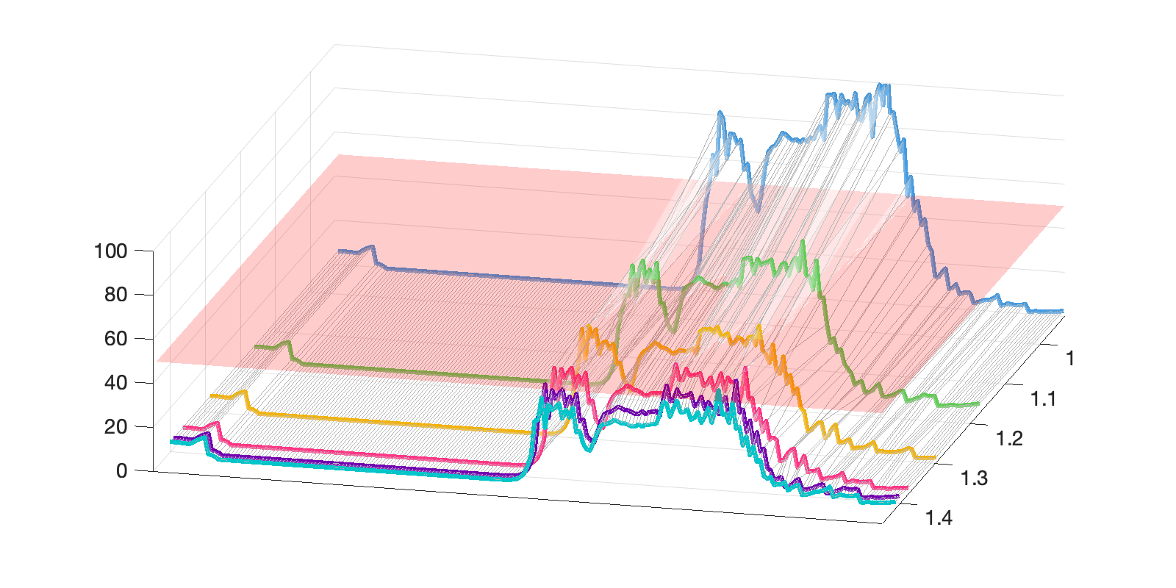
Environmental cost (USD/kg P)
0
6.6
13.2
33
46.2
66
Conc. of Chl-a (mg/m³)
Economic Cost (million USD)
Apr.
May
Jun.
Jul.
Aug.
Sep.
Oct.

