Slide 1
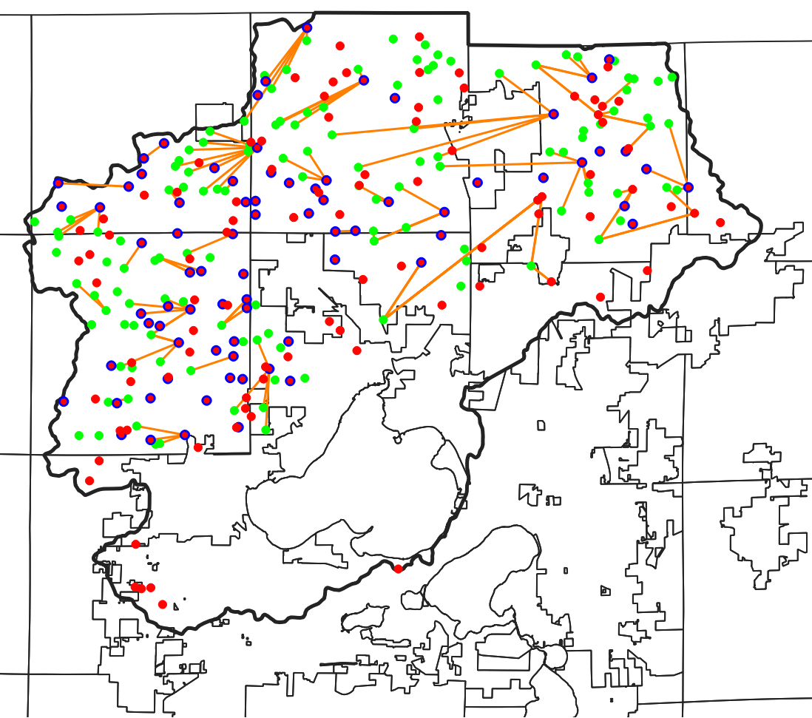
Farm Nodes
Aggregated Land Nodes
Farm Nodes with Storage
Transportation of Dairy Cow Manure
43.293° N
43.206° N
43.118° N
43.031° N
89.602° W
89.486° W
89.365° W
89.247° W

