Slide 1
SVMLight
SVMLight is an implementation of Support Vector Machine (SVM) in C.
Download source from :
http://svmlight.joachims.org/
Detailed description about:
What are the features of SVMLight?
How to install it?
How to use it?
…

Slide 2
Training Step
svm-learn [-option] train_file model_file
train_file contains training data;
The filename of train_file can be any filename;
The extension of train_file can be defined by user arbitrarily;
model_file contains the model built based on training data by SVM;

Slide 3
Format of input file (training data)
For text classification, training data is a collection of documents;
Each line represents a document;
Each feature represents a term (word) in the document;
  The label and each of the feature: value pairs are separated by a space character
  Feature: value pairs MUST be ordered by increasing feature number
Feature value : e.g., tf-idf;

Slide 4
Testing Step
svm-classify test_file model_file predictions
The format of test_file is exactly the same as train_file;
Needs to be scaled into same range;
We use the model built based on training data to classify test data,
and compare the predictions with the original label of each test
document;

Slide 5
Example
In test_file, we have:
After running the svm_classify, the
Predictions may be:
1 101:0.2 205:4 209:0.2 304:0.2…
-1 202:0.1 203:0.1 208:0.1 209:0.3…
…
…
1.045
-0.987
…
…
Which means this classifier
classify these two documents
Correctly.
or
1.045
0.987
…
…
Which means the first
document is classified
correctly but the second
one is incorrectly.

Slide 6
Confusion Matrix
a is the number of correct predictions that an instance is negative;
b is the number of incorrect predictions that an instance is positive;
c is the number of incorrect predictions that an instance if negative;
d is the number of correct predictions that an instance is positive;
 |  | Predicted
 |  | negative | positive
Actual | negative | a | b
 | positive | c | d

Slide 7
Evaluations of Performance
Accuracy (AC) is the proportion of the total number of predictions that were correct.
AC = (a + d) / (a + b + c + d)
Recall is the proportion of positive cases that were correctly identified.
R = d / (c + d)
Precision is the proportion of the predicted positive cases that were correct.
P = d / (b + d)
Actual positive cases number
predicted positive cases number

Slide 8
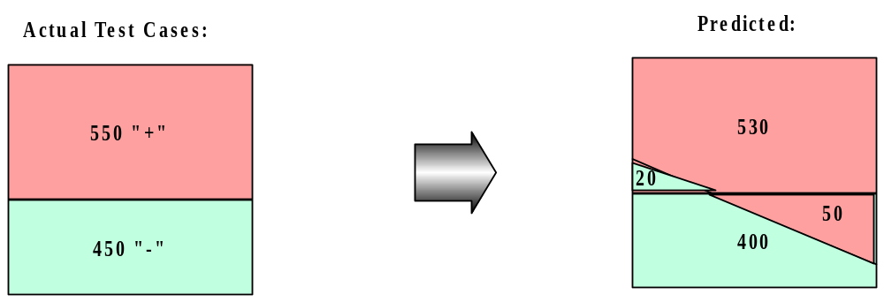
Example
For this classifier:
a = 400
b = 50
c = 20
d = 530
Accuracy = (400 + 530) / 1000 = 93%
Precision = d / (b + d) = 530 / 580 = 91.4%
Recall = d / (c + d) = 530 / 550 = 96.4%

