Slide 1
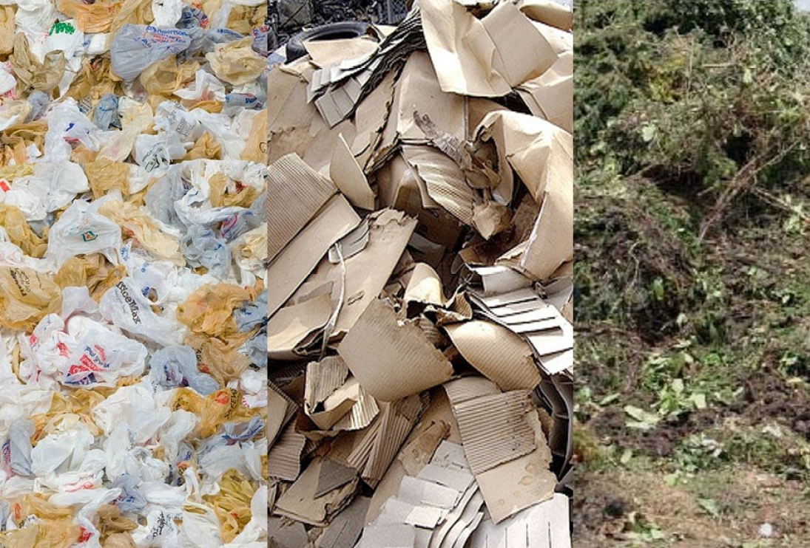
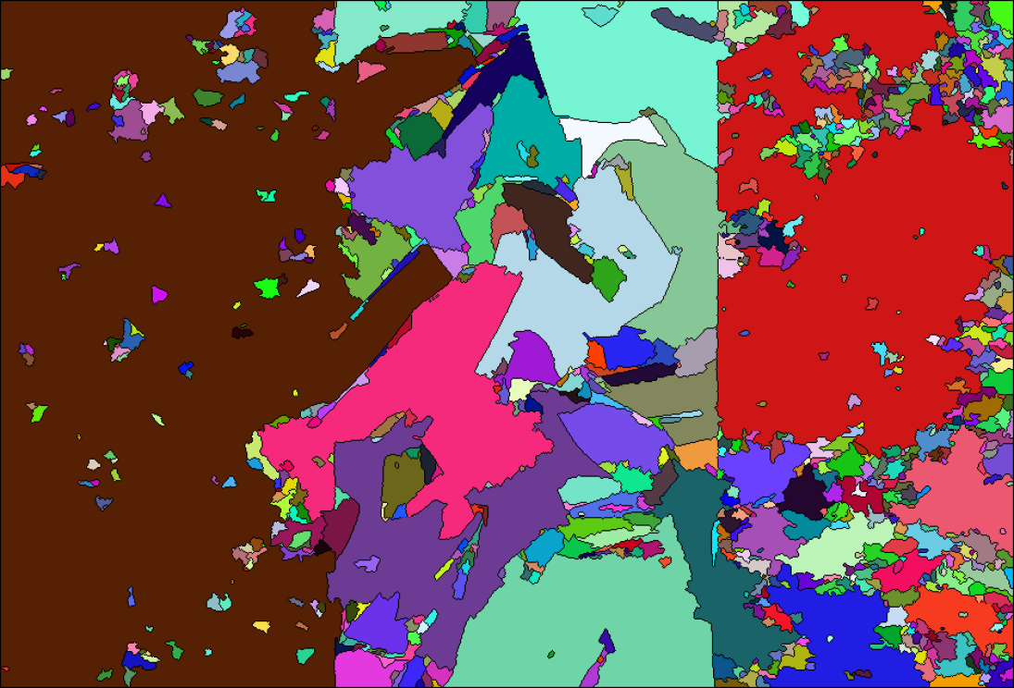
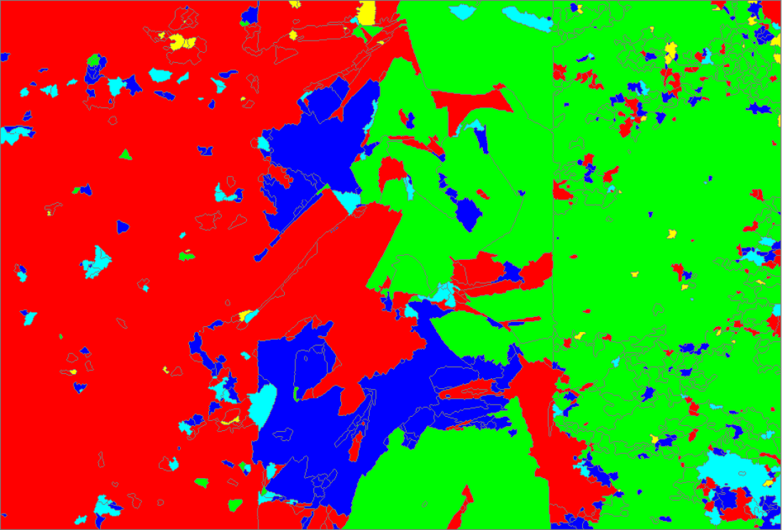
Finding Recyclable Material Using Computer Vision and Support Vector Machine
Rory Main
ramain@alaska.edu
Masa Hu
yhu9@alaska.edu
Martin Cenek
mcenek@uaa.alaska.edu
Project
Image Recognition
Results
In 2014, it is estimated that the United States produced 258 million tons of Municipal Solid Waste (MSW).We present here a strategy combining computer vision techniques, machine learning algorithms, and automated drone flight for image capturing to estimate the different types of material present at a waste management site.
The image classification model must first be trained before being usable for classification. The following steps are taken in order to train the model
:
1. Segmentation of in-group images
2. Extraction of HSV color distribution of each segment
3. Repeat step 1-2 for out-group images
4. Train the model on each segment instance given the groups
5. repeat steps 1-4 for all other categories
Results indicate that trash bags are mistakenly categorized as plywood, and cardboard is mistaken for tree matter and construction material. Tree matter was the most accurate classification. However, even this classification looks to have several instances of false positives.
Usage of singular categorizations produces strong results greater than 90%. However, when classifying between multiple categories the accuracies dramatically decrease.
Segmentation
Photo Gathering
To gather images of the waste, we were supplied with a hexacopter mounted with a GoPro Hero 3, and equipped with a PixHawk flight controller.
Currently the drone will be piloted by a skilled pilot, while the GoPro takes a phot every two seconds. The gathered pictures are then put into PhotStitcher to create one large panorama of the waste.
KEY
Blue – construction material
Green – tree matter
Red – plywood
Turquoise – cardboard
Yellow – trashbags
Classification
Future Work
- Usage of other machine learning algorithms for comparison of accuracies
- Automation of the drone flight
Classification of an image uses the following steps:
1. Segment the image
2. Classify the segment with each model
3. Color the segment using the model with the maximum value
4. If the minimum value subtracted by the maximum value is not greater than 1.0 than color the segment white
5. Repeat steps 1-4 for each segment found in the image
6. Count the number of pixels for each model color and record the results

