Slide 1





COP 5725
School of Computer and Information Sciences
Francisco R. Ortega, Ph.D.
Lecture #5 – R & G SQL Ch. 5 Part 2
SQL

Slide 2

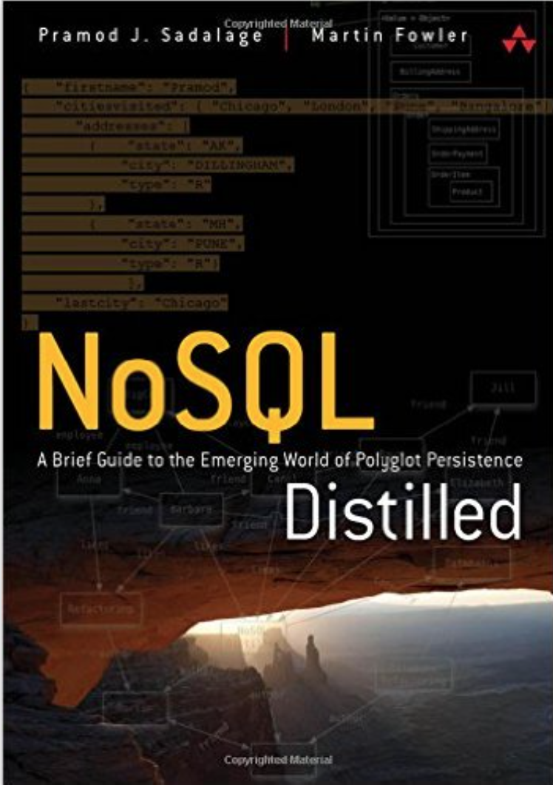
Book and Materials
Most of the material here has been obtained from the following Sources:
R & G Book
R & G Resources (Web,…)
Dr. Rishe’s Semantic DB Book
Dr. Pavlo’s material (CMU)
Additional publications
NoSQL Book
Additional Resources will be announced.

Slide 3
Outline
Complex Joins
Views
Nested Queries
Common Table Expressions
Triggers
Database Application Example

Slide 4
Example Database
STUDENT
ENROLLED
sid | name | login | age | gpa
53666 | Trump | trump@cs | 45 | 4.0
53688 | Bieber | jbieber@cs | 21 | 3.9
53655 | Tupac | shakur@cs | 26 | 3.5
sid | cid | grade
53666 | Pilates101 | C
53688 | Reggae203 | D
53688 | Topology112 | A
53666 | Massage105 | D
COURSE
cid | name
Pilates101 | Pilates
Reggae203 | 20th Century Reggae
Topology112 | Topology + Squirrels
Massage105 | Massage & Holistic Therapy

Slide 5
Join Query Grammar
SELECT ...
FROM table-name1 join-type table-name2
ON qualification
[WHERE ...]
Join-Type: The type of join to compute.
Qualification: Expression that determines whether a tuple from table1 can be joined with table2. Comparison of attributes or constants using operators =, ≠, <, >, ≤, and ≥.

Slide 6
INNER JOIN
sid | name | login | age | gpa
53666 | Trump | trump@cs | 45 | 4.0
53688 | Bieber | jbieber@cs | 21 | 3.9
53655 | Tupac | shakur@cs | 26 | 3.5
sid | cid | grade
53666 | Pilates101 | C
53688 | Reggae203 | D
53688 | Topology112 | A
53666 | Massage105 | D
SELECT name, cid, grade
FROM student INNER JOIN enrolled
ON student.sid = enrolled.sid
SELECT name, cid, grade
FROM student, enrolled
WHERE student.sid = enrolled.sid
name | cid | grade
Bieber | Reggae203 | D
Bieber | Topology112 | A
Trump | Massage105 | D
Trump | Pilates101 | C
SELECT name, cid, grade
FROM student NATURAL JOIN enrolled

Slide 7
OUTER JOIN
sid | name | login | age | gpa
53666 | Trump | trump@cs | 45 | 4.0
53688 | Bieber | jbieber@cs | 21 | 3.9
53677 | Tupac | shakur@cs | 26 | 3.5
sid | cid | grade
53666 | Pilates101 | C
53688 | Reggae203 | D
53688 | Topology112 | A
53666 | Massage105 | D
SELECT name, cid, grade
FROM student LEFT OUTER JOIN enrolled
ON student.sid = enrolled.sid
name | cid | grade
Bieber | Reggae203 | D
Bieber | Topology112 | A
Trump | Massage105 | D
Trump | Pilates101 | C
Tupac | NULL | NULL

Slide 8
OUTER JOIN
sid | name | login | age | gpa
53666 | Trump | trump@cs | 45 | 4.0
53688 | Bieber | jbieber@cs | 21 | 3.9
53677 | Tupac | shakur@cs | 26 | 3.5
sid | cid | grade
53666 | Pilates101 | C
53688 | Reggae203 | D
53688 | Topology112 | A
53666 | Massage105 | D
SELECT name, cid, grade
FROM enrolled RIGHT OUTER JOIN student
ON student.sid = enrolled.sid
name | cid | grade
Bieber | Reggae203 | D
Bieber | Topology112 | A
Trump | Massage105 | D
Trump | Pilates101 | C
Shakur | NULL | NULL

Slide 9
Join Types
SELECT * FROM A JOIN B ON A.id = B.id
Join Type | Description
INNER JOIN | Join where A and B have same value
LEFT OUTER JOIN | Join where A and B have same value AND where only A has a value
RIGHT OUTER JOIN | Join where A and B have same value AND where only B has a value
FULL OUTER JOIN | Join where A and B have same value AND where A or B have unique values
CROSS JOIN | Cartesian Product

Slide 10


Slide 11
Outline
Complex Joins
Views
Nested Queries
Common Table Expressions
Triggers
Database Application Example

Slide 12
Views
Creates a “virtual” table containing the output from a SELECT query.
Mechanism for hiding data from view of certain users.
Can be used to simplify a complex query that is executed often.
Won’t make it faster though!

Slide 13
View Example
Create a view of the CS student records with just their id, name, and login.
CREATE VIEW CompSciStudentInfo AS
SELECT sid, name, login
FROM student
WHERE login LIKE ‘%@cs’;
sid | name | login | age | gpa
53666 | Trump | trump@cs | 45 | 4.0
53688 | Bieber | jbieber@cs | 21 | 3.9
Original Table
sid | name | login
53666 | Trump | trump@cs
53688 | Bieber | jbieber@cs
View

Slide 14
View Example
Create a view with the average age of the students enrolled in each course.
CREATE VIEW CourseAge AS
SELECT cid, AVG(age) AS avg_age
FROM student, enrolled
WHERE student.sid = enrolled.sid
GROUP BY enrolled.cid;
cid | avg_age
Massage105 | 45.0
Pilates101 | 45.0
Topology112 | 21.0
Reggae203 | 21.0

Slide 15
Views vs. SELECT INTO
CREATE VIEW AvgGPA AS
SELECT AVG(gpa) AS avg_gpa FROM student
WHERE login LIKE ‘%@cs’
SELECT AVG(gpa) AS avg_gpa INTO AvgGPA
FROM student WHERE login LIKE ‘%@cs’
INTO→Creates static table that does not get updated when student gets updated.
VIEW→Dynamic results are only materialized when needed.

Slide 16
Materialized Views
Creates a view containing the output from a SELECT query that is automatically updated when the underlying tables change.
CREATE MATERIALIZED VIEW AvgGPA AS
SELECT AVG(gpa) AS avg_gpa FROM student
WHERE login LIKE ‘%@cs’

Slide 17
Outline
Complex Joins
Views
Nested Queries
Common Table Expressions
Triggers
Database Application Example

Slide 18
Nested Queries
Queries containing other queries
Inner query:
Can appear in FROM or WHERE clause
“outer query”
“inner query”
SELECT cname FROM customer WHERE
acctno IN (SELECT acctno FROM account)
cname
Johnson
Smith
Jones
Smith
Think of this as a function
that returns the result of
the inner query

Slide 19
Nested Queries
Find the names of students in ‘Massage105’
SELECT name FROM student
WHERE ...
“sid in the set of people that take Massage105”

Slide 20
Nested Queries
Find the names of students in ‘Massage105’
SELECT name FROM student
WHERE ...
SELECT sid FROM enrolled
WHERE cid = ‘Massage105’

Slide 21
Nested Queries
Find the names of students in ‘Massage105’
SELECT name FROM student
WHERE sid IN (
SELECT sid FROM enrolled
WHERE cid = ‘Massage105’
)
name
Trump

Slide 22
Nested Queries
ALL →Must satisfy expression for all rows in sub-query
ANY →Must satisfy expression for at least one row in sub-query.
IN → Equivalent to ‘=ANY()’.
EXISTS → At least one row is returned.
Nested queries are difficult to optimize. Try to avoid them if possible.

Slide 23
Nested Queries
Find the names of students in ‘Massage105’
SELECT name FROM student
WHERE sid = ANY(
SELECT sid FROM enrolled
WHERE cid = ‘Massage105’
)
name
Trump

Slide 24
Nested Queries
Find student record with the highest id.
This won’t work in SQL-92:
Runs in MySQL, but you get wrong answer:
X
SELECT MAX(sid), name FROM student;
sid | name
53688 | Tupac

Slide 25
Nested Queries
Find student record with the highest id.
SELECT sid, name FROM student
WHERE ...
“is greater than every other sid”

Slide 26
Nested Queries
Find student record with the highest id.
SELECT sid, name FROM student
WHERE sid
SELECT sid FROM enrolled
is greater than every

Slide 27
Nested Queries
Find student record with the highest id.
SELECT sid, name FROM student
WHERE sid => ALL(
SELECT sid FROM enrolled
)
sid | name
53688 | Bieber

Slide 28
Nested Queries
Find student record with the highest id.
SELECT sid, name FROM student
WHERE sid IN (
SELECT MAX(sid) FROM enrolled
)
SELECT sid, name FROM student
WHERE sid IN (
SELECT sid FROM enrolled
ORDER BY sid DESC LIMIT 1
)

Slide 29
Nested Queries
Find all courses that nobody is enrolled in.
SELECT * FROM course
WHERE ...
“with no tuples in the ‘enrolled’ table”
cid | name
Pilates101 | Pilates
Reggae203 | 20th Century Reggae
Karate101 | Karate Kid Aerobics
Topology112 | Topology + Squirrels
Massage105 | Massage & Holistic Therapy
sid | cid | grade
53666 | Pilates101 | C
53688 | Reggae203 | D
53688 | Topology112 | A
53666 | Massage105 | D

Slide 30
Nested Queries
Find all courses that nobody is enrolled in.
SELECT * FROM course
WHERE NOT EXISTS(
)
tuples in the ‘enrolled’ table

Slide 31
Nested Queries
Find all courses that nobody is enrolled in.
SELECT * FROM course
WHERE NOT EXISTS(
SELECT * FROM enrolled
WHERE course.cid = enrolled.cid
)
cid | name
Karate101 | Karate Kid Aerobics

Slide 32
Outline
Complex Joins
Views
Nested Queries
Common Table Expressions
Window Functions
Triggers
Database Application Example

Slide 33
Common Table Expressions
Provides a way to write auxiliary statements for use in a larger query.
Alternative to nested queries and views.
WITH cteName AS (
SELECT 1
)
SELECT * FROM cteName

Slide 34
Common Table Expressions
Find student record with the highest id that is enrolled in at least one course.
SELECT name FROM student
WHERE sid = ANY(
SELECT sid FROM enrolled
WHERE cid = ‘Massage105’
)
WITH cteSource (maxId) AS (
SELECT MAX(sid) FROM enrolled
)
SELECT name FROM student, cteSource
WHERE student.sid = cteSource.maxId

Slide 35
CTEs – Recursion
Print 1 to 10.
Postgres CTE Demo!
WITH RECURSIVE cteSource (counter) AS (
(SELECT 1)
UNION ALL
(SELECT counter + 1 FROM cteSource
WHERE counter < 10)
)
SELECT * FROM cteSource
Notes:
-- Postgres
-- Infinite loop with recursion
SET statement_timeout = ‘10s’;
WITH RECURSIVE source AS ( (SELECT 1) UNION ALL (SELECT 1 FROM source) ) SELECT * FROM source;
-- For Loop
WITH RECURSIVE source (counter) AS ( (SELECT 1) UNION ALL (SELECT counter + 1 FROM source WHERE counter < 10) ) SELECT * FROM source;

Slide 36
Outline
Complex Joins
Views
Nested Queries
Common Table Expressions
Triggers
Database Application Example

Slide 37
Database Triggers
Procedural code that is automatically executed in response to certain events on a particular table or view in a database.
BEFORE/AFTER
INSERT
UPDATE
DELETE

Slide 38
Trigger Example
Set a timestamp field whenever a row in the enrolled table is updated.
First we need to add our timestamp field.
ALTER TABLE enrolled
ADD COLUMN updated TIMESTAMP;

Slide 39
Trigger Example
Register a function that sets the ‘updated’ column with the current timestamp.
CREATE OR REPLACE FUNCTION update_col()
RETURNS TRIGGER AS $$
BEGIN
NEW.updated = NOW();
RETURN NEW;
END;
$$ language 'plpgsql';
Postgres

Slide 40
Trigger Example
Invoke the update_col function when a row in the enrolled table is updated.
CREATE TRIGGER update_enrolled_modtime
AFTER UPDATE ON enrolled
FOR EACH ROW
EXECUTE PROCEDURE update_col();
Postgres

Slide 41
MySQL Alternative
Non-standard way to do this just for setting timestamps.
CREATE TABLE enrolled (
⋮
updated TIMESTAMP
DEFAULT CURRENT_TIMESTAMP
ON UPDATE CURRENT_TIMESTAMP
);

Slide 42
Today's Party
DDLs
Complex Joins
Views
Nested Subqueries
Triggers
Database Application Example

Slide 43
Outline of an DB application
Establish connection with DB server
Authenticate (user/password)
Execute SQL statement(s)
Process results
Close connection

Slide 44
Database Connection Libraries
DBMS-specific Libraries
“Universal” Libraries
Open Database Connectivity (ODBC)
Java Database Connectivity (JDBC)
Application framework libraries

Slide 45
ORM Libraries
Object-Relational Mapping
Automatically convert classes into database-backed objects.
Method calls on objects are automatically converted into SQL queries.
Removes the tediousness of writing SQL queries directly in application code.

Slide 46
ORM Example
class Location(models.Model):
zipcode = CharField(max_length=5,primary_key=True)
state = USStateField()
city = CharField(max_length=64)
class Company(models.Model):
name = CharField(max_length=64,unique=True)
address1 = CharField(max_length=128)
location = ForeignKey(Location)
website = URLField()
public = BooleanField(default=True)

Slide 47
ORM Example
CREATE TABLE location (
zipcode VARCHAR(5) NOT NULL,
state CHAR(2) NOT NULL,
city VARCHAR(64) NOT NULL,
PRIMARY KEY (zipcode),
);
CREATE TABLE company (
id INT(11) NOT NULL AUTO_INCREMENT,
name VARCHAR(64) NOT NULL,
address1 VARCHAR(128) NOT NULL,
location_id VARCHAR(5) NOT NULL \
REFERENCES location (zipcode),
website VARCHAR(200) NOT NULL,
public TINYINT(1) NOT NULL,
PRIMARY KEY (id),
);

Slide 48




ORM Libraries
Standalone:
Hibernate (Java)
SQLAlchemy (Python)
Doctrine (PHP)
Integrated:
Django (Python)
ActiveRecord (Ruby on Rails)
CakePHP (PHP)

