Slide 1

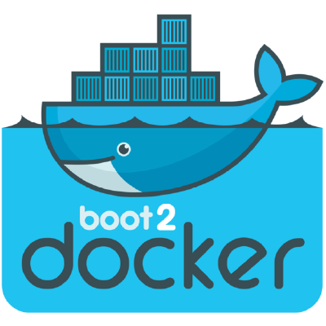

Dockerized PostgreSQL Database on Mac OS X Boot2Docker
PostgreSQL DB
5432
49153
49153
Host% psql -h localhost -p 49153 -U docker_hartl

Slide 2

Two-container Rails Application on Mac OS X Boot2Docker
Rails App
PostgreSQL DB
5432
3000
5432
49154
49153
49154
49153
Host% curl http://localhost:49154

Slide 3
Dockerized Rails Application with PostgreSQL Database on Mac OS X Host
Rails App
15432
10.0.2.2
3000
49154
49154
15432
Host% curl http://localhost:49154
PostgreSQL DB

Slide 4
5432
15432
5432
49153
15432
PostgreSQL DB

