Slide 1
Gaining Control of Cellular Traffic Accounting by Spurious TCP Retransmission
Younghwan Go, Jongil Won, Denis Foo Kune*,
EunYoung Jeong, Yongdae Kim, KyoungSoo Park
KAIST University of Michigan*

Slide 2




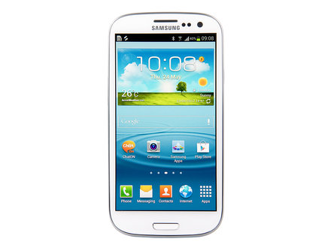








Mobile Devices as Post-PCs
Smartphones & tablet PCs for daily network communications
Notes:
We use mobile devices such as smartphones and tablet PCs for most of daily network communications now.

Slide 3
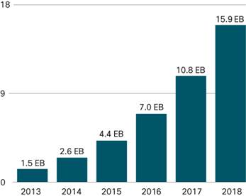
Mobile Devices as Post-PCs
Smartphones & tablet PCs for daily network communications
Massive growth in cellular data traffic (Cisco VNI Mobile, 2014)
1.7x increase
in 1 year!
Notes:
As a result, we are seeing a massive growth in cellular data traffic in very short time.
The cellular data traffic is expected to increase by almost 2 times in just one year.
Then what does this mean for the cellular users?

Slide 4
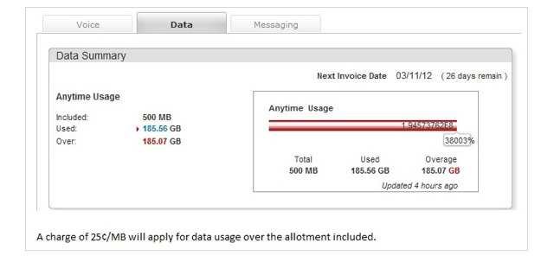

Cellular Traffic Accounting
Increase in cellular traffic bill
Average: $71 per month (2011) – J.D. Power & Associates
US raw mobile data price most expensive in the world – ITU Oct, 13
500MB → $85 (US), $24.1 (China), $8.8 (UK), $4.7 (Austria)
Overage fee
$15 per 1GB
Verizon | 0.5GB | 1GB | 2GB | 4GB | 6GB | 8GB
Mobile Share with Unlimited Talk & Text | $40 | $50 | $60 | $70 | $80 | $90
= $43,377.92!
Cellular network subscribers want accurate accounting!
Notes:
As people use more and more traffic, obviously they have to pay more. As of 2011, the average cellular bill was $71 per month.
Unfortunately, according to ITU, people in the US, which are you guys, are paying for one of the most expensive raw mobile data in the world.
Moreover, as people ask for more data, the price further increases, even more when they consume the data beyond the threshold.
So it is inevitable that all cellular network subscribers want accurate accounting of their data usage.
Let’s see what happens if the accounting is done incorrectly. In 2012, one subscriber was accounted for overusing the data plan by 185GB. As a result, she received a bill that said you should pay for $43,000! Certainly you don’t want this happen to you.

Slide 5
3G/4G Accounting System Architecture
Charging Data Record (CDR)
Billing information (e.g., user identity, session elements, etc.)
Record traffic volume in IP packet level
Question:
Most of traffic is done via TCP (95%) [Woo’13]
Then, should we account for TCP retransmissions?
$
NodeB
BS
3G UMTS
RNC
S-CDR
G-CDR
SGSN
GGSN
NodeB
CGF
UE
Internet
Target Server
eNodeB
S-GW
P-GW
4G LTE
MME
RAN
CN
Notes:
Then let’s look at how the cellular ISP charges your data traffic. Here’s the architecture of the cellular ISP.
The charging of cellular data traffic is done in the middlebox inside the ISP’s core network. While the client uses cellular network, the information for billing, CDR, is stored in the CN, then is transferred to the billing system where the actual accounting takes place.
And we note that the basic unit for accounting is byte-per-byte IP packets.
Alright. So we now know that all IP packets flowing through the ISP are accounted.
Then here’s a question that we want to ask. Should the ISPs charge for retransmissions?

Slide 6

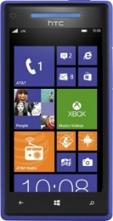

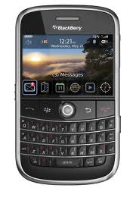
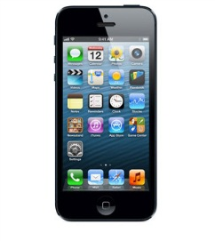
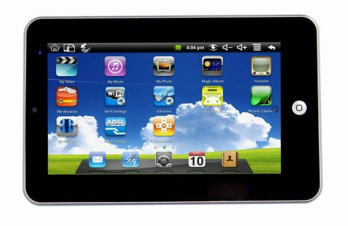
Cellular Provider’s Dilemma: Charging TCP Retransmissions
Subscriber’s stream of consciousness
What’s TCP retransmission?
Pay for application data only!
Network condition is not my problem
Charge volume = content size
Notes:
First, how would the subscriber think about charging TCP retransmissions?
Most of people will first ask what’s TCP retransmission anyways? Ok. I see… But TCP retransmission occurs due to poor network environment. Network condition is not my concern. I would expect to be charged for the size of the content I downloaded.
In conclusion, I want to pay for the application data only!

Slide 7

Cellular Provider’s Dilemma: Charging TCP Retransmissions
Cellular ISP’s stream of consciousness
Need to update the system
Charge for all packets!
Question:
How serious is TCP retransmission in the real-world?
Retransmission = another IP packet
Result:
Average users do not experience retransmission (0.4 – 1.7%)
But some users may suffer from high cellular bills!
Daejeon (South Korea): 85%, Princeton (New Jersey): 80%
Notes:
Next, let’s look at the same problem from the cellular ISPs’ view.
Most likely, they will first think about what’s needed to enable TCP retransmission detection. This would require an upgrade of the current accounting system. Nah that’s too complex.
But wait, TCP retransmission still consumed our infrastructure resources. So it should be considered as just another IP packet. And of course, we need to make money!
In conclusion, we want to charge for all packets!
Then how much retransmission does it actually occur in the real-world? We did a measurement study of retransmission rate and found that average users do not experience much retransmission. However, we found that some flows experienced retransmission rate of over 85%. So blinding charging for all retransmission may cause high cellular bills for users and be unfair.

Slide 8
Contributions
Identify current TCP retransmission accounting policies of 12 cellular ISPs in the world
Some ISPs account for retransmissions (blind), some do not (selective)
Implement and show TCP retransmission attacks in practice
Blind → “Usage-inflation” attack
Overcharge a user by 1 GB in just 9 minutes without user’s detection!
Selective → “Free-riding” attack
Use the cellular network for free without ISP’s detection!
Design an accounting system that prevents “free-riding” attack
Accurately identify all attack packets
Works for 10 Gbps links even with a commodity desktop machine
Notes:
Before going into details, we first summarize the contributions of our work.
We first identify the retransmission accounting policies of total of 12 ISPs in the world and find that some decide to blindly account for retransmissions while some selectively discards them from charging.
Next, we show that no matter what policy the ISPs choose, we are able to carry out “usage-inflation” attack for blind policy ISPs where an attacker overcharges a user by 1 GB in just 9 minutes without user’s detection or “free-riding” attack for selective policy ISPs where a user can use the cellular network for free without ISP’s detection. We note that these attacks are indeed real and work in practice. We have specifically notified the ISPs that are vulnerable to “free-riding” attack to fix the problem, but as of now, the attacks still work.
Lastly, to prevent the “free-riding” attack, we design and implement an accurate accounting system, which can deterministically identify attack packets event at 10 Gbps links with a typical commodity desktop machines.

Slide 9
TCP Retransmission Accounting Policy
Tested 12 ISPs in 6 countries
ISPs (Country) | Policy
AT&T, Verizon, Sprint, T-Mobile (U.S.) | Blind
Telefonica (Spain) | Blind
OS (Germany) | Blind
T-Mobile (England) | Blind
China Unicom, CMCC (China) | Blind
SKT, KT, LGU+ (South Korea) | Selective
Vulnerable to “usage-inflation” attack!
Vulnerable to “free-riding” attack!
Notes:
First, we look at what is the retransmission accounting policy in 12 ISPs of 6 countries.
Through the test, we find that all countries we investigated except South Korea adopt a “blind” accounting policy that accounts for all IP packets regardless of TCP retransmission. In contrast, all three ISPs in South Korea enforce a “selective” policy that does not charge for retransmission packets.
As we explained before, the rationale behind the “blind” accounting policy is that the ISP network should be responsible only for the IP layer functionalities while retransmission in the transport layer is regarded as an end-node issue. However, from a client’s perspective, this could be unfair as she might have to pay for the packets that were discarded before reaching the application layer. That is, the subscribers have to pay for any packet that passes through the billing system regardless of whether it reaches the application on the client device or not.
So we see that ISPs choose their own policies depending on their reasons.
However, as we will show next, no matter what policy they follow, ISPs are either vulnerable to “usage-inflation” or “free-riding” attack where a malicious attacker can either overcharge the victim client’s data bill or bypass ISP’s accounting system to use the network for free.

Slide 10

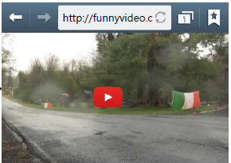
Usage-inflation Attack
Intentionally retransmit packets even without packet losses
ISPs with blind accounting policy charge for all packets
Strength:
No need to compromise the client
User does not notice an attack
Inflate more than 1GB in just 9 minutes!
User clicks on the URL
Retransmit in background
Notes:
Let’s first focus on the usage-inflation attack.
The “usage-inflation” attack arbitrarily inflates the cellular data usage of a target subscriber by intentionally retransmitting packets in the flow even without actual packet losses. As a result, any ISP that follows the blind accounting policy will end up inflating the victim user’s bill.
Here’s one real-world attack scenario that we envision. A malicious attacker sends a phishing SMS message to a target client with the URL that leads to a malicious site.
When a user clicks on the link, he is redirected to that malicious Web server that inflates the usage by spurious packet retransmissions in the background. However, at the application layer, the server transfers the requested content to the client in a normal TCP connection.
The strength of this attack is that we do not need any modification of the client. As long as the user is redirected to the server, the attacker can inject any number of retransmission packets, which does not violate the TCP semantics.
Moreover, the user does not notice that any attack has taken place unless he verifies the packet usage with the bill. Some of you may think that the attack must last long to actually inflate the user. Actually, we were able to inflate the user by over 1GB in just 9 minutes.

Slide 11


Retransmit after RST
Ignore client’s RST to prevent TCP teardown
Utilize full bandwidth to overcharge the usage
Some ISPs allow attacks even after 4 hours!
$
Overcharge Victim UE
Packet 1
Wired Internet
$
Cellular Networks
Packet 2
$
Packet 3
Request
Packet 1
RST
Packet 3
Packet 2
Packet 3
Packet 3
$
Packet 3
Malicious Server
$
Billing System
Victim Client
Packet 3
Notes:
We can carry out “usage-inflation” attack via two methods. First, we can start retransmitting after the client finishes the data transfer and alerts the other host to teardown the connection, for example a RST packet. This is advantageous in that the attacker can greatly overcharge the user by utilizing the full bandwidth.
We have confirmed that some ISPs keep the connection on, allowing us to carry out the attack even after 4 hours. Of course, the attacks were done on our own phones and sadly, we had to pay for all the money overcharged.

Slide 12
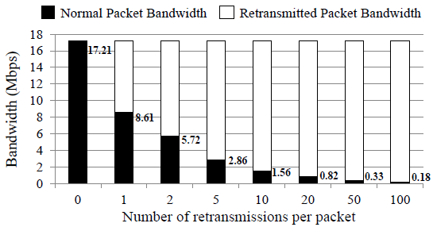
Retransmit during Normal Transfer
ISP may block data packet retransmissions after RST
Embed retransmission packets in stream of normal packets
Guarantee minimum goodput for interactive content
Notes:
Although strong, this has a weakness that the ISP can easily detect the attack by preventing high retransmissions after RST.
A more sophisticated attack is to embed the retransmission packets in the middle of the data transfer. Instead of blindly retransmitting the same packet over and over again, the attacker can carefully pick a random packet in its send window.
To prevent the user from noticing a slowdown, the attacker can control the goodput in case of interactive contents. (Audio stream typically requires 500 Kbps while video streaming requires 2 Mbps)
Here’s a graph that shows the effect of inserting retransmission to the stream of normal packets. We see that as the number of retransmissions per packet increases, the goodput for normal data packets decreases linearly. So if we pick the right number of retransmissions, we’ll be able to inflate the user without alerting the user with a slowdown.

Slide 13
Free-riding Attack
Tunnel payload in a packet masquerading as a retransmission
ISPs with selective accounting policy inspects TCP header only
Tunnel TCP Packet
Wired Internet
Cellular Networks
$
Fake TCP Hdr
Packet 1
For a detailed implementation method, please read our paper ☺
Packet 2
Packet 1
Fake TCP Hdr
Packet 2
Packet 1
Packet 1
Packet 3
Packet 2
Fake TCP Hdr
Packet 3
Request
Fake TCP Hdr
Packet 2
Fake TCP Hdr
Packet 3
Packet 3
Fake TCP Hdr
Destination
Server
TCP Tunneling
Proxy
Billing System
Malicious UE
Notes:
Next, if the cellular ISPs decide to exclude retransmission packets from billing, an adversary can launch a “free-riding” attack against them by tunneling the actual packet inside a retransmission packet. This is possible since the ISP only inspects the TCP header. This is pretty intuitive since to validate the retransmission, the ISP would have to buffer all payloads for future comparison, which is not easy.
This is how the attack works…
The user places a colluding TCP tunneling proxy in the Internet. Client’s packets are relayed through the proxy in order to make the proxy look like a client to the destination server.
Due to the limited time, we do not explain the details of the attack implementation. Please refer to our paper if you are interested.

Slide 14
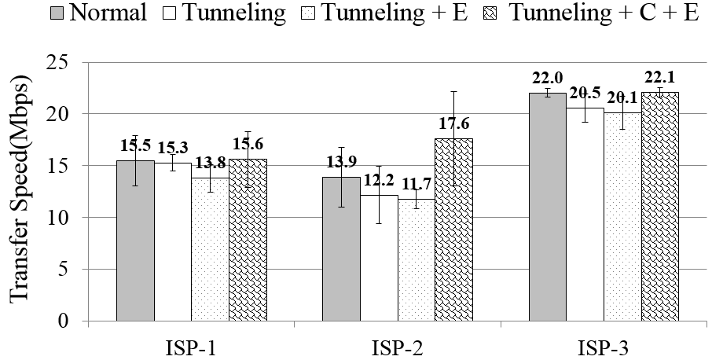
Free-riding Attack in Practice
Attack successful in all 3 South Korean ISPs
Demo video @ http://abacus.kaist.edu/free_riding.html
Packet encryption → evade tunnel header detection
Packet compression → increase data transfer speed
Notes:
We have built and successfully carried out the “free-riding” attack on all three Korean ISPs that do not account for retransmissions. The power of our implementation is that we can actually use this attack while enjoying our daily network communications. You can check out our demo at the given link, where the user is able to watch a YouTube video for free with our attack mechanism.
To further strengthen our attack, we have implemented number of optimizations. First, we evade the detection of tunneled header inside the payload from the accounting system by encrypting the payload of all tunneled packets. Optionally, we also apply packet compression to increase the overall data transfer speed.
We implemented these optimizations and measured the transfer speed with Speedtest.net. We find that even after tunneling and transferring packets through the proxy, the overall transfer speed does not degrade that much. And also, by compressing the packet, we show a similar or better performance than normal data transfer, between 15 to 22Mbps.

Slide 15
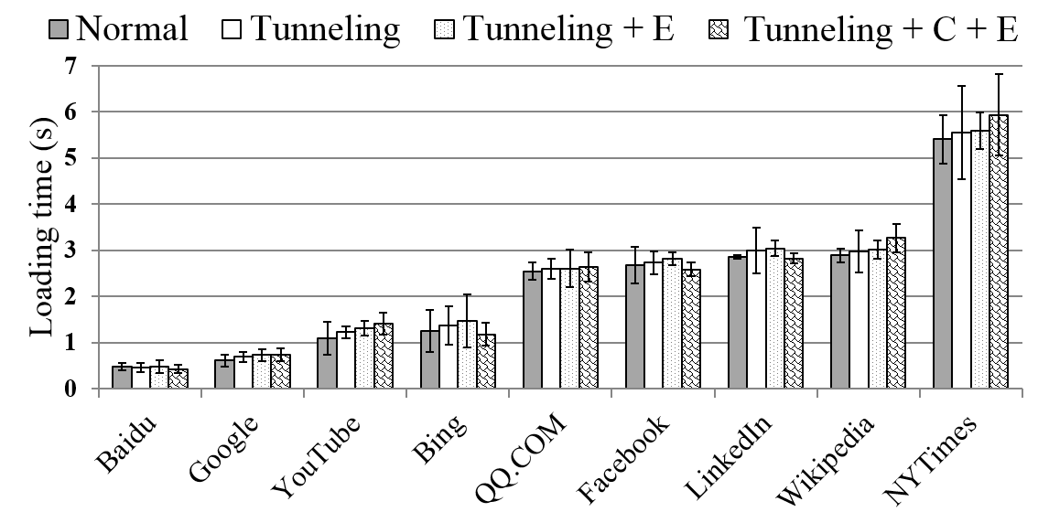
Optimizations
Practical even for normal web browsing
Notes:
We also find that our attack is practical even for normal web browsing.
We measured the web page loading time of 9 popular web sites. We find that tunneling and encryptions only slightly delays the loading time while the compression reduces the time similar to that of no attack case.

Slide 16
Defending against Retransmission Attacks
Difficult to fundamentally defend against “usage-inflation” attack
Detect attack by a retransmission rate threshold
85% retransmission ratio for legitimate flows → lead to false positives
Monitor TCP sender behavior
Hard to know from a middlebox [Floyd’99, Savage’99, Kuzmanovic’07]
Relay every TCP connection via Performance Enhancing Proxy (PEP)
Expensive, proxy becomes a new target of attack
Reasonable to defend against “free-riding” attack
Attacker can simulate behavior of poorly-provisioned environment
Accurately identify retransmission tunneled packets via DPI
ISPs should not charge for retransmissions
but defend against “free-riding” attack!
Notes:
Until now, we have shown two retransmission attacks that either overcharge users or bypass data charging. Then can we defend against these attacks?
We argue that defending against “usage-inflation” attack is fundamentally difficult. A simple defense mechanism could be setting a retransmission rate threshold. However, as we have shown previously, even legitimate users experience retransmission rate up to 85% thus is difficult to select an appropriate threshold. A more sophisticated approach would be to monitor the TCP sender behavior and see if the user is following the congestion control algorithm. However, it has been proved by number of previous works that exactly knowing the sender’s behavior from the middlebox is difficult. A separate approach is to place a performance enhancing proxy in the ISP that relays every TCP connection. As some of you may already know, PEPs are deployed in US ISPs for HTTP connections. Although this may mitigate the attack, we have checked that PEP does not support non-HTTP ports and it could be difficult to handle all TCP connections instead of only HTTPs. Also, PEP may become a new target of the attack.
On the other hand, for “free-riding” attack, we show that deterministically identifying the tunneled packets is possible via DPI even if the attacker simulates a behavior of poorly-provisioned environment.
In conclusion, we argue that the ISPs should first not charge for retransmissions to provide a fair billing policy while defending against the “free-riding” attacks.

Slide 17





How much should I charge?
Abacus: Cellular Data Accounting System
Notes:
To prevent the “free-riding” attack, we present Abacus, an accurate cellular data accounting system at 10 Gbps links.

Slide 18
Abacus: Deterministic DPI
Byte-by-byte comparison of original vs. retransmitted packets
Buffer size: 2 x Receive Window Size
Accounting process
Head seq: 0
Window: 2KB
Next expected seq: 2048
Flow 0
W
W
ACKed
Buffer for new data
Strength:
No false-positives!
Compare for
payload length!
Retransmitted Packet! (Seq = 1024)
Weakness:
Require large memory!
Packet (Src: 102.58.35.5 / Dst: 142.98.7.90)
Notes:
Abacus supports two DPI modes. First, we can detect attacks deterministically by buffering the entire payload then comparing it with the retransmitted payload in byte-by-byte level.
Then one challenge in d-DPI is to determine the buffering amount of a flow. Theoretically, you need (RTT * Bandwidth). But since per-flow RTT and effective bandwidth change on a short time scale, we use the receive window size in each direction of a TCP connection instead. To be able to compare the retransmitted payload with the already received payload, we buffer the ACKed data for window size as well.
Let’s then look at the actual accounting process. Let’s say that we have a buffer with window size of 2KB and we are expecting a next sequence number to be 2048. When a packet with a smaller sequence number comes, it detects that there is a retransmission, and extracts the payload from the ACKed buffer to compare. If the compared buffers match, Abacus confirms that it is a legitimate retransmission and excludes the packet from the bill. Else it either charges or drops it.
The strength of d-DPI is that it guarantees detection of all possible “free-riding” attacks.
However, obviously there is a limitation since it requires a large memory to buffer the entire payload as well as consume high memory bandwidth for byte-by-byte comparisons. Then what’s the alternative?

Slide 19

Abacus: Probabilistic DPI
Store payload by sampling and compare for the sampled data
E.g., store 5 bytes out of 1,024-byte → reduce memory by ~200x
Prevent attacker from guessing the sampled byte locations
Calculate byte location via per-flow key = ${HMAC}_{Secret_Key}\{nonce\}$
Base Seq Num: 1024
Flow Key
A
h
o
a
p
p
i
b
H
m
Offset = SHA1
{Flow Key | BSN}
1
f
s
t
t
f
r
s
\
b
Retransmitted Packet! (Seq = 1024)
Notes:
As an alternative, we present probabilistic DPI (p-DPI), which stores only a sample of payload instead of the entire payload, and see if the retransmission packets have the identical values for the sampled data. For example, we currently store 5 bytes out of 1KB packet, which reduces the memory usage by 200 times. For details about how to pick an appropriate sample size, please refer to our paper.
The challenge of p-DPI is that we need to prevent the attacker from guessing where the sampled byte locations are. For this, we randomize the locations by calculating the byte location via a per-flow key unknown to the attacker. Per-flow key is generated by HMAC of a nonce with a secret key at connection setup time where the nonce is a 8-byte random number generated per each flow and the secret key is the system-wide key known only to Abacus.
Now with p-DPI, when we detect a retransmission packet, we use the flow key and bsn of the entry, which would be 1024 in this case, to calculate the random offsets and extract the samples from the payload to compare for verification.

Slide 20
Evaluation
Environment setup
Traffic generator (custom HTTP server & client)
Dual Intel Xeon E5-2690 CPU (2.90 GHz, 2 octacores)
64GB RAM
Intel 10G NIC with 82599 chipsets
d-DPI Abacus
Same as traffic generator
p-DPI Abacus
Intel i7-3770 CPU (3.40 GHz, quadcore)
16GB RAM
Intel 10G NIC with 82599 chipsets
All machines are connected to 10 Gbps Arista 7124 switch
Abacus monitors all packets via port mirroring
Notes:
To evaluate Abacus, we use a traffic generator by implementing a custom HTTP server and client with the shown machine specs.
We use the same machine for d-DPI.
For p-DPI, we use a commodity desktop machine with the given specs to show the power of sampling.
All machines are connected to each other via 10 Gbps Arista switch and Abacus monitors the packets via port mirroring.

Slide 21
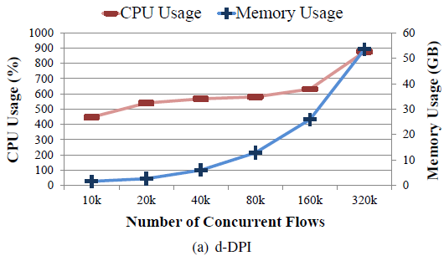
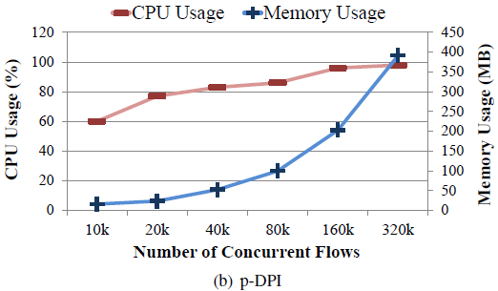
Microbenchmark
d-DPI requires large memory for buffering
53.6GB @ 320K flows
Begins to drop packets 320K flows
p-DPI requires small memory & CPU
391MB @ 320K flows
CPU usage stays under 100% even @ 320K flows
Notes:
We first run a Microbenchmark to measure the CPU and memory usage for different number of concurrent flows. 100% CPU usage means 1 CPU core is fully utilized. We note that in all cases, the server and client fully utilize the 10 Gbps link.
For d-DPI, we clearly see that it requires large amount of memory for buffering the packets. We see that at 320K concurrent flows, it uses 53.6GB of memory and the CPU usage goes up to almost 900%. Moreover, we noticed a packet drop at 320K flows.
For p-DPI, we see that it requires small memory as well as small CPU. It only uses 391MB at 320K concurrent flows without any packet drops. Moreover, the CPU usage always stays under 100% even at 320K flows. This result is powerful since it shows that we can handle accounting even in commodity desktop machines.

Slide 22
Real Traffic Simulation
Replay 3G cellular traffic logs
Measured in a commercial cellular ISP in South Korea [Woo’13]
11PM – 12AM on July 7th, 2012
61 million flows
2.79 TB in volume
Inject 100 “free-riding” attacks during replay
Result:
d-DPI & p-DPI accurately detect and report all of the attacks!
Notes:
Lastly, we measured whether Abacus can accurately detect “free-riding” attacks in real environment.
We build a cellular traffic generator that replays the 3G cellular traffic logs measured in a commercial cellular ISP in South Korea…
During the log replay, we inject 100 flows that simulate “free-riding” attacks. Each flow randomly adds retransmission packets with different payload from the original packets. We find that d-DPI and p-DPI report all of the attack flows accurately.

Slide 23
Conclusion
Massive growth in cellular data usage
Importance of accurate accounting of cellular traffic
Cellular ISP dilemma
Should we account for TCP retransmissions packets or not?
Accounting policies differ between countries
Vulnerabilities in current accounting system
Usage-inflation attack
Free-riding attack
Abacus
Reliably detect free-riding attack
Manage 100Ks of concurrent flows with a small memory and CPU usage
HotMobile’13, Jekyll Island, GA, USA

Slide 24
Thank You! Any Questions?
http://abacus.kaist.edu
yhwan@ndsl.kaist.edu

Slide 25
Retransmission Rate Measurement
Measurement environment
11 volunteers (graduate students in KAIST)
38 days (March 22nd – April 29th, 2013)
151,469 flows (3.62GB)
Packet analyzer
Process captured TCP flows
Calculate retransmission rate
Overall retransmission rate = 0.4 – 1.7%
Average users do not experience retransmission! But…
Notes:
To measure the retransmission rate in real-world, we gathered 11 volunteers, all graduate students in KAIST and had them capture all network packets in their main smartphones for 38 days. The total number of flows analyzed was about 150,000, which was 3.6GB in volume.
We then ran our packet analyzer which processes the captured TCP flows and creates per-flow log that calculates the total number of transferred bytes/packets, and retransmission rates of data packets and duplicate ACK packets.

Slide 26
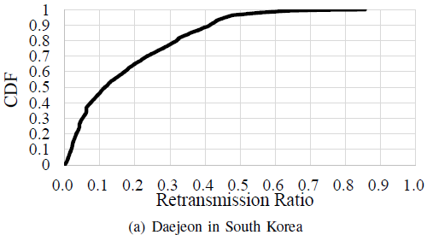
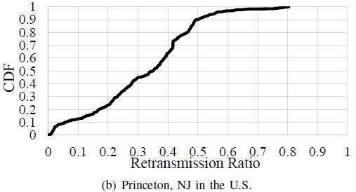
Some flows experience high retransmission rates
CDF of flows with at least one retransmitted packet
Worst 10%
Daejeon: 40-85% / Princeton: 49-80%
Up to 93% retransmission in 3G cellular backhaul link [HotMobile’13]
Finding:
Charging TCP retransmissions may cause
some legitimate users to suffer from high cellular bills!
85%
82%
Notes:
We draw a retransmission rate CDF graph of the retransmission rate with flows that experienced at least one retransmission.
Surprisingly, we find that some flows experience extremely high retransmission rates.
The flow with the highest retransmission rate is 85 and 80% respectively, which is in line with the previous measurement of 93% we did in 3G cellular backhaul link from HotMobile.
As a result, blindly charging TCP retransmissions may cause legitimate users to suffer from high cellular bills! So we see that there is a potential problem in cellular accounting of TCP retransmissions.

Slide 27
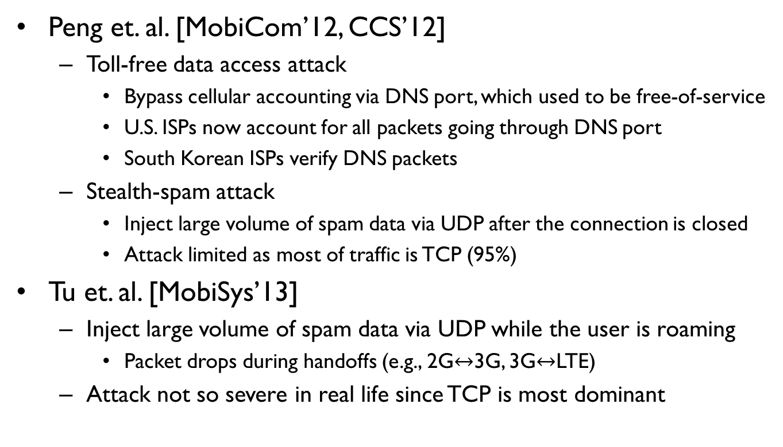
Related Works
Peng et. al. [MobiCom’12, CCS’12]
Toll-free data access attack
Bypass cellular accounting via DNS port, which used to be free-of-service
U.S. ISPs now account for all packets going through DNS port
South Korean ISPs verify DNS packets
Stealth-spam attack
Inject large volume of spam data via UDP after the connection is closed
Attack limited as most of traffic is TCP (95%)
Tu et. al. [MobiSys’13]
Inject large volume of spam data via UDP while the user is roaming
Packet drops during handoffs (e.g., 2G$↔$3G, 3G$↔$LTE)
Attack not so severe in real life since TCP is most dominant
Notes:
Then what are some existing works that address cellular traffic accounting attacks? There have been only few works that look at accounting attacks.
Peng and others showed toll-free data access attack, which bypasses accounting by transferring packets via DNS port, which used to be a free-of-service port. However, right after the paper was published, the ISPs changed their policy to charge for all packets going through DNS port. On the other hand, South Korean ISPs actually verify whether the packets going through the DNS port are really DNS port by running a DPI.
They also showed a stealth-spam attack, which tries to overcharge users by transmitting large number of UDP packets after the user either closes the connection or goes into low signal environment. However, this attack is limited in practice since 95% of cellular traffic is done via TCP.
Tu and others showed a similar spam attack where the UDP packets were injected while the user was switching between different networks. This would result in handoffs and drop of all packets buffered in the base stations. However, similar to the steal-spam attack, this attack would be not so severe since TCP is the most dominant transport protocol.
We note that our attacks are more effective and fundamentally difficult to solve since inferring TCP retransmission in the middlebox is difficult.

Slide 28
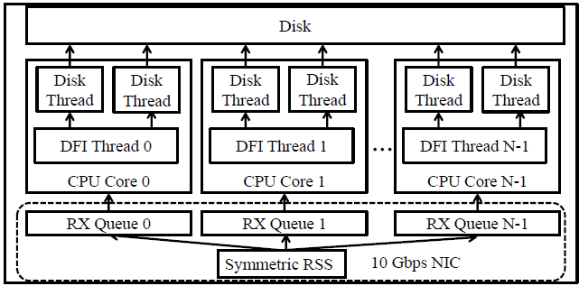
Monbot
Highly-scalable flow monitoring system [Woo’13]
PacketShader I/O (PSIO)
High-speed packet I/O
Symmetric Receive-Side Scaling (S-RSS)
Map packets in same TCP connection to the same CPU core
Notes:
Abacus extends Monbot to handle the TCP flow management, which is a highly-scalable flow monitoring system.
Monbot uses the PacketShader I/O Engine (PSIO) that delivers a batch of incoming packets from NICs into the user-level process at speeds between 10 Gbps and 100 Gbps.
Monbot also implements Symmetric Receive-Side Scaling (S-RSS) to evenly distribute connections to multiple CPU cores while mapping the packets in the same TCP connection to the same CPU core.
Here’s the architecture. The packet is mapped to a CPU core via S-RSS where a Deep Flow Inspection (DFI) thread on each core handling the flow management. The log is then passed to the disk threads and written to the disk.

Slide 29
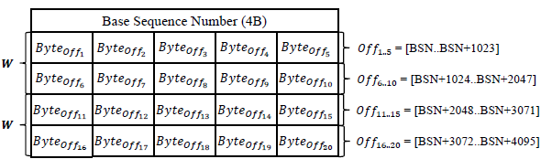
Probabilistic DPI
Store payload by sampling and compare for the sampled data
E.g., store 5 bytes out of 1,000-byte → reduce memory by 200x
4-byte base sequence number
Entry
Randomly sampled byte between [bsn, bsn + 1023]
Notes:
As an alternative, we present probabilistic DPI (p-DPI), which stores only a sample of the payload and see if the retransmission packets have the identical values for the sampled data. For example, if we store 5 bytes out of 1000 byte packet, we can reduce the memory usage by 200 times.
The implementation of p-DPI is similar to d-DPI except that p-DPI buffers the sampled flow data.
Basic way is to have p-DPI sample ‘n’ bytes per each 1024-byte flow data at random. For this, we allocate a flow table per each flow direction that consists of a set of sampled entries. Each table has a 4-byte base sequence number. Each sampled byte on the entry is randomly chosen from the sequence number space of [bsn, bsn + 1023]. The window of the monitored flow data is tracked in the same way as in d-DPI.

Slide 30

p-DPI Byte Sampling
Prevent attacker from guessing the sampled byte locations
Random offset: K = SHA1{Flow Key | BSN}
Flow Key = ${HMAC}_{Secret_Key}\{nonce\}$
Offset calculation per 1KB buffer → 10 bits to represent each offset
N = 5 → Bernstein hash function to produce 64-bit output
Base Seq Num: 0
Flow Key
A
h
o
a
p
p
i
b
H
m
K = SHA1
{Flow Key | BSN}
1
f
s
t
t
f
r
s
\
b
Retransmitted Packet! (Seq = 1024)
Notes:
The challenge of p-DPI is that we need to prevent the attacker from guessing where the sampled byte locations are.
We randomize the locations by running a hash function with the per-flow key and the bsn for the entry. Per-flow key is generated by HMAC of a nonce with a secret key at connection setup time where the nonce is a 8-byte random number generated per each flow and the secret key is the system-wide key known only to Abacus.
Since we need 10 bits to represent a 1KB entry, any hash function is fine as long as its output size is (10*n) bits or larger. In our current implementation, we pick the ‘n’ value to be 5 and use Berstein hash function which generates 64-bit output.
Now with p-DPI, when we detect a retransmission packet, we use the flow key and bsn of the entry to calculate the random offsets and extract the samples from the payload to compare for verification.

Slide 31

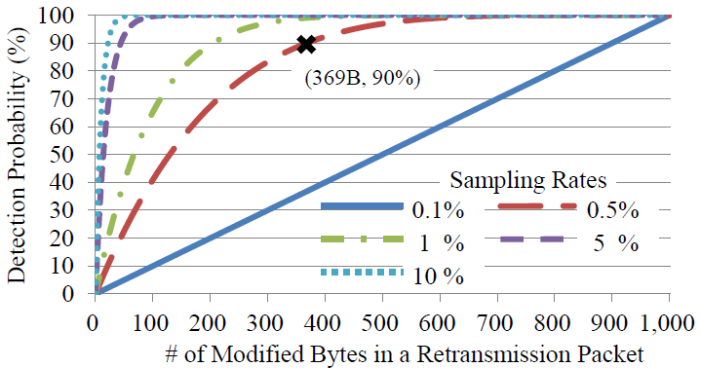
Choosing ‘n’
Choice of n-byte sampling
Memory space efficiency vs. attack detection accuracy
For 1000-byte size packet, attack detection probability:
Notes:
So then how should pick this ‘n’ value sample for each 1024 Byte entry?
Abacus samples y bytes from an original packet
Attacker modifies x bytes of the retransmission packet for the “free-riding” attack while keeping the remaining bytes intact.

